Slide 1
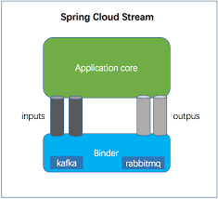
Spring Cloud Data Flow
Spring Cloud Data Flow
Spring Cloud Stream
Event streaming (real-time and long-running)
Spring Cloud Task/Batch
task/batch (short-lived) data-intensive applications

Slide 2
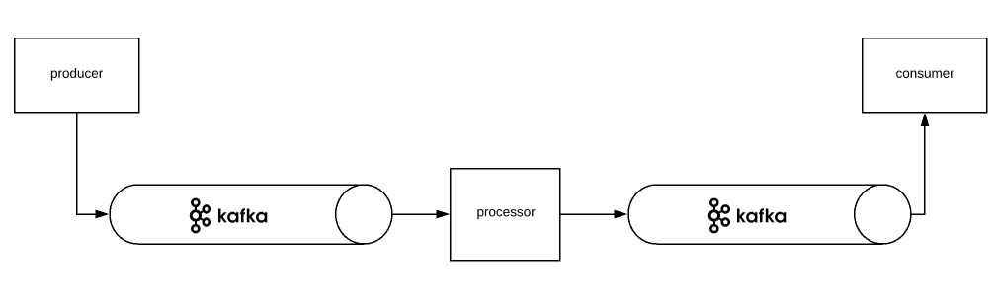
Data Pipeline
A flow that receives an event from an input, perform some action(s) and send the result to an output

Slide 3
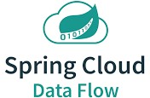
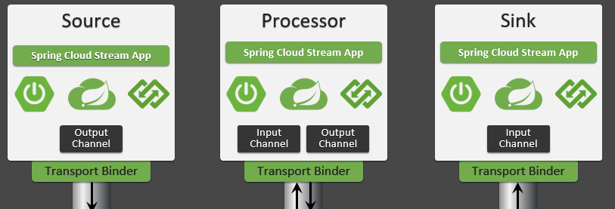

Spring boot application which performs streaming operations
Spring Cloud Data Flow orchestrate streaming and task/batch data pipelines
Spring Cloud Stream app
Spring boot app
Spring boot app
Spring Cloud Stream app
Spring Cloud Stream app

Slide 4
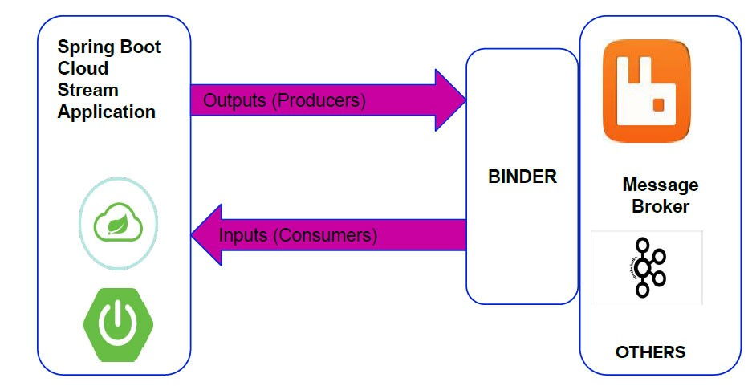
Dataflow

Slide 5
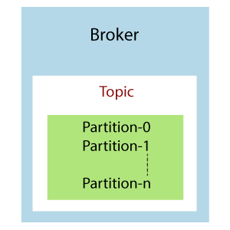
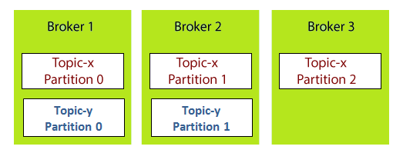
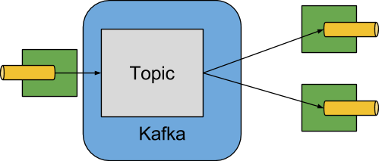

Slide 6
