Slide 1
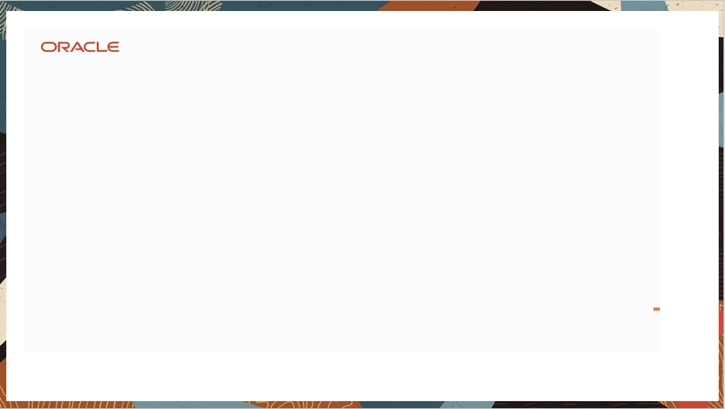
Azure Service Bus Queues
By
Ragini Kulkarni

Slide 2
Service Bus Features
Sending Message to the Queue
Receiving Messages from the Queue
Dead Lettered Queue
Duplicate Deduction of Messages
Managing Entities in Queue
Prefetch the Messages in Queue

Slide 3
What is Service Bus
Microsoft Azure Service Bus is a fully managed enterprise integration message broker. Service Bus can decouple applications and services. Service Bus offers a reliable and secure platform for asynchronous transfer of data and state.
Data is transferred between different applications and services using messages. A message is in binary format and can contain JSON, XML, or just text. For more information, see Integration Services.
Namespaces
A namespace is a container for all messaging components. Multiple queues and topics can be in a single namespace, and namespaces often serve as application containers.

Slide 4
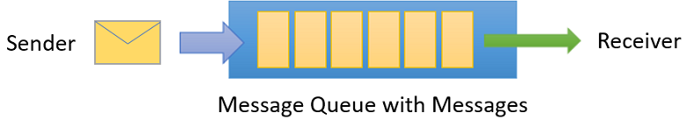
Queues
Messages are sent to and received from queues. Queues store messages until the receiving application is available to receive and process them.
Messages in queues are ordered and timestamped on arrival. Once accepted, the message is held safely in redundant storage. Messages are delivered in pull mode, only delivering messages when requested.

Slide 5
Prerequisites
An Azure subscription to create a queue. .
Create a Service Bus namespace.
Get the connection string.
Create a Service Bus queue.
Install Azure SDK for Java.

Slide 6
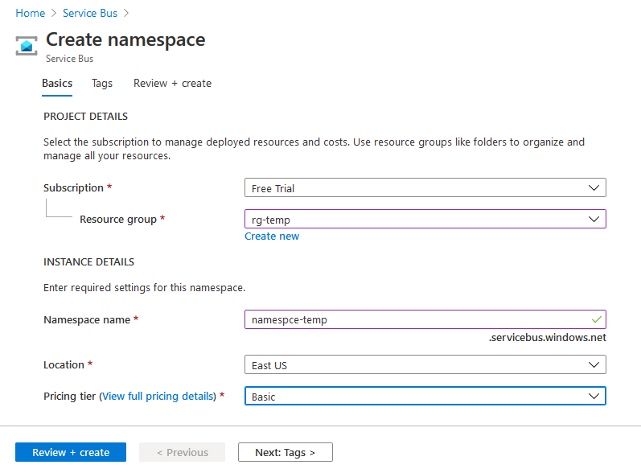
Creating NameSpace

Slide 7
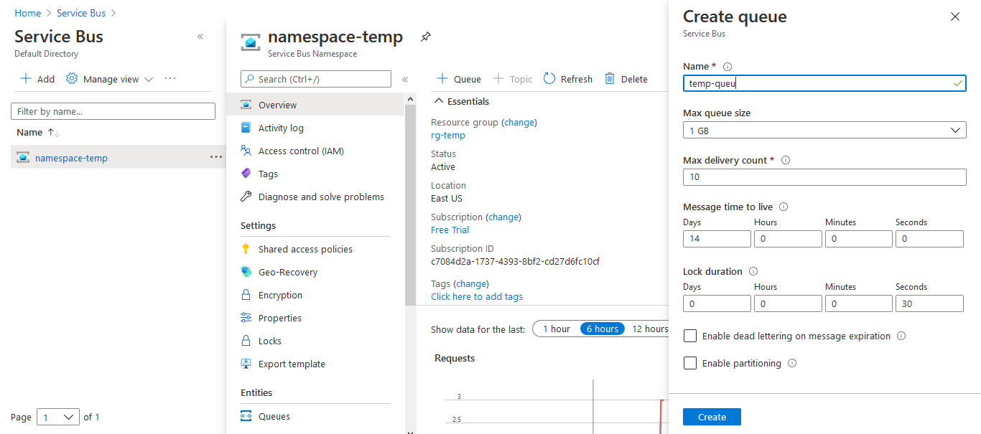
Creating a Queue

Slide 8
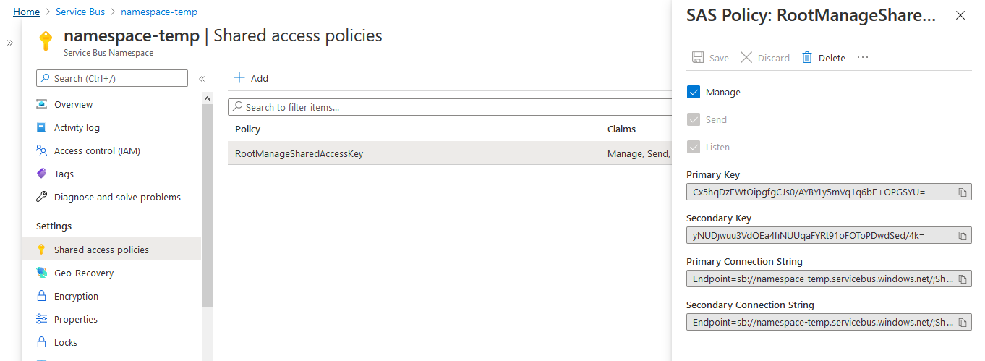
Getting the Connection String

Slide 9
Sending Messages to a Queue
To send messages to a Service Bus Queue, your application instantiates a QueueClient object and sends messages asynchronously.
Messages sent to, and received from Service Bus queues are instances of the Message class. Message objects have a set of standard properties (such as Label and TimeToLive), a dictionary that is used to hold custom application-specific properties, and a body of arbitrary application data.
An application can set the body of the message by passing any serializable object into the constructor of the Message, and the appropriate serializer will then be used to serialize the object. Alternatively, you can provide a java.IO.InputStream object.

Slide 10
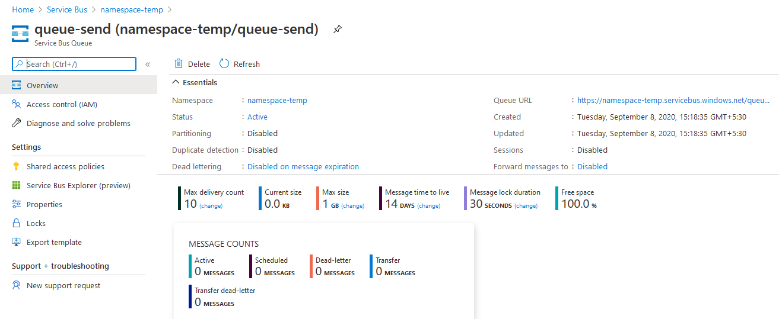
Sending Messages to a Queue
Active Message count is zero before sending the message

Slide 11
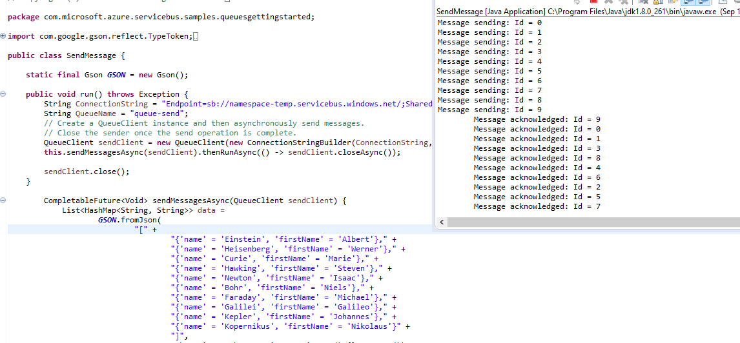
Sending Messages to a Queue
Sending Messages to the service bus

Slide 12
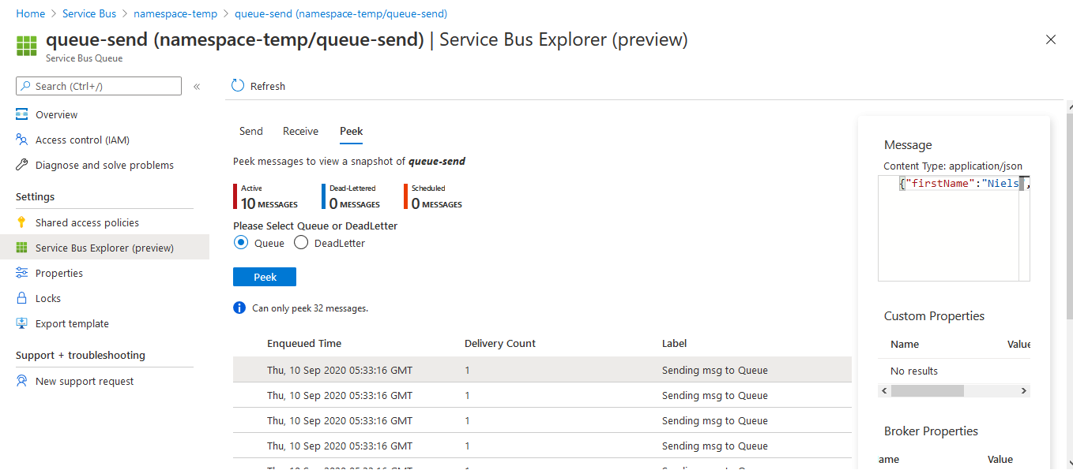
Sending Messages to a Queue
Message count is increased to 10 and can be viewed by peeking the particular message we want to see

Slide 13
Receiving Messages from a Queue
The primary way to receive messages from a queue is to use a ServiceBusContract object. Received messages can work in two different modes: ReceiveAndDelete and PeekLock.
When using the ReceiveAndDelete mode, receive is a single-shot operation - that is, when Service Bus receives a read request for a message in a queue, it marks the message as being consumed and returns it to the application
In PeekLock mode, receive becomes a two stage operation, which makes it possible to support applications that cannot tolerate missing messages. When Service Bus receives a request, it finds the next message to be consumed, locks it to prevent other consumers receiving it, and then returns it to the application.

Slide 14
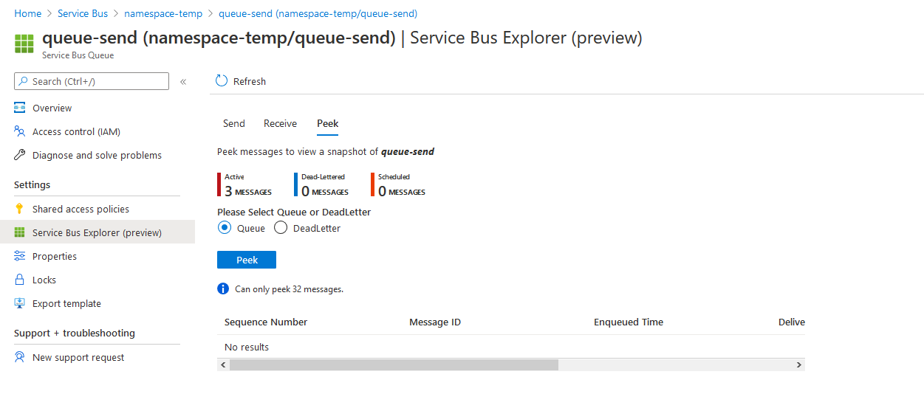
Receiving Messages from the Queue
Receiving the message from the Queue which was earlier sent. The Active count is increases as it being received.

Slide 15
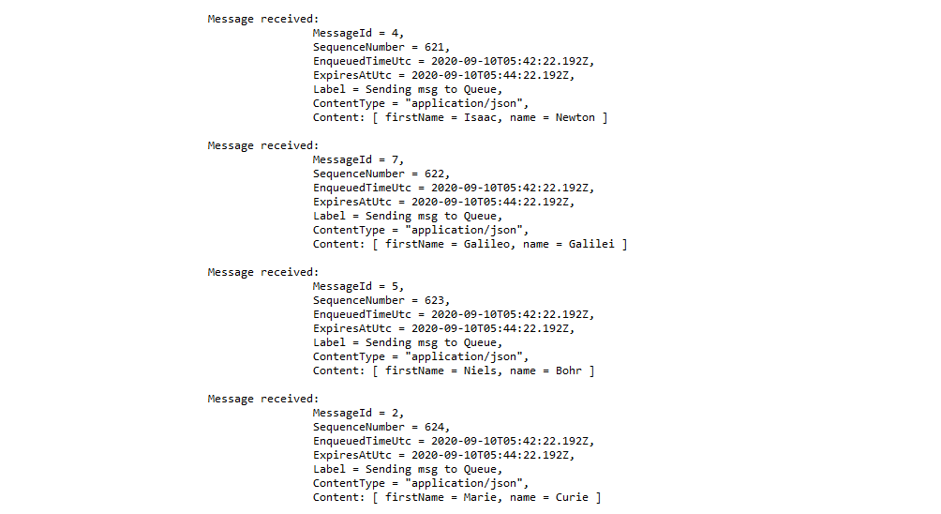
Receiving Messages from the Queue

Slide 16
Dead Lettered Queue
The purpose of the dead-letter queue is to hold messages that can't be delivered to any receiver, or messages that couldn't be processed. Messages can then be removed from the DLQ and inspected. An application might, with help of an operator, correct issues and resubmit the message, log the fact that there was an error, and take corrective action.
Moving messages to the DLQ
There are several activities in Service Bus that cause messages to get pushed to the DLQ from within the messaging engine itself. An application can also explicitly move messages to the DLQ.
As the message gets moved by the broker, two properties are added to the message as the broker calls its internal version of the DeadLetter method on the message: DeadLetterReason and DeadLetterErrorDescription.

Slide 17
Dead Lettered Queue
Moving messages to the DLQ
DeadLetterReason | DeadLetterErrorDescription
HeaderSizeExceeded | The size quota for this stream has been exceeded.
TTLExpiredException | The message expired and was dead lettered. See the Exceeding TimeToLive section for details.
Session ID is null. | Session enabled entity doesn't allow a message whose session identifier is null.
MaxTransferHopCountExceeded | The maximum number of allowed hops when forwarding between queues. Value is set to 4.
MaxDeliveryCountExceededExceptionMessage | Message could not be consumed after maximum delivery attempts. See the Exceeding MaxDeliveryCount section for details.

Slide 18
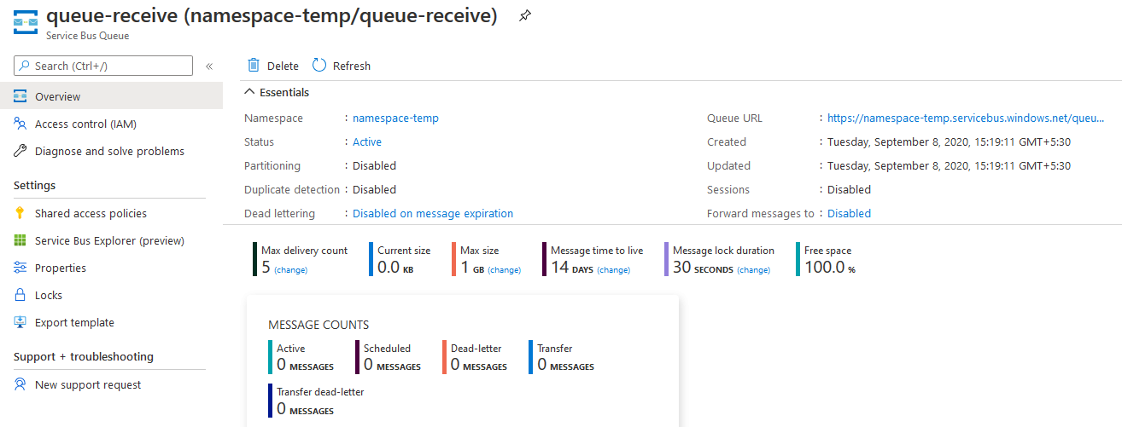
Dead Lettered Queue
Max Delivery count is set to 5, after reaching the mx count the message will be fed to Dead Lettered Queue

Slide 19
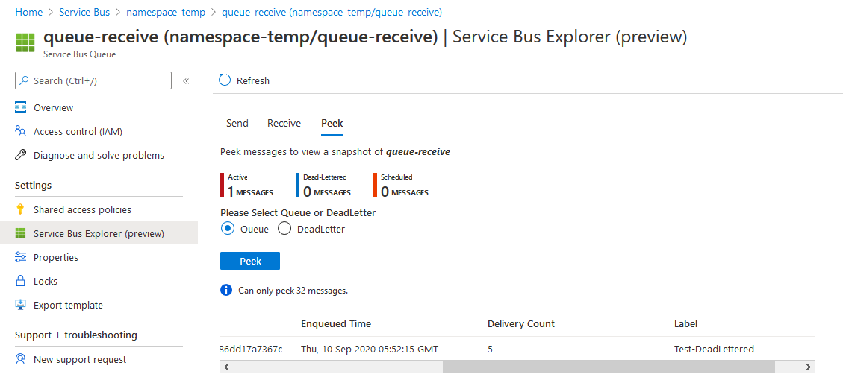
Dead Lettered Queue
The active message will now be empty and Dead Lettered Queue will be 1 after exceeding the max delivery count

Slide 20
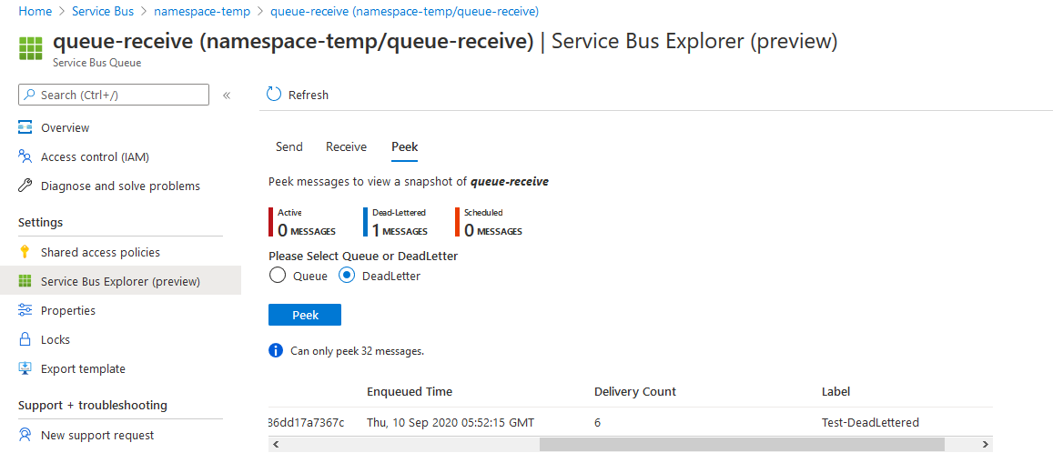
Dead Lettered Queue

Slide 21
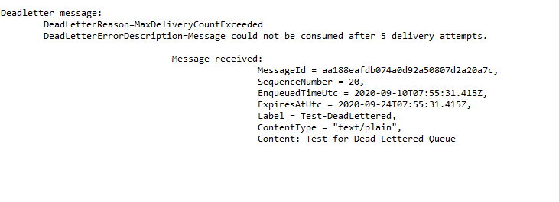
Dead Lettered Queue
Receiving the Messages from dead lettered queue

Slide 22
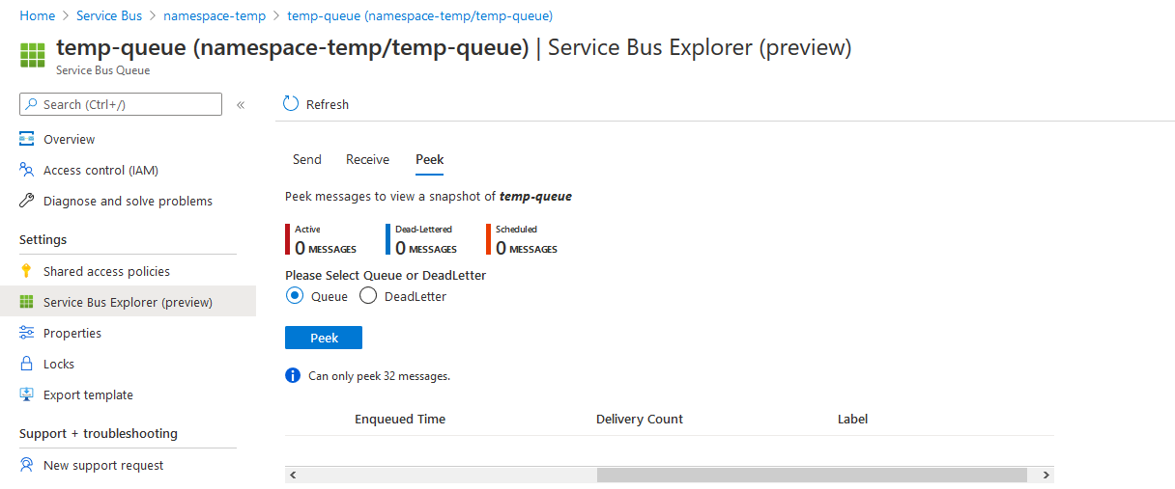
Dead Lettered Queue

Slide 23
Duplicate Detection in Queue
An error could cause the client to have a doubt about the outcome of a send operation. Duplicate detection enables the sender to resend the same message. Another option is for the queue or topic to discard any duplicate copies.
Enabling duplicate detection helps keep track of the application-controlled MessageId of all messages sent into a queue or topic during a specified time window. If any new message is sent with MessageId that was logged during the time window, the message is reported as accepted (the send operation succeeds), but the newly sent message is instantly ignored and dropped. No other parts of the message other than the MessageId are considered.

Slide 24
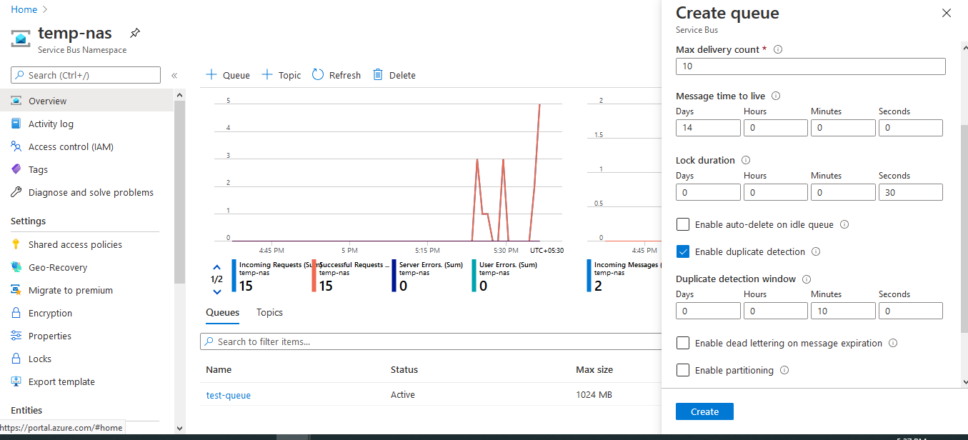
Duplicate Detection in Queue

Slide 25

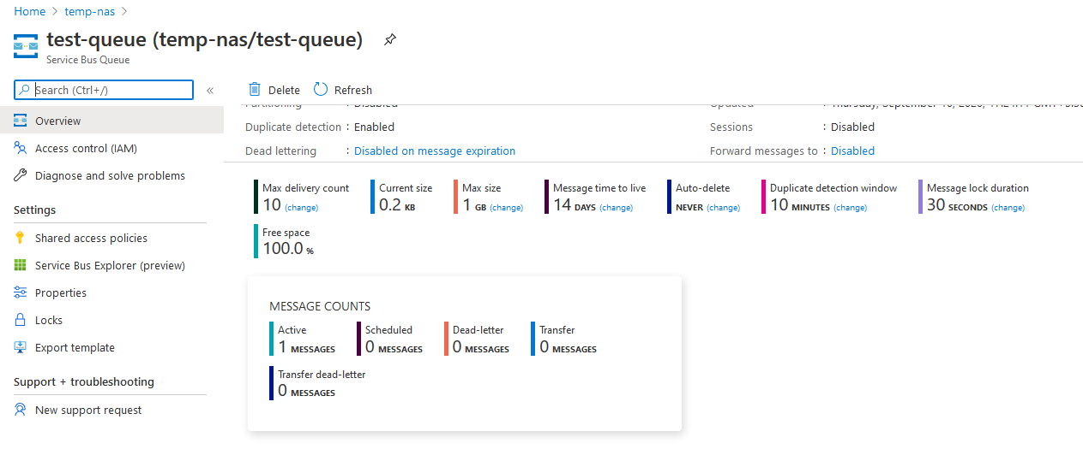
Duplicate Detection in Queue

Slide 26
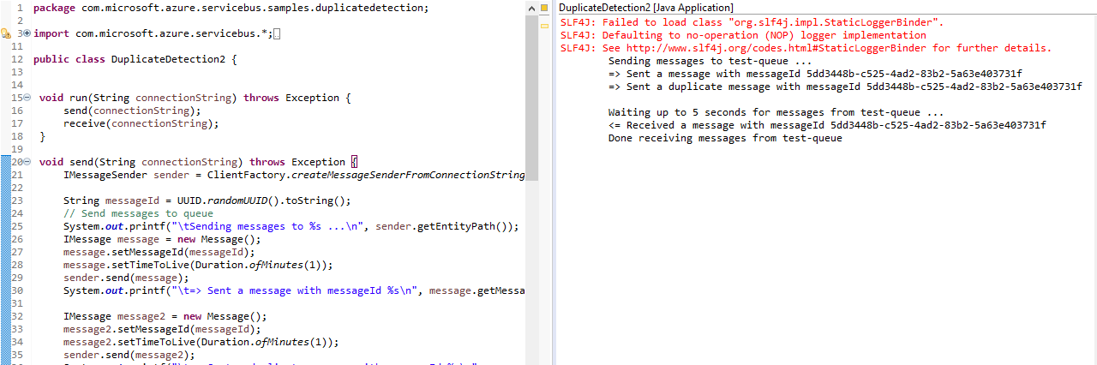
Duplicate Detection in Queue
Duplicate message will be discarded and only original message will be received

