Slide 1
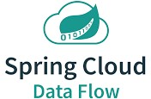
Spring Cloud Dataflow

Slide 2
What is Spring Cloud Dataflow?
Orchestration tool.
In order to use Spring Cloud Data Flow, you will need to choose what platform you want to run it on and install the server components on that platform.
Data Flow supports three platforms out of the box: Local, Cloud Foundry, and Kubernetes.
After installing Data Flow you will want to get started deploying prebuilt microservices that Data Flow orchestrates.
Spring Cloud Stream
Event streaming (real-time and long-running)
Spring Cloud Task/Batch
task/batch (short-lived) data-intensive applications

Slide 3
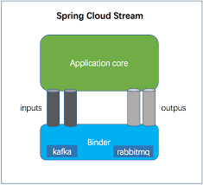
Spring Cloud Stream Applications
Spring Cloud Stream Applications are standalone executable applications that communicate over messaging middleware such as Apache Kafka and RabbitMQ.
These applications can run independently on a variety of runtime platforms, including Kubernetes, Docker, Cloud Foundry, or even on your laptop.

Slide 4
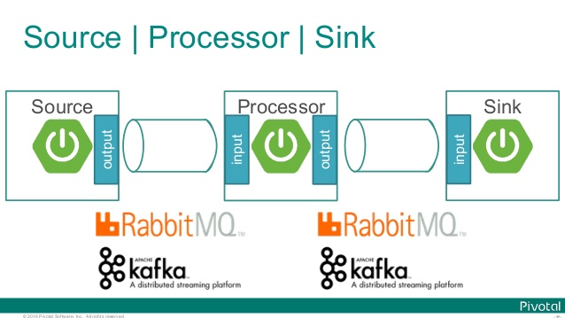
Spring cloud Stream is a binding framework that binds the (source-processor-sink) code to a destination middleware

Slide 5
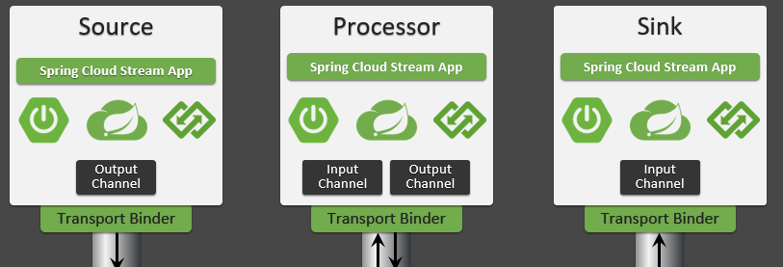
To build an event streaming pipeline, Spring Cloud Data Flow provides a set of application types:
A source represents the first step in the data pipeline, a producer that extracts data from the external systems like databases, filesystem, FTP servers, IoT devices, etc.
A processor represents an application that can consume from an upstream producer (a source or a processor), perform the business operation on the consumed data and emit the processed data for downstream consumption
A sink represents the final stage in the data pipeline, which can write the consumed data to external systems like Cassandra, PostgreSQL, Amazon S3, etc

Slide 6
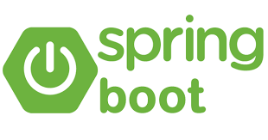
Spring boot application which performs streaming operations
Spring Cloud Data Flow orchestrate streaming and task/batch data pipelines
Spring Cloud Stream app
Spring boot app
Spring boot app
Spring Cloud Stream app
stream create
‘source-app | processor-app | sink-app’
Spring Cloud Stream app

Slide 7
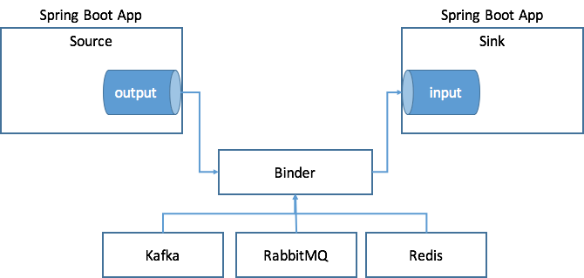
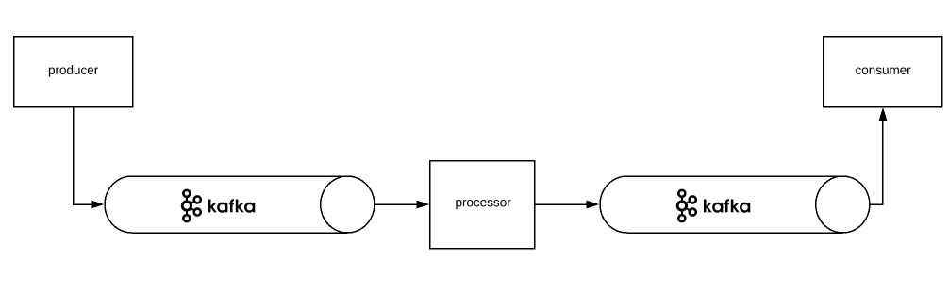
Binders

Slide 8
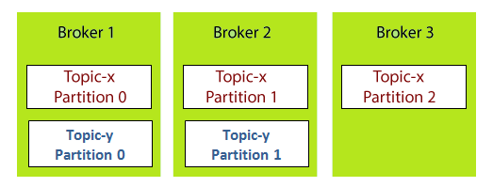
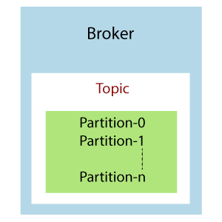
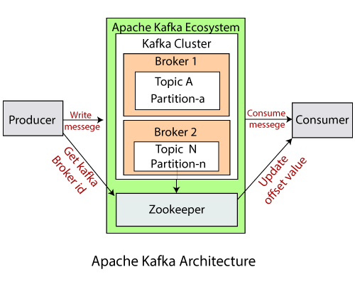
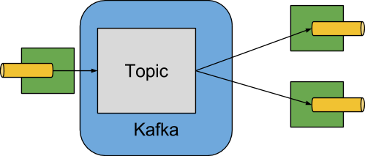
Kafka Components

Slide 9
Application Registration
In this step, we register the applications we previously created. When you register an application, you provide its:
Location URI (Maven, HTTP, Docker, file, and so on)
Application version
Application type (source, processor, or sink)
Application name
App Name | App Type | App URI
usage-detail-sender | Source | maven://io.spring.dataflow.sample:usage-detail-sender-rabbit:0.0.1-SNAPSHOT
usage-cost-processor | Processor | maven://io.spring.dataflow.sample:usage-cost-processor-rabbit:0.0.1-SNAPSHOT
usage-cost-logger | Sink | maven://io.spring.dataflow.sample:usage-cost-logger-rabbit:0.0.1-SNAPSHOT

Slide 10
App registration
app register --name source-app --type source --uri docker:root/ image-source-app :0
app register --name processor-app --type processor --uri docker:root / image-processor-app :0
app register --name sink-app --type sink --uri docker:root / image-sink-app:0
creating a stream for the registered app
stream create --name stream-log --definition ‘source-app | processor-app | sink-app’
deploying the stream
stream deploy --name stream-log

