Slide 1
MACHINE LEARNING MINI PROJECT
Customer Purchase
Prediction from E-Commerce
TEAM MEMBERS
Ragini Singh
Roll No.: 150096724023
Predicting whether a customer is likely to make a purchase using supervised machine learning.
Sakshi Shinghole
Roll No.: 150096724056
E-COMMERCE • CLASSIFICATION
Models
Logistic Regression • Decision Tree • Random Forest
Project focus: PurchaseStatus prediction
ML MINI PROJECT • E-COMMERCE • CUSTOMER PURCHASE PREDICTION
1

Slide 2
02
Problem Statement
Why predicting customer purchase behaviour matters in e-commerce
THE BUSINESS PROBLEM
WHAT WE PREDICT
WHY ML?
E-commerce businesses collect customer information such as age, income, purchase history, website activity, loyalty-program status and discounts used.
However, not every customer completes a purchase.
PurchaseStatus
0 → No Purchase
1 → Purchase
ML learns patterns from historical customer data and applies them to new customers.
Our project asks:
“Can we predict whether a customer will make a purchase using Machine Learning?”
WHO CAN BENEFIT?
• E-commerce businesses
• Marketing & customer-engagement teams
• Sales and product teams
ML MINI PROJECT • E-COMMERCE • CUSTOMER PURCHASE PREDICTION
2

Slide 3
03
Objectives
What the project is designed to achieve
01
Understand the customer dataset
02
Clean & preprocess the data
Identify the input features and prediction target.
Handle duplicates, validate the target and prepare features.
03
Perform EDA
04
Build ML models
Use meaningful visualizations to understand purchase behaviour.
Train Logistic Regression, Decision Tree and Random Forest.
05
Evaluate & compare
06
Select & demonstrate
Use Accuracy, Precision, Recall and F1-score.
Choose the best model and perform a final customer prediction.
ML MINI PROJECT • E-COMMERCE • CUSTOMER PURCHASE PREDICTION
3

Slide 4
04
Dataset
Customer-level e-commerce data used for purchase prediction
ORIGINAL RECORDS
COLUMNS
INPUT FEATURES
AFTER CLEANING
MISSING
1,500
9
8
1,388
0
FEATURES
TARGET VARIABLE
• Age
• ProductCategory
PurchaseStatus
• Gender
• TimeSpentOnWebsite
0 → No Purchase
1 → Purchase
Problem type: Binary Classification
• AnnualIncome
• LoyaltyProgram
• NumberOfPurchases
• DiscountsAvailed
Dataset source: supplied project file `customer_purchase_data.csv`
ML MINI PROJECT • E-COMMERCE • CUSTOMER PURCHASE PREDICTION
4

Slide 5
05
Data Preprocessing
Preparing the data before model training
1
Missing values
2
Duplicate removal
3
Target validation
0 missing values found
112 duplicates removed
Only 0 and 1 present
No imputation required
1,500 → 1,388 records
Valid binary target
4
Feature scaling
5
Train-test split
StandardScaler for Logistic Regression
80% / 20%
Tree models do not need scaling
1,110 train • 278 test
Why this matters: clean and correctly prepared data reduces noise and ensures a fair comparison between models.
ML MINI PROJECT • E-COMMERCE • CUSTOMER PURCHASE PREDICTION
5

Slide 6
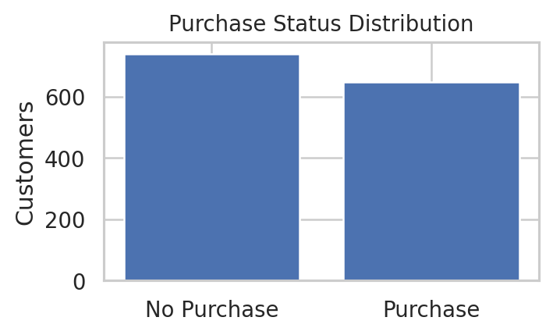
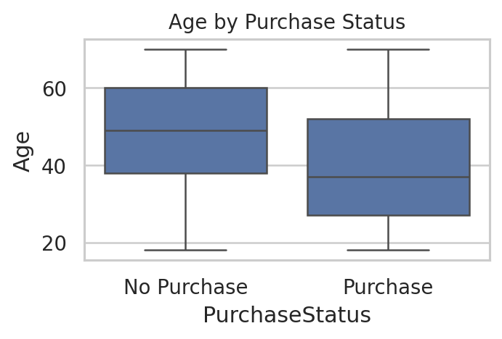
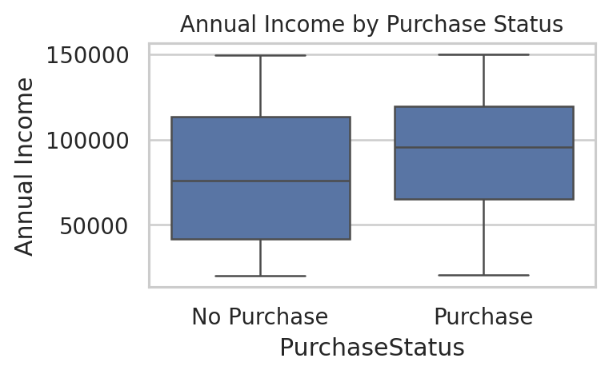
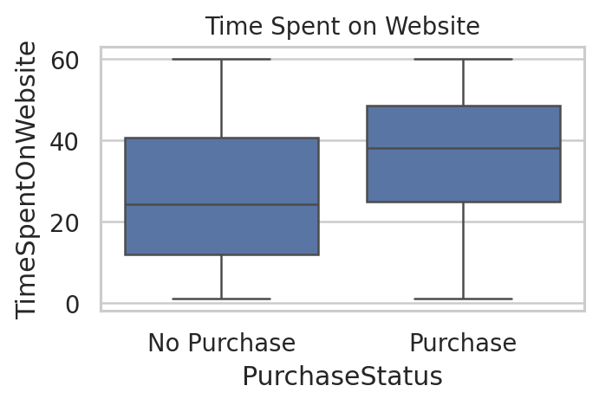
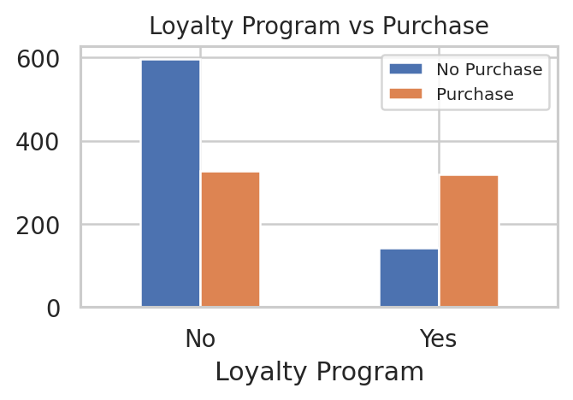
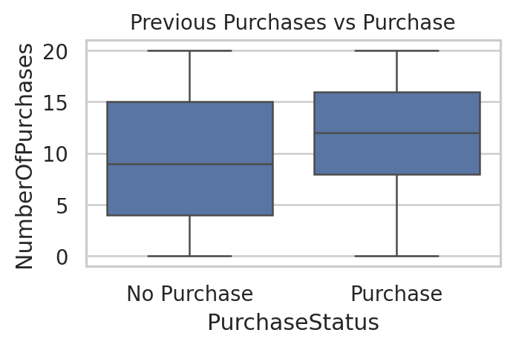
06
Exploratory Data Analysis
Seven visualizations were used to understand purchase behaviour
Purchase status
Age distribution
Annual income
Website time
Loyalty program
Previous purchases
Correlation highlights: LoyaltyProgram 0.318 • DiscountsAvailed 0.297 • TimeSpentOnWebsite 0.282 • NumberOfPurchases 0.219 • Age -0.254
Key insight: LoyaltyProgram, DiscountsAvailed, TimeSpentOnWebsite and NumberOfPurchases show the strongest positive correlations with PurchaseStatus.
ML MINI PROJECT • E-COMMERCE • CUSTOMER PURCHASE PREDICTION
6

Slide 7
07
Machine Learning Algorithms
Three classification models were implemented and compared
Logistic Regression
Decision Tree
Random Forest
BINARY CLASSIFICATION BASELINE
RULE-BASED CLASSIFIER
ENSEMBLE CLASSIFIER
Estimates the probability of purchase vs no purchase.
Makes predictions through a sequence of feature-based splits.
Combines many Decision Trees to make a more robust prediction.
Why chosen: simple, fast and interpretable.
Why chosen: easy to explain and captures non-linear patterns.
Why chosen: captures complex patterns and often generalizes better.
Model settings: StandardScaler + LogisticRegression
Model settings: max_depth = 5
Model settings: 100 trees • max_depth = 10
Team split: Ragini → Logistic Regression + Decision Tree | Sakshi → Random Forest
ML MINI PROJECT • E-COMMERCE • CUSTOMER PURCHASE PREDICTION
7

Slide 8
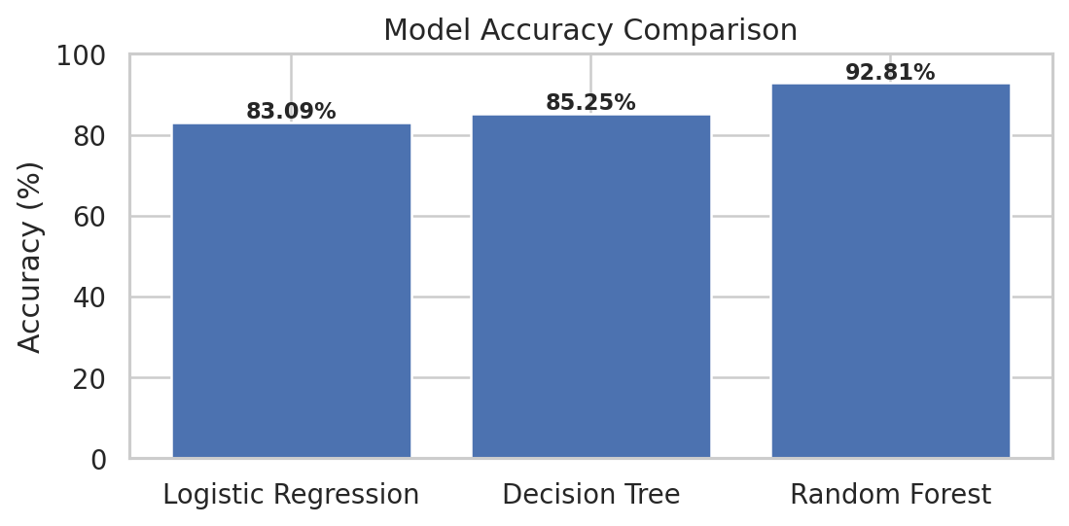
08
Model Performance
Test-set performance using classification metrics
LR ACCURACY
DT ACCURACY
83.09%
85.25%
RF ACCURACY
RF F1-SCORE
92.81%
92.25%
METRICS USED
Accuracy • Precision • Recall • F1-score
Confusion Matrix
Random Forest achieved the strongest test-set performance across the main metrics.
ML MINI PROJECT • E-COMMERCE • CUSTOMER PURCHASE PREDICTION
8

Slide 9
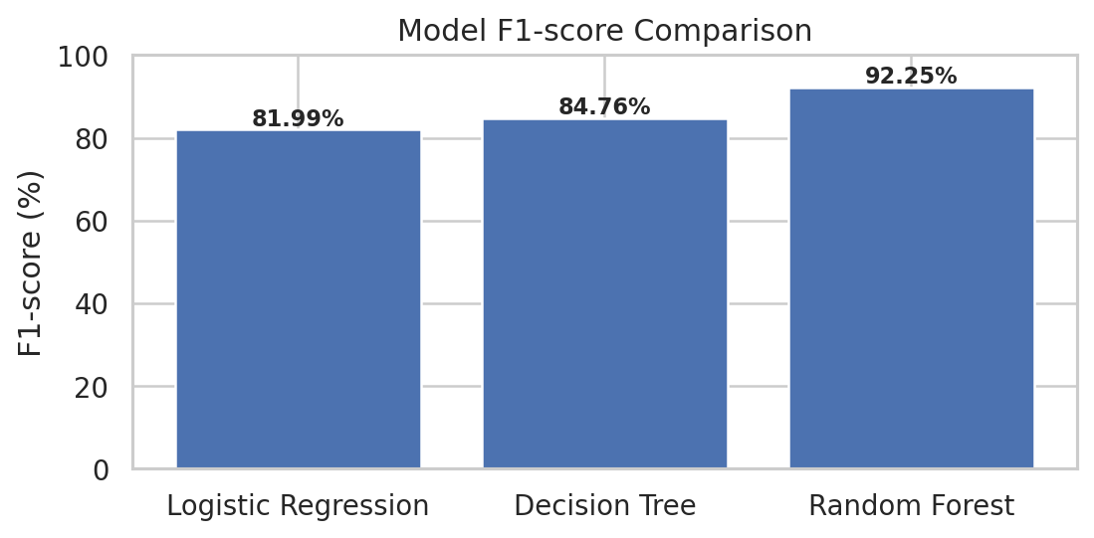
09
Model Comparison
Same test split • same target • directly comparable results
WHAT THE COMPARISON TELLS US
• Logistic Regression provides the baseline.
• Decision Tree improves recall.
• Random Forest delivers the strongest overall balance.
Conclusion:
Random Forest ranks first.
Model
Accuracy
Precision
Recall
F1-score
Logistic Regression
83.09%
81.68%
82.31%
81.99%
Decision Tree
85.25%
82.01%
87.69%
84.76%
Random Forest
92.81%
92.97%
91.54%
92.25%
ML MINI PROJECT • E-COMMERCE • CUSTOMER PURCHASE PREDICTION
9

Slide 10
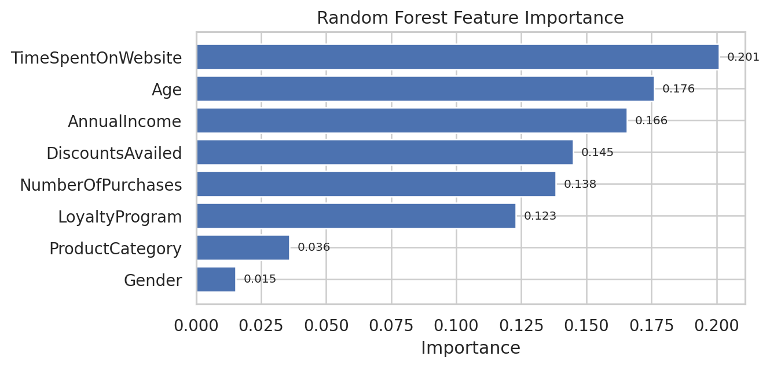
10
Best Model & Key Findings
Why Random Forest was selected
🏆 BEST MODEL
KEY FINDINGS
Random Forest
• TimeSpentOnWebsite is the most influential feature in Random Forest.
• LoyaltyProgram, discounts and purchase history show meaningful relationships with the target.
• Feature importance describes model behaviour; it does not prove causation.
ACCURACY
F1-SCORE
92.81%
92.25%
Highest overall test performance.
Strong balance between precision and recall.
Suitable as the final model for this dataset.
Sample customer:
Purchase probability ≈ 97.28%
ML MINI PROJECT • E-COMMERCE • CUSTOMER PURCHASE PREDICTION
10

Slide 11
11
Conclusion & Future Scope
What the project achieved and how it can be extended
CONCLUSION
FUTURE SCOPE
• Built a complete ML workflow for e-commerce purchase prediction.
• Cleaned the dataset and removed 112 duplicate records.
• Performed 7 EDA visualizations to understand purchase behaviour.
• Compared Logistic Regression, Decision Tree and Random Forest.
• Random Forest achieved 92.81% accuracy and 92.25% F1-score.
• Demonstrated a final purchase prediction for a sample customer.
• Use a larger and more diverse dataset.
• Add richer customer/session-level features.
• Apply hyperparameter tuning and cross-validation.
• Compare additional models such as Gradient Boosting or SVM.
• Deploy the model as a real-time prediction service.
• Use predictions for personalized offers and customer engagement.
ML MINI PROJECT • E-COMMERCE • CUSTOMER PURCHASE PREDICTION
11

Slide 12
12
References
Sources used for the project, analysis and implementation
01
Project Dataset
customer_purchase_data.csv — supplied project dataset used for analysis.
02
Project Notebook
Customer_Purchase_Prediction.ipynb — Google Colab notebook containing the implementation and results.
03
Scikit-learn
https://scikit-learn.org/stable/user_guide.html — ML algorithms and evaluation metrics.
04
Pandas
https://pandas.pydata.org/docs/ — data loading and manipulation.
05
Faculty Guidelines
Machine Learning Mini Project – Assignment Guidelines and Project Domains.
THANK YOU • Questions & Discussion
ML MINI PROJECT • E-COMMERCE • CUSTOMER PURCHASE PREDICTION
12

