Slide 1
SEMICONDUCTOR PHYSICS
Fundamentals • PN Junction • Diode • Modern Applications
PHYSICS MINI PROJECT
Ragini Singh | Roll No. 150096724023

Slide 2
01 • Why Semiconductors Matter
The invisible foundation of modern electronics.
• Their conductivity can be controlled.
• They can act as switches, rectifiers, amplifiers and light emitters.
• They enable tiny, fast and energy-efficient electronic systems.
• They power computers, phones, sensors, solar cells and many modern technologies.

Slide 3
02 • What Is a Semiconductor?
A material with electrical conductivity between a conductor and an insulator.
• Common materials: silicon and germanium.
• Conductivity changes with temperature, light and doping.
• Charge carriers are electrons and holes.
• This controllability is the key to semiconductor technology.

Slide 4
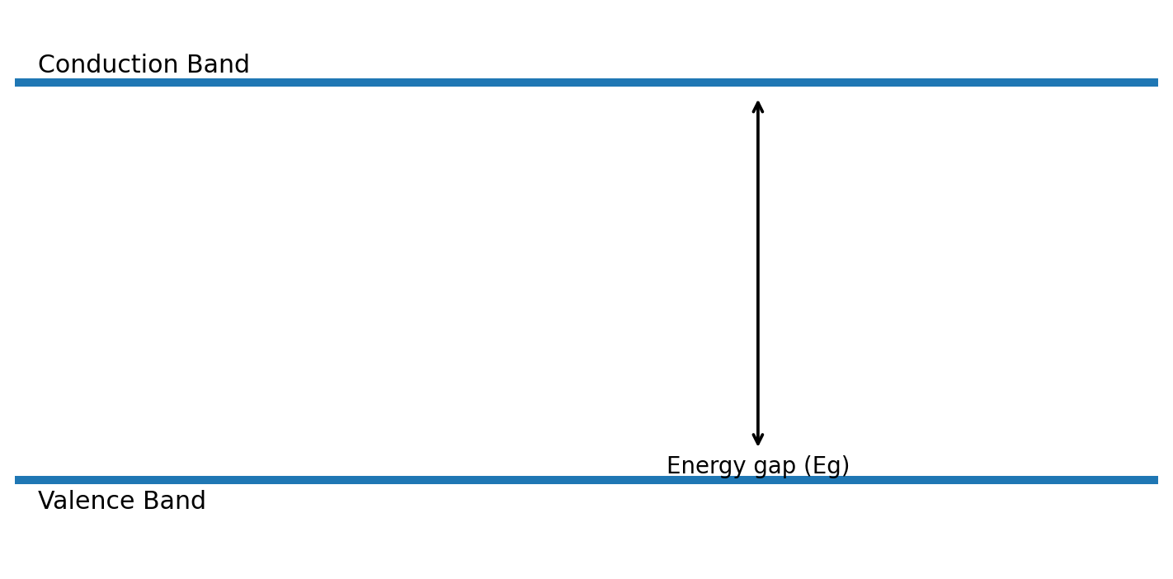
03 • Energy Bands
The band gap explains why semiconductor behaviour is controllable.
• Valence band → electrons are normally bound.
• Conduction band → electrons can contribute to conduction.
• Band gap (Eg) → energy needed to move an electron across the gap.
• Thermal or optical energy can create electron–hole pairs.

Slide 5
04 • Intrinsic vs Extrinsic
Purity versus engineered conductivity.
• Intrinsic → pure semiconductor; electrons and holes are generated thermally.
• Extrinsic → intentionally doped semiconductor.
• Doping changes carrier concentration without changing the material into a metal.
• This is the basis for engineering P-type and N-type regions.

Slide 6
05 • Doping: P-Type and N-Type
A tiny amount of impurity creates a major change in electrical behaviour.
P-TYPE
Trivalent dopant
Example: boron
Majority carriers: holes
N-TYPE
Pentavalent dopant
Example: phosphorus
Majority carriers: electrons

Slide 7
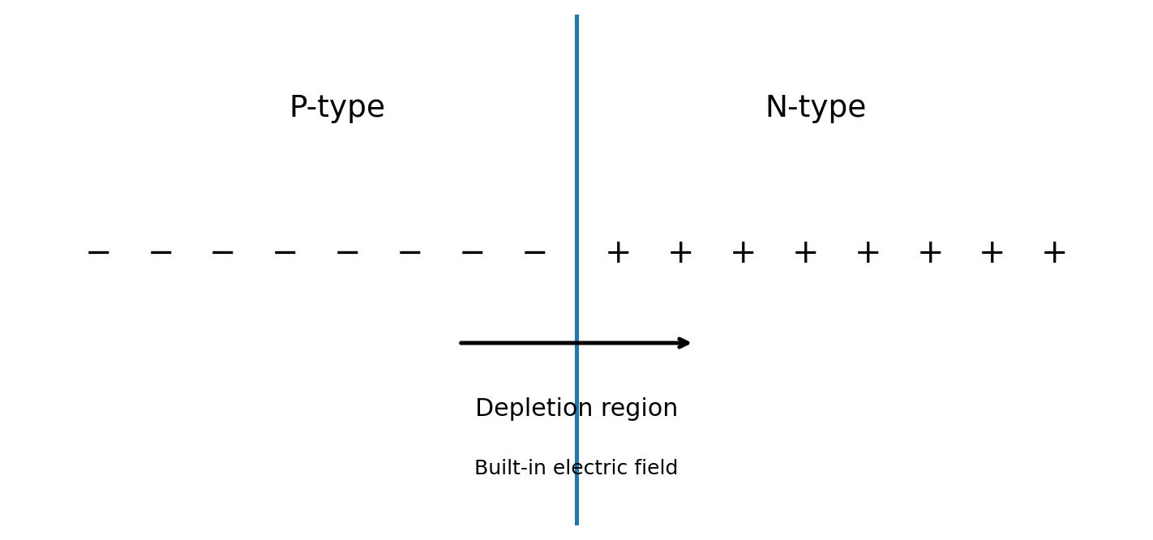
06 • PN Junction
Joining P-type and N-type regions creates a device-building boundary.
• Electrons diffuse from N toward P.
• Holes diffuse from P toward N.
• Recombination leaves fixed ions near the junction.
• This creates the depletion region and a built-in electric field.

Slide 8
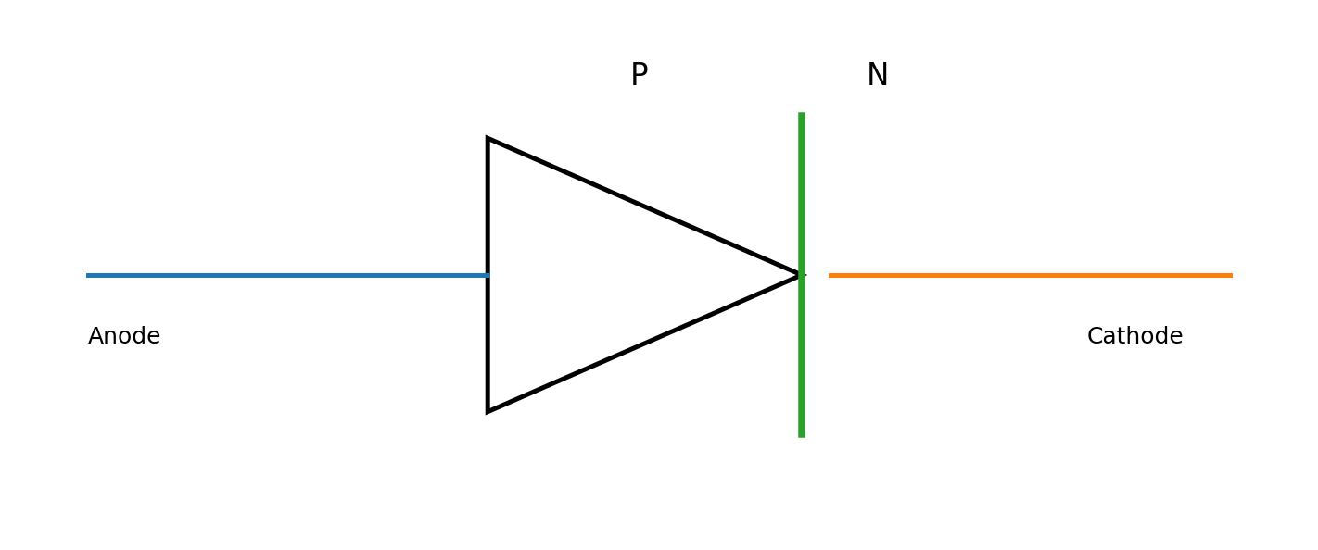
07 • Semiconductor Diode
A PN junction designed mainly for controlled one-way current flow.
• Forward bias → depletion region narrows → current flows readily.
• Reverse bias → depletion region widens → current is strongly limited.
• Used for rectification, protection and signal control.
• Diode behaviour is the first step toward understanding many semiconductor devices.

Slide 9
08 • Important Principles & Equations
Focus on physical meaning, not memorisation alone.
• Semiconductor conduction depends on charge carriers.
• Doping controls carrier concentration.
• Diode equation: I = I₀[e^(qV/ηkT) − 1].
• Photon energy: E = hf — important in optoelectronic devices.
• Core idea: controlled carriers → controlled current → useful device.

Slide 10
09 • Real-Life Applications
From a single diode to billions of transistors on a chip.
• Diodes — rectifiers and circuit protection
• Transistors — switching and amplification
• LEDs — electrical energy to light
• Solar cells — light to electrical energy
• Integrated circuits — computing and control
• Sensors — light, temperature, magnetic and chemical sensing
• Power electronics — chargers, inverters and electric systems

Slide 11
10 • Modern Applications
Semiconductor physics drives the technology around us.
• Microprocessors and memory chips
• Smartphones and communication hardware
• Artificial-intelligence accelerators
• Electric vehicles and battery-management systems
• Solar power and power converters
• SiC and GaN devices for high-efficiency power electronics
• Advanced optical and sensing systems

Slide 12
11 • Advantages & Limitations
Why semiconductor technology is powerful — and what engineers must manage.
• ✓ Small size and very high integration
• ✓ Fast switching and low power in many applications
• ✓ Conductivity can be precisely engineered
• ⚠ Excessive heat can affect performance and reliability
• ⚠ Fabrication requires high precision and controlled environments
• ⚠ Advanced devices can be complex and expensive to manufacture

Slide 13
12 • Viva Ready
Likely conceptual questions from the faculty.
• What is a semiconductor?
• Why is silicon widely used?
• What is doping?
• Difference between P-type and N-type?
• What is a PN junction?
• What is the depletion region?
• Why does a diode conduct mainly in one direction?
• Where are semiconductors used?

Slide 14
13 • Conclusion
Controlling charge carriers made modern electronics possible.
• Semiconductors have controllable electrical conductivity.
• Energy bands and the band gap explain their behaviour.
• Doping creates P-type and N-type materials.
• PN junctions enable diodes and many other devices.
• Semiconductor technology connects fundamental physics to computing, communication, energy and sensing.

Slide 15
14 • References
Sources for conceptual preparation and the report.
• NCERT — Physics Class XII: Semiconductor Electronics.
• NCERT — Science Class X: foundational electricity concepts.
• OpenStax — University Physics: semiconductor and electronic-device concepts.
• S. M. Sze & Kwok K. Ng — Physics of Semiconductor Devices.
• Boylestad & Nashelsky — Electronic Devices and Circuit Theory.

Slide 16
THANK YOU
Questions & Discussion

