Slide 1

Introduction to Open Source Development

Slide 2
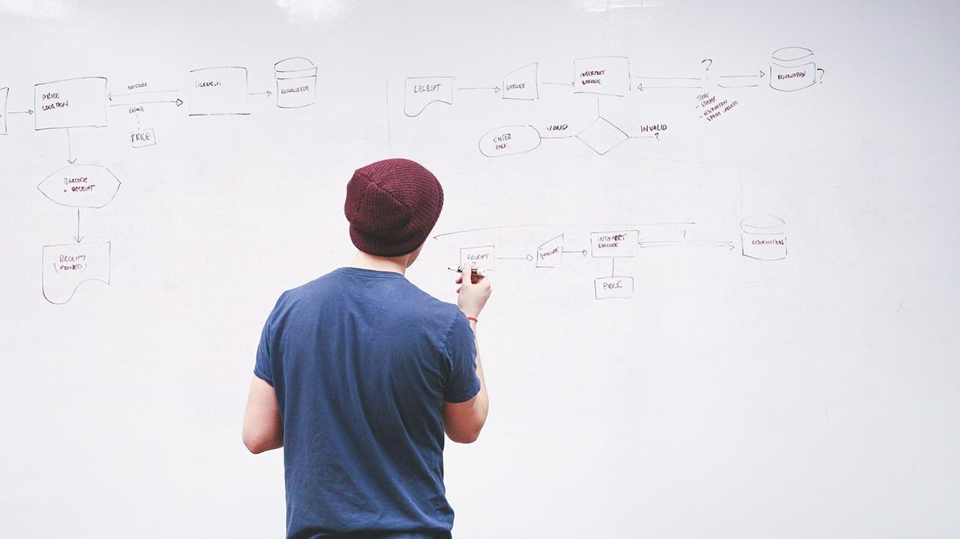
HELLO!
I am Ricky Noel!
www.diancin.com
info@diancin.com
0999 702 2868

Slide 3
Open Source Development
Methodology for creating software products, from the design and development to distribution.
Author offers access to the source code

Slide 4
You will learn about:
A brief history about open source software development
The evolution of the open source movement
Open source versus free software
Advantages and disadvantages of open source
Trends and perspectives
Career prospective in the open source world

Slide 5
A brief history about open source development
The story of open source development

Slide 6
History of Open Source Development
In the 50's and 60's almost all the software that existed was mostly produced by research institutes.
Software was not seen as a product.

Slide 7
History of Open Source Development
Computer companies were in the hardware business
During this time software was developed and distributed by communities of user groups and no effort was needed to make it freely available
Notes:
and software was made freely available to encourage hardware sales.
The source code was distributed with the software because users often had to change the code to fix bugs or add new features to support hardware issues.

Slide 8
History of Open Source Development
Things started to change in the early 1970's
Early 1980's computer vendors and software companies began to routinely charge for software licenses
Impose legal restrictions on new software developments through: copyrights, trademarks, and leasing contracts
Notes:
OSs and compilers began to grow very fast, with the emergence of micro-processors.
sell software as a product imposing legal restrictions on new software developments through copyrights, trademarks, and leasing contracts.

Slide 9
History of Open Source Development
2 Groups on open source software (OSS) philosophy
In the East coast, a programmer at the MIT Artificial Intelligence Lab launched the GNU Project and the Free Software Foundation, his name was Richard Stallman
Notes:
with the emergence of micro-processors.
sell software as a product imposing legal restrictions on new software developments through copyrights, trademarks, and leasing contracts.

Slide 10
History of Open Source Development
On the West coast, the Computer Science Research Group (CSRG) of the University of California at Berkeley were improving the UNIX system - “BSD UNIX”.
Notes:
This is when the real development of the open source movement began.

Slide 11
BIG CONCEPT
With the advent of Usenet, an Internet user group, programming communities started to share their software and contribute to each others' work.

Slide 12
The evolution of the open source movement
The story of open source development

Slide 13
Control over the use of one's ideas really constitutes control over other people's lives; and it is usually used to make their lives more difficult.
-R.S.

Slide 14
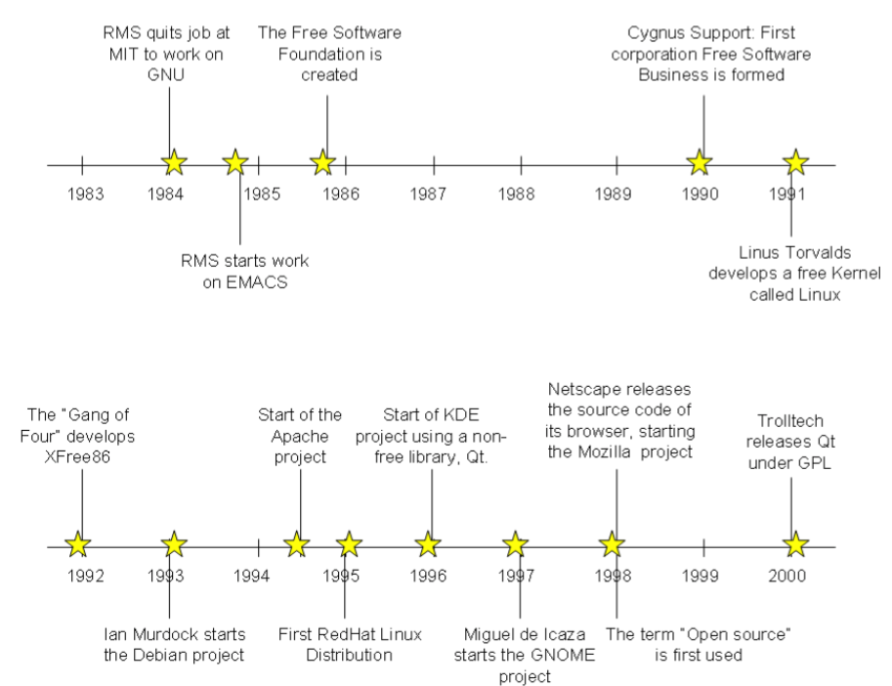
Evolution of Open Source Development
Notes:
This is when the real development of the open source movement began.

Slide 15
Evolution of Open Source Development
1984, Stallman started the GNU project with the ultimate goal of building a free operating system.
In 1985 Stallman created the Free Software Foundation (FSF)
1990 the foundation was dedicated to writing more software.
Notes:
- Within this project, he wrote the EMACS editor, which is considered by many as the most powerful text editor.
- Free Software Foundation (FSF), a nonprofit organization dedicated to the elimination of restrictions on copying, redistribution, understanding and modification of computer programs. The organization's goal was to promote the development and use of open source software in all areas of computing, particularly in helping to develop the GNU operating system and its tools.

Slide 16
Evolution of Open Source Development
GNU General Public License (GPL) was designed not only to ensure that the software produced by GNU would remain free, but to promote the production of more and more open source software
1987 Stallman created an open source compiler, the GNU C Compiler (GCC)
Notes:
GNU C Compiler (GCC) - with the idea to encourage more open source code contributions.

Slide 17
Evolution of Open Source Development
For many years, employees of Cygnus Support, a small company founded by Michael Tiemann, David Vinayak Wallace, and John Gilmore were the maintainers of several key GNU software products, including the GNU Debugger (gdb) and GNU Binutils

Slide 18
Evolution of Open Source Development
1991 a student of the Department of Computer Science at the University of Helsinki in Finland, Linus Torvalds, created with the help of several volunteer programmers through Usenet the Linux® kernel.

Slide 19
Evolution of Open Source Development
1993 the Debian GNU/Linux operating system was created by Ian Murdock in order to assemble all the GNU tools that existed at the time and the Linux kernel.

Slide 20
Evolution of Open Source Development
1994, Robert McCool developed the Apache HTTP server
This Web server played a key role in the development of the World Wide Web
Notes:
first open source alternative to the Netscape Web server

Slide 21
FLOSS - Free, libre, open source software
Until now the use of the term "open source" has many opponents

Slide 22
FLOSS - Free, libre, open source software
Stallman uses the term "free software”
Not referring to price as indicated by his quote
On the other hand, using the term "free software" was commonly confused with the no-charge connotation
Notes:
Stallman and others with similar thoughts object to "open source" as they say it does not make users realize the freedom that the software in question gives to them
no-charge connotation, which obviously made business organizations uneasy.

Slide 23
Free software is a matter of liberty, not price. To understand the concept, you should think of free as in free speech, not as in free beer

Slide 24
FLOSS
In order to end this discussion other terms have been proposed

Slide 25
FLOSS - Free, libre, open source software
Free software is a philosophical concept that aims to convey the idea of software that can be used, studied and modified without any restriction.
It does not refer to price, but liberty
Softwares can be freely distributed

Slide 26
FLOSS - Free, libre, open source software
Libre is a word used by several Romanic Languages such as Spanish, Portuguese and French
Free as in "free speech", freedom as a right that a citizen has and not freedom associated with zero cost (Gratis)

Slide 27
FLOSS - Free, libre, open source software
Open source on the other hand is a movement which emphasizes on source code of software being freely available
It also talks about certain criteria which must exist in the license of software to make it open source.

Slide 28
Did you know?
The first use of the phrase “free open source software” on Usenet was in a posting on 18 March 1998, just a month after the term “open source” itself was introduced.

Slide 29

Advantages and Disadvantages of Open Source
Notes:
Based on the fact that open source software is free and can be seen by everyone has great advantages. But the fact that it is being developed by a nonprofit community has some disadvantages.

Slide 30
Pros: Lower Monetary Costs
Support and license costs are fairly minimal when compared to proprietary software
For example, IBM offers a quality service with the Linux operating system.
Another company, RedHat is selling the Linux operating system with support services.
Notes:
This does tempt many organizations to use open source software in their business model.
In fact many companies do business with open source, IBM being one of them.

Slide 31
Pros: Security and Reliability
Many people analyze the source code, a safer and more secure code will be produced
Since open source software has so many people participating in its development, some programs are faster and scale better than the proprietary counterparts
Notes:
Also depending on usage and need, open source software is also changed by experienced users thereby making code more stable.

Slide 32
Pros: Incompatible Formats
Uses open standards, that is, standards that are known or are accessible to all the people
One such example is OpenDocument Text (.odt), which is an open standard for word processor documents
Notes:
Also depending on usage and need, open source software is also changed by experienced users thereby making code more stable.

Slide 33
Pros: Licensing
No worry about complicated licensing
Do not suffer the risk of having illegal copies that infringe copyrights
Notes:
Therefore, they don’t need anti-piracy measures, such as CD keys, product activation and serial keys.

Slide 34
Pros: Community Driven and Community Serving
A large number of bright, and generous developers work openly and with the whole community
For example when an open source program crashes it provides useful information to find the source of the error or to report a possible bug

Slide 35
Pros: Independent
If the company goes bankrupt or the authors fail to maintain the program, the code continues to belong to the community
Open source software can live by itself
Notes:
Therefore, many people believe open source software can live by itself
As long as there are passionate contributors from the community, this is indeed the case

Slide 36
Cons: A Few
Adoption in the desktop arena is much slower
Many software is not yet compatible with open source
(When a user chooses a Linux desktop he has to remove several software that are not supported on Linux, or in some cases, there is no similar nor viable open source application)
Notes:
Open source software has been focused to provide solutions to servers
Linux desktops are still not used as much as Microsoft® Windows®
A good example is the gaming industry, which is still very focused on Windows.

Slide 37
Cons: A Few
Proprietary software offers better service and support.
The quality and availability of assistance in an open source project is proportional to the interest and use of the program by the community.
Notes:
An open source tool with few users can be poorly documented and have almost no means to help you understand it.

Slide 38
Trends & Perspectives
The advantages of OSS outweigh its disadvantages

Slide 39
Open Source Trends and Perspectives
LAMP stack
Linux
Apache
MySQL®
PHP/Perl/Python
Eclipse IDE
(Integrated Development Environment)
Eclipse was developed by IBM in 2001
Eclipse is one of the widest IDEs in use worldwide.

Slide 40
Open Source Trends and Perspectives
There are more and more companies whose business model relies on open source
For example, some companies specialize in delivering an integrated and fully tested environment consisting of different open source software like LAMP
Notes:
The fact that such companies exist is the greatest measure of the success of open source community developed software.

Slide 41
Career Path
Notes:
Based on the fact that open source software is free and can be seen by everyone has great advantages. But the fact that it is being developed by a nonprofit community has some disadvantages.

Slide 42
Career Path
The number of jobs in OSS is much higher than that for proprietary software - niche market
With the growing trends of involvement and usage of OSS in companies – Demand is High
Needless to say that being an expert in a niche area always calls for a premium salary for oneself
Notes:
The fact that such companies exist is the greatest measure of the success of open source community developed software.

Slide 43
Summery
You have learned about the history of open source and how it evolved over the years.
The difference between the terms "free software" and "open source software".
Advantages and disadvantages of open source software
How working in the open source space could benefit your career in the long term
Notes:
The fact that such companies exist is the greatest measure of the success of open source community developed software.

Slide 44
THANKS!
Any questions?

Slide 45
Quiz # 1
When was the term "Open source" first used and by who?
What does FLOSS stands for?
List 1 pros of FLOSS
List 1 cons of FLOSS
Which foundation was started when Netscape Communicator software was made open source?
Notes:
The fact that such companies exist is the greatest measure of the success of open source community developed software.

Slide 46
Quiz # 1
6. Which of the following open-source projects appears in the 90s?
A. EMACS
B. XFree86
C. KDE
D. Eclipse IDE
E. None of the above
Notes:
The fact that such companies exist is the greatest measure of the success of open source community developed software.

Slide 47
Quiz # 1
7. Who was the founder of the Free Software Foundation?
A. Richard Stallman
B. Ian Murdock
C. Miguel de Icaza
D. Linus Torvalds
E. None of the above
Notes:
The fact that such companies exist is the greatest measure of the success of open source community developed software.

Slide 48
Quiz # 1
8. One of the two groups who established the roots of OSS were:
A. The founders of the GNU project
B. The creators of BSD UNIX
C. The founders of the GNOME project
D. A&B
E. None of the above
Notes:
The fact that such companies exist is the greatest measure of the success of open source community developed software.

Slide 49
Quiz # 1
9. In Stallman's definition of Free Software, "Free" means:
A. Free as in "Free beer"
B. Free as in "Free speech”
C. Free as in "Free of charge"
D. All of the above
E. None of the above
Notes:
The fact that such companies exist is the greatest measure of the success of open source community developed software.

Slide 50
Quiz # 1
10. In Stallman's definition, Free Software is:
A. Freeware
B. Libre
C. Software that can be modified, studied and distributed with no restriction, but may not be free of charge
D. BandC
E. None of the above
Notes:
The fact that such companies exist is the greatest measure of the success of open source community developed software.

Slide 51
BIG CONCEPT
Bring the attention of your audience over a key concept using icons or illustrations

Slide 52
This is a slide title
Here you have a list of items
And some text
But remember not to overload your slides with content
You audience will listen to you or read the content, but won’t do both.

Slide 53
You can also split your content
White
Is the color of milk and fresh snow, the color produced by the combination of all the colors of the visible spectrum.
Black
Is the color of coal, ebony, and of outer space. It is the darkest color, the result of the absence of or complete absorption of light.

Slide 54
In two or three columns
Yellow
Is the color of gold, butter and ripe lemons. In the spectrum of visible light, yellow is found between green and orange.
Blue
Is the colour of the clear sky and the deep sea. It is located between violet and green on the optical spectrum.
Red
Is the color of blood, and because of this it has historically been associated with sacrifice, danger and courage.

Slide 55

A picture is worth a thousand words
A complex idea can be conveyed with just a single still image, namely making it possible to absorb large amounts of data quickly.

Slide 56
Use charts to explain your ideas
White
Gray
Black

Slide 57
And tables to compare data
 | A | B | C
Yellow | 10 | 20 | 7
Blue | 30 | 15 | 10
Orange | 5 | 24 | 16

Slide 58
Maps
our office

Slide 59
89,526,124
Whoa! That’s a big number, aren’t you proud?

Slide 60
89,526,124$
185,244 users
100%
That’s a lot of money
And a lot of users
Total success!

Slide 61
Our process is easy
first
second
last

Slide 62
Let’s review some concepts
Yellow
Is the color of gold, butter and ripe lemons. In the spectrum of visible light, yellow is found between green and orange.
Blue
Is the colour of the clear sky and the deep sea. It is located between violet and green on the optical spectrum.
Red
Is the color of blood, and because of this it has historically been associated with sacrifice, danger and courage.
Yellow
Is the color of gold, butter and ripe lemons. In the spectrum of visible light, yellow is found between green and orange.
Blue
Is the colour of the clear sky and the deep sea. It is located between violet and green on the optical spectrum.
Red
Is the color of blood, and because of this it has historically been associated with sacrifice, danger and courage.

Slide 63
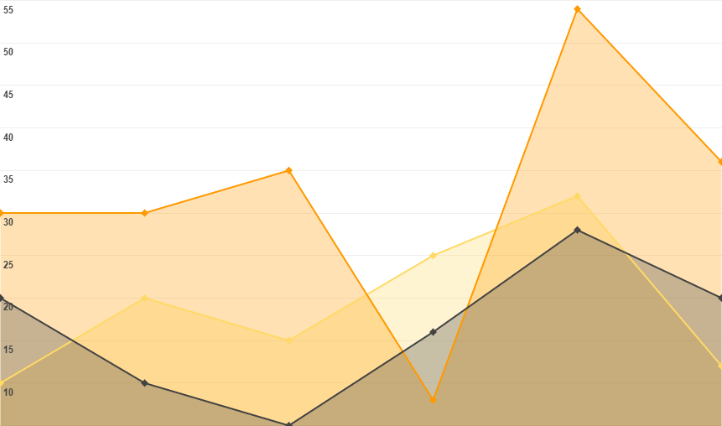
You can insert graphs from Google Sheets

Slide 64
ANDROID PROJECT
Show and explain your web, app or software projects using these gadget templates.
Place your screenshot here

Slide 65
iPHONE
PROJECT
Show and explain your web, app or software projects using these gadget templates.
Place your screenshot here

Slide 66
TABLET
PROJECT
Show and explain your web, app or software projects using these gadget templates.
Place your screenshot here

Slide 67
DESKTOP PROJECT
Show and explain your web, app or software projects using these gadget templates.
Place your screenshot here

Slide 68
THANKS!
Any questions?
You can find me at @username & user@mail.me

Slide 69
Credits
Special thanks to all the people who made and released these awesome resources for free:
Presentation template by SlidesCarnival
Photographs by Startupstockphotos

Slide 70
Presentation design
This presentation uses the following typographies and colors:
Titles: Dosis
Body copy: Roboto
You can download the fonts on these pages:
https://www.fontsquirrel.com/fonts/dosis
https://material.google.com/resources/roboto-noto-fonts.html
Orange #ff8700
You don’t need to keep this slide in your presentation. It’s only here to serve you as a design guide if you need to create new slides or download the fonts to edit the presentation in PowerPoint®

Slide 71
SlidesCarnival icons are editable shapes.
This means that you can:
Resize them without losing quality.
Change line color, width and style.
Isn’t that nice? :)
Examples:

Slide 72
😉
Now you can use any emoji as an icon!
And of course it resizes without losing quality and you can change the color.
How? Follow Google instructions https://twitter.com/googledocs/status/730087240156643328
✋👆👉👍👤👦👧👨👩👪💃🏃💑❤😂😉😋😒😭👶😸🐟🍒🍔💣📌📖🔨🎃🎈🎨🏈🏰🌏🔌🔑 and many more...

