Slide 1

Open Source Business Models

Slide 2

Hello!
I am Ricky Noel
I am here because I love to give presentations.
info@diancin.com

Slide 3

There’s no such thing as a free answer
So please take down some effin notes!
Notes:
Do you think this applies to open source?
Are the users of open source software getting a free lunch?
If the creators of open source software are giving their users a free lunch, then how do they themselves earn a living or even be profitable?

Slide 4

You will learn about:
The different business models employed by companies (not communities) involved in open source.
How the business models affect you, as a contributor to open source, if any.

Slide 5

Why should this matter to me as developer?
You may use this knowledge to your advantage, and perhaps use it as a guide towards your success when you start your own open source project! Understanding the economics behind how open source operates can be interesting in itself!
Notes:
Strictly speaking, at this point you can choose not to bother; however, from our experience, this knowledge will help you understand some of the nuances behind why communities and companies do what they do.

Slide 6
The Big Picture
It is a model used by companies that are involved in the development of open source software to keep themselves financially viable and successful

Slide 7

Open Source Business Models
Let’s start with the first set of slides

Slide 8
Open Source Business Models
Traditional software companies get revenue by the sale of the software they create
They earn money for each copy of the software sold

Slide 9
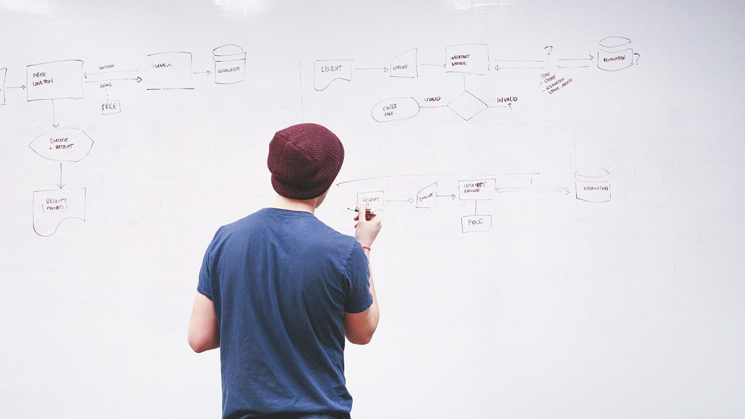
Business Models for Proprietary Software
Sales of Software Products
Traditional Software Business Models
Sale of Software Development Services
Notes:
traditional software business models monetize software by either directly selling software products or by providing software development services.

Slide 10
Did you know?
When IBM sold the first mainframes, the software that was bundled with them was made freely available in open source. Users were allowed to modify and enhance it.

Slide 11
Business Models for OSS Companies
How about open source software companies?

Slide 12
OSS Business Models
Community projects which had mutual sharing as their main concern (over business ambitions) as in the case of the GNU project
Funded by government contracts as in the case of BSD UNIX.

Slide 13
OSS Business Models
However as OOS usage progressed to the extent that many of them were viable alternatives to their commercial counterparts
Commercial software companies became interested in finding ways by which they could promote, develop and monetize OSS

Slide 14
OSS Business Models
During this period many startup companies emerged, such as Red Hat
Companies involved in the development and promotion of OSS – has lasted for around a decade or more now
Today there are probably very few domains of product software in which there are no commercial companies promoting open source communities and their software

Slide 15

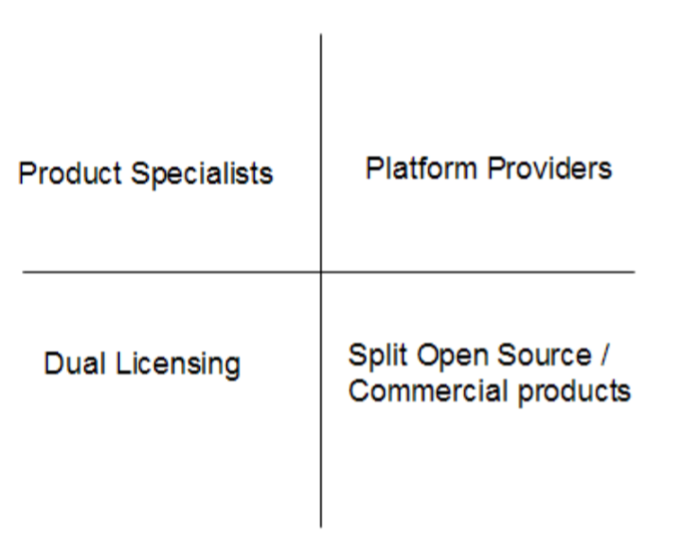
Top 4 Business Models for OSS

Slide 16
OSS Business Models
Companies that develop and promote open source software are sometimes referred to as
Commercial Open Source Software companies (COSS)
Professional Open Source Software companies (POSS).
Notes:
POSS companies help the consumer manage the risks of deploying open source software.

Slide 17
Dual licensing
OOS is licensed by the POSS company under both:
GPL
Commercial
The POSS company generates revenue when it sells the open source software under a commercial license.
Notes:
POSS companies help the consumer manage the risks of deploying open source software.

Slide 18

Why would a consumer of OOS pay the POSS company to obtain the same software which is also available free of charge?

Slide 19
Dual licensing
This is needed when the consumer wants to link his own proprietary software to the open source software, but does not want this to cause its proprietary software to become open source as it would under the GPL license.

Slide 20
Dual licensing
According to the GPL license, when one accepts GPL licensed source code and links it with any other code, the linked software also becomes open source.
Notes:
Thus the only way proprietary software vendors can link with GPL software without causing their own software to become GPL is by paying the POSS company.

Slide 21
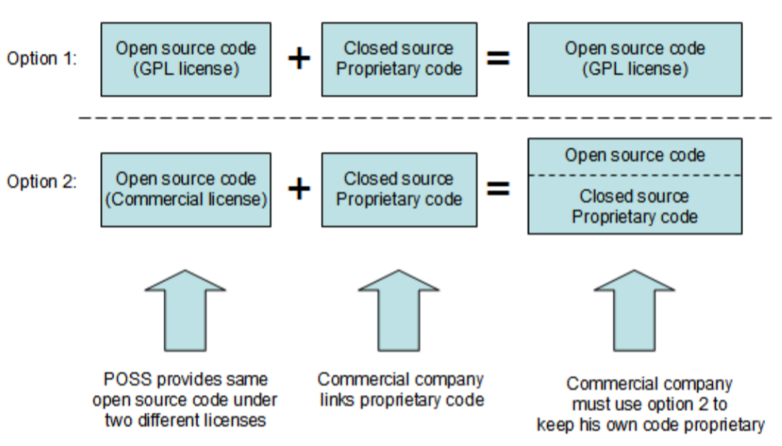

Slide 22
Dual licensing Business Model
As a developer, you may want to consider this if you are planning to make code contributions to an open source project that has dual license.
You will be giving the POSS company the right to make money directly out of your contribution by commercially licensing your code.
Notes:
Of course if the POSS company plans to accept your contributions they will ask you to sign a legal document which states that you have given them the rights to do so.

Slide 23

Examples of POSS Companies
MySQL
SugarCRM
JBoss

Slide 24
Did you know?
When Oracle bought Sun Microsystems in 2009, MySQL became an Oracle product since MySQL had been bought by Sun a few years earlier. At the time of writing, Oracle has not made it clear what are its plans for MySQL.

Slide 25
Split OSS / Commercial Products
There is a core portion of the software which is available as open source
This core provides the base functionality
Then there are other portions or extensions that are built on top of or extend the functionality provided by the core
Notes:
Of course if the POSS company plans to accept your contributions they will ask you to sign a legal document which states that you have given them the rights to do so.

Slide 26
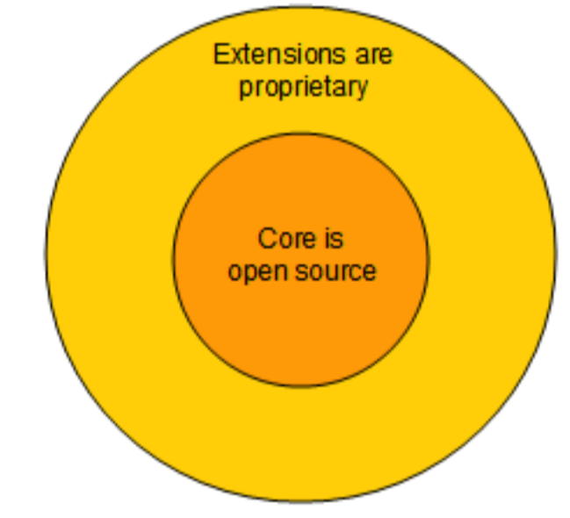
Split OSS / Commercial Products Business Model
Notes:
This model is used by many commercial software companies that participate in open source including IBM.
In fact, IBM is an acknowledged leader in this space.
Does this mean IBM is a POSS company?
A company is considered a POSS when most of its revenue comes from open source software sales.
Since this is not the case for IBM it would not be considered a POSS company by that definition.
Probably the best example of IBM’s successful usage of this open source business model is Eclipse – the world’s default IDE and tooling platform.

Slide 27
Split OSS / Commercial Products
If you are a developer planning to contribute to an open source project under this business model, you can be certain that your code will never be licensed under a commercial license, since it would be part of the core, which must be open source.
Notes:
This model is used by many commercial software companies that participate in open source including IBM. In fact, IBM is an acknowledged leader in this space.

Slide 28
Product specialists
Training &
Consulting Services
(Fee-based)
A POSS company that nurtured an open source software project either by creating it from the start or contributing and maintaining it, can generate revenue from it by providing training and consulting services to the customers of the open source software.
Open Source Code
(no-charge)

Slide 29
Platform Providers
In a not so distant past software systems were monolithic.
In those days one probably bought the entire system from a single vendor who provided all the software and support needed.

Slide 30
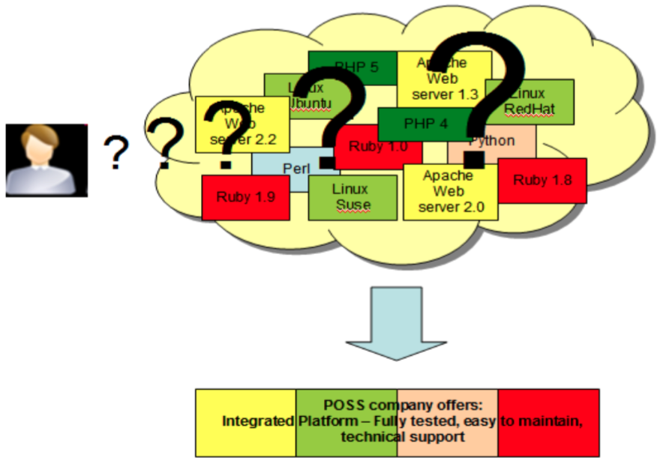
The Platform Providers' Business Model
Notes:
An example of a POSS company using this business model is Zend, "the PHP company". Zend provides a platform fully tested to develop PHP applications.

Slide 31
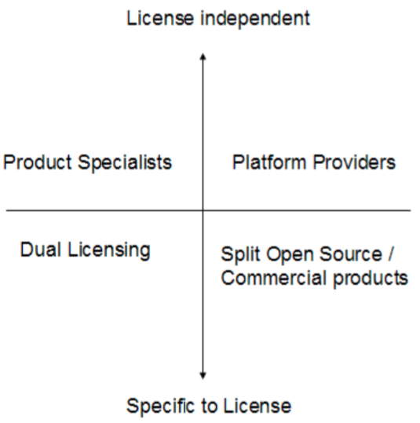
Business Model Relationship to OSS License
Notes:
In the bottom quadrants, the business model is tied to the license of the open source software
Dual licensing applies only when the open source software is GPL- licensed, and Split Open Source / Commercial products when the open source software is Mozilla-based.
However the business models in the top quadrant have no bearing on the license of the open source software itself.

Slide 32
Business Model Relationship to License
The relationship these models have is vis-à-vis to open source licenses
In the bottom quadrants, the business model is tied to the
However the business models in the top quadrant have no bearing on the license of the open source software itself
Notes:
In the bottom quadrants, the business model is tied to the license of the open source software
Dual licensing applies only when the open source software is GPL- licensed, and Split Open Source / Commercial products when the open source software is Mozilla-based.
However the business models in the top quadrant have no bearing on the license of the open source software itself.

Slide 33
Open Source Business Model and Proprietary Software
A widely used strategy is to offer no-charge versions of their fee- based products
The source code of these no-charge versions remains close
A typical example is with Database Management Systems (DBMS)
IBM, Oracle® and Microsoft compete today with open source DBMSs like MySQL and PostgreSQL by offering "Express" editions of their popular fee-based DBMS systems.
Notes:
The Express editions are free of charge, and by default have no customer support.
This means that if you run into a problem such as a defect in the product, the vendor will not provide you with any support.
However, vendors often optionally offer support for a fee.
Thus proprietary software vendors are using the same approach as the open source business model – not charging for the software itself but generating revenue by providing support.

Slide 34
Adoption & Upgrade
In addition to customer support revenue, proprietary vendors view this as an opportunity for adoption and upgrade to fee-based versions in the future
Notes:
For example a startup company in its initial stages may not be in a position to spend lots of money to purchase software licenses; however, if the company grows, they would need more sophisticated product features which are generally not available in the free versions or on open source software.
Therefore, an obvious choice for these companies would be to upgrade to a fee-based version of the proprietary software.

Slide 35
Did you know?
IBM DB2 Express-C database server does not provide any restriction on the amount of data you can store. It can run on Linux, Windows, and the Mac OS, and can be installed on hardware of any size. Applications developed for DB2 Express-C will work with no modification on other editions of DB2, should you need to upgrade, because DB2 Express- C is built using the same code base as the other DB2 editions.

Slide 36

Summary
This chapter started with an explanation about the open source software ecosystem, and how it generates money to sustain itself
It then explained the different business models that exist in the world of open source, and how choosing a model can impact you as a contributor to open source software communities

Slide 37

Thank you for listening!
Any questions?

Slide 38
QUIZ

Slide 39
Quiz #2
Name a well-known database company that uses the dual licensing business model.
In which business model would the Eclipse project and its various plug-ins fall under?
What are Professional Open Source Software Companies?
Notes:
MySQL.
Split Open Source software / commercial products.
POSS companies help the consumer manage the risks of deploying open source software.
The POSS company generates revenue when it sells the open source software under a commercial license.

Slide 40
Quiz #2
Describe how DB2 Express-C is different from its competitors like Oracle XE or Microsoft SQL Server Express.
What is the value proposition from businesses using the Platform Providers' Business Model?
Notes:
4. Not limits on data storage and usage. No limits on type of hardware used. Paid support option 5. It is difficult to work in an OSS environment with many different OSS products that have not been tested together.
Using the Platform providers' business model, a company offers a tested environment and provides support.

Slide 41
Quiz #2
Which of the following is not one of the top business models used in open source:
Dual licensing
Platform Providers
OS Providers
All of the above
None of the above
Notes:
C. OS Providers is not a business model

Slide 42
Quiz #2
Which of the following business models require specific licenses?
A. Split open source / Commercial products B. Platform providers
C. OS Providers
D. All of the above
E. None of the above
Notes:
A. Split open source / commercial products

Slide 43
Quiz #2
Which of the following is a characteristic of DB2 Express-C?
A. DB2 Express-C is a free database server by IBM
B. DB2 Express-C has no limitation on the database size or the number of users
C. DB2 Express-C can run on Linux, Windows and the Mac OS
D. All of the above
E. None of the above
Notes:
D

Slide 44
Quiz #2
What are the advantages of the express versions of some commercial products like DB2 Express-C?
A. It's free
B. It has optional fee-based support when your company grows
C. It provides an easy upgrade path when your company grows
D. All of the above
E. None of the above
Notes:
D

Slide 45
Quiz #2
A company using the "Product Specialists" business model:
A. Does not spend a lot of money in marketing
B. Uses this model because it delivers complex OSS software in a large market
C. Relies on its expertise to deliver training given that it developed the software
D. All of the above
E. None of the above
Notes:
D

Slide 46
100%
Total success!

Slide 47
Big concept
Bring the attention of your audience over a key concept using icons or illustrations

Slide 48
A picture is worth a thousand words
A complex idea can be conveyed with just a single still image, namely making it possible to absorb large amounts of data quickly.

Slide 49
Want big impact?
Use big image.

Slide 50
Use charts to explain your ideas
Yellow
Blue
Red

Slide 51
And tables to compare data
 | A | B | C
Yellow | 10 | 20 | 7
Blue | 30 | 15 | 10
Orange | 5 | 24 | 16

Slide 52

Maps
our office

Slide 53
89,526,124
Whoa! That’s a big number, aren’t you proud?

Slide 54
89,526,124$
185,244 users
100%
That’s a lot of money
And a lot of users
Total success!

Slide 55
Our process is easy
first
second
last

Slide 56
Let’s review some concepts
Yellow
Is the color of gold, butter and ripe lemons. In the spectrum of visible light, yellow is found between green and orange.
Blue
Is the colour of the clear sky and the deep sea. It is located between violet and green on the optical spectrum.
Red
Is the color of blood, and because of this it has historically been associated with sacrifice, danger and courage.
Black
Is the color of coal, ebony, and of outer space. It is the darkest color, the result of the absence of or complete absorption of light.

Slide 57

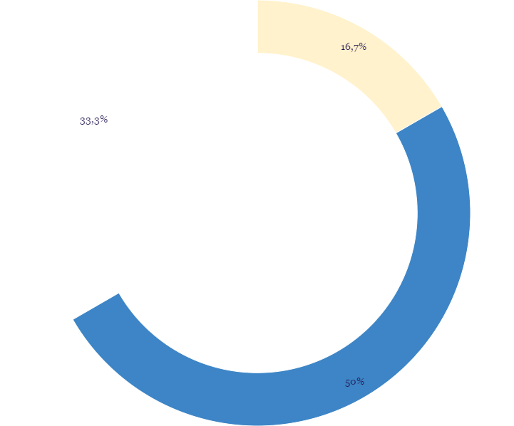
You can insert graphs from Google Sheets

Slide 58
Android project
Place your screenshot here
Show and explain your web, app or software projects using these gadget templates.

Slide 59
iPhone project
Place your screenshot here
Show and explain your web, app or software projects using these gadget templates.

Slide 60
Tablet project
Place your screenshot here
Show and explain your web, app or software projects using these gadget templates.

Slide 61
Desktop project
Place your screenshot here
Show and explain your web, app or software projects using these gadget templates.

Slide 62
Thanks!
Any questions?
Find me at @username & user@mail.me

Slide 63
Credits
Special thanks to all the people who made and released these awesome resources for free:
Presentation template by SlidesCarnival
Photographs by Startup Stock Photos

Slide 64
Presentation design
This presentation uses the following typographies and colors:
Titles: Merriweather
Body copy: Open sans
You can download the fonts on these pages for free:
https://www.fontsquirrel.com/fonts/merriweather
https://www.fontsquirrel.com/fonts/open-sans
Yolk Yellow #ffa800
Navy Blue #294667
You don’t need to keep this slide in your presentation. It’s only here to serve you as a design guide if you need to create new slides or download the fonts to edit the presentation in PowerPoint®

Slide 65
SlidesCarnival icons are editable shapes.
This means that you can:
Resize them without losing quality.
Change line color, width and style.
Isn’t that nice? :)
Examples:

Slide 66
😉
Now you can use any emoji as an icon!
And of course it resizes without losing quality and you can change the color.
How? Follow Google instructions https://twitter.com/googledocs/status/730087240156643328
✋👆👉👍👤👦👧👨👩👪💃🏃💑❤😂😉😋😒😭👶😸🐟🍒🍔💣📌📖🔨🎃🎈🎨🏈🏰🌏🔌🔑 and many more...

