Slide 1
Licensing

Slide 2
What you will learn
The tenets of intellectual property, copyright and the intents of an open source license
An explanation of what makes a license an open source license
A brief description of some of the most commonly used open source licenses
Things to keep in mind while choosing a license for a software

Slide 3
Intellectual Property (IP)
legally protected rights that one has over new ideas or creations
Common types of intellectual property include:
copyrights
trademarks
patents
industrial design rights
trade secrets

Slide 4
Copyright
Gives the creator of the original work exclusive rights
Usage
Distribution
Customization

Slide 5
Copyright
Some of the privileges copyright provides to the author of software include:
The right to produce and sell copies of the work
The right to create derivative works
The right to sell, transfer or reassign any of the rights granted by copyright to others

Slide 6
The Big Picture
Intellectual property, copyright and licensing

Slide 7
The transfer of rights by the author partly or wholly at his own terms is what we refer to as licensing

Slide 8
Intellectual property, copyright and licensing
The term license means permission
The copyright holder, or licensor, grants another person, known as the licensee, specific permissions to use the work

Slide 9
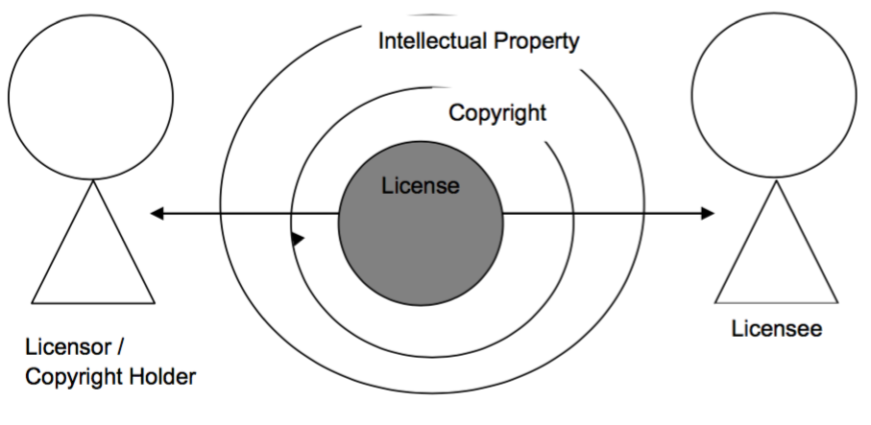
Relationship between licensor, licensee and license
Notes:
shows that a license is a subset of the privileges that the Copyright Act grants the licensor
licensor permits the licensee to use these privileges as agreed between the two parties in the license.

Slide 10
History of OS Licensing
A brief history about open source licensing, its intent, and a brief description of commonly used licenses

Slide 11
History of Open Source Licensing
The open source software movement traces its history to the formation of the Free Software Foundation ("FSF") in 1985 by Richard Stallman.
In essence, free software is an attempt to guarantee certain rights for both, users and developers
Notes:
As discussed in Chapter 1, Free Software is more of an ideology that emphasizes the freedom users have with the source code and not with the price one pays for the software.

Slide 12
History of Open Source Licensing
Freedom to execute the program for any reason
Freedom to examine the source code, see how it works and change it to do what
you would like it to do
Freedom to redistribute the source and keep the money generated from it
Freedom to modify and redistribute the modified source code
Notes:
In order to guarantee these freedoms the GNU General Public License (GPL) was created. In short any software licensed under GPL must include the source code.
Any modifications made to a GPL source code will also be licensed under GPL.
This was to ensure that software once "opened" to the community could not be "closed" at a later time.

Slide 13
History of Open Source Licensing
In order to guarantee these freedoms the GNU General Public License (GPL) was created.
In short any software licensed under GPL must include the source code.
Any modifications made to a GPL source code will also be licensed under GPL.
This was to ensure that software once "opened" to the community could not be "closed" at a later time.

Slide 14
History of Open Source Licensing
In 1998 a non-profit institution called Open Source Initiative (OSI) defined the term "open source software" to emphasize a break with the anti-business past associated with GNU to place a new emphasis in the community on the possibilities of extending the free software model to the commercial world.
The OSI does not define a specific license as GPL but lays down the pre-requisites of the distribution terms of open source software.
It thereby accepts various licenses whose distribution terms comply with the Open Source Definition (OSD).
Notes:
The OSI does not define a specific license as GPL but lays down the pre-requisites of the distribution terms of open source software.

Slide 15
Intentions of Open Source Software
Intention
Licensees are free to use open source software for any purpose whatsoever.
Licensees are free to make copies of open source software and are free to distribute those copies without payment of royalties to a licensor.
Explanation
This basically means that the licensee need not justify the usage of the open source software.
This implies that the licensee can redistribute the software at a cost or free of charge.

Slide 16
Intentions of Open Source Software
Intention
Licensees are free to create derivative works of open source software and are free to distribute those works without payment of royalties to a licensor.
Licensees are free to access and use the source code of open source software.
Explanation
This allows the licensee to modify the open source software and then redistribute it with or without charge. The licensee is in no way liable to pay any amount to the licensor for this neither can the licensor pose any restrictions on the derivative works. A pre-requisite for intention 3 to occur is the pre-existence of intention 4.
This means the source code is freely available

Slide 17
Intentions of Open Source Software
Intention
Licensees are free to combine open source and other software.
Explanation
This gives the licensee the ability to mix open source software with other software.

Slide 18
Commonly Used OS Licenses
There are over 50 OSI approved licenses most of the licenses fall under two categories

Slide 19
Commonly Used OS Licenses
Academic licenses
Allow software to be used for any purpose
Software obtained via an academic license can be freely changed, sold, redistributed, sublicensed, and combined with other software
Berkeley Software Distribution (BSD) license
Reciprocal licenses
Allow software to be used for any purpose, however it enforces that the changed or modified software must also be licensed under the exact terms as the original license
GNU General Public License (GPL)
Notes:
Though there are over 50 OSI approved licenses most of the licenses fall under two categories:

Slide 20
GPL Licensed Code
A GPL licensed code does not allow proprietary software to link to it
It also does not permit redistribution with software having a GPL non-compatible license
Also redistribution of the derivative works need to be with GPL
Notes:
Though there are over 50 OSI approved licenses most of the licenses fall under two categories:

Slide 21
MIT Licensed Software
Allows ALL (counter GPL)
It permits proprietary code to link to it
Redistribution with non-MIT license software and redistribution of derivative works with non-MIT license
Notes:
Interestingly, they both are open source software licenses as they follow the open source definition specified by the OSI

Slide 22
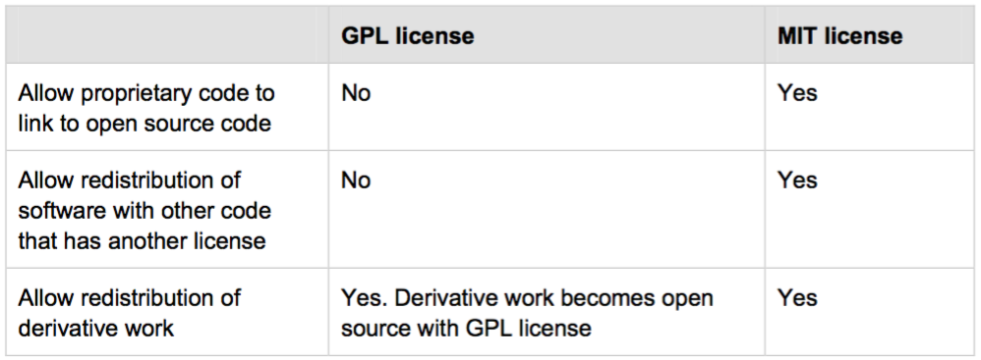
GPL vs MIT Licensed Software
Notes:
Comparing the GPL vs. the MIT reciprocal licenses

Slide 23
Did you know?
The IBM Public License (IPL) was IBM's first open source license. The Common Public License (CPL) is essentially the next version of the IPL. In 2009 CPL was superseded by the Eclipse Public License (EPL).

Slide 24
Choosing the Right License
By now you must be feeling more of a lawyer and less of a developer

Slide 25
Is this Relevant?
It can help you avoid a lawsuit.
An interesting licensing violation is the case between the Free Software Foundation (FSF) and Cisco. In 2004 a German court ordered Cisco to stop selling its wireless routers because it was in violation of the terms and conditions of the GPL license - Cisco’s products were using GPL-licensed software in their code, but not providing free availability of their source code.
Notes:
On May 20, 2009 the parties announced a settlement that included Cisco appointing a director to ensure Linksys products comply with free-software licenses, and Cisco making an undisclosed financial contribution to the FSF.

Slide 26
What is right?
So what is the right open source license to use for a given software?
Notes:
There is no magic formula

Slide 27
Choosing the Right License
Is the work in question a derived work?
Or would the work be redistributed with other open source software?
If so, what are the license terms you have agreed as a licensee?
Notes:
Interestingly, they both are open source software licenses as they follow the open source definition specified by the OSI

Slide 28
Choosing the Right License
Do you want the software to be revenue generating? (Business Models)
Do you want access to use licensees’ contributions?
How do you add this clause to your license?
Notes:
This and several other factors are things to consider while choosing an appropriate license for the software in question.
Depending on the scope of the project you could get into legal discussions to help you chose an appropriate license.

Slide 29
Summary
In this chapter you learned about the concept of Intellectual Property and how it related to a license.
You also learned about the relationship between a license, licensor and licensee.
Next, the chapter explained what makes a license an open source license, and provided a description and comparison between the BSD, GPL and MIT licenses.
Finally the chapter provided questions that would help you choose the most appropriate open source license for your needs.

Slide 30
Thanks!
Any questions?

Slide 31
Instructions for use
Open this document in Google Slides (if you are at slidescarnival.com use the button below this presentation)
You have to be signed in to your Google account
EDIT IN GOOGLE SLIDES
Go to the File menu and select Make a copy.
You will get a copy of this document on your Google Drive and will be able to edit, add or delete slides.
EDIT IN POWERPOINT®
Go to the File menu and select Download as Microsoft PowerPoint. You will get a .pptx file that you can edit in PowerPoint.
Remember to download and install the fonts used in this presentation (you’ll find the links to the font files needed in the Presentation design slide)
More info on how to use this template at www.slidescarnival.com/help-use-presentation-template
This template is free to use under Creative Commons Attribution license. You can keep the Credits slide or mention SlidesCarnival and other resources used in a slide footer.

Slide 32
Hello!
I am Jayden Smith
I am here because I love to give presentations.
You can find me at @username

Slide 33
Transition headline
Let’s start with the first set of slides

Slide 34
Quotations are commonly printed as a means of inspiration and to invoke philosophical thoughts from the reader.

Slide 35
This is a slide title
Here you have a list of items
And some text
But remember not to overload your slides with content
You audience will listen to you or read the content, but won’t do both.

Slide 36
BIG CONCEPT
Bring the attention of your audience over a key concept using icons or illustrations

Slide 37
You can also split your content
White
Is the color of milk and fresh snow, the color produced by the combination of all the colors of the visible spectrum.
Black
Is the color of coal, ebony, and of outer space. It is the darkest color, the result of the absence of or complete absorption of light.

Slide 38
In two or three columns
Yellow
Is the color of gold, butter and ripe lemons. In the spectrum of visible light, yellow is found between green and orange.
Blue
Is the colour of the clear sky and the deep sea. It is located between violet and green on the optical spectrum.
Red
Is the color of blood, and because of this it has historically been associated with sacrifice, danger and courage.

Slide 39

A picture is worth a thousand words
A complex idea can be conveyed with just a single still image, namely making it possible to absorb large amounts of data quickly.

Slide 40

Want big impact? Use big image.

Slide 41
Use charts to explain your ideas
White
Gray
Black

Slide 42
And tables to compare data
 | A | B | C
Yellow | 10 | 20 | 7
Blue | 30 | 15 | 10
Orange | 5 | 24 | 16

Slide 43
Maps
our office

Slide 44
89,526,124
Whoa! That’s a big number, aren’t you proud?

Slide 45
89,526,124$
185,244 users
100%
That’s a lot of money
And a lot of users
Total success!

Slide 46
Our process is easy
first
second
last

Slide 47
Let’s review some concepts
Yellow
Is the color of gold, butter and ripe lemons. In the spectrum of visible light, yellow is found between green and orange.
Blue
Is the colour of the clear sky and the deep sea. It is located between violet and green on the optical spectrum.
Red
Is the color of blood, and because of this it has historically been associated with sacrifice, danger and courage.
Yellow
Is the color of gold, butter and ripe lemons. In the spectrum of visible light, yellow is found between green and orange.
Blue
Is the colour of the clear sky and the deep sea. It is located between violet and green on the optical spectrum.
Red
Is the color of blood, and because of this it has historically been associated with sacrifice, danger and courage.

Slide 48
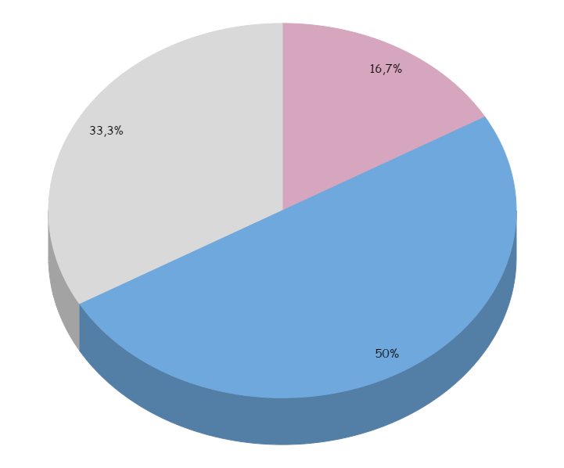
You can insert graphs from Google Sheets

Slide 49
Android project
Show and explain your web, app or software projects using these gadget templates.
Place your screenshot here

Slide 50
iPhone project
Show and explain your web, app or software projects using these gadget templates.
Place your screenshot here

Slide 51
Tablet project
Show and explain your web, app or software projects using these gadget templates.
Place your screenshot here

Slide 52
Desktop project
Show and explain your web, app or software projects using these gadget templates.
Place your screenshot here

Slide 53
Thanks!
Any questions?
You can find me at:
@username
user@mail.me

Slide 54
Credits
Special thanks to all the people who made and released these awesome resources for free:
Presentation template by SlidesCarnival
Photographs by Unsplash

Slide 55
Presentation design
This presentation uses the following typographies and colors:
Titles: Patrick Hand SC
Body copy: Sniglet
You can download the fonts on these pages:
https://www.fontsquirrel.com/fonts/sniglet
http://www.1001freefonts.com/patrick_hand_sc.font
You don’t need to keep this slide in your presentation. It’s only here to serve you as a design guide if you need to create new slides or download the fonts to edit the presentation in PowerPoint®

Slide 56
SlidesCarnival icons are editable shapes.
This means that you can:
Resize them without losing quality.
Change fill color and opacity.
Isn’t that nice? :)
Examples:

Slide 57
😉
Now you can use any emoji as an icon!
And of course it resizes without losing quality and you can change the color.
How? Follow Google instructions https://twitter.com/googledocs/status/730087240156643328
✋👆👉👍👤👦👧👨👩👪💃🏃💑❤😂😉😋😒😭👶😸🐟🍒🍔💣📌📖🔨🎃🎈🎨🏈🏰🌏🔌🔑 and many more...

