Slide 1
CURLS
DIVERGENCE

Slide 2
CURLS
Clockwise
Anti-clockwise

Slide 3


DIVERGENCE
$$∇⋅F>0$$
$$∇⋅F<0$$

Slide 4

Momentum Equation
The Movement Of A Blob Of Fluid :
$$m⋅\frac{Du}{Dt}=\overset{Gravity Force}{\overbrace{mg}}+\overset{Pressure}{\overbrace{−V∇p}}+ \overset{Viscosity}{\overbrace{V_{u}∇⋅∇u}} | Divide by volume$$
$$ρ⋅\frac{Du}{Dt}=ρg−V∇p+V_{u}∇⋅∇u$$
$$\frac{Du}{Dt}+\frac{1}{ρ}∇p=g+s∇⋅∇u$$

Slide 5

Momentum Equation
The Acceleration Of The Particle :
$$a≡\frac{Du}{Dt}$$
Based on 2nd Newton Law:
$$m⋅\frac{Du}{Dt}=F$$

Slide 6
Navier-Stokes Equations
$$Change In Momentum=\frac{Pressure Force+Viscocity+External Force}{Mass}$$
$$Density−Change =\frac{θρ}{θt}=−\left(u⋅∇\right)ρ+k⋅∇^{2}ρ+S$$
$$Velocity−Change =\frac{θu}{θt}=−\left(u⋅∇\right)u+k⋅∇^{2}u+F$$

Slide 7
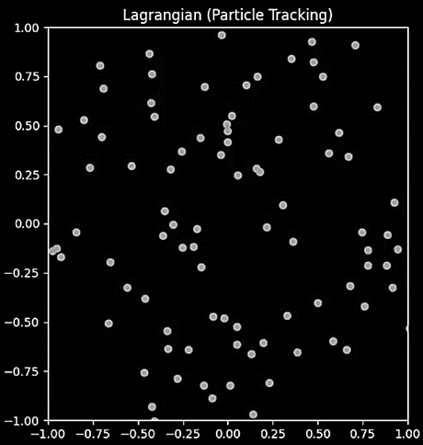
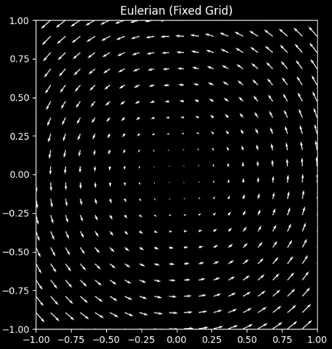
Lagrangian and Eulerian Viewpoints

Slide 8
Domain Behavior
REBOUNDED BOX
SEAMLESS DOMAIN:

Slide 9
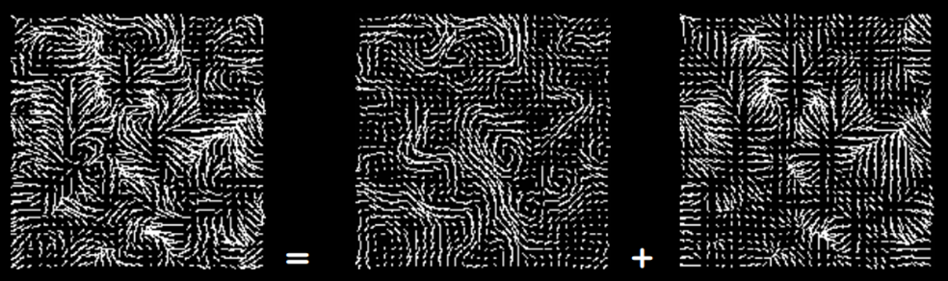
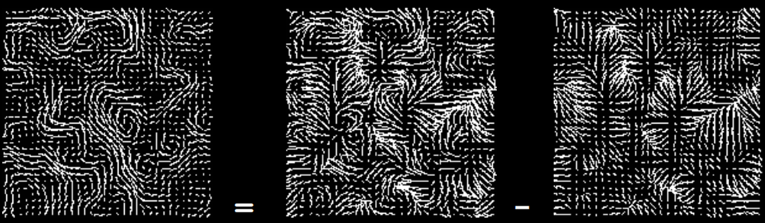
Helmholtz Decomposition
OUTPUT
CURLS
DIVERGENCE
CURLS
OUTPUT
DIVERGENCE

