Slide 1
Library Management
System
📚
CS27 - The Relational Model & Databases
Burkina Institute of Technology Instructor: Kweyakie Afi Blebo Deadline: March 15, 2026 | Scenario 4
CS27 - Library Management System

Slide 2
Group Members
N'ZOMBIE Rodrigue
SOULAMA Ulrich
Group Leader
Database Design
DRABO Amine Farel Isao
SAWADOGO Azael Wend-Panga
Normalization
SQL Implementation
OUEDRAOGO Abdoulaye
KERE H. Noeldinolippeu
Queries & Aggregates
Presentation & Video
KOANDA Cheikib
Support & Testing
CS27 | BIT | 2025-2026

Slide 3
Scenario Overview
5 Entities
Library Management System
auteurs
► Manage books, authors and categories
► Register and track library members
categories
► Record book borrowings and returns
livres
► Calculate and manage late fees
membres
► Generate activity reports
emprunts
CS27 | BIT | 2025-2026

Slide 4
1.1 Entities & Attributes
auteurs
categories
livres
PK: auteur_id
PK: categorie_id
PK: livre_id
nom, prenom, nationalite, date_naissance
nom, description
titre, isbn, auteur_id (FK), categorie_id (FK), annee_publi, editeur, nb_exemplaires
membres
emprunts
PK: membre_id
PK: emprunt_id
nom, prenom, email (UNIQUE), telephone, adresse, date_adhesion, actif
membre_id (FK), livre_id (FK), date_emprunt, date_retour_prevue, date_retour_reelle, amende_montant, amende_payee
CS27 | BIT | 2025-2026

Slide 5
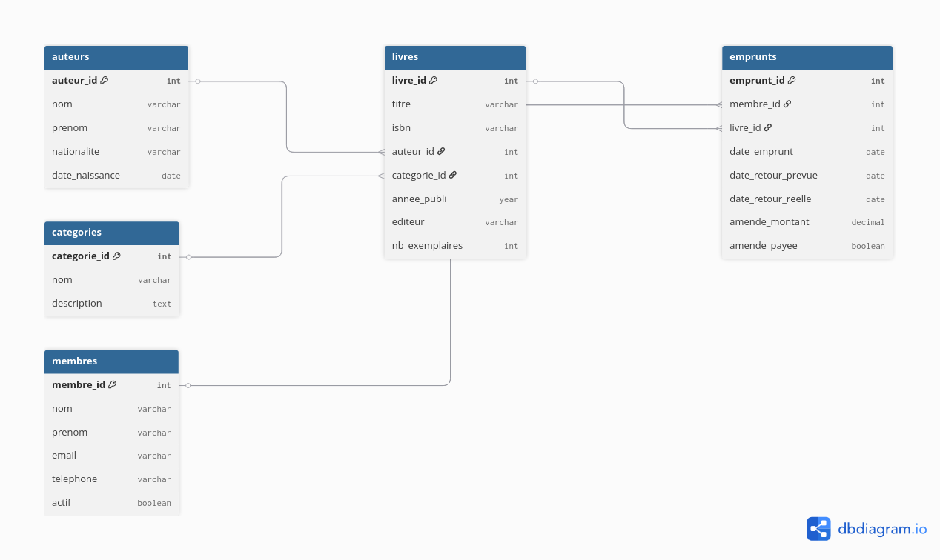
1.3 Schema Diagram
CS27 | BIT | 2025-2026

Slide 6
1.2 Relationships
Relationship | Type | Foreign Key in... | Plain English
auteurs → livres | 1 : M | livres.auteur_id | One author can write many books
categories → livres | 1 : M | livres.categorie_id | One category groups many books
membres → emprunts | 1 : M | emprunts.membre_id | One member can borrow many books
livres → emprunts | 1 : M | emprunts.livre_id | One book can be borrowed many times
Design Decisions:
All foreign keys use ON DELETE RESTRICT to protect data integrity.
ON UPDATE CASCADE ensures changes propagate automatically across related tables.
CS27 | BIT | 2025-2026

Slide 7
1.4 Normalization (UNF → 3NF)
UNF
(Unnormalized)
1NF
2NF
3NF ✓
One big table with everything:
member_name, email, book_title,
author_name, borrow_date, fine...
✗ No clear primary key
✗ Repeated data everywhere
Added a unique ID per row.
Removed repeating groups.
✓ Each cell = one atomic value
✓ Primary key defined
Separated members, books
and authors into own tables.
✓ Every attribute depends
fully on the whole PK
✓ No partial dependencies
Separated categories and fines.
✓ No transitive dependencies
✓ 5 clean normalized tables
✓ Final schema achieved
→
→
→
CS27 | BIT | 2025-2026

Slide 8
2.1 MySQL Implementation
CREATE TABLE emprunts (
emprunt_id INT NOT NULL AUTO_INCREMENT,
membre_id INT NOT NULL,
livre_id INT NOT NULL,
date_emprunt DATE NOT NULL
DEFAULT (CURRENT_DATE),
date_retour_prevue DATE NOT NULL,
date_retour_reelle DATE,
amende_montant DECIMAL(8,2) DEFAULT 0.00,
amende_payee BOOLEAN DEFAULT FALSE,
PRIMARY KEY (emprunt_id),
FOREIGN KEY (membre_id)
REFERENCES membres(membre_id)
ON DELETE RESTRICT ON UPDATE CASCADE,
FOREIGN KEY (livre_id)
REFERENCES livres(livre_id)
ON DELETE RESTRICT ON UPDATE CASCADE,
CHECK (date_retour_prevue > date_emprunt)
);
PRIMARY KEY
AUTO_INCREMENT on every table
FOREIGN KEY
Referential integrity enforced
NOT NULL
Required fields protected
CHECK
Logical constraint on dates
UNIQUE
Member email & book ISBN
CS27 | BIT | 2025-2026

Slide 9
Most Complex Query
Report: Members with unpaid fines over 200 FCFA
SELECT m.nom, m.prenom, m.email,
COUNT(e.emprunt_id) AS total_borrowings,
SUM(e.amende_montant) AS total_fines,
SUM(CASE WHEN e.amende_payee = FALSE
THEN e.amende_montant ELSE 0 END) AS unpaid_fines
FROM membres m
INNER JOIN emprunts e ON m.membre_id = e.membre_id
WHERE e.amende_montant > 0
GROUP BY m.membre_id, m.nom, m.prenom, m.email
HAVING unpaid_fines > 200
ORDER BY unpaid_fines DESC;
INNER JOIN — Link members + borrowings
GROUP BY — Group results per member
CASE WHEN — Calculate only unpaid fines
HAVING — Filter groups (> 200 FCFA)
CS27 | BIT | 2025-2026

Slide 10
Conclusion & Deliverables
GitHub Repository
library_db.sql + README.md — fully documented
Presentation
10 slides covering design, normalization and implementation
YouTube Video
5-10 min — Live MySQL demo — All members speak
Deadline: March 15, 2026 at 11:55 PM | Submit: Group Leader only
CS27 — Burkina Institute of Technology | blebo.kweyakie@bit.bf

