Slide 1
Agentic RAG Chatbot for Multi-Format Document QA
Powered by Model Context Protocol (MCP)
Author: RAGUNATH R
Date: July 2025

Slide 2
Problem Statement & Objective
Problem: Build a chatbot to answer questions from diverse document formats
Goal: Enable intelligent document Q&A with modular agents and message-driven architecture
Supported Formats: PDF, PPTX, CSV, DOCX, TXT/Markdown

Slide 3
Architecture Overview (Agentic + MCP)
Agents:
IngestionAgent: Parses and splits documents
RetrievalAgent: Embeds and searches chunks
LLMResponseAgent: Generates answers from context
CoordinatorAgent: Manages flow & tracks context
MCP Messaging:
Structured messages for communication between agents
Fields: sender, receiver, type, trace_id, payload

Slide 4
System Flow with MCP Message Passing
1. Upload → Coordinator: INGESTION_REQUEST
2. Coordinator → IngestionAgent → RetrievalAgent → LLMResponseAgent
3. Response streamed back to UI with sources
MCP Message: {type, sender, receiver, trace_id, payload}

Slide 5
Tech Stack Used
Frontend: Gradio (with custom CSS)
LLM: Llama 3.1 8B via HuggingFace Infernce cli
Vector Store: FAISS
Embeddings: sentence-transformers/all-MiniLM-L6-v2
Parsers: PyPDF2, python-docx, python-pptx, pandas
Messaging: In-memory bus using Python classes

Slide 6
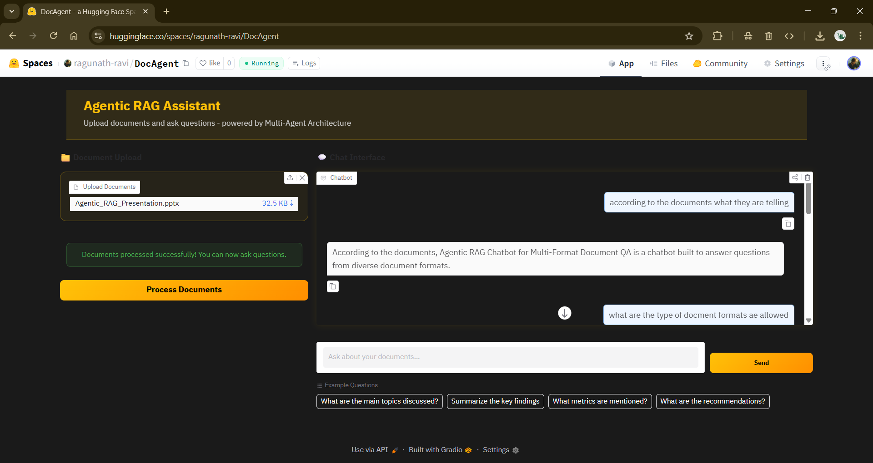
DocAgent-Demo

Slide 7
UI Features & Challenges
Multi-file upload, multi-turn chat, visible examples
Dark theme UI with styled messages and input box
Challenges: LLM streaming consistency, parser errors, message delays
Future: REST-based MCP, memory agent, GPU optimization

