Slide 1


DEPARTMENT OF ARTIFICIAL INTELLIGENCE
SMART VOTING SYSTEM
Presented by :
Guided by :
Derel Jasper M - 811722001008
Kamalnath S - 811722001020
Ragul S - 811722001041
Sitharth R - 811722001047
Mr. T. Praveen Kumar, M.E.
Assistant Professor / AI

Slide 2
OBJECTIVE
To modernize elections by leveraging biometric technologies that ensure secure, efficient voting and prevents voter fraud and reduce manual errors.

Slide 3
EXISTING SYSTEM
The existing voting systems can primarily be categorized into traditional paper-based voting and basic electronic voting systems.
These systems also do not provide immediate feedback or confirmation to voters, leaving them uncertain about the status of their vote.

Slide 4
PROPOSED SYSTEM
The proposed system introduces a secure and technologically advanced voting process.
It employs a multi-layered authentication mechanism that includes QR code verification and biometric fingerprint scanning to ensure that only eligible voters can access the voting interface.

Slide 5
LITERATURE SURVEY
SNO | TITLE | YEAR | AUTHOR | TECNIQUES AND TOOLS USED | MERITS | DEMERITS
1 | Secured E-Voting System using two-factor Biometric Authentication | 2020 | H. Kim, J. Lee, S. Park | Blockchain, cryptographic hashing, smart contracts Biometric fingerprint scanning, cloud storage | Enhanced voter verification with dual-factor biometrics. | High implementation cost with biometric devices.
2 | Blockchain based electronic voting system with Biometric Verification Detection | 2021 | Zhang et al. | Blockchain, cryptographic hashing, smart contracts | Immutable records via blockchain for vote integrity. | High computational resource demand for blockchain.

Slide 6
LITERATURE SURVEY
SNO | TITLE | YEAR | AUTHOR | TECNIQUES AND TOOLS USED | MERITS | DEMERITS
3 | Privacy Preserving Biometric Voting Systems in IoT Environments | 2021 | Kumar, S., and Chen, X | IoT devices, RFID, cloud-based processing | High data security with privacy-preserving encryption. | Complex IoT setup may require high technical expertise.
4 | QR Code and Facial Recognition for Secure Voting | 2022 | Patel, R. et al | QR codes, OTP authentication, mobile app | QR codes make user interaction simple and cost-effective. | Facial recognition affected by environmental conditions.

Slide 7
LITERATURE SURVEY
SNO | TITLE | YEAR | AUTHOR | TECNIQUES AND TOOLS USED | MERITS | DEMERITS
5 | QR and OTP based Online Voting with Biometrics | 2023 | Singh, P., and Arora, T | Homomorphic encryption, cryptographic protocols | Multi-layered security with QR, OTP, and biometrics. | OTP requires internet, which may not be reliable.

Slide 8
FLOW DIAGRAM
Personal details
Verification success
YES
Dataset with fingerprint templates
Voting interface
Cast vote
NO
One time access
Fingerprint verification
Voting process
Acknowledgement
START
QR code
YES
Matching process
NO
Voter ID
Personal SMS
Update in database
Fingerprint scanner
password
Rejected
STOP
Unique

Slide 9
SYSTEM AND SOFTWARE SPECIFICATIOS
HARDWARE
Processor: Intel Core i5 or higher
RAM: 8 GB or higher
OS: Windows 10
Fingerprint Scanner
Camera QR Code Scanner
Mobile Devices for QR code Scanning
SOFTWARE
Frontend : DotNet
Backend : c#
Database : MySQL
Biometrics: Digital Persona SDK

Slide 10
MODULES
QR Code Verification
Fingerprint Verification
Voting Interface Creation
Confirmation Message Generation

Slide 11
MODULE EXPLANATION
QR CODE VERIFICATION
PURPOSE
The QR Code Generation Module creates unique QR codes that can be used for various purposes, such as voter authentication etc.., and they are sent to the user’s email ID after the user registers himself in the database. QR codes streamline the voting process by enabling fast and secure interactions.

Slide 12
KEY FUNCTIONS
Generate QR Codes: Creates QR codes that contain encoded information relevant to the voting process, such as voter ID, voter’s personal information.
Encode Data: Transforms data into a format that can be encoded into a QR code. This data might include a unique voter token or ballot identifier.
Display QR Codes: Provides a way to display QR codes on devices such as voter terminals, mobile apps, or printed materials.

Slide 13
MODULE EXPLANATION
FINGERPRINT VERIFICATION
PURPOSE
The Fingerprint Verification Module is designed to ensure that only legitimate and authorized voters can access the voting system. This module addresses key concerns such as voter impersonation, unauthorized access, and multiple voting attempts.

Slide 14
KEY FUNCTIONS
Fingerprint Scanning: The module captures the voter's fingerprint using a biometric scanner at the time of voting.
Identity Verification: The scanned fingerprint is compared with pre-registered fingerprints stored in the database. This real-time matching ensures that the person voting is the rightful owner of the corresponding voter ID.
Access Control: Upon a successful match, the system validates the voter and grants access to the voting interface. For mismatches, it denies access and logs the attempt for audit purposes.

Slide 15
MODULE EXPLANATION
VOTING INTERFACE CREATION
PURPOSE
The Voting Interface Creation Module is a user-centric component of the secure voting system, designed to provide voters with a seamless and intuitive platform to cast their votes. This module ensures that the voting process is simple, transparent, and secure while maintaining the privacy of the voter.

Slide 16
The voting interface is accessible only after successful QR code and fingerprint verification. This ensures that only authenticated voters can proceed to cast their votes.
KEY FUNCTIONS
Secure Access: The Voting Interface is accessible only after successful QR code and fingerprint verification. This ensures that only authenticated voters can proceed to cast their votes.
Vote Casting: Voters can select their preferred candidate by clicking the "Vote" button associated with that candidate. A confirmation popup is displayed to prevent accidental selections, allowing the voter to confirm their choice before submission.
Candidate display: interface displays a list of election candidates along with their respective political party names. Each candidate is presented in a clear and professional layout for easy selection.

Slide 17
MODULE EXPLANATION
CONFIRMATION MESSAGE GENERATION
PURPOSE
The Confirmation Message Generation Module ensures transparency and accountability by providing voters with immediate feedback after casting their vote. It generates a confirmation message that serves as proof of voting, reinforcing trust in the system and enabling voters to verify the details of their participation in the election.

Slide 18
The voting interface is accessible only after successful QR code and fingerprint verification. This ensures that only authenticated voters can proceed to cast their votes.
KEY FUNCTIONS
Real-Time Message Generation: Once a voter successfully casts their vote, the module generates a confirmation message instantly, ensuring no delay in feedback.
Delivery Mechanism: The message is sent as an SMS to the voter’s registered mobile number in the database. This ensures accessibility and allows voters to retain a record of their participation.
System Integration: The module works in sync with the database, verifying the voter’s contact information and updating the voting status to "voted."

Slide 19
ADVANTAGES
Enhanced Security
Transparency and Accountability
Ease of use
Real-Time Updates

Slide 20
APPLICATIONS
National and State-level Elections
Corporate Decision-Making
Community Elections
Non-Governmental Organizations (NGOs)

Slide 21
CONCLUSION
This Voting System enhances election processes by offering secure, transparent, and efficient voting through technologies like biometrics, and QR codes.
It improves voter authentication, reduces fraud, and increases accessibility.

Slide 22
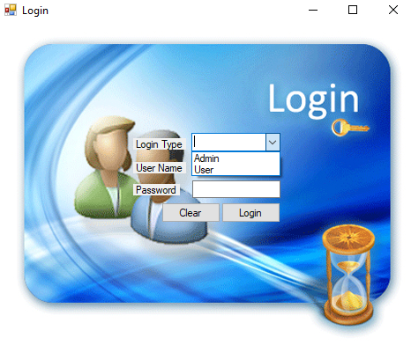
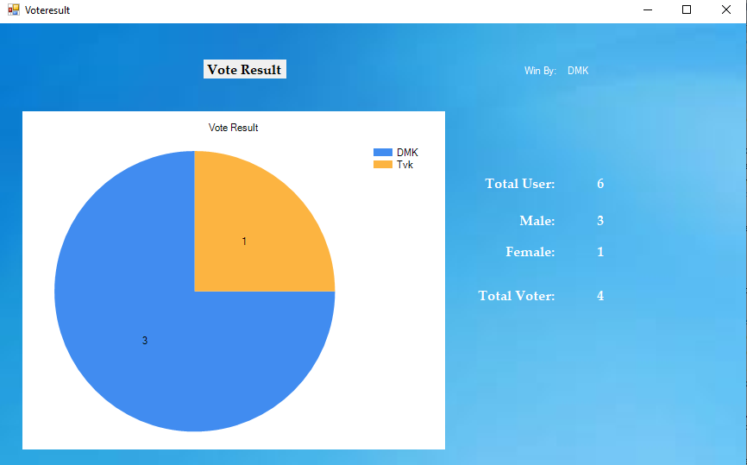
SCREENSHOTS

Slide 23
REFERENCES
Alshahrani, S. S., & Aljamaan, H. (2021). "Design and Implementation of Secure QR Code Authentication System for Mobile Payment Applications." International Journal of Network Security 23(1): 27-35.
Chakraborty, A., & Mukhopadhyay, S. (2020). "Blockchain Technology in Secure Electronic Voting: A Review." IEEE Access 8: 183850-183866.
Chen, L., Jiang, T., & Wang, H. (2021). "Enhancing Election Security: Biometric and QR Code-Based Approaches." Journal of Systems and Software 181: 110983.

Slide 24
Thank You…

