Slide 1
Python Banking Application
MSc Computer Science Project

Slide 2
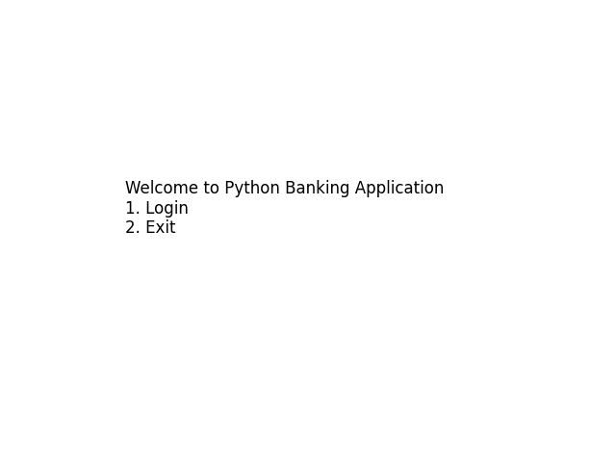
Output Screenshot 1

Slide 3
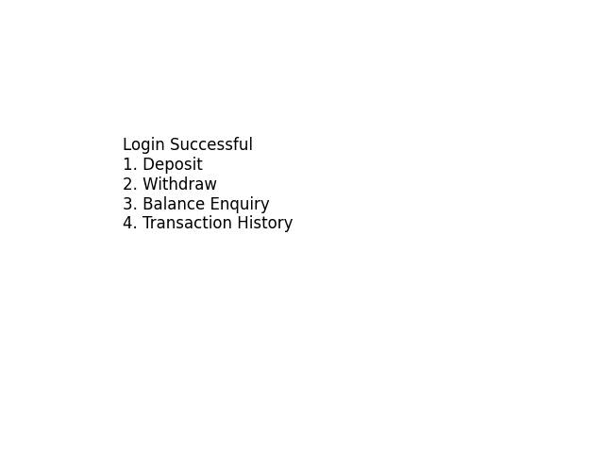
Output Screenshot 2

Slide 4
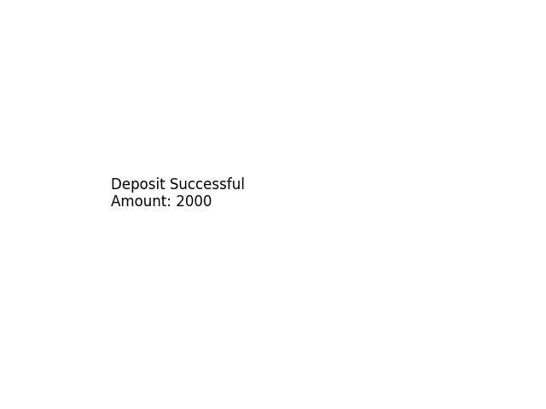
Output Screenshot 3

Slide 5
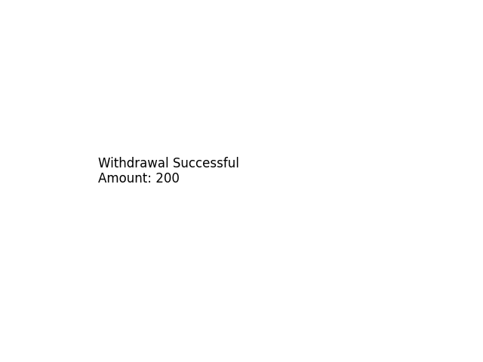
Output Screenshot 4

Slide 6

Output Screenshot 5

