Slide 1
DETECTION AND COMPARISON OF ALGORITHM FOR PREDICTION OF PNEUMONIA
Guide:
Mrs.Ezhil Dyana M V, M.E
Team Members:
Riffa Hammed
(312419104110)
Ragul R
(312419104103)

Slide 2
INTRODUCTION
Pneumonia is a lung disease that is caused by acute respiratory infection which causes reduced oxygen intake and painful breathing.
Some popular tools to evaluate the presence of pneumonia in a person are Chest X-Ray(CXR),Computed Tomography(CT) of the lungs,Magnetic Resonance Imaging(MRI).
Mining Medical Pictures includes procedures like as data processing.
This utilizes a typical arrangement technique specifically SVMs & neural systems.

Slide 3
ABSTRACT
Treatment of pneumonia can be challenging but it can be prevented by early diagnosis using computer-aided diagnosis (CAD) systems.
Chest x-rays (CXRS) are currently the primary imaging tool for detection of pneumonia, which are widely used by radiologists.
This model is trained for several epochs and the weights which are utilized to extract the most representative image features .

Slide 4
LITERATURE SURVEY
S.No | Year | Title | Description | Advantages | Disadvantages
1. | 2016 | “Lung cancer detection using digital Image processing On CT scan Images” | Image enhancement, segmentation,feature extraction stage are used in this approach.The watershed segmentation tequnique gives more accuracy (84.55%) than other approach. | Accuracy of 84.55% more than other approach | Magnetic Resonance Imaging are costly
2. | 2017 | “A Survey On Prediction of Heart Diseases Using Big Data Algorithms” | The research work central point is on finding the efficient classification algorithm for the prediction of heart disease in the early stage based on the accuracy using validation metrics that are Mean Absolute Error(MAE), Relative Squared Error(RSE) and Root Mean Square Error(RMSE). | Weighted association classifier can enhance performance and accuracy | Difficulties in storage and analyzing the information
3. | 2018 | “Disease Prediction Using Machine Learning Over Big Data” | Using structured and unstructured data from hospital it use Machine Learning Decision Tree algorithm and Map Reduce algorithm.The calculation exactness of our proposed algorithm reaches 94.8% which is faster than that of the CNNbased unimodal disease risk prediction (CNN-UDRP) algorithm. | Structured and unstructured data in healthcare field | Quality of medical data is incomplete

Slide 5
S.No | Year | Title | Description | Advantages | Disadvantages
4. | 2018 | "Deep learning for healthcare: Review, opportunities and challenges" | In this article, we review the recent literature on applying deep learning technologies to advance the health care domain. Based on the analyzed work, we suggest that deep learning approaches could be the vehicle for translating big biomedical data into improved human health. | Federated inference,Model privacy | Temporality,Domain complexity
5. | 2019 | "Clinical features for diagnosis of pneumonia among adults in primary caresetting" | Development of clinical decision rule that combine these clinical features together with molecular biomarkers may further increase overall accuracy for diagnosis of radiographic pneumonia among adults in primary care setting. | Large-scale case-control studies using the clinical data | Heterogeneity among the selected studies
6. | 2020 | "Computer-aided diagnosis in the era of deep learning" | CAD uses machine learning methods to analyze imaging and/or nonimaging patient data and makes assessment of the patient's condition, which can then be used to assist clinicians in their decision-making process. | DDSM contains a big dataset | Higher number of unnecessary biopsies

Slide 6
S.No | Year | Title | Description | Advantages | Disadvantages
7. | 2020 | "Older adults hospitalized for pneumonia in the United States: Incidence,epidemiology" | The current incidence, epidemiology, and mortality of older adult patients hospitalized with community-acquired pneumonia (CAP) in Louisville, KY and thus estimate the burden of CAP in the older adult population of the United States. To define risk factors associated with early and late outcomes. | Incidence of CAP and outcomes were measured | Analysis only for older adults
8. | 2020 | "A Novel Method for Pneumonia Classification Based on Hybrid CNN-PCA" | In this study, a novel ML model for automatic detection of various types of pneumonia with improved performance has been developed | It provides an optimistic result | An experienced radiologist is required
9. | 2020 | “Severe COVID-19 pneumonia: Pathogenesis and clinical management” | Covid-19 survivors, especially patients with ARDS, are at high risk for long term physical and mental impairments, and an interdisciplinary approach is essential for critical illness recovery. | Avoids risk for disease transmission | High risk for long term physical damages

Slide 7
S.No | Year | Title | Description | Advantages | Disadvantages
10. | 2021 | “Pneumonia Nature Revised Disease Primers” | New antibiotic and non-antibiotic therapies, in addition to rapid and accurate diagnostic tests that can detect pathogens and antibiotic resistance will improve the management of pneumonia. | Implemention new molecular platforms | It lead to poor outcomes
11. | 2021 | “Viral Pneumonia Screening on Chest X-Rays Using Confidence-Aware Anomaly Detection” | The confidence-aware anomaly detection (CAAD) model, which consists of a shared feature extractor, an anomaly detection module, and a confidence prediction module | Modeling individual viral pneumonia classes are avoided | Confidence prediction module is small
12. | 2021 | “Intelligent Pneumonia Identification From Chest X-Rays: A Systematic Literature Review” | The review analyzes the usability, goodness factors, and computational complexities of the algorithms that implement these techniques. It also discusses the quality, usability, and size of the available datasets, and ways of coping with unbalanced datasets. | Deep learning techniques have been used | Offering guidelines for medical practitioners is lacking

Slide 8
S.No | Year | Title | Description | Advantages | Disadvantages
13. | 2021 | “Interpretable Pneumonia Detection by Combining Deep Learning and Explainable Models With Multisource Data” | This approach is intuitive to detect pneumonia interpretably. We first build a large dataset of community-acquired pneumonia consisting of 35389 cases (distinguished from nosocomial pneumonia) based on actual medical records. | Provides intuitive explanations for the diagnosis results | Models intuition cannot be represented explicitly
14. | 2022 | "Pneumonia Detection Proposing a Hybrid Deep Convolutional Neural Network” | A novel hybrid Convolutional Neural Network (CNN) model is proposed using three classification approaches. In the first classification approach, Fully-Connected (FC) layers are utilized for the classification of CXR images | Created web-based CAD system to assist radiologists | Clinicians’ decisions differ from predictions
15. | 2022 | “MRI vs. X-ray: What you need to know Healthline Accessed” | Magnetic resonance imaging (MRIs) and X-rays are two types of imaging tests a medical professional can order to help diagnose and treat various conditions. In some cases, your doctor may require multiple types of imaging tests for better accuracy. | Consistent for frequent imaging tests | Magnetic field can affect the data

Slide 9
EXISTING SYSTEM
Advanced diagnostic tools are required.
Using a CNN model for detection of pneumonia.
Magnetic resonance imaging (MRI) of the chest are required.
CAD system are implemented for detection of pneumonia.

Slide 10
PROPOSED SYSTEM
The proposed hybrid CNN model with fully connected (FC) layers and trained the hybrid model for a defined number of epochs.
To prevent over fitting in training the proposed hybrid CNN model with fc layers, a dropout ratio of 0.5 was deployed after each FC layer during the training process.
To train the proposed ensemble classifier,CNN model and ml classifiers has to be utilized to extract the features of CXR images in the test set.
The highest training accuracy in the proposed hybrid CNN model with fc layers is 97.78%, which was brought about in epoch 20.

Slide 11
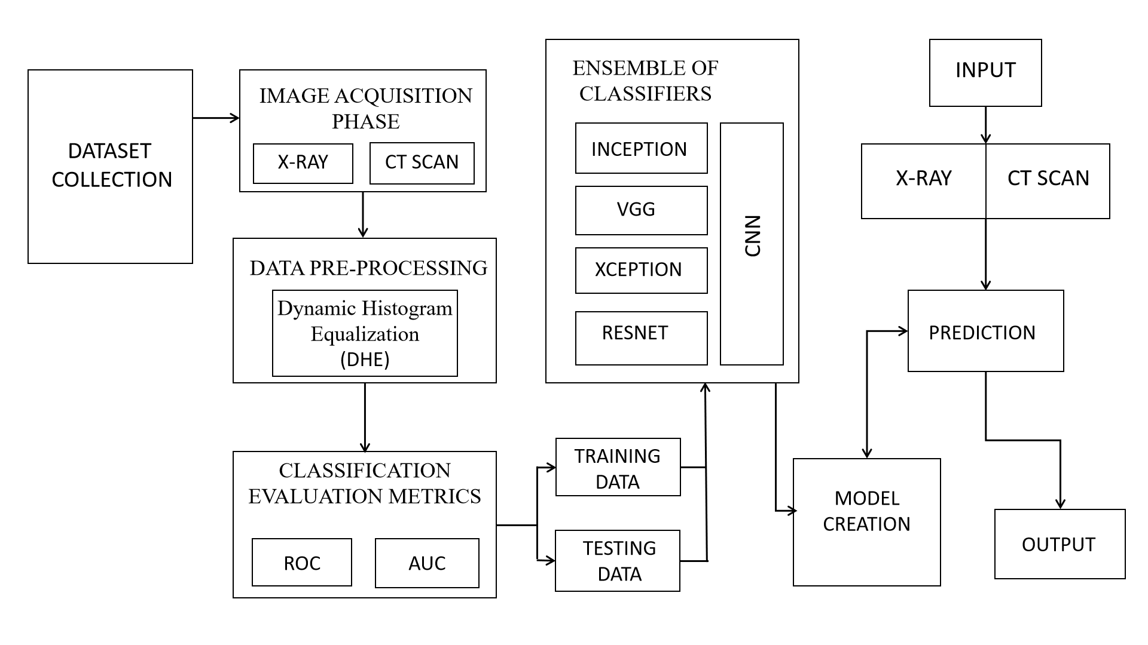
SYSTEM ARCHITECTURE

Slide 12
MODULES
MODULES LIST
IMAGE ACQUISITION PHASE
DATA PRE-PROCESSING
CLASSIFICATION EVALUATION METRICS
ENSEMBLE OF CLASSIFIERS

Slide 13
IMAGE ACQUISITION PHASE :
The first step is to acquire images.
The computer needs to view many images to recognize an object.
Images that could be used include chest X-ray, CT scan image.
The output of this step is images that will later be used to train the model.

Slide 14
DATA PRE-PROCESSING :
Image pre-processing is a very common and beneficial technique in the deep learning process.
It is used to enlarge the quantity of the original dataset and also enrich the information implicit in the dataset.
As previously mentioned, we utilized an effective image enhancement method named Dynamic Histogram Equalization (DHE).

Slide 15
CLASSIFICATION EVALUATION METRICS :
In this subsection, several evaluation metrics, accuracy, precision, recall, F1 score and so on, are described.
According to the outputs of model, four indices, True Positive, True Negative, False Positive, False Negative, are used to analyze and identify the performance of model.
The True Positive means that the chest X-ray images, which suffer from pneumonia, are signed as pneumonia as well by the model.
The True Negative means if the chest X-ray images do not show pneumonia as well as the model predicts.
In addition, the Receiver Operating Characteristic (ROC) and AUC are calculated to compare the performance of different models.

Slide 16
ENSEMBLE OF CLASSIFIERS :
When more than one classifier is combined to make a prediction, this is known as ensemble classification.
Ensemble decreases the variance of predictions, therefore making predictions that are more accurate than any individual model.
From work found in the literature, the ensemble techniques used include majority voting, probability score averaging and stacking.
In probability score averaging, the prediction scores of each model are added up and divided by the number of models involved.
In stacking ensemble, an algorithm receives the outputs of weaker models as input and tries to learn how to best combine the input predictions to provide a better output prediction.

Slide 17
ALGORITHM MODELS :
Xception Model
Inception Model
VGG Model
RESNET Model

Slide 18
XCEPTION MODEL :
Xception is a deep convolutional neural network architecture.
The Xception model replaces the traditional CNN architecture with depth-wise separable convolutions.
Depth-wise separable convolutions reduce the number of parameters in the model.

Slide 19
INCEPTION MODEL :
It is designed to improve the accuracy of image classification tasks while keeping the computational cost relatively low.
It uses parallel path in its architecture.
It helps the model to capture different types of features and improve its accuracy.
It is widely used in applications such as image and video analysis, autonomous vehicles, and medical imaging.

Slide 20
VGG MODEL :
The VGG model is characterized by its use of very small 3x3 convolutional filters.
It also uses max pooling layers to reduce the spatial dimensions of the feature maps.
It has achieved state-of-the-art results on several image classification benchmarks.
This model is widely used in computer vision applications, including object detection, image segmentation, and style transfer.

Slide 21
RESNET MODEL :
ResNet abbreviates to Residual Network.
It is designed to address the vanishing gradient problem that can occur in very deep neural networks.
The ResNet model is characterized by its use of "residual blocks," which contain multiple convolutional layers and skip connections.
These blocks are repeated throughout the network, resulting in a very deep architecture with hundreds of layers.

Slide 22
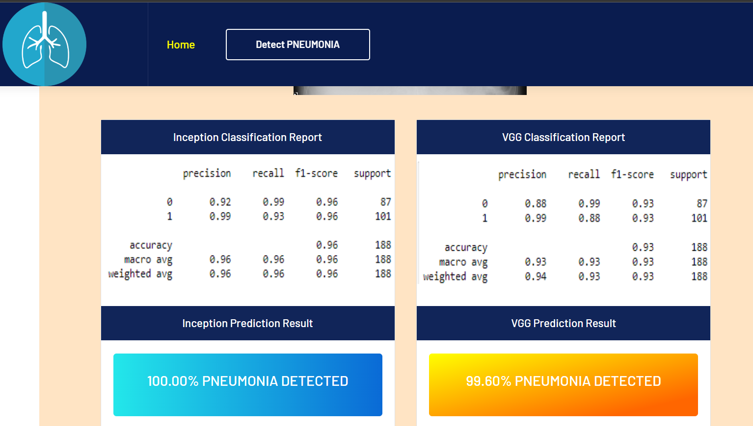
OUTPUT SNAPSHOT

Slide 23
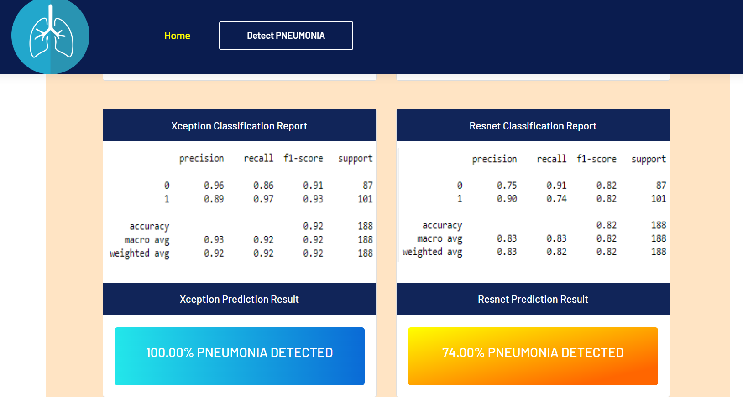

Slide 24
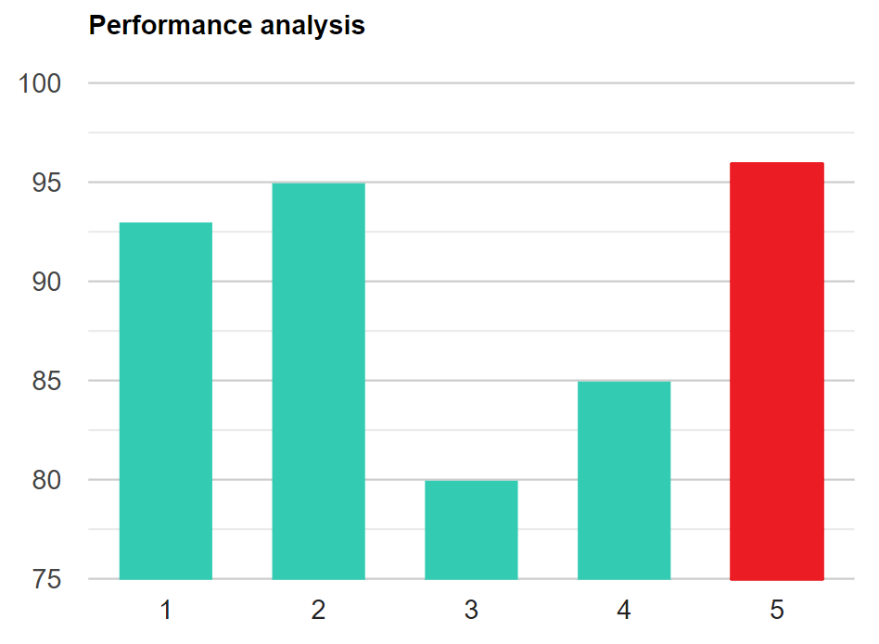
PERFORMANCE ANALYSIS

Slide 25
CONCLUSION
X-ray imaging examination of chest is usually performed by trained human examiners or doctors, making the process time-consuming and hard to standardize.
This research proposed and developed a pneumonia detection model using the deep convolutional neural network and pneumonia chest x-ray dataset.
This data was collected from the various patients and clinically examined and categorized by human examiners.
The classification accuracy of the proposed model achieved the average accuracy of 98.55% percentage in unseen chest x-ray images.
This will allow clinicians to recognize lung diseases from chest x-ray images with lower prevalence at an earlier stage of the disease.

Slide 26
FUTURE WORK
To integrate the pneumonia detection algorithm with EHRs to enable real-time detection of pneumonia cases.
To investigate the use of multimodal imaging data to improve the accuracy of pneumonia detection.

Slide 27
REFERENCES
[1]Aniket Gaikwad1, Azharuddin Inamdar2, Vikas Behera3.” Lung cancer detection using digital Image processing On CT scan Images”Issue: 04 | Apr-2016.
[2] Ms. S.Suguna, Sakthi Sakunthala,N, S.S anjana,S.S.Sanjhan, A Survey On Prediction of Heart Diseases Using Big Data Algorithms, International Journal of Advanced Research in Computer Engineering & Technology (IJARCET), Volume 6, Issue 3, March 2017,ISSN:22781323.
[3] Vinitha S, Sweetlin S, Vinusha H and Sajini S. Disease Prediction Using Machine Learning Over Big Data, Computer Science & Engineering: An International Journal (CSEIJ), Vol.8, No.1, February 2018.
[4] R.Miotto, F.Wang,S.Wang,X.Jiag,"Deep learning for healthcare: Review, opportunities and challenges"PMID: 28481991 PMCID: PMC6455466 DOI: 10.1093/bib/bbx044,February 2018.
[5] Y. Sun, H. L. Chua, and J. Pang, ‘‘Clinical features for diagnosis of pneumonia among adults in primary care setting: A systematic and meta-review,’’ Sci. Rep., vol. 9, no. 1, p. 7600, Dec. 2019, doi: 10.1038/ s41598-019-44145.
[6] H. Chan, L. M. Hadjiiski, and R. K. Samala, ‘‘Computer-aided diagnosis in the era of deep learning,’’ Med. Phys., vol. 47, no. 5, pp. e218–e227, May 2020, doi: 10.1002/mp.13764.
[7] F. W. Arnold, A. M. R. Vega, V. Salunkhe, S. Furmanek, C. Furman, L. Morton, A. Faul, P. Yankeelov, and J. A. Ramirez, ‘‘Older adults hospitalized for pneumonia in the United States: Incidence, epidemiology, and outcomes,’’ J. Amer. Geriatrics Soc., vol. 68, no. 5, pp. 1007–1014, May 2020, doi: 10.1111/jgs.16327.

Slide 28
[8]M.D.Nahiduzzaman,M.D.Omaer Faruq Goni ,"A Novel Method for Multivariant Pneumonia Classification Based on Hybrid CNN-PCA"October 2021. DOI: 10.1109/ACCESS.2021.3123782.
[9] A. H. Attaway, R. G. Scheraga, A. Bhimraj, M. Biehl, and U. Hatipoğlu, ‘‘Severe COVID-19 pneumonia: Pathogenesis and clinical management,’’ BMJ, vol. 372, p. n436, Mar. 2021, doi: 10.1136/bmj.n436.
[10] A. Torres, C. Cilloniz, M. S. Niederman, R. Menéndez, J. D. Chalmers, R. G. Wunderink, and T. van der Poll, ‘‘Pneumonia,’’ Nature Rev. Disease Primers, vol. 7, no. 1, p. 25, Dec. 2021, doi: 10.1038/s41572-021-00259-0.
[11] Jianpeng Zhang, Yutong Xie, Guansong Pang,”Viral Pneumonia Screening on Chest X-Rays Using Confidence-Aware Anomaly Detection” ,PMID: 33245693 DOI: 10.1109/TMI.2020.3040950,2021.
[12]Wazif Khan,Nazar Zaki,and Luqman Al,“Intelligent Pneumonia Identification From Chest X-Rays: A Systematic Literature Review”,DOI: 10.1007/978-981-13-8798-2_1, 2021.
[13] Hao Ren,Aslan B.Wong,Wanmin Lian,“Interpretable Pneumonia Detection by Combining Deep Learning and Explainable Models With Multisource Data”,DOI: 10.1109/ACCESS.2021.3090215, 2021.
[14] Mohammed Yseliani, Amir Mosavi,"Pneumonia Detection Proposing a Hybrid Deep Convolutional Neural Network”DO - 10.1109/ACCESS.2022.3182498,2022.
[15] K. Cherney,“MRI vs. X-ray: What you need to know Healthline Accessed”,: https://www.healthline. com/health/mri-vs-xray , 2022

Slide 29
Thank You

