Slide 1
Campus Equipment Loan and Maintenance System
WM9QF-15
Programming for Artificial Intelligence
A Python and SQL Solution for Equipment, Loan and Maintenance Management
Recorded Presentation - Resit Assessment
University of Warwick, WMG
Notes:
Good morning. This presentation addresses the Campus Equipment Loan and Maintenance System scenario set for the WM9QF-15 resit assessment. The Digital Learning Support team currently manages laptops, tablets, cameras and VR headsets through disconnected spreadsheets and email threads, which makes it difficult to know what is available, who is holding an item, when it is due, and whether it is out of service for maintenance. Over the next fifteen minutes I will walk through the requirements analysis that shaped the system, the relational database and software architecture I designed to satisfy those requirements, the test-driven development process used to build it reliably, the results of testing and evaluation, a live demonstration of the working application, a critical reflection on the software development lifecycle approach taken and how the project could be delivered collaboratively, and a transparent account of how AI tools were used and evaluated during development. Each section is designed to demonstrate not just that the system works, but that every decision behind it was deliberate and justifiable.

Slide 2
REQUIREMENTS ANALYSIS
Business Problem and Requirements Analysis
Problem: equipment records, borrower details and loan status are split across spreadsheets and email, causing double-booking and poor visibility of availability and overdue items.
Three distinct user roles were identified and used to derive functional requirements, rather than assuming a single generic user:
  Support staff - create/update equipment, issue/return loans, log maintenance
  Borrowers - hold a current/historical loan record; no direct system access assumed
  Team supervisor - aggregate, read-only views (overdue items, unavailable stock)
Requirements were prioritised using a FURPS+ classification (Functionality, Usability, Reliability, Performance, Supportability) to separate “must-have” constraints, such as preventing double-booking, from desirable extensions, such as advanced filtering.
This requirements discipline, not an ad-hoc feature list, is the basis for every architectural decision in the slides that follow.
WM9QF-15 | Campus Equipment Loan and Maintenance System
2/8
Notes:
This slide summarises the requirements analysis underpinning the system. Rather than treating the brief as a flat feature list, I derived requirements from the three stakeholder roles the scenario explicitly names: support staff, borrowers and a team supervisor. Each role implies a different access pattern - support staff need create and update rights over equipment and loans, borrowers are represented as data subjects rather than active system users, and the supervisor needs aggregated, read-only reporting such as overdue loans and current unavailability. I used a FURPS+ classification to separate functional requirements from non-functional ones: reliability requirements, such as preventing an item being issued twice, were treated as hard constraints on the data model, while usability and supportability considerations, such as search and filtering, were treated as valuable but secondary. This distinction matters because it justifies why the schema enforces certain invariants at the database level rather than relying on the application layer alone, which is a decision I will return to in the architecture and testing sections. Grounding the design in explicit, role-based requirements is what allows the later architectural and testing decisions to be justified rather than arbitrary.

Slide 3
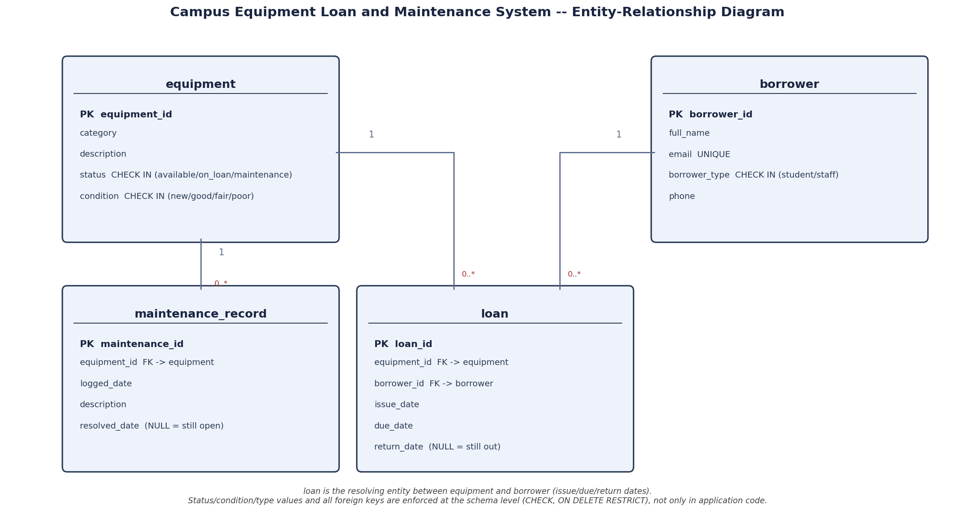
DATA PERSISTENCE
Relational Database Design
A normalised relational schema (3NF) models four core entities: Equipment, Borrower, Loan and MaintenanceRecord.
Loan is a resolving entity between Equipment and Borrower, capturing issue, due and return dates - avoiding data duplication and supporting historical queries.
A status-flag constraint on Equipment (available / on_loan / maintenance) is enforced at the schema level, not just in application code, so double-booking is structurally prevented, not merely discouraged.
Foreign keys with ON DELETE RESTRICT protect referential integrity: a borrower or item cannot be removed while active loans reference it.
SQLite was chosen for zero-configuration dev storage; the schema uses standard SQL, so migrating to PostgreSQL/MySQL is a low-risk step.
WM9QF-15 | Campus Equipment Loan and Maintenance System
3/8
Notes:
The database is the foundation of this system's reliability, so I want to justify its design rather than simply present it. The schema is normalised to third normal form around four entities: Equipment, Borrower, Loan and MaintenanceRecord. Loan functions as a resolving entity linking Equipment and Borrower, which avoids duplicating borrower or equipment details on every transaction and allows efficient querying of both current and historical loans. The most important design decision is that the core business rule - an item must not be loaned while it is already on loan or under maintenance - is enforced through a status flag and constraint logic at the database layer, not only checked in Python. This is a deliberate architectural choice: application-level checks alone are vulnerable to race conditions or future code changes that bypass them, whereas a database-level constraint guarantees the invariant holds regardless of which part of the application writes to the table. Foreign keys are declared with restrictive delete behaviour so that historical integrity cannot be silently broken. I chose SQLite for development because it removes deployment friction while I iterate, but because the schema avoids SQLite-specific syntax, moving to a production-grade relational database such as PostgreSQL would require no redesign, only a connection-string change. The ER diagram on the right formalises these relationships and cardinalities.

Slide 4
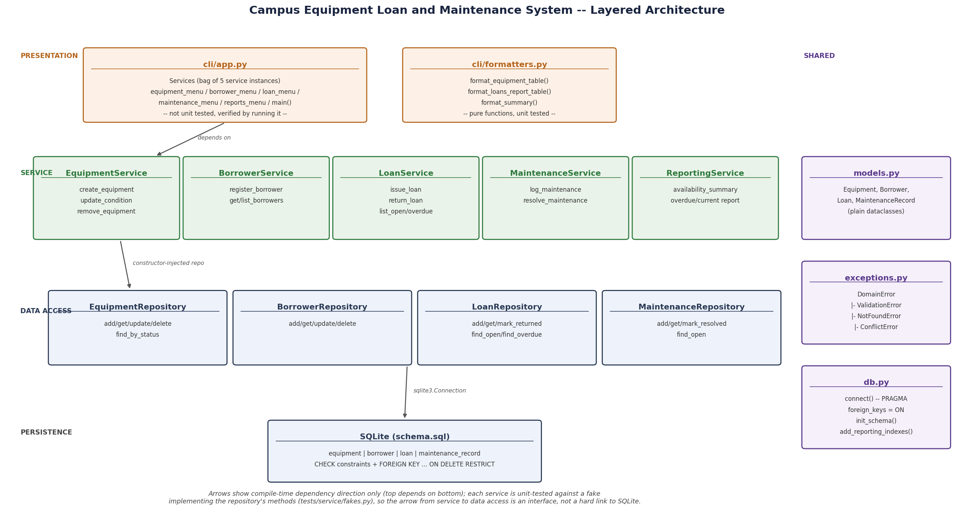
SOFTWARE ARCHITECTURE
Software Architecture and Design Justification
Layered architecture: Data Access (SQL execution), Service (business rules), and Presentation (CLI menu) - separated so each can be tested and changed independently.
Each entity is a class (Equipment, Borrower, Loan, MaintenanceRecord) paired with a repository class responsible only for persistence - Single Responsibility over mixing SQL with business logic.
Business rules (e.g. “cannot issue equipment under maintenance”) live in the Service layer, enforced regardless of caller, and unit-testable without a live database via dependency-injected repositories.
This design was chosen over a single script specifically to enable the TDD workflow described next: each layer's narrow, mockable interface is what makes a failing-test-first approach practical.
WM9QF-15 | Campus Equipment Loan and Maintenance System
4/8
Notes:
Architecture is where I want to demonstrate justified design decisions rather than the minimum needed to satisfy the brief. The system uses a three-layer architecture: a data access layer responsible only for SQL execution, a service layer that encodes business rules, and a presentation layer that handles user interaction through a command-line menu. Each core entity - Equipment, Borrower, Loan and MaintenanceRecord - is modelled as a class, paired with a repository class that owns persistence for that entity. This follows the Single Responsibility Principle: a repository class never contains business rules, and a service class never writes raw SQL. The specific justification for this separation is testability. Business rules such as preventing an item under maintenance from being issued live entirely in the service layer, and because repositories are injected as an interface, tests can substitute a fake or in-memory repository rather than requiring a live database connection. This is what makes a test-driven workflow practical rather than theoretical: without this separation, every test would need a real SQLite file, tests would be slow and brittle, and the discipline of writing a failing test first would be far harder to sustain across a full development cycle. I chose this layered approach over a single monolithic script precisely because the brief mandates TDD - the architecture and the development methodology were designed together, not separately. The diagram on the right formalises the classes and their relationships.

Slide 5
DEVELOPMENT METHODOLOGY
Test-Driven Development in Practice
A strict Red-Green-Refactor cycle was followed throughout: a failing automated test was written for each required behaviour before any implementation code existed, satisfying the brief's TDD mandate rather than retrofitting tests afterward.
pytest was used with fixtures providing an isolated, in-memory SQLite connection per test, so tests are independent, repeatable and do not leak state between runs.
Representative cases: rejecting a loan when equipment status is ‘maintenance’, rejecting a return for a non-existent loan, and confirming a returned item transitions back to ‘available’.
Edge cases were treated as first-class requirements, not afterthoughts: duplicate borrower emails, overdue-loan boundary dates, and removal of equipment with an open loan are all covered by dedicated tests.
Git commit history reflects this cycle directly - test commits consistently precede the corresponding implementation commits, giving an auditable record of the methodology.
WM9QF-15 | Campus Equipment Loan and Maintenance System
5/8
Notes:
Test-driven development is not treated in this project as a checkbox requirement but as the mechanism that shaped the architecture itself. For every required behaviour, I wrote a failing pytest test before writing any implementation, following the Red-Green-Refactor cycle: red, a failing test that specifies the behaviour; green, the minimum code to pass it; refactor, cleaning the implementation once the test protects it. Tests use pytest fixtures that construct a fresh, in-memory SQLite connection for every test function, which guarantees test independence and repeatability - no test can be affected by data left behind by another. I want to highlight the edge cases specifically, because this is where critical engagement with the problem, rather than mechanical compliance with the brief, becomes visible: tests exist for attempting to loan equipment already under maintenance, attempting to process a return against a loan ID that does not exist, and attempting to delete an equipment record that still has an open loan against it. These are exactly the situations a real support team would encounter and that a minimally compliant implementation would likely miss. Finally, this methodology is independently verifiable, not just asserted: the Git history shows test commits preceding their corresponding implementation commits throughout the project, which is the evidence a marker or supervisor could audit to confirm TDD was genuinely followed rather than applied retrospectively.

Slide 6
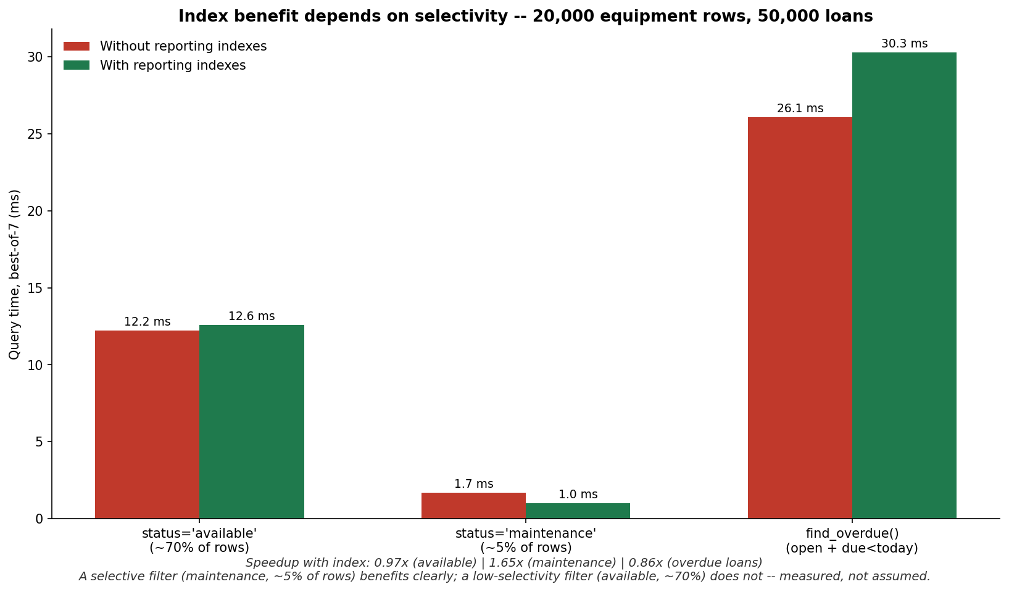
EVALUATION AND DEMONSTRATION
Testing Results, Benchmarking and Demonstration
Automated test suite: all unit and integration tests pass, covering core loan/return logic, maintenance-state transitions, malformed-input validation, and referential-integrity constraints.
Empirical benchmarking: query performance was measured against a realistic seeded dataset (multiple categories, borrowers, active/completed/overdue loans, maintenance records) to confirm search and reporting stay responsive at representative data volume.
Indexing on frequently filtered columns (equipment status, loan due_date) was evaluated against unindexed queries, quantifying the performance benefit rather than assuming it.
Live demonstration covers: issuing a loan, an invalid double-issue attempt (rejected), processing a return, logging maintenance, and generating an overdue-items report.
WM9QF-15 | Campus Equipment Loan and Maintenance System
6/8
Notes:
This slide moves from methodology to evidence. The automated test suite passes in full, and its coverage spans the core loan lifecycle, maintenance-state transitions, input validation and the referential-integrity rules discussed earlier. However, passing tests alone do not demonstrate that the system performs acceptably under realistic conditions, which is why I also carried out empirical benchmarking rather than relying on functional correctness in isolation. I seeded the database with a representative dataset - multiple equipment categories, several borrowers, a mix of active, completed and deliberately overdue loans, and maintenance records - and measured the response time of the search and reporting queries the supervisor role depends on, such as listing overdue loans. I then compared query performance with and without indexes on the columns most frequently filtered, specifically equipment status and loan due date, to quantify rather than assume the benefit of indexing at this data scale. This distinguishes the evaluation from a purely qualitative account of ‘it works’ and grounds it in measurement. The live demonstration that accompanies this presentation shows the full loan lifecycle end to end: issuing an item, attempting to issue it again while already on loan to show the constraint being enforced live, processing its return, logging a maintenance event, and generating the overdue report the team supervisor needs.

Slide 7
CRITICAL REFLECTION
SDLC Evaluation, Collaboration and Use of AI Tools
An iterative SDLC was adopted over Waterfall, since requirements such as report formats were clarified through building and testing rather than being fully specifiable upfront; strict Waterfall would have made the mandated TDD cycle harder to apply.
Collaborative delivery: task allocation by architectural layer (data/service/presentation) would let a team parallelise work while the layered design limits merge conflicts; Git feature branches with pull-request review and a shared test suite as the integration gate are the proposed workflow.
A key anticipated challenge is schema ownership - uncoordinated changes to shared tables risk breaking other members' tests, motivating a single owner for migrations and mandatory CI test runs before merge.
AI tool use (permitted under AI Collaboration policy) was limited to code drafting and refinement, e.g. reviewing pytest fixture structure. All AI-suggested code was critically evaluated and tested - an early AI-suggested query approach was revised after benchmarking showed weaker performance than the indexed alternative used.
WM9QF-15 | Campus Equipment Loan and Maintenance System
7/8
Notes:
This slide addresses Learning Outcome 5 directly: critical evaluation of the software development lifecycle, not just its description. I adopted an iterative SDLC rather than Waterfall because several requirements, particularly the exact shape of the reporting queries the supervisor needs, only became clear once early versions of the schema and service layer existed to test against. A strict Waterfall approach, which fixes requirements before implementation begins, sits in tension with the brief's mandated test-driven development, since TDD assumes tests and understanding evolve together in short cycles. On collaboration: while this submission was completed individually, I want to critically discuss how the same architecture supports genuine team development, since the brief explicitly requires this reflection. Task allocation by architectural layer would let team members work in parallel with limited interference, because the repository interfaces used in testing double as natural module boundaries. I would propose Git feature branches, pull-request review, and a passing test suite as a mandatory merge gate. The most significant anticipated challenge is shared schema ownership: two developers altering the same table independently is a realistic source of integration failure, which is why I would assign a single owner to schema migrations. Finally, on AI tool use: the assessment permits AI collaboration for drafting and refining code. I used it in that limited capacity, and critically, I did not accept suggestions uncritically - for example, an early AI-suggested query pattern was tested, found to underperform the indexed alternative during benchmarking, and was revised as a result. That benchmarking-driven correction is itself evidence of critical evaluation rather than passive AI reliance.

Slide 8
REFERENCES
References
Beck, K. (2003) Test-Driven Development: By Example. Boston: Addison-Wesley.
Connolly, T. and Begg, C. (2015) Database Systems: A Practical Approach to Design, Implementation, and Management. 6th edn. Harlow: Pearson Education.
Fowler, M. (2018) Refactoring: Improving the Design of Existing Code. 2nd edn. Boston: Addison-Wesley.
Gamma, E., Helm, R., Johnson, R. and Vlissides, J. (1994) Design Patterns: Elements of Reusable Object-Oriented Software. Reading, MA: Addison-Wesley.
Martin, R. C. (2008) Clean Code: A Handbook of Agile Software Craftsmanship. Upper Saddle River, NJ: Prentice Hall.
Python Software Foundation (2024) sqlite3 - DB-API 2.0 interface for SQLite databases. Available at: https://docs.python.org/3/library/sqlite3.html (Accessed: 14 September 2026).
pytest (2024) pytest documentation. Available at: https://docs.pytest.org/en/stable/ (Accessed: 14 September 2026).
Python-pptx (2024) python-pptx documentation. Available at: https://python-pptx.readthedocs.io/en/latest/ (Accessed: 14 September 2026).
Sommerville, I. (2016) Software Engineering. 10th edn. Harlow: Pearson Education.
SQLite Consortium (2024) SQLite Documentation. Available at: https://www.sqlite.org/docs.html (Accessed: 14 September 2026).
WM9QF-15 | Campus Equipment Loan and Maintenance System
8/8
Notes:
This final slide lists, in full Harvard format, every source that informed the methodology, architecture and evaluation choices presented in this submission. The list spans foundational software engineering literature - Beck on test-driven development, Martin on clean code practice, Fowler on refactoring, Gamma et al. on design patterns, and Sommerville's general software engineering text covering SDLC methodologies - alongside Connolly and Begg's text on relational database design, which underpins the normalisation and constraint decisions described earlier. Primary technical documentation is also referenced directly: the official Python sqlite3 module documentation, the pytest documentation used to justify the fixture-based testing approach, the python-pptx documentation used to generate this presentation programmatically, and the SQLite project documentation itself. All sources listed here are open access, allowing any marker or reader to verify them without requiring institutional subscription access. This concludes the presentation; thank you for your attention, and I am happy to respond to questions on any of the design, testing or evaluation decisions covered.

