Slide 1
ESTIMATION OF BUSINESS EXPENSES GOVERNMENT ARTSCOLLAGE KARUR-5 FACULTY MENTOR K.KALPANA M.SC,B.BED GUEST PROFESSOR IN MATHEMATIES

Slide 2
TEAM MEMBERS
T.PRADEEPA ---- TEAM LEADER
K.PRIYATHARSHINI ---- TEAM MEMBER
B.RAGUL ---- TEAM MEMBER
T.PRAVEENKUMAR ---- TEAM MEMBER

Slide 3
INTRODUCTION
Business expenses are incurred as part of a company’s operations.
Business subtract their expenses from their revenue to determine their net profit or loss and taxable income.

Slide 4
PURPOSE
Estimates are documents that provide approximate costs for a project.
Small businesses create them for potential clients so both parties are clear on the ins and outs of a project before it starts.
Fresh books has an estimates feature that help you build an estimate quickly and easily.

Slide 5
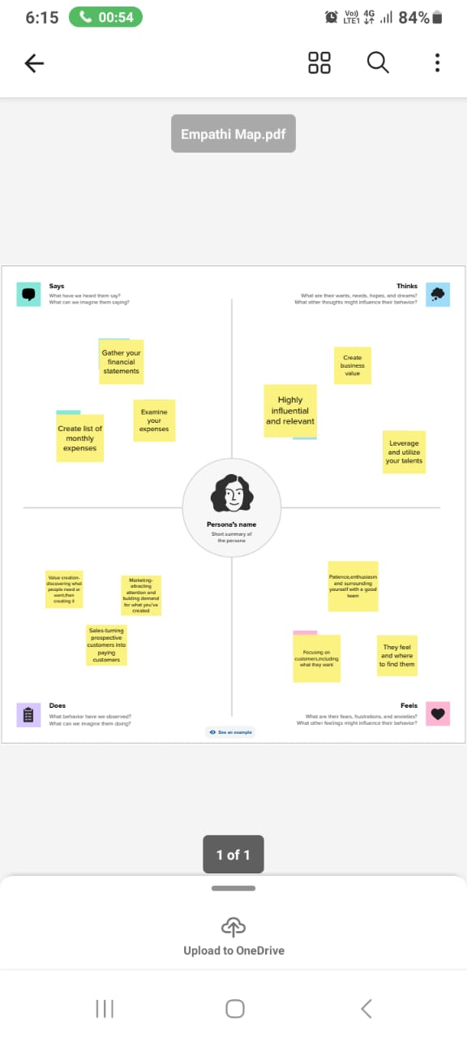
EMPATHI MAP

Slide 6
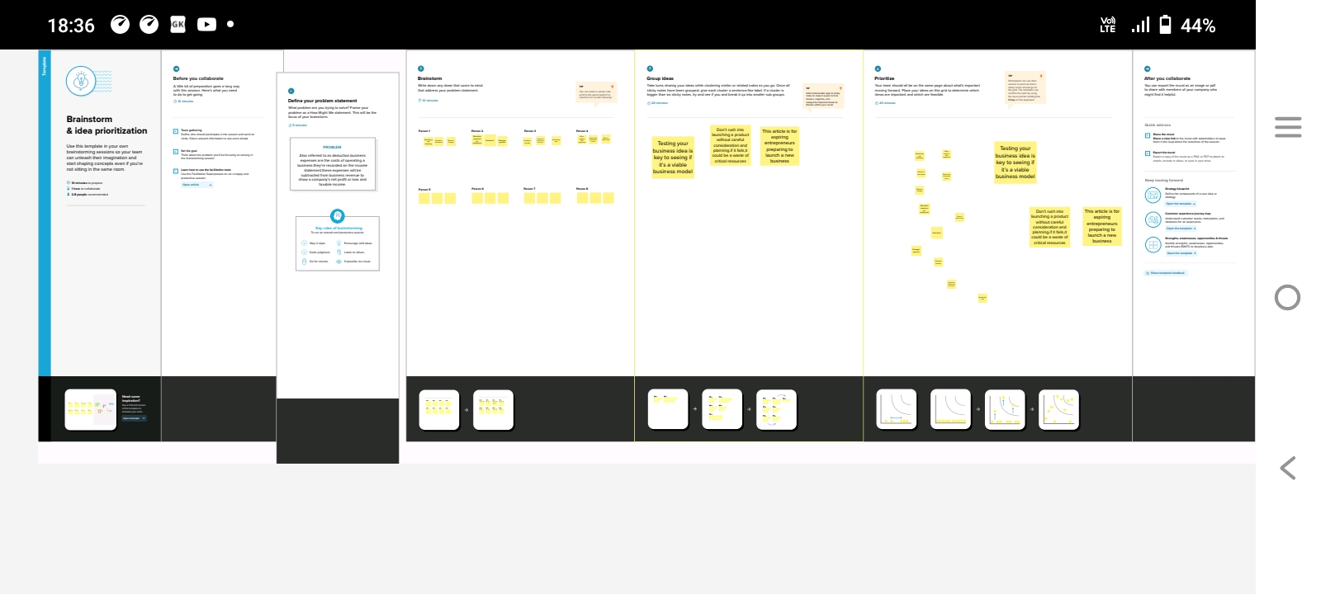
BRAINSTORMING IDEAS

Slide 7
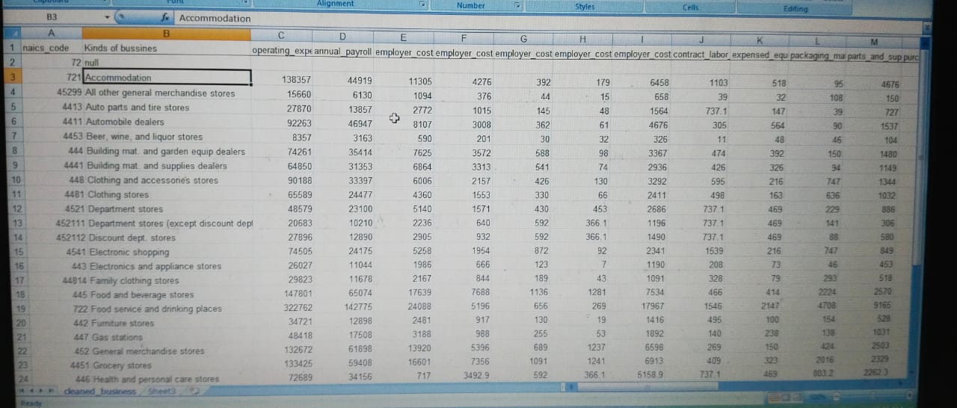
DATASET

Slide 8
ABOUT THE DATASET
ANNUAL PAY ROLL
ADVERTISEMENT COST
CONTRACT LABOUR VS EMPLOYEE
EMPLOYEE(INSURANCE VS PENSION)
EQUIPMENT COSTS
EXPENSES YOY
FUEL
MAINTENANCE OF BUILDINGS
POWER EXPENDITURE
RENTAL PAYMENT MACHINERY
TAXES & LICENSES
TRANSPORTATION

Slide 9
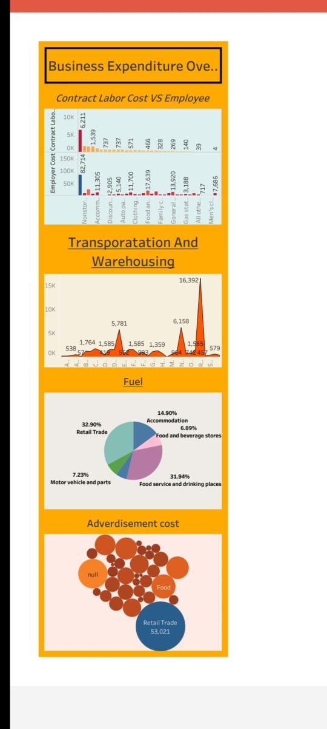
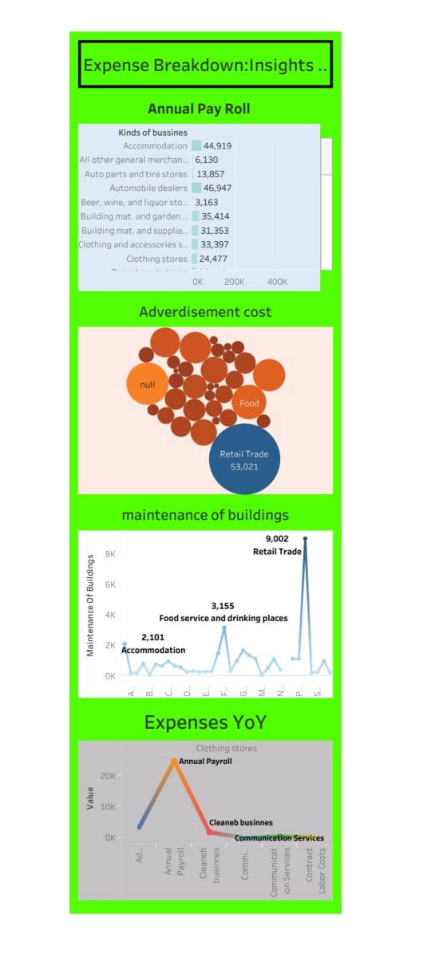
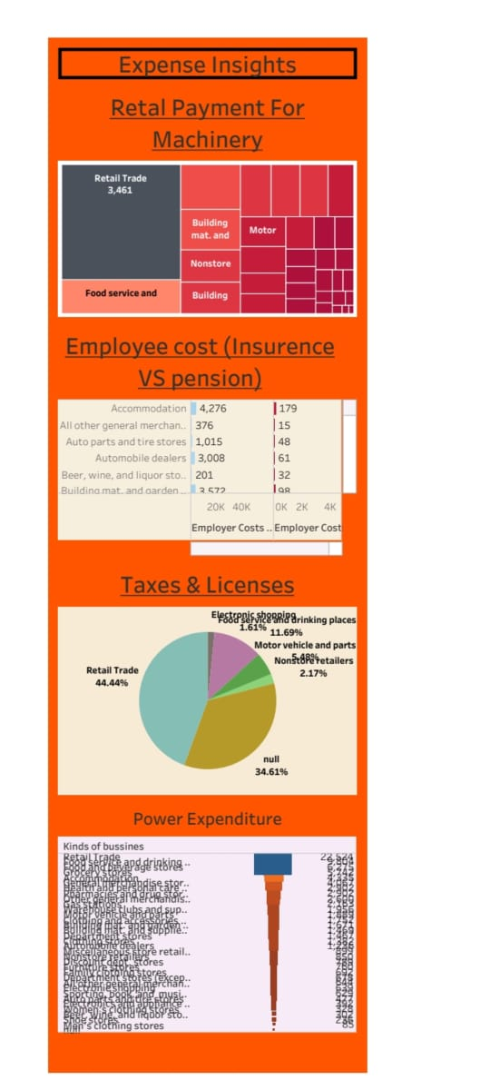
DASHBOARD

Slide 10
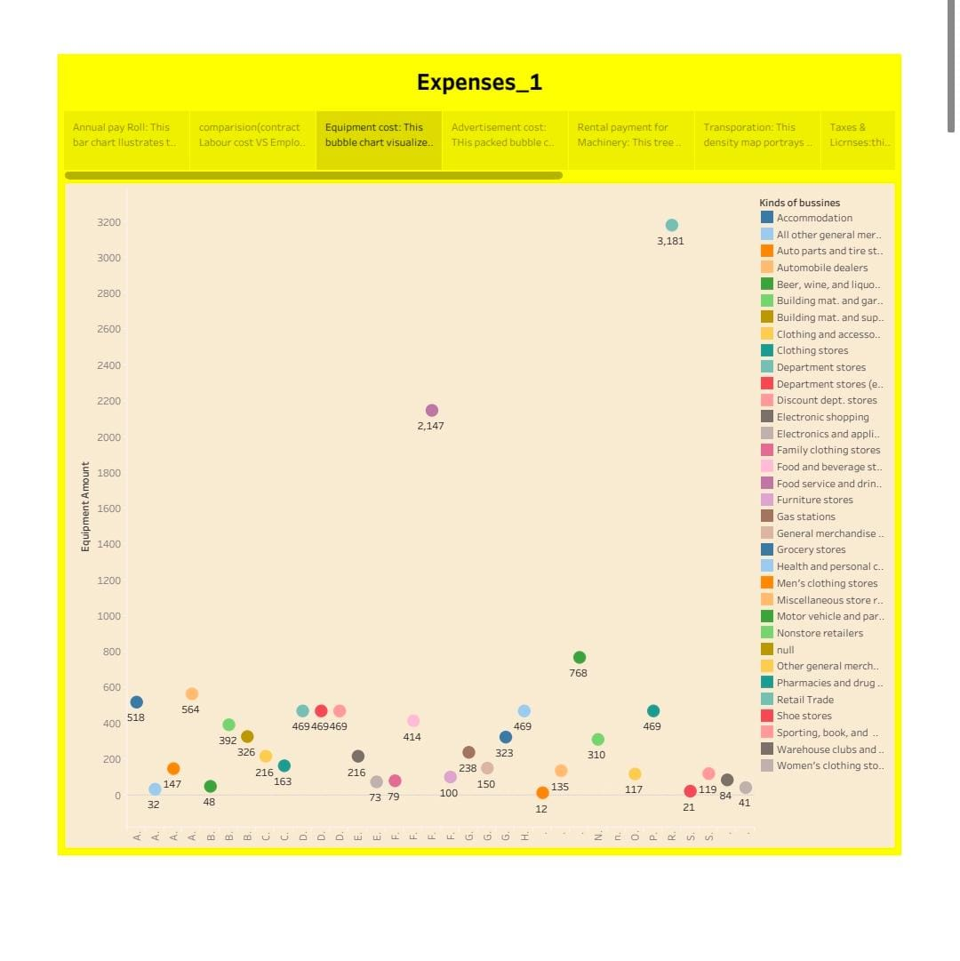
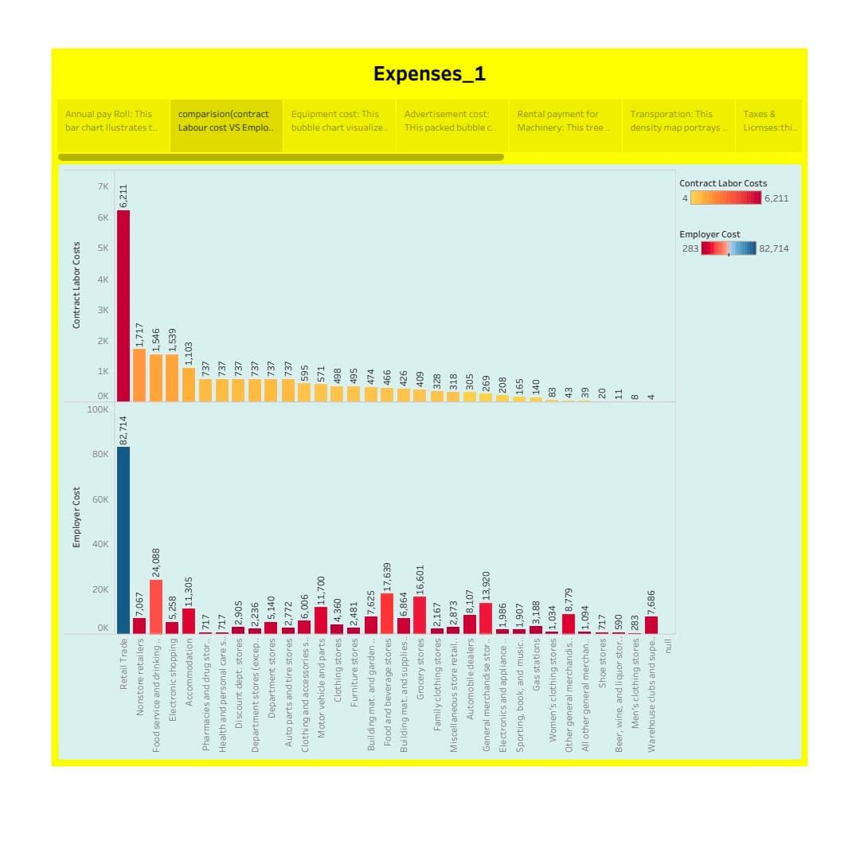
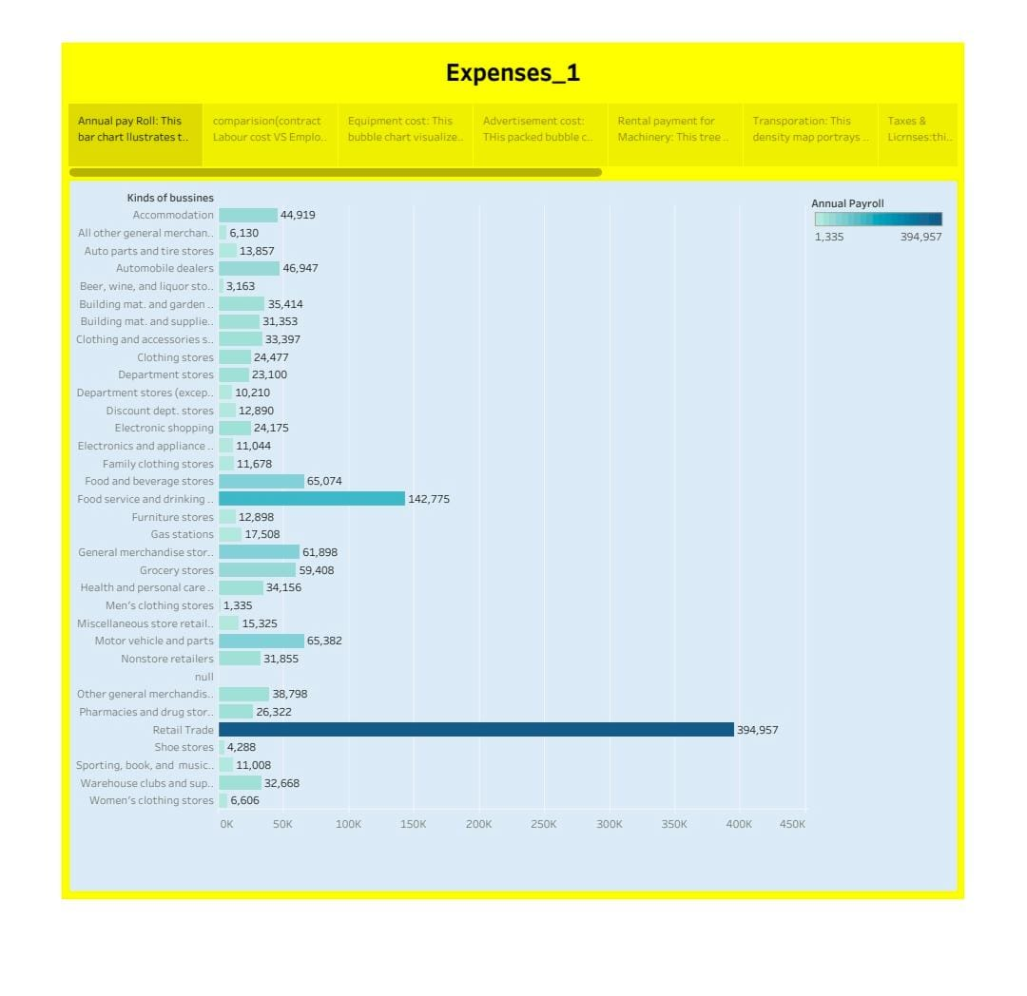
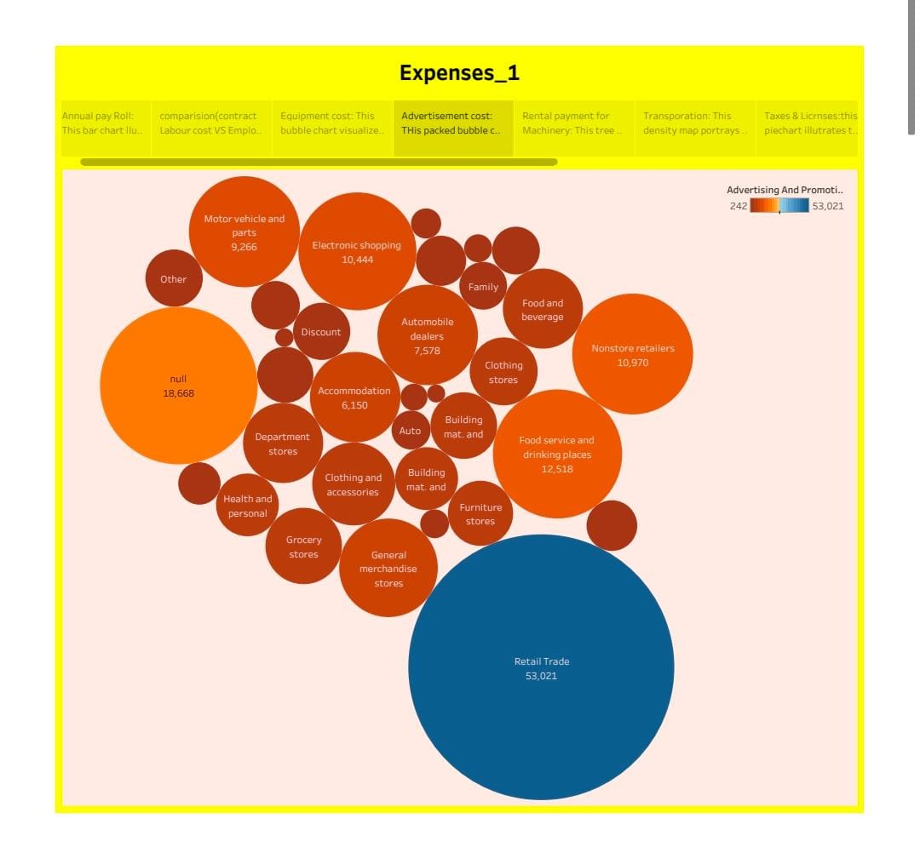
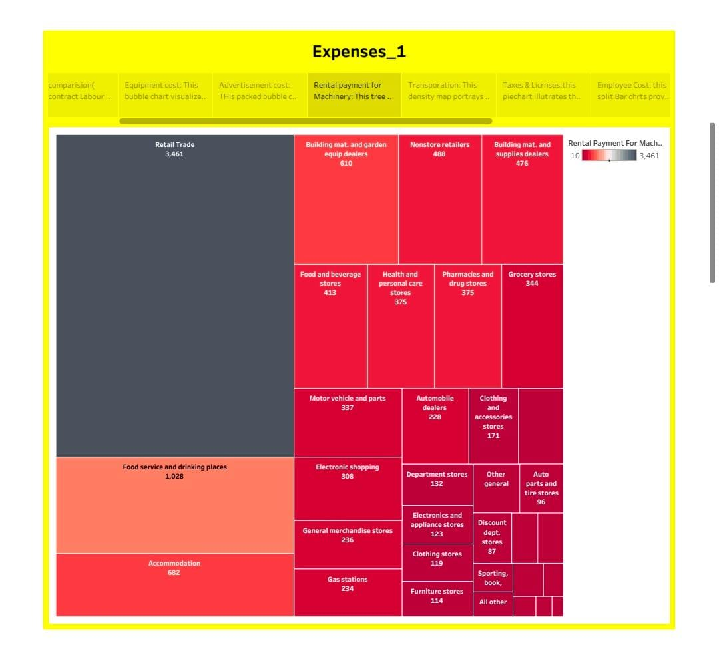
STORY

Slide 11
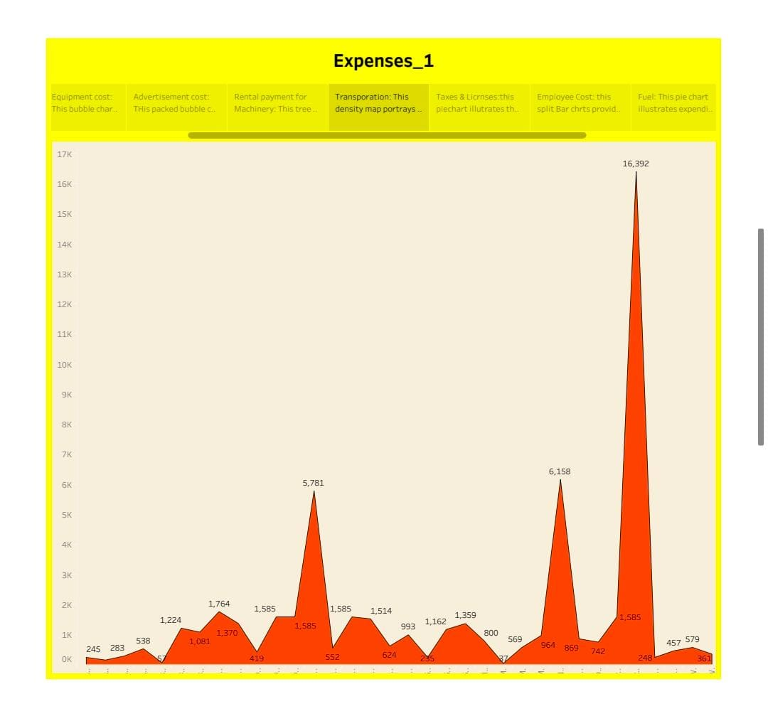
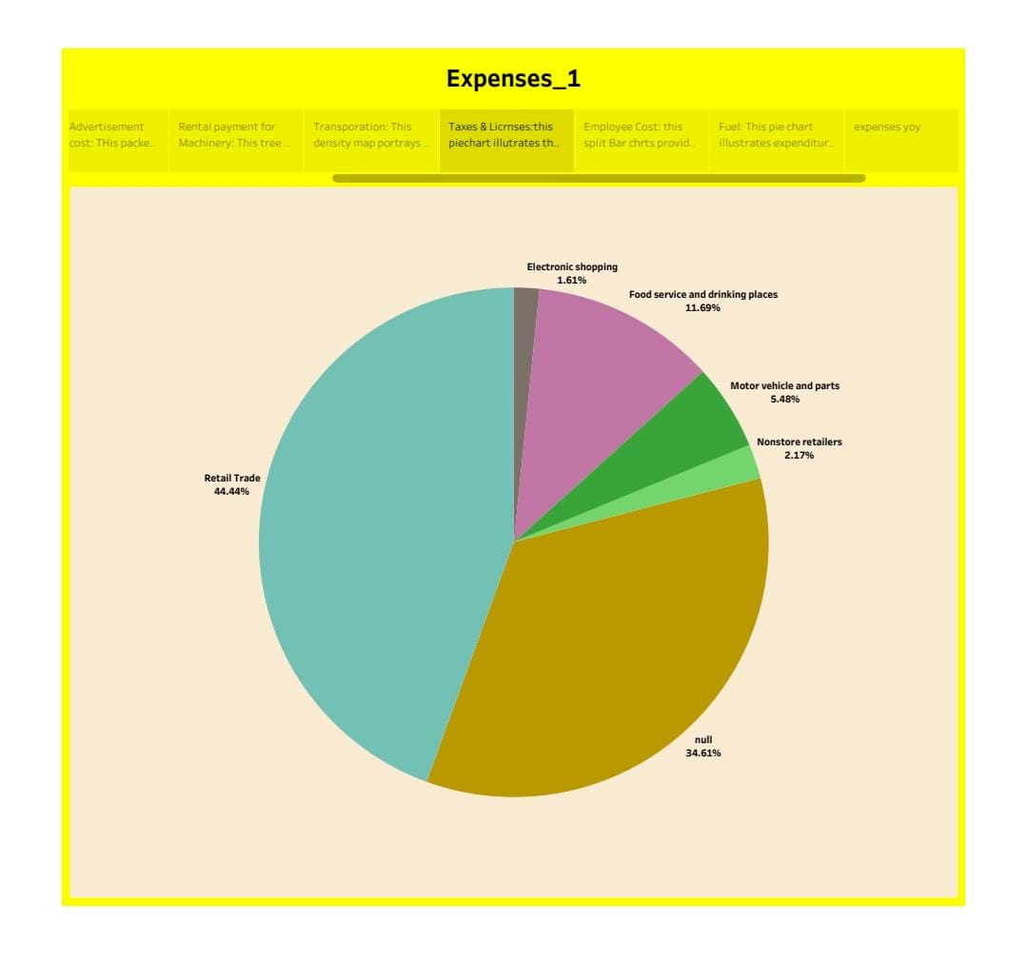
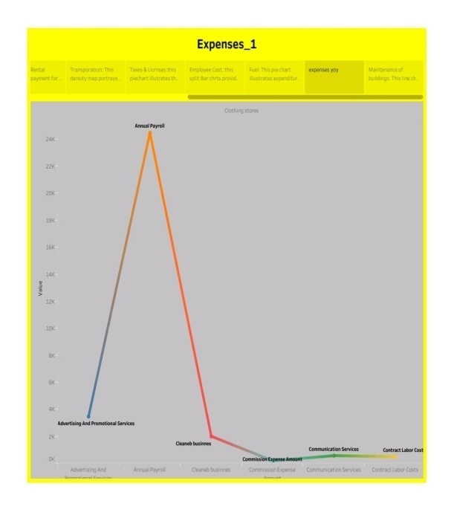
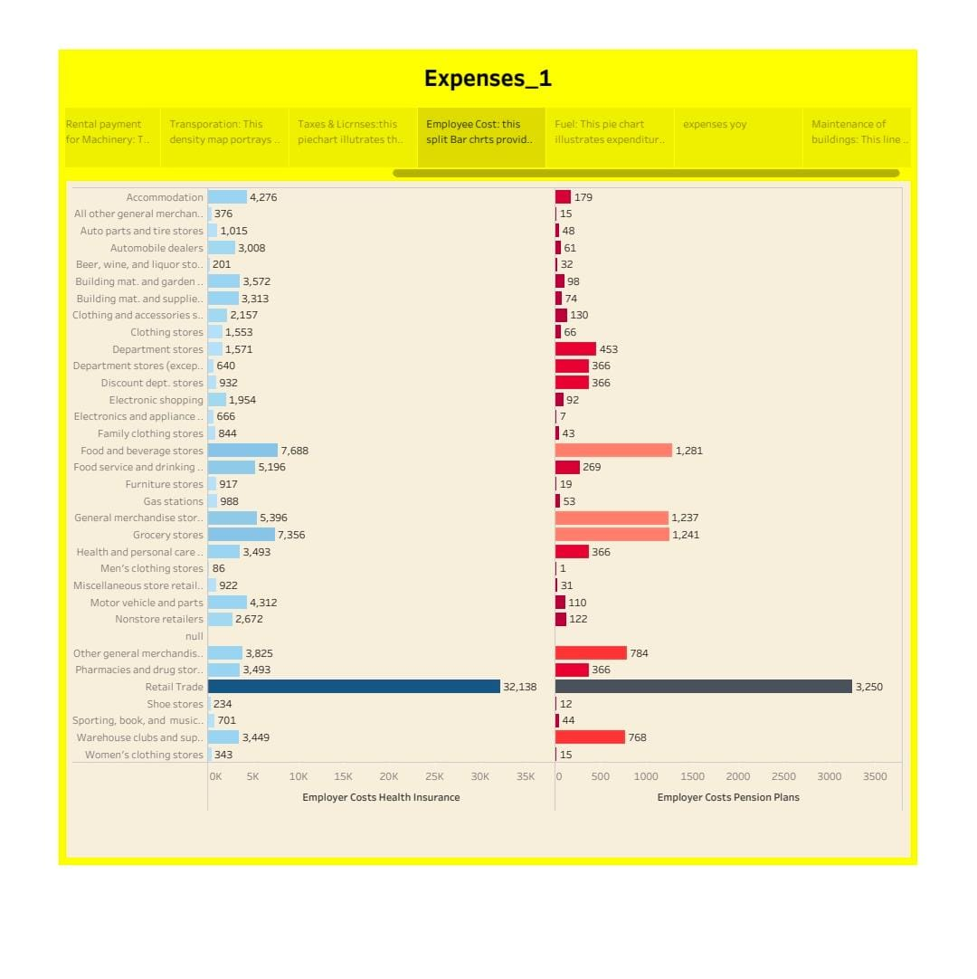
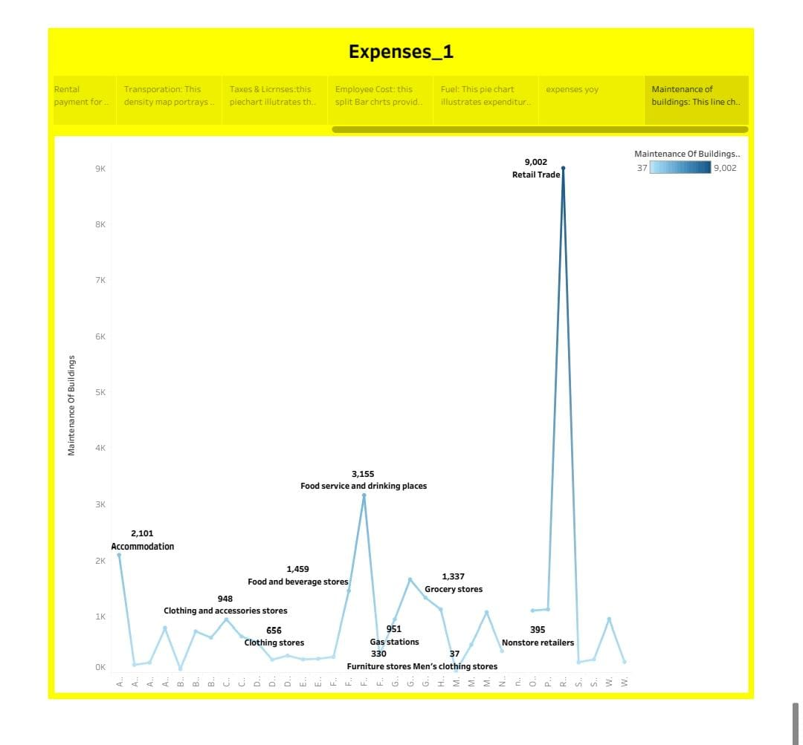
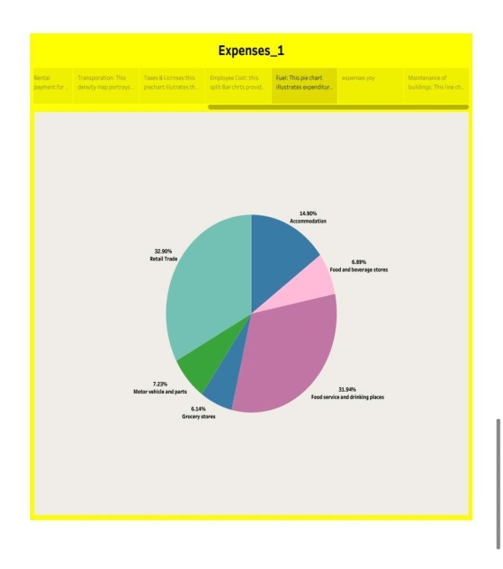
STORY

Slide 12
ADVANTAGES
More accurate estimations results in smoother execution of the project.
So you are spared last minute overheads, unforeseen expenditures and blocked working capital.
What this means are lesser project costs.
The right estimation means glitch free, uniterrupted project execution.

Slide 13
DISADVANTAGES
It can be expensive to implement and it is time consuming.
It is not flexible enough to answer what-if questions.
New estimates must be built for each alternative.
The product specification must be well-known and stable.

Slide 14
FUTURE SCOPE
If one owns a business, then he/she must know the issues that comes with it and should therefore be prepared for the solutions too.
Business can be a real good scope for future,but one needs to be very calculative in its decisions and very accurate in future prospects.

Slide 15
CONCLUSION
Patience is essential to setting up a successful business, and a plan should never be hurried.
Businesses provide a lifestule and a secure future.
A business is an amalgamation of several activities such as accounting, finance, manufacturing, etc.
A lot of time should be invested in research and planning before setting up a business.

Slide 16
“THANK YOU”

