Slide 1





RecipeRover
Team Members: Guide:
1.Mohammed Thajudeen R Mrs.Uma Mageshwari
2.Kavichozhan K
3.Shantosh N
4.Ragul Raj R
5.Gopal S
Disclaimer: The content is curated for educational purposes only.

Slide 2
OUTLINE :
Abstract
Problem Statement
Aims, Objective & Proposed System/Solution
System Design/Architecture
System Development Approach (Technology Used)
Algorithm & Deployment
Conclusion
Future Scope
References
Video of the Project
Notes:
These are the list of chapters that we are going to cover in these foundation codes. Those are chapter one what are AI and ML? chapter 2 applied Python programming in AI, and chapter 3 is exploratory data analysis for ML.

Slide 3
ABSTRACT :
"RecipeRover" is a revolutionary recipe search platform designed to tackle user-centric challenges by providing personalized culinary experiences.
The project aims to enhance the recipe discovery process by leveraging advanced algorithms to understand user preferences, dietary restrictions, and cooking skill levels.
Through intuitive interfaces and machine learning, RecipeRover delivers tailored recipe recommendations, ensuring users find the perfect dish effortlessly.
This innovative platform redefines the way individuals explore, discover, and create meals, fostering a more engaging and satisfying cooking journey.
RecipeRover's user-centric approach transforms the culinary landscape, making it an indispensable tool for food enthusiasts seeking a delightful and personalized cooking experience.

Slide 4

PROBLEM STATEMENT :
The problem lies in the difficulty many individuals face in finding reliable and diverse recipes tailored to their preferences.
Existing recipe websites often lack user-friendly interfaces and may not cater to specific dietary needs or skill levels.
This project aims to address these issues by creating a user-centric food recipe platform that offers a wide range of recipes, personalized recommendations, and an intuitive interface.

Slide 5
AIM :
RecipeRover aims to create a dynamic and user-centric food recipe platform using Java, fostering a culinary community.
The goal is to provide a seamless user experience through user authentication, a comprehensive recipe database, efficient search and filtering options, personalized recipe recommendations, interactive user engagement features, and a responsive design.
By leveraging Java's robust backend capabilities, RecipeRover seeks to empower users to explore, share, and enhance their culinary skills in an engaging online environment.

Slide 6
OBJECTIVES :
The objectives of RecipeRover encompass the development of a feature-rich food recipe website.
Firstly, establish secure user authentication for account creation and personalization.
Secondly, implement a well-organized recipe database to store diverse recipes with details such as ingredients, cooking steps, and nutritional information.
Thirdly, enable efficient recipe discovery through search and filters based on ingredients, cuisine, dietary preferences, and skill levels. Implement a recommendation algorithm for personalized suggestions based on users' preferences and cooking history. Foster user interaction through ratings, reviews, and sharing features, including a commenting system for culinary tips.
Finally, ensure a seamless experience across devices with a responsive design, creating a vibrant and collaborative community within the RecipeRover platform.

Slide 7
PROPOSED SOLUTION :
RecipeRover, a Java-based food recipe website, offers a user-friendly platform with key features:
User Authentication for personalized profiles,
a well-organized Recipe Database,
Search and Filters for easy recipe discovery,
Personalized Recommendations using an algorithm,
User Interaction through ratings, reviews, and sharing, and
a Responsive Design for accessibility.
This solution aims to create an engaging culinary community, encouraging users to explore and share experiences.
Leveraging Java ensures a robust and scalable backend, providing a seamless experience for RecipeRover users as they contribute to and navigate the diverse world of recipes on the platform.

Slide 8
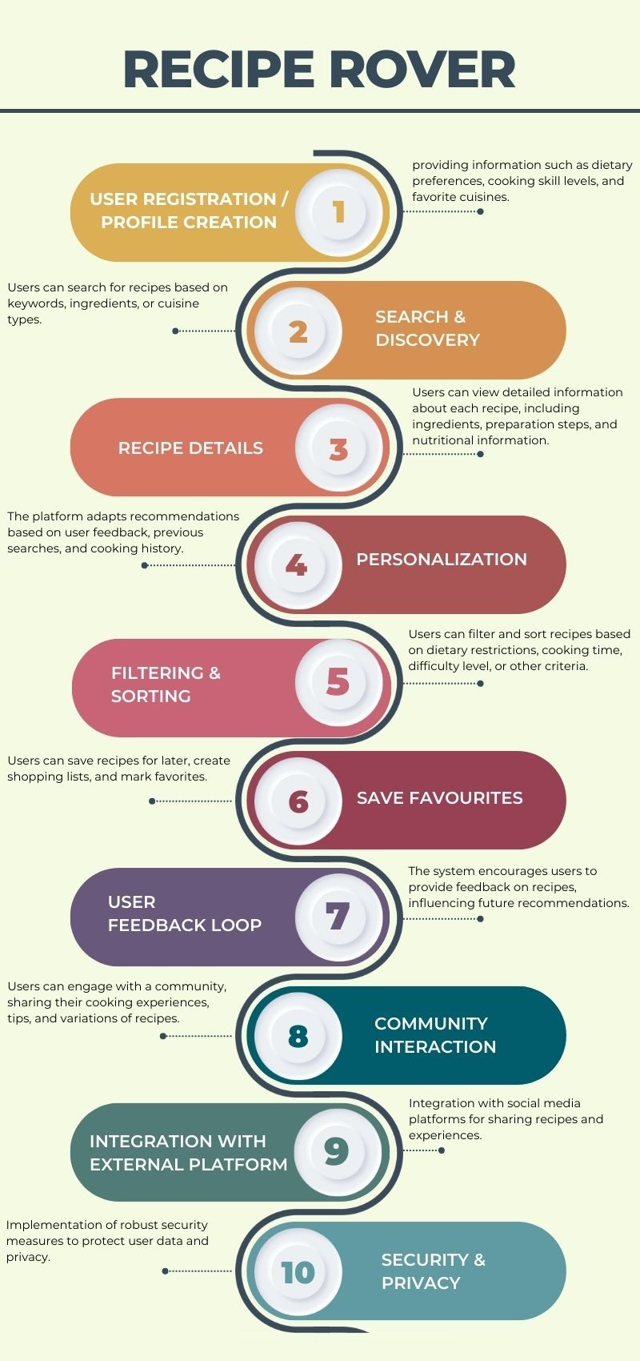
SYSTEM ARCHITECTURE :
1.User registration / Profile creation
2.Search & Discovery
3.Recipe details
4.Personalization
5.Filtering & Sorting
6.Save favorites
7.User feedback loop
8.Community Interaction
9.Integration with external platform
10.Security & Privacy

Slide 9
SYSTEM DEPLOYMENT APPROACH :
1. Frontend Deployment: Deploy the frontend using a responsive web design, ensuring compatibility across devices. Utilize a framework for a dynamic and user-friendly interface
2. Backend Deployment: Implement the Java backend using a microservices architecture. Utilize containers for easy deployment and management. Employ a relational database for storing recipes and user data.
3. Authentication Integration: Integrate a secure authentication system for user login and profile personalization.
4. Recipe Database Configuration: Set up and populate the recipe database with diverse recipes, incorporating details like ingredients, cooking steps, and nutritional information.
5. Testing and Monitoring: Implement monitoring tools to track system health and user interactions, ensuring a stable and responsive RecipeRover platform.

Slide 10
ALGORITHMS & DEPLOYMENTS :
Algorithm Implementation :
RecipeRover employs a recommendation algorithm to enhance user experience. This algorithm analyzes users' past preferences and cooking history, providing personalized recipe suggestions. Leveraging user ratings, reviews, and interactions, the system continually refines recommendations, ensuring accuracy and relevance. This algorithmic approach enriches the platform, creating a tailored and engaging culinary journey for users exploring the RecipeRover community.
Deployment Strategy :
RecipeRover's deployment involves a dual-stack approach. The frontend, developed with HTML, CSS, and JS, is deployed on web servers for seamless user interaction. The Java servlet-based backend ensures a robust and scalable foundation, handling user authentication, recipe database interactions, and algorithmic computations. Employing containerization, the system utilizes Docker for efficient deployment across cloud-based infrastructures, guaranteeing flexibility and scalability. Rigorous testing and continuous monitoring contribute to a reliable and responsive RecipeRover platform, where users seamlessly navigate, discover, and contribute to the diverse world of recipes.

Slide 11

CONCLUSION :
In conclusion, RecipeRover emerges as a transformative solution to the challenges of recipe discovery and user engagement. By seamlessly integrating a user-friendly frontend with HTML, CSS, and JS, and a robust Java servlet-based backend, the platform offers a dynamic culinary experience. The personalized recommendation algorithm enhances user interactions, providing tailored suggestions based on individual preferences. With features like user authentication, interactive ratings, reviews, and a responsive design, RecipeRover not only addresses existing limitations in recipe platforms but also fosters a vibrant community. This project represents a harmonious blend of technology and gastronomy, creating a collaborative space for users to explore, share, and savor the diverse world of recipes.

Slide 12
FUTURE SCOPE :
The future scope of RecipeRover extends beyond its current features.
Enhancements can include expanding the recipe database to encompass more global cuisines, collaborating with nutritionists for detailed dietary insights, and integrating advanced user engagement features like live cooking sessions or virtual cooking classes.
Exploring partnerships with local markets for ingredient delivery services and incorporating community-driven events, such as recipe contests, can further enrich user interaction.
Additionally, the platform could evolve into a go-to resource for culinary enthusiasts, offering curated content like kitchen hacks, seasonal recipe collections, and user-generated cookbooks.
Continuous user feedback will be integral for refining and expanding RecipeRover's offerings, ensuring its sustained growth and relevance in the culinary landscape.

Slide 13
Reference
http://www.oreilly.com/data/free/the-new-artificial-intelligence-market.csp
GitHub Link
Demo Video
Notes:
Reference
These are the references for this session.
13

Slide 14
Thank you!
Notes:
thank you very much for joining this PPT, keep learning.
14

