Slide 1
Employee Data Analysis using Excel
STUDENT NAME: Ragul .D
REGISTER NO: 312200959,
7395990986, (0DA77E9976E56B9B0AD4F93941BD4AEF)
DEPARTMENT: B.COM(GENERAL) 3rd year .
COLLEGE: D.R.B.C.C.C.HINDU COLLEGE.

Slide 2

PROJECT TITLE : -
Employee Performance
Analysis using Excel

Slide 3

AGENDA :-
Problem Statement
Project Overview
End Users
Our Solution and Proposition
Dataset Description
Modelling Approach
Results and Discussion
Conclusion
3/21/2024 Annual Review

Slide 4



PROBLEM
STATEMENT :-
Employee performance evaluations can help you easily know about the good work and efforts of the top performance . You will be able to provide positive reinforcements for carrying out tasks properly .
Positive reinforcements are crucial for boosting
workplace morale and the good performance of the employees .

Slide 5






PROJECTOVERVIEW
It is a rigorous and systematic approach to defining workforce problems and testing successful solutions. To achieve it’s highest potential.
.
Download the data from the edunet foundation .
To ready for the pivot charts in multiple times or multiple charts.
Select the data from the excel to editing with format
, filter.
To put the columns to row, column, values like this ,and pivot table is ready for the charts .
Select the all data from the excel to new sheet to insert pivot table.

Slide 6

WHO ARE THE END USERS?
The project benefit for end users are employer, employees, organization, IT sectors.

Slide 7



OUR SOLUTION AND ITS VALUE PROPOSITION
Conditional formatting : To use blank values.
Filtering : To use missing items. Inserts : To choose the pivot table. Pivot table : To find the grand total of employee data analysis.
Charts : For see the employee database in percentage.

Slide 8
Dataset Description :-
Employee data set – edunet foundation [ 9 features ]
Feature : 6 features
Employee I’d – like [ PR00147 ] Gender – [Male and female] Name - [Minerva Ricardot ] Salary – [105468.7 ]
FTE - 1
Employee type – [Permanent ]

Slide 9
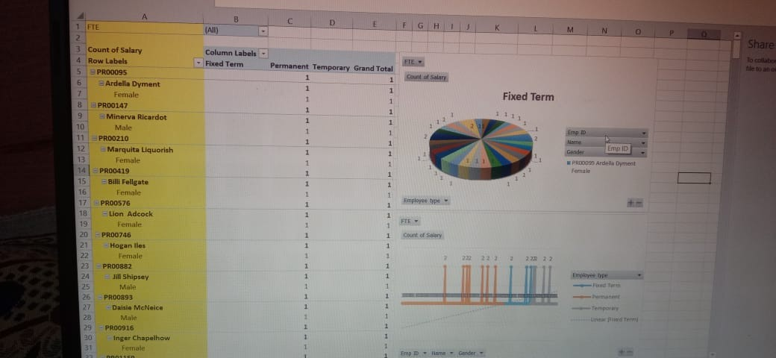

THE "WOW" IN OUR SOLUTION :-
3/21/2024 Annual Review

Slide 10
MODELLING :-
DATA COLLECTION : Download the edunet foundation .
DATA CLEANING : To clean the data from downloading data to
editing.
TECHNIQUES : I choose the technique in first is format, filter, highlights the heading with colour .
RESULTS : Result is the data analysis shown on new sheets.
PIVOT TABLE : Select the data and distribute the pivot table in rows, column , values and extra ,.
CHART GRAPHS : Once distribute the pivot table and it should
be shown on grand total with the data analysis then the pivot charts choose for the bar diagram, pie charts , extra,.
III.

Slide 11
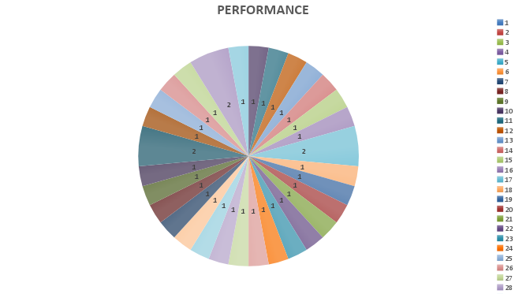
RESULTS :-

Slide 12


Slide 13
Conclusion :-
The employee data analyzing using with pivot table was clearly said to be how to analysis for the employee data in simple . How to calculate the different charts for the dataset description.

Slide 14


