Slide 1


K.RAMAKRISHNAN COLLEGE OF TECHNOLOGY
(AUTONOMOUS), TRICHY.
ONLINE BOOK BUYING AND SELLING PORTAL
PRESENTED
RAGUNATH.S
2303811710421128
SUPERVISOR
Mr. A.MALARMANNAN, M.E.,
AP/CSE.

Slide 2
PRESENTATION OVERVIEW
Objective
Project Introduction
Problem Statement
Methodologies (Programming concepts relevant to problem statement)
Architecture of the proposed system
List of Modules
Merits
Results and Discussion
Queries

Slide 3
OBJECTIVE
The objective of this program is to develop a basic online book store application with a user-friendly graphical interface using Java Swing. It allows users to register, log in, view available books, purchase books, and sell their own books. The program manages user accounts, book listings, and purchases through various panels, offering a seamless browsing and transaction experience. It aims to demonstrate basic CRUD operations, user authentication, and event handling within a desktop application.

Slide 4
PROJECT INTRODUCTION
This project is a simple online book store application built using Java Swing. It features a graphical user interface (GUI) that allows users to register, log in, view available books, purchase books, and sell their own books. The program includes user authentication, data management for book listings, and purchase history. By using `CardLayout` for navigation, the system offers a structured way to interact with the store, providing basic functionality for both users and book transactions.

Slide 5
PROBLEM STATEMENT
The problem addressed by this project is the lack of a simple, user-friendly platform for users to browse, buy, and sell books online. Many online bookstores are complex and difficult for beginners to navigate. This program aims to provide a straightforward solution by allowing users to register, log in, view books for sale, make purchases, and sell books through an intuitive graphical interface. The goal is to create a basic book store application with essential features for personal use or educational purposes.

Slide 6
METHODOLOGIES
Object-Oriented Programming (OOP): Modeling User and Book as objects for modularity.
Swing for GUI: Using Swing components for interactive user interfaces.
CardLayout: Managing different screens (e.g., Login, View Books) for smooth navigation.
Event-Driven Programming: Responding to user actions like button clicks.
Basic Data Management: Using ArrayList to store books and users temporarily.

Slide 7
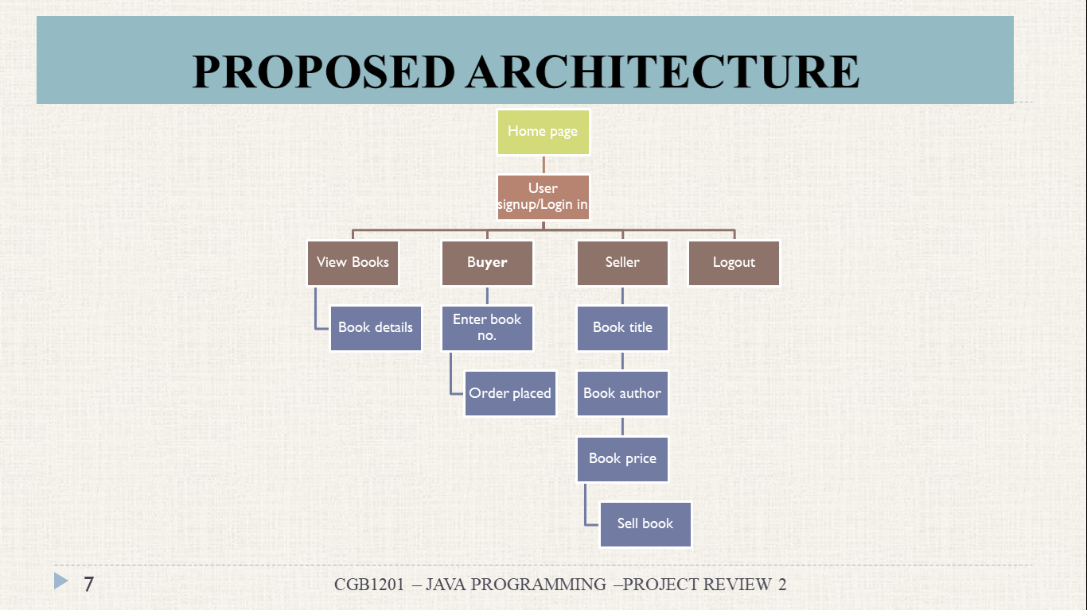
ARCHITECTURE OF THE PROPOSED SYSTEM

Slide 8
LIST OF MODULES – MODULE DESCRIPTION
User Authentication and Management Module
Manages user registration, login, and password verification, ensuring secure access to the platform with personalized features.
Book Listing and Display Module
Displays available books for sale, updating the list dynamically and showing book details like title, author, and price.
Book Purchase Module
Allows users to select and purchase books, adding purchased items to their account and updating inventory accordingly.
Book Selling Module
Enables users to add new books for sale by entering details like title, author, and price, updating the catalog.
Main Menu and Navigation Module
Provides easy navigation between different sections, such as login, book viewing, buying, selling, and logging out.

Slide 9
MERITS
Intuitive Interface: Easy navigation with CardLayout for smooth transitions between sections.
Secure Authentication: Login and registration ensure safe access to user accounts.
Book Management: Browse, buy, and sell books with real-time updates.
Personalized Experience: Users can track their purchased books.
Error Handling: Input validation minimizes errors and ensures reliability.
Multi-Functionality: Supports viewing, buying, and selling books in one platform.
Easy Navigation: Quick access to key features through the main menu.

Slide 10
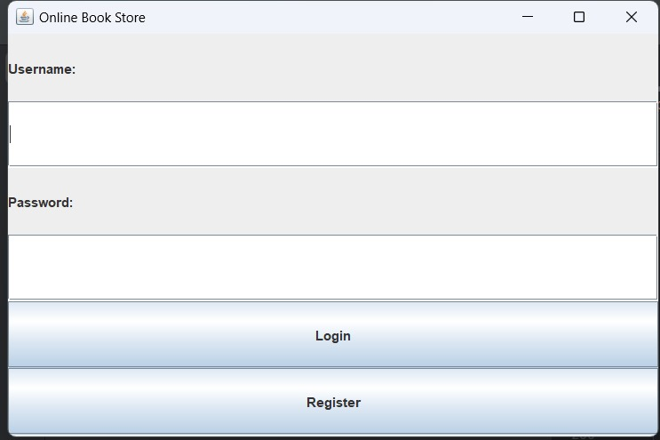
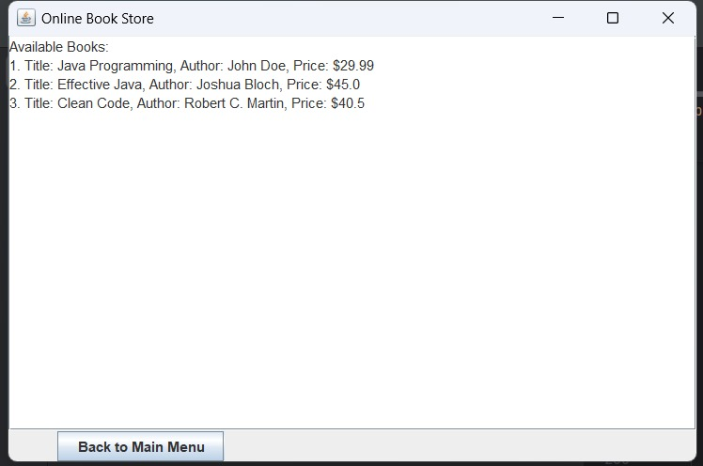
RESULTS AND DISCUSSION

Slide 11
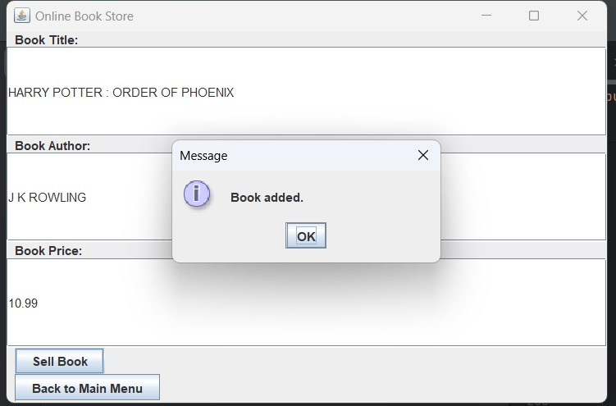
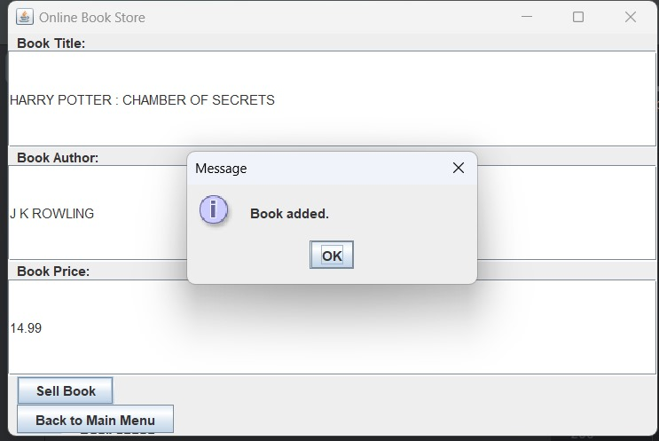
RESULTS AND DISCUSSION

Slide 12
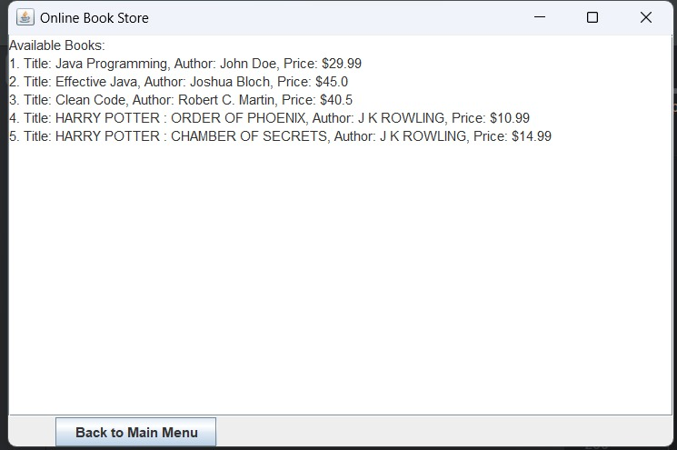
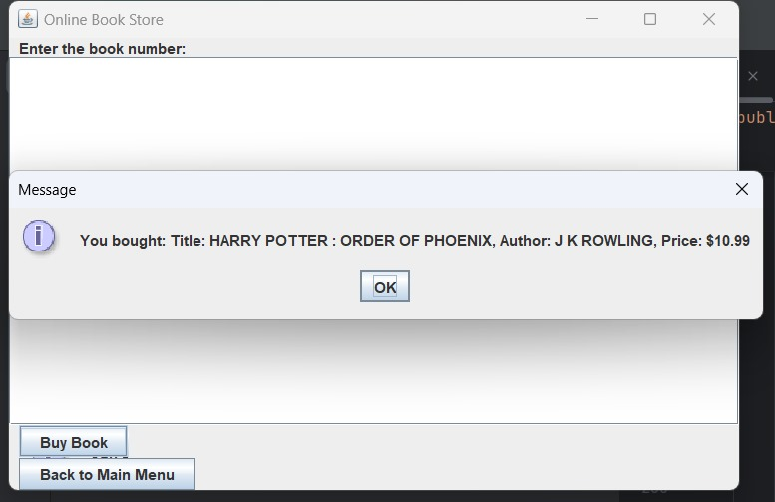
RESULTS AND DISCUSSION

Slide 13
THANK YOU

