Slide 1
Secure Authentication and Authorization of IoT Resources based on Blockchain Technology
Design Secure Networking & Computer Systems (SYSC5500F), Fall 2019
Final Presentation
Presented By: Dana Haj Hussein
Ragunath Anbarasu

Slide 2
Outline:
Scope
Proposed IoT Security System
Threat Model
Results
Conclusion

Slide 3











Scope
IoT platforms (e.g. Smart homes), enable clients remote connectivity to read data and/or control IoT device functionalities.
Security requirements are very critical !
Clients authentication and authorization
Enforcing access control policies
IoT data integrity and confidentiality when transmitting to the clients
Resource Owner
Clients
Security Requirements
?
Resource Server
IoT Resources
IoT Resources

Slide 4
Proposed IoT Security System
Deploying a private blockchain network that:
uses the authentication and authorization in constrained environment (ACE) frame work proposed by the IETF to allow third party access.
enforces access control policy by introducing an Authorization Sensitivity factor (AuthSf) to provide three classes of access privileges.
Class 1, IoT-Control Authorization
Class 2, Real-Time IoT Data Visualization
Class 3, Restricted IoT Data Visualization
AuthSf
Resource Owner
Clients
Authorization Blockchain Network
Resource Server
IoT Resources

Slide 5
Threat Model
Assumptions:
Passwords are distributed to authorized clients through out-of-bound communication.
Based on agreement, clients are assigned with an AuthSf that is used to determine their access privileges.
Attack:
An insider compromises Class 3 accounts and lunches a DDoS attack on the application layer by continuously requesting access token to higher level privileges
Mitigation Method :
Using modifier functions in the smart contract to restrict function calls to authorized Class 1 clients.
Class 3
DDoS
Authorization Blockchain Network
Class 2
Class 1
Resource Server
IoT Resources
Legitimate Client Requests
Authentication Privileges of IoT Clients

Slide 6
Implementation: Overview
Blockchain network: Ethereum geth 1.9.5 private network
Security policy: Smart contract in Solidity 0.5.0 v
Resource Server: Raspberry Pi3
Clients & Resource Owner: Windows 10
Attacker: Ubuntu 64-bit 18.04v

Slide 7
Implementation: Blockchain Network Interaction
Resource Owner publishes a smart contract with:
Client addresses mapped to hash passwords & AuthSf
A client calls the function AddToken to request an access token and provides its password.
*
client initiates a transaction to the RS with the Token
Function AddToken
Input argument Password
Function:
Init.Auth
Init.Access_Control
Function:
UsersToken.
Input argument address
Resource server calls UsersToken function to verify the Token
Authentic-ation
Successful
Update UsersToken function
Access Control
Token is generated. Token:(RS_add, Client_add, AuthSf)
Else
Successful
Authentication Failed
Access is provided
*

Slide 8
Results: System Performance Under DDoS Attack

Slide 9
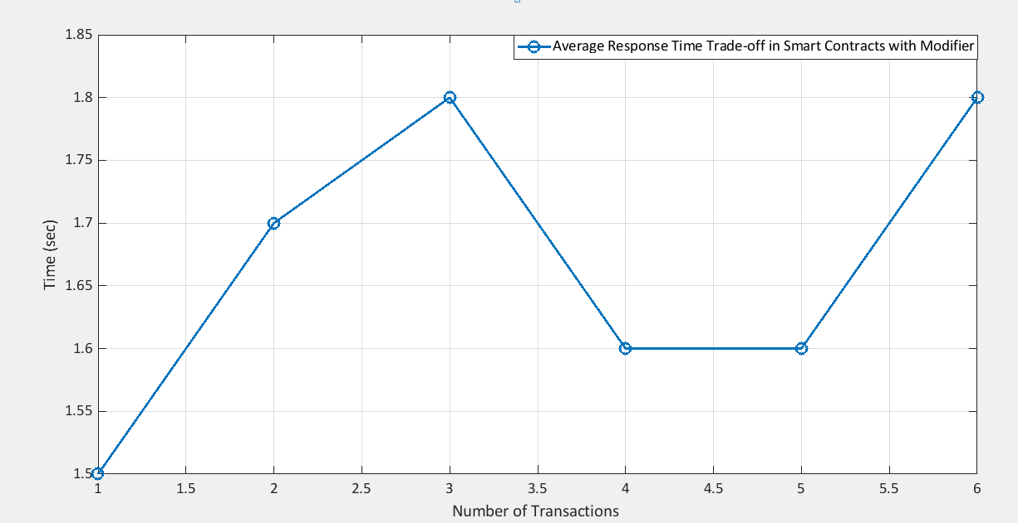
Results: Modifier Function Performance Trade off
Maximum | Average | Minimum
1.8 sec | 1.7 sec | 1.5 sec

Slide 10
Results: Main Findings
By deploying the mitigation method, the system is robust to DDoS attack.
the average response time does not increase compared to the system without a modifier function
The consumed gas per transaction of the DDoS attack increased significantly when using the mitigation method.
An attacker needs more computational power to lunch a DDoS attack if the modifier function is used compared to the system without a modifier.
The trade off in system performance when using the modifier function is an average increase of 1.7 sec in the response time.

Slide 11
Conclusion
A system for secure authentication and authorization of third party access is presented.
The system is implemented using Ethereum blockchain platform
The performance of the system is studied under a DDoS attack in terms of the average response time.
The results illustrate the robustness of the system under a DDoS attack.
An average of 1.7 sec delay trade-off in the response time is caused by the deployment of the mitigation method in the smart contract

Slide 12

Questions

