Slide 1

AMAZON FOOD REVIEW ANALYSIS (SENTIMENTAL ANALYSIS)
Afreen Banu & G. Raguwing

Slide 2
AGENDA
Life Cycle
Problem Statement
Objective of the Project
Exploratory Data Analysis
Data Preprocessing
Model Building and Evaluation
Challenges Faced
Conclusion
Q&A

Slide 3
PROJECT LIFE CYCLE
Business
understanding
Exploratory Data Analysis
Data Preparation
Build the Model
Evaluation Metric

Slide 4
PROBLEM STATEMENT/OBJECTIVE
The aim here in this ML Project is to predict the score for the given text_review by an individual for the product they brought on Amazon.
Perform data preprocessing on the given text data and convert it into numerical vectors.
Build models to predict the Score of a given text review.
Notes:
Key Problem statements:
Show the client some nice analysis on the given data.
Show the client comparison of various ML models.
Model that we built should be light for deployment.
Model that we built should have very less latency.

Slide 5
Data-Descripition
Description:
This dataset consists of reviews of fine foods from amazon. The data span a period of more than 10 years, including all ~500,000 reviews up to October 2012. Reviews include product, user information, score, and a plain text review. It also includes reviews from all other Amazon categories.
Sentiment Analysis:
It is a task of identifying whether the opinion expressed in a text is positive or negative.

Slide 6

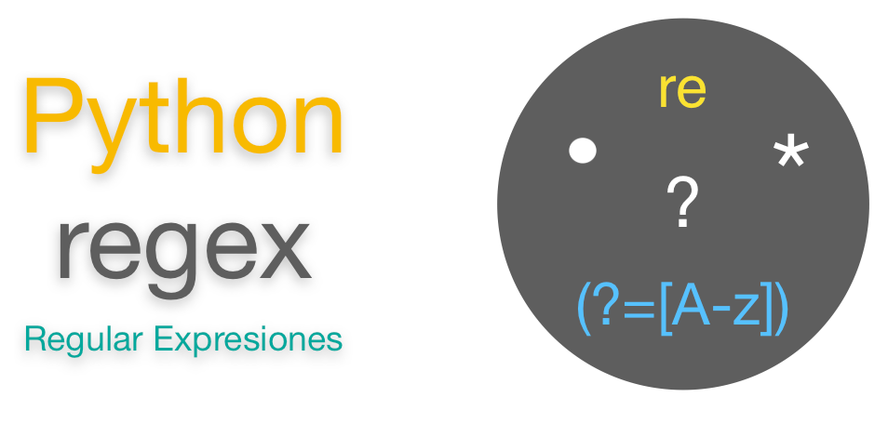

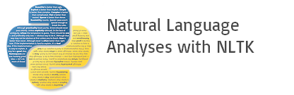




Libraries and Resources

Slide 7
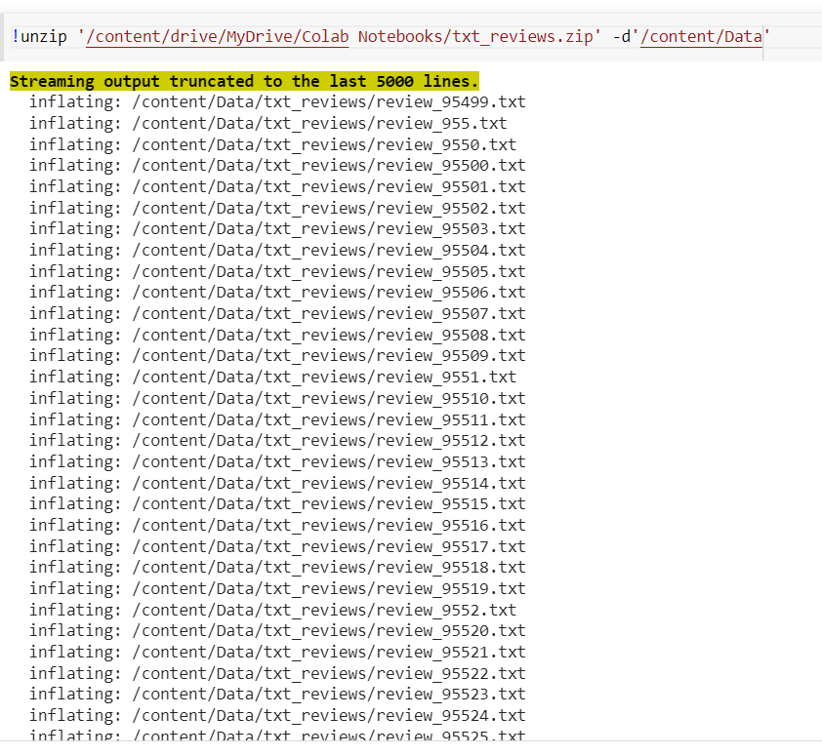
Dataset

Slide 8
Exploratory Data Analysis
Data Cleaning Steps
Data Manipulation Steps

Slide 9
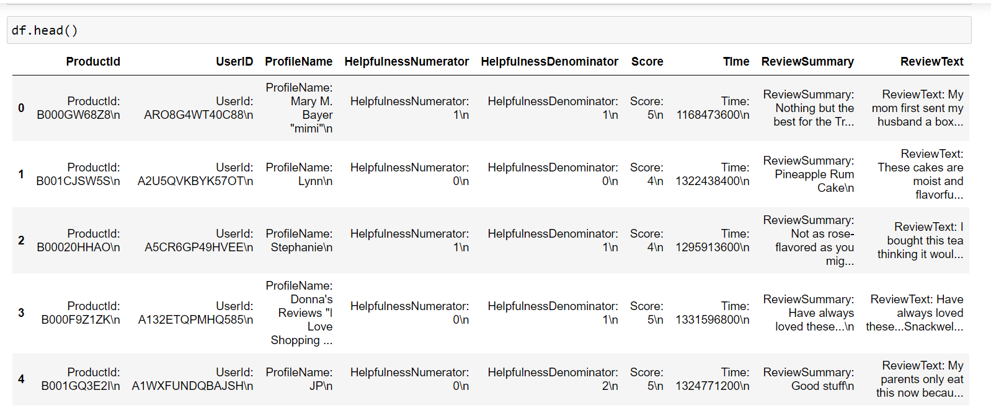
Raw Data-Frame: Before cleaning
Insert the Data frame screen shot here after extraction from the text documents provided to us.

Slide 10
Data Cleaning Steps
Removed Duplicate values.
Drop the Column.(Unnamed: 0)
Data type conversion.
Concatenation

Slide 11
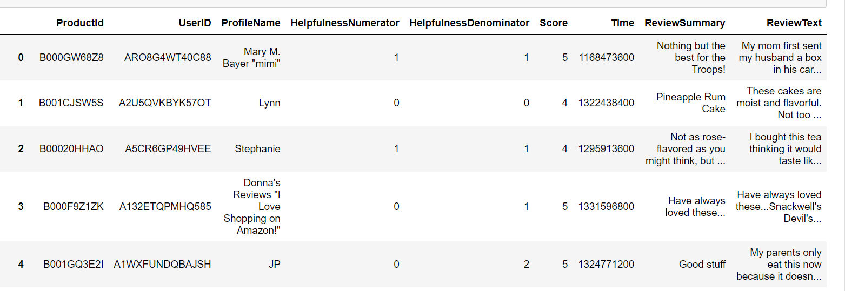
Data-Frame: After cleaning

Slide 12
Data Visualization:
The aim of the EDA is to explore the data to find insights or clues that generate hypothesis for the problem statement.
EDA plays a crucial role in understanding the 3 characteristics of Problem Statement :
→ Why do we need a problem statement.
→ What is the problem statement.
→ How to resolve the problem statement.

Slide 13
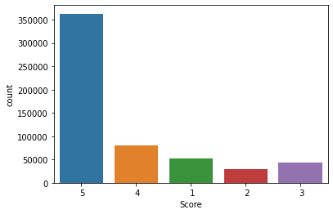
Distribution of Score-1
Observation: The ‘Score -5’ has more number of counts and the least count has ‘Score-2’ .

Slide 14
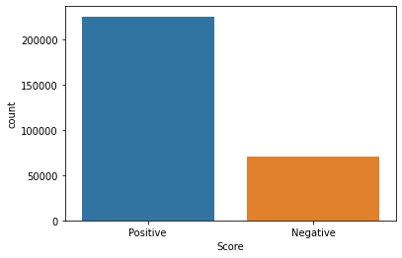
Distribution of Score-2
Observation: The ‘Score -Positive’ has more number of counts and the least count has ‘Score-Negative’ .

Slide 15
Data pre-processing Steps:
Split the Data into train and test
Tokenization
Case conversion
Remove all the Special characters
Remove stop words
Root form
Applying Transformation:
Bag of word / TFIDF Representation
To Convert Text data to Numerical vectors

Slide 16
Model Building and Evaluation
Problem:
Target variable - Score.
ML Type- Supervised learning.
Task - Classification
Evaluation Metric- Accuracy
Classification Algorithms:
Logistic Regression
KNearestNeighbor classifier
Decision Tree classifier
Ensemble:
Random Forest
Ada Booster
GBDT

Slide 17
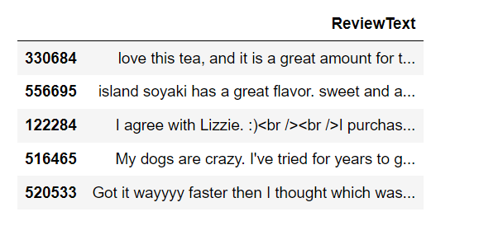
Experiment-1 (Review-Text & Score)

Slide 18
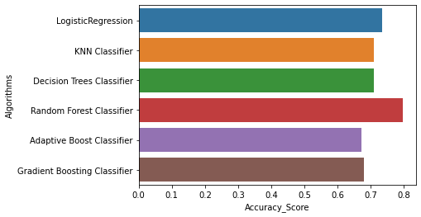
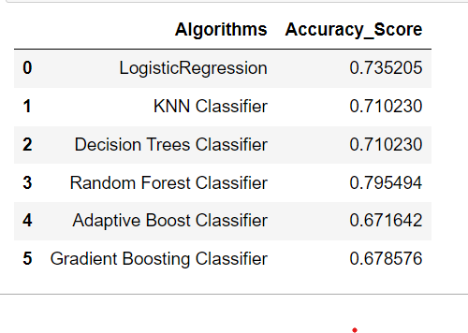
Experiment-1
​
Conclusion:
The best algorithm for predicting "Output- Score" is the Random Forest Classifier; it has a maximum accuracy of 79.5%.

Slide 19
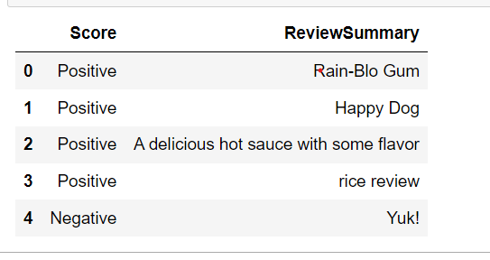
Experiment-2 (Review-Summary & Score)

Slide 20
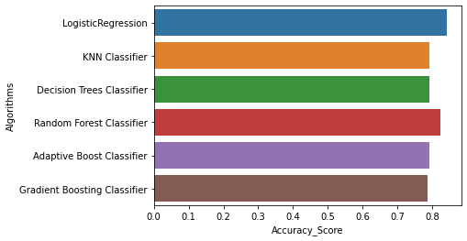
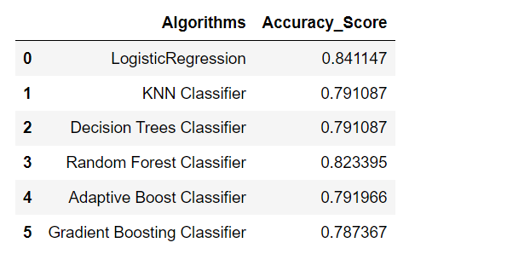
Experiment-2
Conclusion:
The best model for "Output- Score" prediction is the Logistic Regression Classifier algorithm, which has a maximum accuracy of 84.11%.

Slide 21
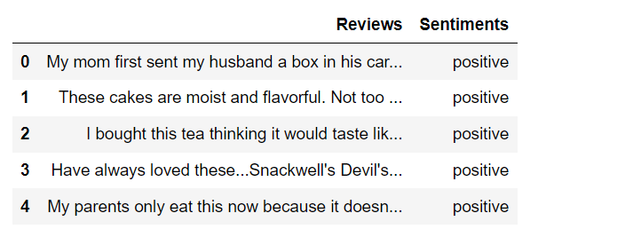
Experiment-3 (Review-Summary, Review-Text & Sentiments)

Slide 22
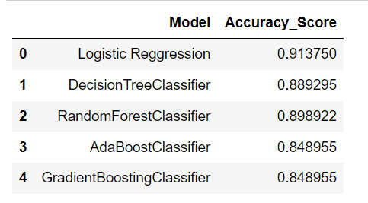
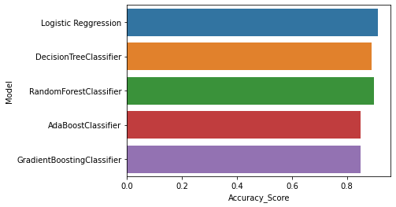
Experiment-3
Conclusion:
The best algorithm for predicting "Output- Score" is Logistic Regression Classifier; it has a maximum accuracy of 91.3%.

Slide 23
Challenges Faced
When I attempted to import the zipped data, I ran across an issue.
It took me longer to import the data and develop the model because there are more than 5 lakh rows in the data.

Slide 24
CONCLUSIONS:
We've seen how sentiment analysis can be used to examine customer opinions in product reviews.
The best algorithm for predicting "Output- Score" is Logistic Regression Classifier; it has a maximum accuracy of 91.3%.
Compared to other models, this one has an extremely low latency.

Slide 25
Q & A Slide

Slide 26

THANK YOU

