Slide 1
Custom Federated Learning Experiment
Experiment setup
Experiment loop used in Colab
How the custom framework was evaluated before reporting power, memory, and complexity
Setting
Value
Setting
Value
Framework
AshwinRJ/Federated-Learning-PyTorch
Dataset
CIFAR-10, IID split
Backend
PyTorch
Clients
20 simulated clients
Model
CNNCifar
Selection
5 clients per round
Each Client Sample Size
2500
Training
1 local epoch, batch 64
Rounds
20 global rounds
Total updates
100 local client updates
static computational-complexity measurement:
62,006 trainable parameters
0.237 MB model size
651,720 MACs per image
1,303,440 estimated forward FLOPs per image
Aggregation
FedAvg
Measurement
RSS + CodeCarbon + THOP
Server sends global model → clients train locally → model weights return → FedAvg updates the global model.
This supports the project validation strategy: simulate federated learning across public datasets before real MCU deployment.
Custom PyTorch FL on CIFAR-10 • Colab host-process measurements
2

Slide 2
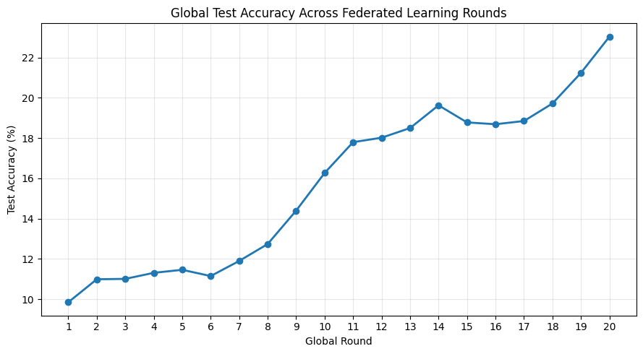
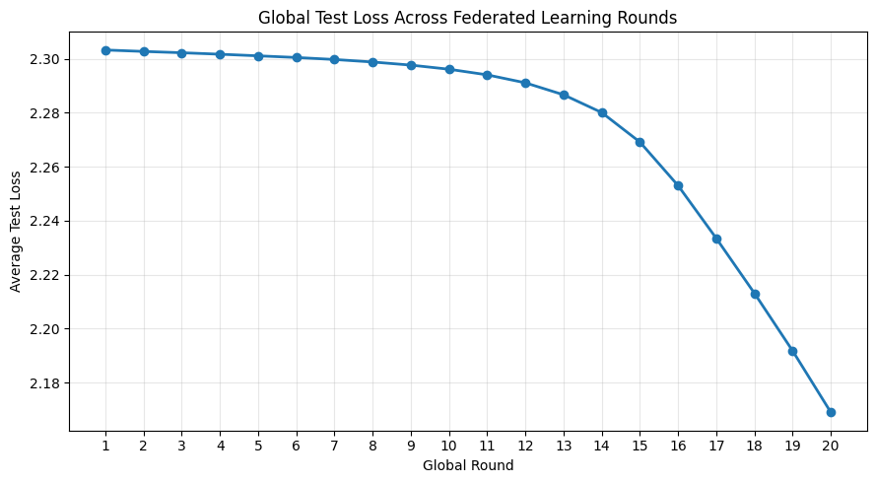
Custom Federated Learning Experiment
CIFAR-10 resource measurement using a custom PyTorch FL framework
23.04%
13.74 W
752.52 MB
260.69B
Final test accuracy after 20 global rounds
Estimated average host-process power
Maximum host-process peak RSS
Total estimated forward FLOPs
Bottom line: the FL loop completed 100 local client updates and showed a clear upward learning trend, while recording power, memory, runtime, and communication cost.
Custom PyTorch FL on CIFAR-10 • Colab host-process measurements
1

Slide 3
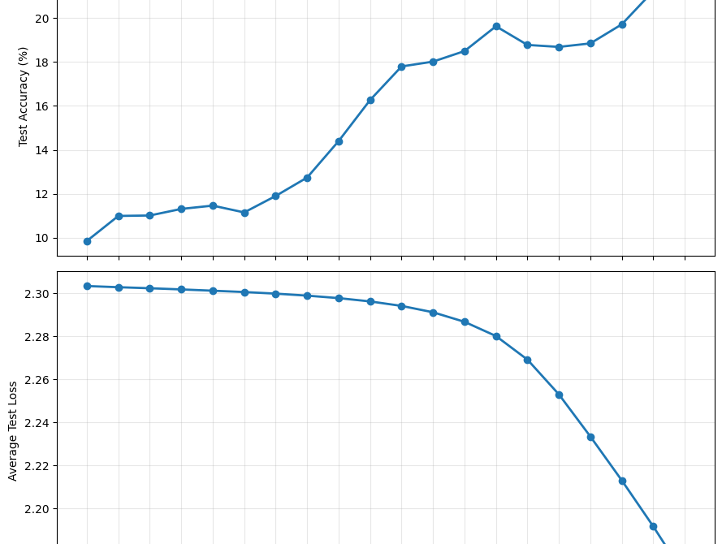
Learning convergence
Accuracy improved and loss decreased across 20 global rounds
Key readout
9.85% → 23.04%
Test accuracy increased from round 1 to round 20
2.3033 → 2.1689
Average test loss decreased after correction
+13.19 points
Net accuracy improvement over 20 rounds
Learning trend is clear but not converged yet. This result validates the measurement pipeline; more rounds/seeds are needed for publication-grade accuracy.
Custom PyTorch FL on CIFAR-10 • Colab host-process measurements
3

Slide 4
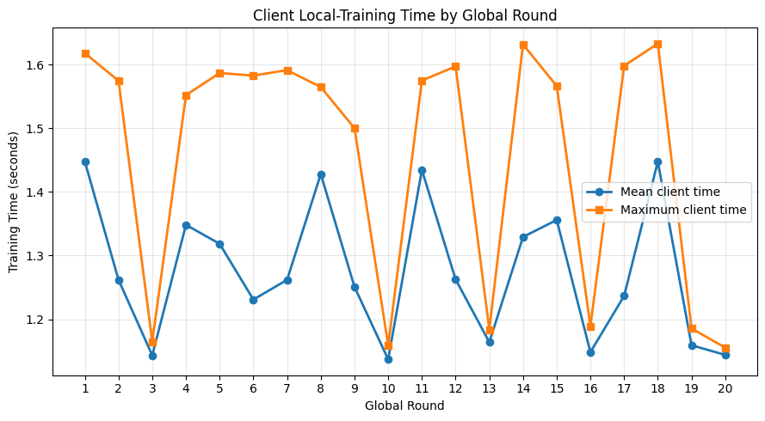
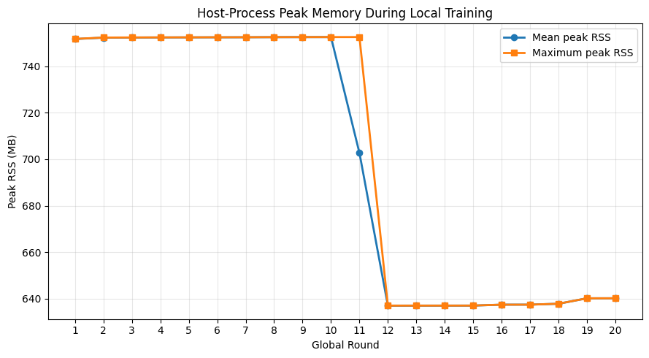
Resource profile
Host-process power, memory, time, and communication measurements
Report-ready resource table
Metric
Final value
Total FL-loop runtime
214.42 s
Mean client training time
1.275 s
Estimated energy
2,946.29 J
Estimated average power
13.74 W
Max host-process RSS
752.52 MB
Total raw communication
47.31 MiB
Interpretation
Power and memory are Colab host-process estimates. They do not represent direct MCU power or SRAM. They are still useful for comparing framework-level compute cost before hardware deployment.
Custom PyTorch FL on CIFAR-10 • Colab host-process measurements
4

Slide 5
Final table for report
Compact summary for your presentation or write-up
Category
Result
Scope / limitation
FL configuration
20 clients, 5/round, 20 rounds, 100 updates
IID CIFAR-10 simulation
Learning
23.04% final accuracy; 2.1689 final loss
Not fully converged
Power
2,946.29 J; 13.74 W average
CodeCarbon host-process estimate
Memory
752.52 MB max peak RSS
Python/PyTorch host memory, not MCU SRAM
Model size
62,006 params; 0.237 MiB
Raw parameter storage
Compute
130.344B MACs; 260.688B forward FLOPs
Forward-only, excludes backward/SGD
Communication
47.31 MiB total raw model exchange
No protocol/serialization overhead
Recommendation for final explanation
“This experiment validates the FL measurement pipeline. For publication, the next step is to repeat with more seeds/rounds and physical MCU power measurement.”
Custom PyTorch FL on CIFAR-10 • Colab host-process measurements
5

