Slide 1
Diverse Approaches to Emotion Detection
CSE – 4120
Technical and Writing Seminar
Presented by:
MST. Rubaiya Raktin Raha
Roll:1907111
Presented to:
Dr. K. M. Azharul Hasan,
Professor
Sunanda Das, Assistant Professor
Department of Computer Science and Engineering Khulna University of Engineering & Technology (KUET)

Slide 2
Source
Table 1: Publication Details
Serial No | Title | Author | Source | Published Year
1 | Textual emotion detection utilizing a transfer learning approach | Mahsa Hadikhah Mozhdehi, AmirMasoud Eftekhari Moghadam | The Journal of Supercomputing, Volume 79, pages 13075–13089, Springer | 2023
2 | Emotion Recognition from Microblog Managing Emoticon with Text and Classifying using 1D CNN | Md. Ahsan Habib, M. A. H. Akhand and Md. Abdus Samad Kamal | Journal of Computer Science, 18(12), Pages 1170-1178, arXiv | 2022
3 | Emotion detection from touch interactions during text entry on smartphones | Surjya Ghosh, Kaustubh Hiwarea, Niloy Gangulya, Bivas Mitraa, Pradipta De | International Journal of Human-Computer Studies Volume 130, Pages 47-57, Elsevier | 2019

Slide 3
Outline
Introduction
Related works
Methodology
Result Analysis
Comparative Discussion
Recommendation
Conclusion
References

Slide 4

Introduction
Emotion Detection Overview:
Emotions play a key role in human communication, impacting interactions, decisions, and well-being

Slide 5
Introduction(contd..)
Significance of Emotion Detection
Detecting emotions can improve
Customer service,
User experience,
Mental health support,
Marketing
Personalized communication

Slide 6
Introduction(contd..)
Purpose of this presentation
Our goal is to explore how different techniques tackle emotion detection, emphasizing their strengths, limitations, and real-world applications

Slide 7
Related Works

Slide 8
Related Works
Table 2:Related work & remarks
Name & Reference | Authors | Remarks
LSTM[4] | Hochreiter S, Schmidhuber J | designed to remember information for long periods. can be computationally intensive and prone to overfitting
GRU[5] | Rahul Dey; Fathi M. Salem | simplified version of LSTMs might not always capture as much contextual information as LSTM
RNN Encoder–Decoder[6] | Cho K, Van Merriënboer B, Gulcehre C, Bahdanau D | comprises two RNNs; one encodes sequences into vectors, and the other decodes these vectors back into sequences.

Slide 9
Related Works(contd..)
Table 2:Related work & remarks
Name & Reference | Authors | Remarks
BiLSTM[7] | Wei, W., Zhang, Y., Duan, R., & Zhang, W | process sequences in both forward and backward directions increased computational requirements
SENN[8] | Batbaatar et al. | includes both CNN and BiLSTM
Touch Interactions[9] | Matteo Ciman and Katarzyna Wac | Better User Privacy but less accuracy

Slide 10
Methodology

Slide 11
Comparative Methodology Overview
Data Source:
Paper 1 (Transfer Learning for Textual Emotion Detection)
Text data from tweets (Wang and MELD datasets).
Paper 2 (Emotion Detection from Touch Interactions)
Touch interaction data from smartphone keyboards from a field study involving 22 participants for 3 weeks.
Paper 3 (Emotion Recognition from Microblogs with 1D CNN)
Microblog data, including text and emoticons, from Twitter.

Slide 12
Comparative Methodology Overview(Contd..)
Table 3: Methodology Analysis
Component | Paper1 | Paper2 | Paper3
Data Preprocessing | Stopwords remove, Lowercased,BERT tokenization | Typing and swiping sessions - Feature extraction (e.g., typing speed, touch pressure) | Text cleaned, Usernames, hashtags removed, Emoticons converted to text
Model Construction | EmotionalBERT with BERT's pre-trained model and softmax layer | Personalized machine learning model using touch-based features | 1D Convolutional Neural Network (CNN) with multiple layers
Experiments | Experiments with varying training data amounts | 3-week study with 22 participants | Data split into training and test sets, followed by CNN training

Slide 13
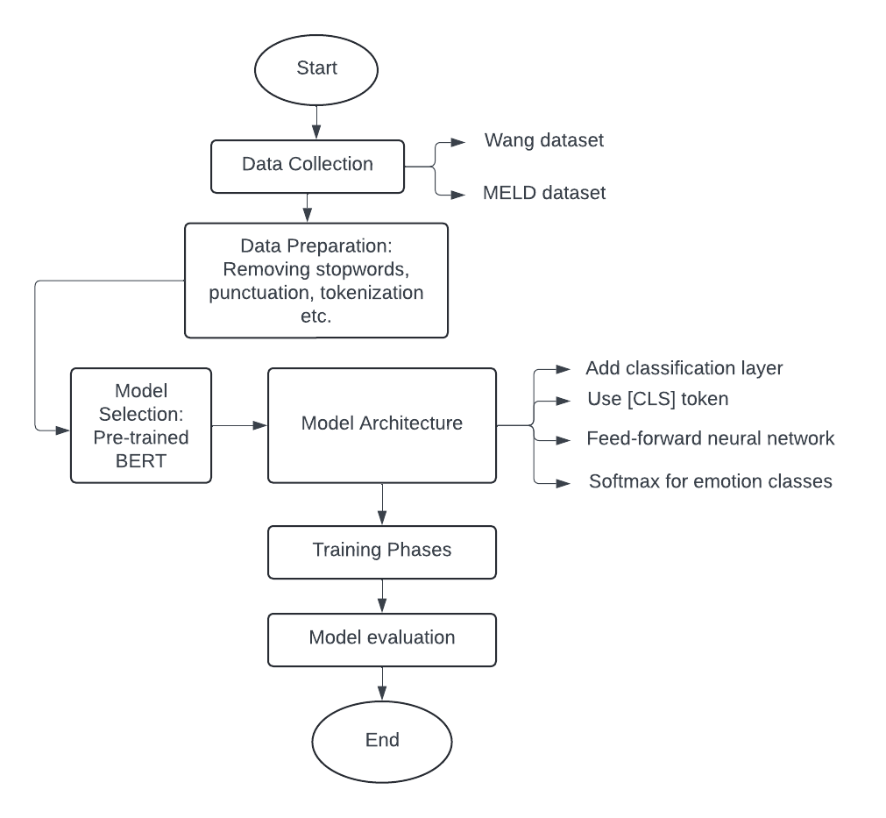
Methodology of paper1(contd..)
Figure 1.1: methodology of paper 1

Slide 14
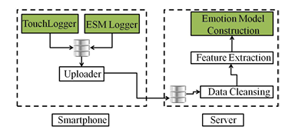
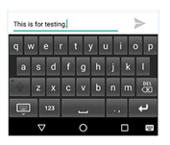
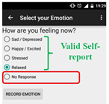
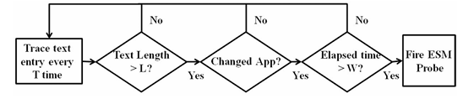
Methodology of paper2(contd..)
Fig.1.2.TouchSensearchitecture
Figure 1.3. ESMLogger implements hybrid ESM for collecting emotion labels. We set the values of the config parameters T, L, W as 15 sec, 80 characters and 30 min respectively.
Fig. 1.4. TouchSense self-report collection interface.

Slide 15
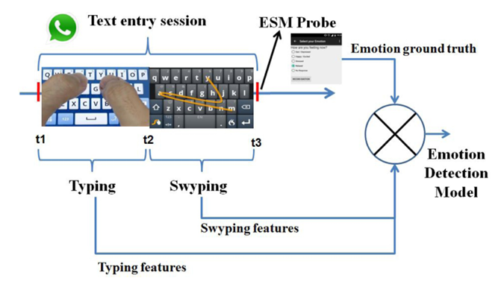
Methodology of paper2 (contd..)
Figure 1.5: methodology of paper 2

Slide 16
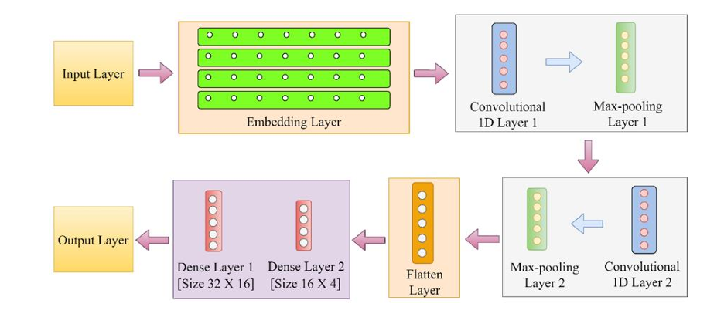
Methodology of paper 3 (contd..)
Figure 1.6: Architecture of 1D CNN

Slide 17
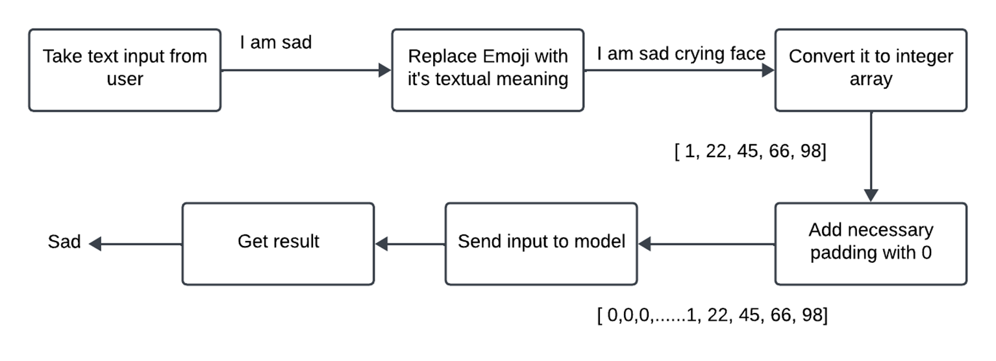
Methodology of paper 3 (contd..)
😢
Figure 1.7: methodology of paper 3

Slide 18
Result Analysis

Slide 19
Result Analysis:
Paper 1 (Transfer Learning for Textual Emotion Detection)
Achieves 60.87% accuracy using the IEMOCAP dataset and 86% F1 score in WANG dataset.
Significantly outperforms current state-of-the-art models in real-time emotion prediction.
Paper 2 (Emotion Detection from Touch Interactions)
obtain an average accuracy (AUCROC) of 73%(std dev. 6%)and a maximum of 87% in a 3-week in the-wild study
Paper 3 (Emotion Recognition from Microblogs with 1D CNN)
Achieves 88.00% accuracy on the twitter dataset and outperform every other models that has been tested with it.

Slide 20
Comparative discussion

Slide 21
Comparative Discussion
Table 4: Comparative Discussions
Aspect | Paper1 | Paper2 | Paper3
Strength | Transfer learning: using pre-trained model allows better performance. Very efficient, fewer training epochs Multilingual potential | Non-Intrusive and natural approach Doesn't require explicit user input High accuracy: 73% Gives realistic insights | Combined Text and Emotion High accuracy: 88% Robustness and scalable Outperforms every existing model
Weakness | Model complexity: Difficult to understand Dataset Dependency Emoticon Limitation | Limited emotional state(4) Small sample size Not generalized | Emoticon Ambiguity: can have multiple meaning Limited Emotional state(4)

Slide 22
Comparative Discussion
Table 4: Comparative Discussions
Aspect | Paper1 | Paper2 | Paper3
Performance Metrics | F1-score, accuracy, and comparisons with RNN-based models | Average accuracy (AUCROC), F-score | Accuracy metrics, comparisons with other emotion detection methods
Applications | Text-based sentiment analysis, Social media monitoring | Emotion detection in smartphone-based applications | Social media sentiment analysis, Microblog emotion detection

Slide 23
Recommendation

Slide 24
Recommendation
The 1st paper ( Transfer learning - BERT model ) is the most convenient and effective as this approach shows significant advantages in terms of
Accuracy
Efficiency
Scalability
But if the requirement is ->
smartphone-based applications and need real-time emotion detection,
Then the 2nd paper (ED from touch interactions) is better.
Need to include emoticon and have to have high accuracy in detecting emotion then
Then the 3rd paper (CNN model) is better.

Slide 25
Conclusion

Slide 26
Conclusions
We explored three distinct methods for emotion detection
Each approach offers unique strengths and is suitable for different applications.
Innovation will lead to more accurate and versatile methods.

Slide 27
References:
Hadikhah Mozhdehi, Mahsa, and AmirMasoud Eftekhari Moghadam. "Textual emotion detection utilizing a transfer learning approach." The Journal of Supercomputing 79.12 (2023): 13075-13089.
Ghosh, Surjya, Kaustubh Hiware, Niloy Ganguly, Bivas Mitra, and Pradipta De. "Emotion detection from touch interactions during text entry on smartphones." International Journal of Human-Computer Studies 130 (2019): 47-57.
Habib, Md Ahsan, M. A. H. Akhand, and Md Abdus Samad Kamal. "Emotion recognition from microblog managing emoticon with text and classifying using 1d cnn." arXiv preprint arXiv:2301.02971 (2023).

Slide 28
References(contd..)
Hochreiter S, Schmidhuber J (1997) Long short-term memory. Neural Comput 9(8):1735–1780.
Dey, Rahul, and Fathi M. Salem. "Gate-variants of gated recurrent unit (GRU) neural networks." 2017 IEEE 60th international midwest symposium on circuits and systems (MWSCAS). IEEE, 2017.
Cho K, Van Merriënboer B, Gulcehre C, Bahdanau D, Bougares F, Schwenk H, Bengio Y (2014) Learning phrase representations using rnn encoder-decoder for statistical machine translation. Conference on Empirical Methods in Natural Language Processing, EMNLP

Slide 29
References(contd..)
Wei, Wenjie, et al. "Microblog sentiment classification method based on dual attention mechanism and bidirectional LSTM." Chinese Lexical Semantics: 20th Workshop, CLSW 2019, Beijing, China, June 28–30, 2019, Revised Selected Papers 20. Springer International Publishing, 2020.
Batbaatar, Erdenebileg, Meijing Li, and Keun Ho Ryu. "Semantic-emotion neural network for emotion recognition from text." IEEE access 7 (2019): 111866-111878.
Liu, M., Xu, M., & Tang, T. (2021). Association between chemotherapy and prognostic factors of survival in hepatocellular carcinoma: a SEER population-based cohort study. Scientific reports, 11(1), 23754.

Slide 30
Thank You

Slide 31

Any Questions?

