Slide 1

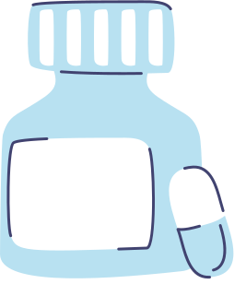




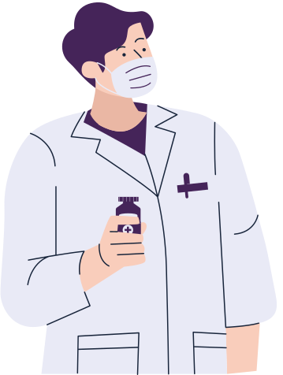
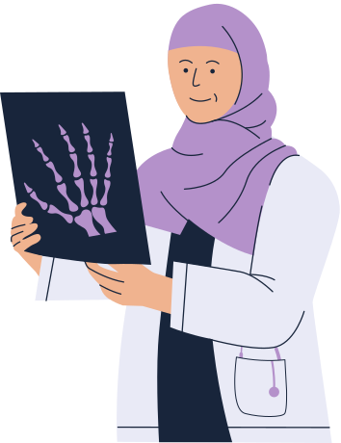


Rahaf Naser 1201319
Rania Rimawi 1201179
Ethics of medical applications

Slide 2
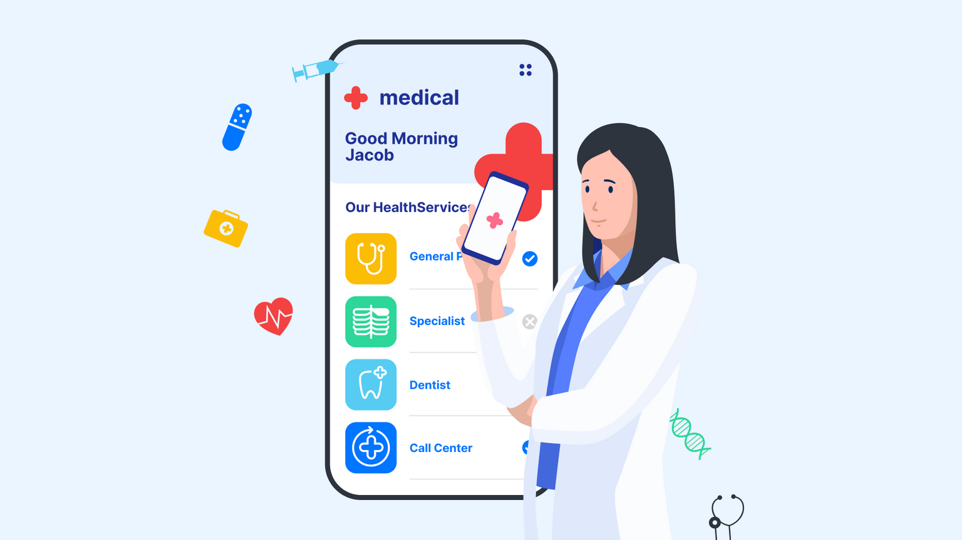
Intoduction
The introduction of this project sheds light on the ethics of medical applications, main principles of ethics in medical applications, exploring examples, benefits, disadvantages, moral dilemmas, and ethical frameworks. Kantian ethics, act utility, and utilitarianism .The implications for the medical profession will also be discussed.

Slide 3
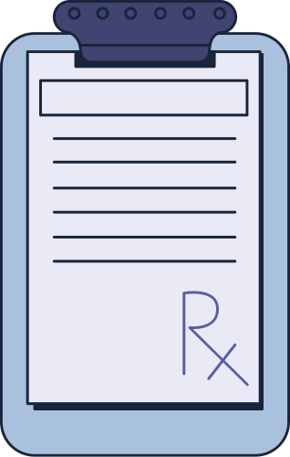
1)Respect and independence
2)Justice
3)Charity
4)Do no harm
5)Privacy and confidentiality
Main principles of ethics in medical applications

Slide 4
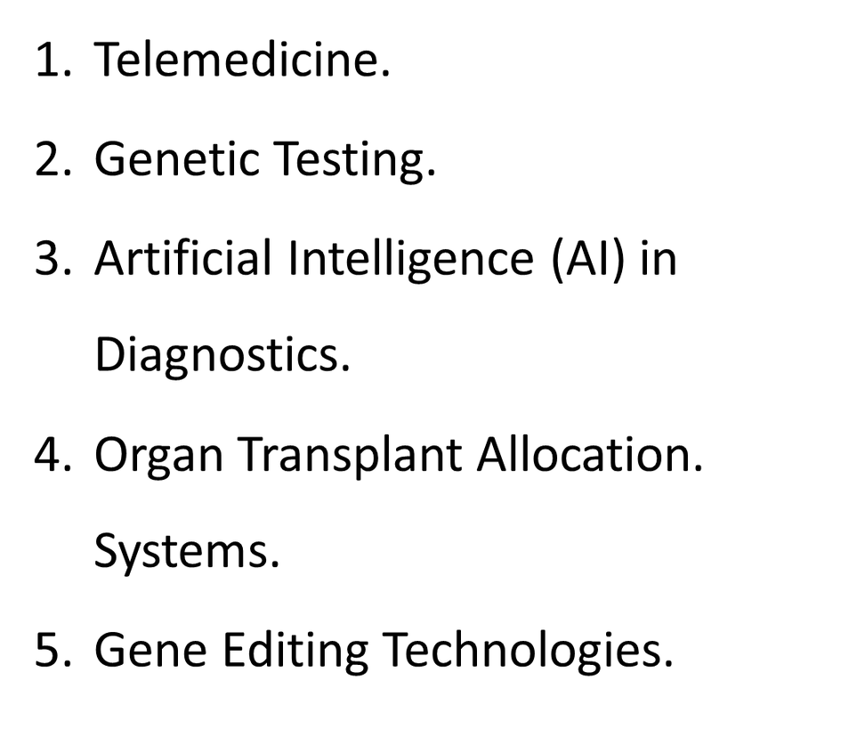
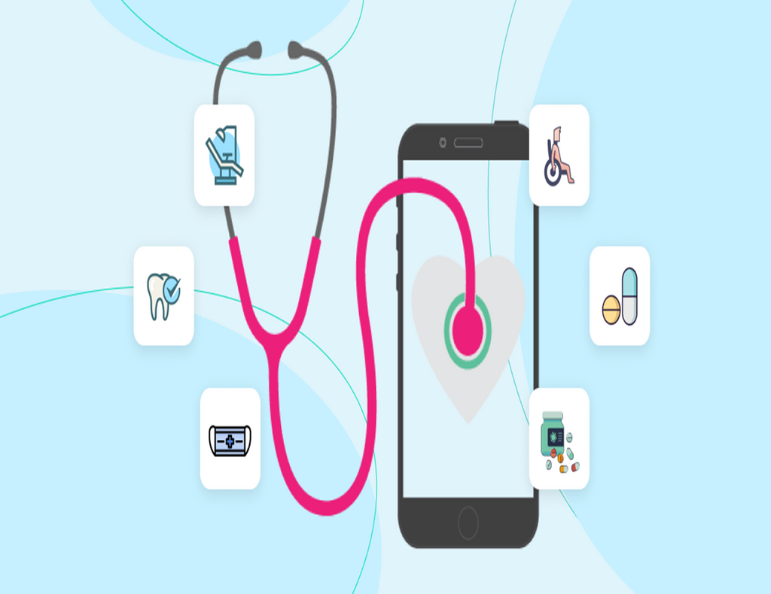
EXAMPLES OF MEDICAL APPLICATIONS:

Slide 5
Benifits
01
02
Improved patient outcomes and quality of cares .
Increased accessibility to healthcare services, particularly for underserved areas.
03
04
Enhanced accuracy and efficiency in diagnostics, leading to early detection and treatment.
Personalized medicine based on genetic information, optimizing treatment plans.

Slide 6
Disadvantages
01
02
Privacy and data security concerns when dealing with sensitive patient information.
Increased reliance on technology, potentially reducing human interaction and empathy.
03
04
Unequal access to medical applications due to socioeconomic disparities.
Ethical concerns related to genetic manipulation and the potential for designer babies.

Slide 7

MEDICAL APPLICATIONS RAISE MORAL DILEMMAS
•Should genetic testing be used to determine employability or insurance coverage?
•Should AI algorithms be trusted to make life-or-death decisions in medical settings?
•Is it ethically justifiable to edit the genes of embryos to prevent hereditary diseases?

Slide 8
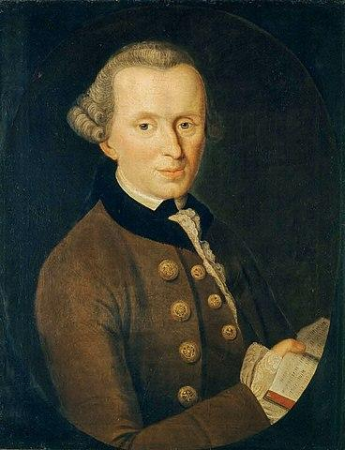
Kantiantianism
Ethical frameworks
Emphasizes respect for human dignity and moral duty.
Focuses on moral actions based on principles, regardless of consequences.
Prioritizes absolute respect for individuals and fulfillment of ethical duties.

Slide 9
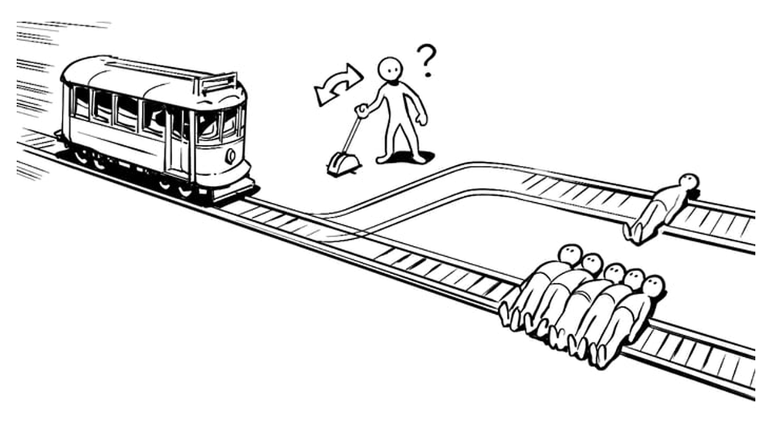
Act Utilitarianism
Ethical frameworks
Seeks to maximize overall benefit for the most people.
Involves analyzing outcomes for each action.
Guides decisions based on maximizing utility in areas like resource allocation or treatment selection.

Slide 10

Rule utilitarianism
Ethical frameworks
Aims to maximize overall happiness or utility.
Promotes decisions that enhance general welfare and reduce suffering.
Guides health policy and app design for public safety and health improvement.

Slide 11

IN TERMS OF THE PROFESSION:
Healthcare professionals have a professional responsibility to ethically utilize medical applications.

Slide 12
Conclusion
Medical ethics plays a vital role in guiding medical practices and ensuring that healthcare is provided in a manner that respects the dignity and rights of patients.
Contemporary challenges, such as the use of new technologies and clinical research, require a careful balance between achieving benefits and avoiding harms, while adhering to the principles of justice and respect.

Slide 13
Thank you for your attention!

