Slide 1


COOP OPEN DAY PRESENTATION
Jadah Hail Digital: Smart Tourism Guide Integrated with Tawakkalna Municipality Services
Student Name
Student ID
Rahaf Bader Alzabni
Academic Supervisor
s202005878
[Supervisor Name]

Slide 2
Introduction
The training was completed at Hail Municipality’s Technology Department within the Digital Transformation Agency, supporting national Vision 2030 efforts through Tawakkalna municipal services. The program covered IT governance, digital service standards, and technical tasks including data handling, development, testing, and reporting. The main outcome was the “Jadah Hail Digital” project, a smart tourism guide showcasing Hail’s landmarks and enhancing the municipality’s digital service ecosystem.

Slide 3
Hail Municipality | Digital Transformation Agency
Tasks During COOP Training
During the digital‑transformation phase at Hail Municipality, the work focused on improving the quality of municipal digital services and organizing scattered tourism data into a structured, accessible format. My tasks included collecting and validating tourism information, preparing periodic digital reports, and supporting data organization for decision‑making. As the project progressed, I contributed to developing the tourism guide, which later evolved into Jadah Hail Digital, a unified smart‑tourism service. The platform received direct engagement from the municipality and was connected with external partners—including tourism and culture authorities—to ensure accurate information and enhance the overall visitor experience.

Slide 4
Hail Municipality | Digital Transformation Agency
Experiences from COOP Training
The COOP training provided hands‑on exposure to the digital‑transformation efforts at Hail Municipality, particularly in enhancing the delivery of municipal digital services.
I gained experience in organizing and documenting tourism data, preparing structured digital reports, and understanding how information moves across departments. As the project progressed, I contributed to evolving the initial tourism guide into Jadah Hail Digital, a more advanced smart‑tourism service.
The work included ongoing coordination with the municipality and external entities—such as tourism and culture authorities—to ensure accurate data and stronger integration, which increased the platform’s impact and usefulness for visitors.

Slide 5
Hail Municipality | Digital Transformation Agency
COOP Project: Jadah Hail Digital — Results
The project delivered a fully functional smart‑tourism platform for Hail, enabling visitors to browse landmarks, events, and suggested routes, explore locations through an interactive map, read descriptions and visitor reviews, use a tourism assistant, and access an admin dashboard for municipality staff. The platform provides structured digital content and aligns with the municipality’s digital‑transformation objectives. Future enhancements include deeper integration with Tawakkalna, expanding tourism content to include more landmarks and seasonal events, and enabling seamless mobile access to improve the visitor experience.

Slide 6
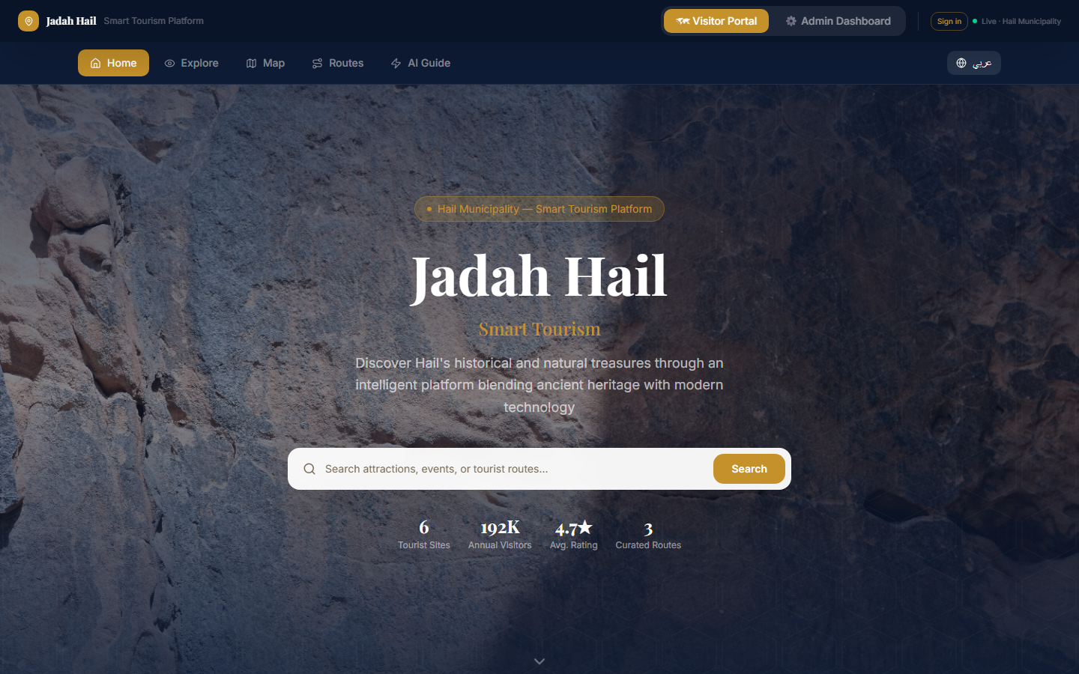
Visitor Portal — Home Page

Slide 7
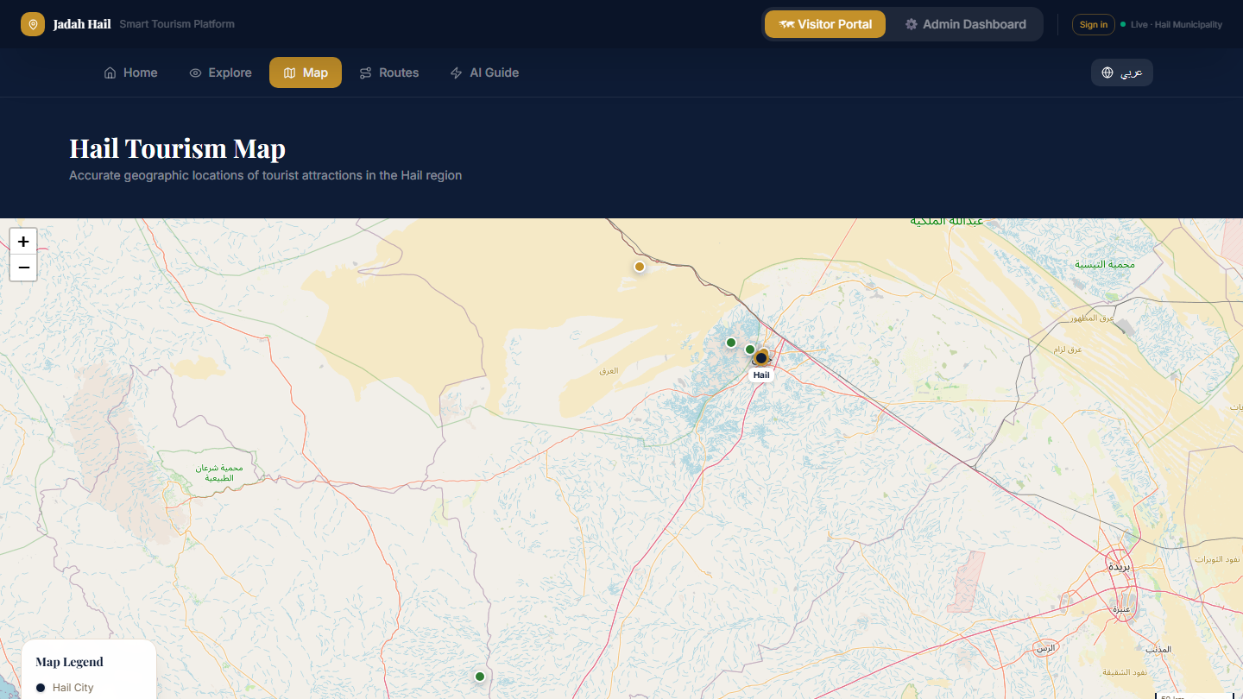
Interactive Hail Tourism Map

Slide 8
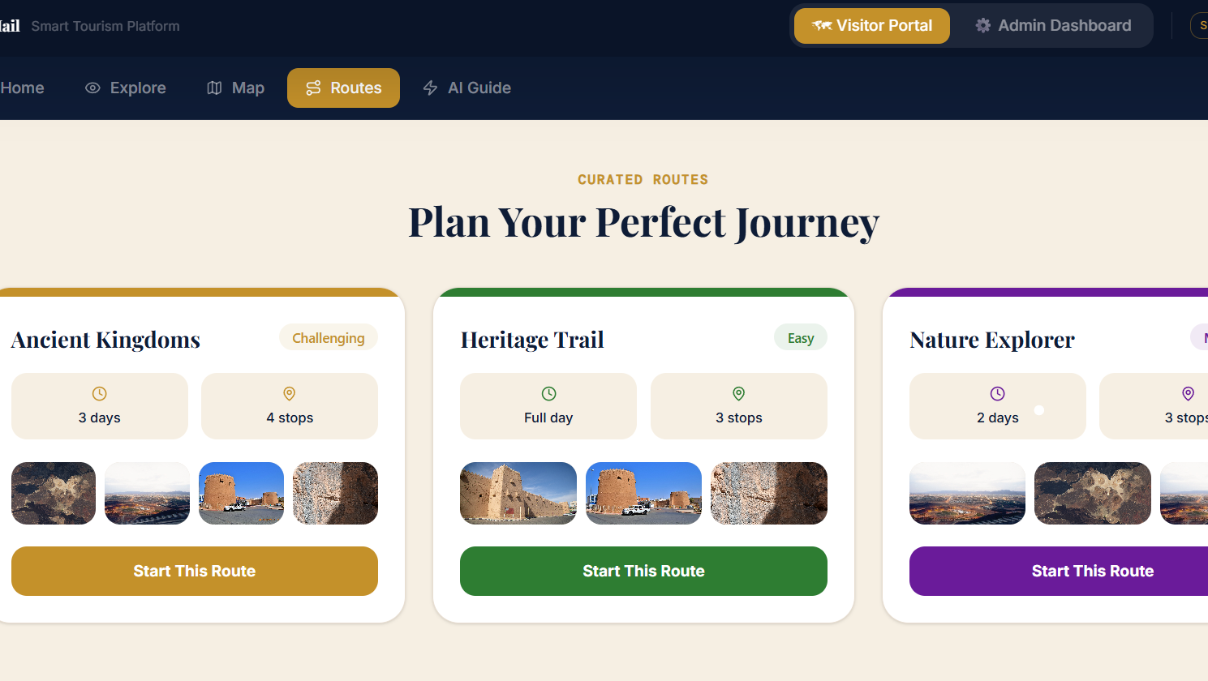
Landmark Details & Reviews

Slide 9
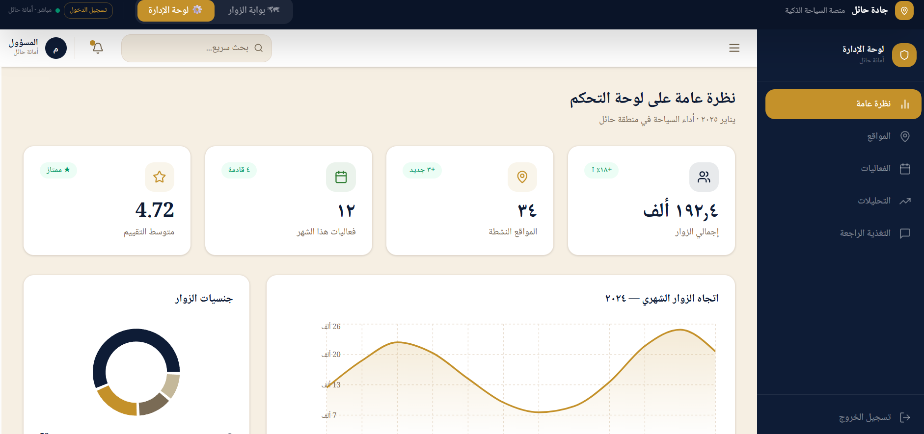
Admin dashboard for monitoring indicators

