Slide 1
Arabic NLP Tasks
Classification, Question Answering and Machine Translation

Slide 2
Preprocessing
Arabic text contains multiple variations, special symbols and noisy characters that can negatively affect models performance, a preprocessing pipeline was designed to reduce noise while preserving meaningful linguistic information
188 duplicate records were identified and removed to avoid bias and overrepresentation of repeated samples
Emoji removal was applied to eliminate non linguistic symbols that do not add semantic meaning to text to reduce noise and improve text consistency before further processing
Tashkeel and Tatweel removal were performed because they create many forms of the same word without adding significant or useful semantic information to the dataset
Arabic normalization was applied to standardize different forms of the same letter (e.g., أ، إ، آ → ا) to reduce vocabulary fragmentation and improved feature consistency across the data
Extra whitespace removal was applied to standardize text formatting, ensure consistent tokenization and prevent identical words or sentences from being represented differently because of spacing inconsistencies

Slide 3
Preprocessing
Regular Expressions (Regex) were used instead of predefined functions because they provided greater flexibility and control over dataset specific cleaning rules and they allow multiple normalization and filtering operations to be performed efficiently within single and customizable preprocessing pipeline simplifying text cleaning and preparation
Different preprocessing strategies were adopted for classification where more aggressive cleaning was applied to reduce noise and improve feature extraction while lighter preprocessing was used for question answering and machine translation to preserve sentence structure and contextual information

Slide 4
Classification

Slide 5
Classification Pipeline
Arabic Dataset
Preprocessing
Representation
Models
Evaluation
TF-IDF, BoW
FastText, Word2Vec
BERT, Qwen, E5, BGE
SVM
LR
RF
NB
Accurcy
Precision
Recall
F1 score
The classification task evaluate the impact of preprocessing techniques, word representation methods and machine learning algorithms on Arabic text classification performance. Multiple configurations were tested to identify the most effective combination for the dataset

Slide 6
Classification
Preprocessing
Preprocessing steps were applied to all classification experiments:
Arabic normalization to unify different forms of Arabic letters and reduce vocabulary fragmentation by removal Non Arabic character (punctuation, numbers, English letters and special symbols) to focus feature extraction on Arabic textual content
Whitespace normalization to ensure consistent tokenization and text formatting
These steps standardize the dataset, reduce textual noise and improve feature quality before classification where traditional classifiers such as SVM, Logistic Regression and Naive Bayes rely on feature frequency statistics, removing irrelevant tokens helps reduce vocabulary size and sparsity resulting in cleaner and more meaningful text representations
To evaluate the impact of preprocessing on classification performance, two additional steps were created:
Stopword Removal: Arabic stopwords were removed while retaining important question words to investigate whether removing frequent functional words improves class discrimination
Stemming ISRI Stemmer was applied after stopword removal to reduce vocabulary sparsity by mapping different word forms to common stem and improving feature consistency

Slide 7
Impact of Preprocessing on TF-IDF Features
Stemming achieved the highest classification accuracy (69.9%) outperforming both the clean and stopword removed versions, this could be because of the morphological richness of the Arabic language where single concept may appear in multiple inflected forms, reducing related word forms to common stem decreases vocabulary size and feature sparsity allowing semantically related terms to contribute to the same feature representation. (5.9% improvment)
stopword removal produced small improvement (65.1% vs. 64.0%) which suggest that stopwords were not major source of noise in the dataset while morphological variation had much stronger impact on performance.
These findings indicate that addressing complex arabic morphological is more beneficial than simply removing high frequency functional words when using frequency based representations such as TF-IDF
The observed improvement match the findings in Arabic text classification literature where stemming has been shown to reduce dimensionality and improve feature quality for classification tasks.
TF-IDF Version | Accuracy
Clean | 64.00%
No Stopwords | 65.10%
Stemmed | 69.90%
An_efficient_stemming_for_Arabic_Text_Classificationph text

Slide 8
Impact of Traditional Feature Representation
One-Hot Encoding was not used because it produces extremely high dimensional and sparse vectors when applied to textual data since each unique word is represented by separate dimension, the feature space grows rapidly with vocabulary size which lead to increased memory requirements and reduced computational efficiency
One-Hot Encoding treats all words equally regardless of their frequently or how strongly they are associated with specific class, so the model cannot distinguish between highly representative keywords and less relevant words.
Instead, TF-IDF and other embedding were selected because they provide more useful representations of text. TF-IDF captures word importance, while other embeddings could capture semantic relationships between words which cannot be represented using One-Hot Encoding
why one hot encoding falis

Slide 9
Impact of Traditional Feature Representation
TF-IDF achieved higher classification accuracy than BoW because it considers both term frequency within a document and term rarity across the entire corpus. Unlike BoW, which represents words using raw occurrence counts, TF-IDF reduces the influence of very common words while assigning greater importance to words that are more useful for distinguishing between classes. As a result, the generated feature vectors become more meaningful, allowing SVM to learn clearer class boundaries and improve classification performance
The results showed that classification accuracy decreased as the n-gram size increased . While unigram features captured the most useful vocabulary patterns, bigram and trigram representations produced much larger and sparser feature space. Many bigram and trigram features appeared only few times in the dataset which limit their statistical usefulness and reduce the model ability to generalize to unseen samples
Representation | SVM Accuracy
TF-IDF Stemmed | 69.90%
BoW Stemmed Unigram | 65.10%
BoW Stemmed Bigram | 46.20%
BoW Stemmed Trigram | 31.70%
An_efficient_stemming_for_Arabic_Text_Classificationph text

Slide 10
Impact of Traditional Feature Representation
Despite using pretrained Arabic embeddings, FastText and AraVec achieved lower classification accuracy than TF-IDF. For example, TF-IDF combined with SVM achieved 69.9% accuracy while FastText achieved approximately 40.5% and AraVec models achieved around 38–39%
One possible explanation is that Word2Vec and FastText generate static word embeddings which mean that the word receive the same representation regardless of its context. In addition, sequence representations were generated using mean pooling which compresses the entire sentence into single averaged vector and may discard important contextual information.
Furthermore, TF-IDF is specifically designed to emphasize words that help distinguish between classes. Therefore, although Word2Vec and FastText capture semantic similarity, this does not necessarily translate into better classification performance.
Representation | LR Accuracy
TF-IDF Stemmed | 68.40%
FastText | 40.50%
AraVec SkipGram | 39.20%
AraVec CBOW | 38.00%
An_efficient_stemming_for_Arabic_Text_Classificationph text

Slide 11
Contextual Embeddings Comparison
All contextual embedding models achieved higher classification accuracy than traditional and static word representations which demonstrate their ability to capture semantic and contextual information more effectively.
Qwen achieved the highest performance (78.4%) followed by BERT (75.6%), BGE (75.2%) and E5 (71.3%). Although all four models are transformer based embeddings, differences in their pretraining objectives, training data and representation strategies resulted in varying classification performance.
The relatively small performance gap between BERT, BGE and Qwen suggests that contextual understanding plays significant role in Arabic text classification. However, Qwen generated the most effective representations for this dataset which allow SVM to learn more accurate decision boundaries.
These results indicate that contextual embeddings are more suitable for Arabic classification tasks than static representations because the meaning of word is interpreted according to its surrounding context rather than being assigned fixed vector.
Embedding | SVM Accuracy
BERT | 75.60%
BGE | 75.20%
E5 | 71.30%
Qwen | 78.40%

Slide 12
Static vs Contextual Embeddings
Transformer based embeddings achieved higher performance than TF-IDF, FastText, and Word2Vec representations because they generate contextual embeddings rather than static word representations.
In contextual embeddings, the representation of word changes according to the surrounding sentence. Therefore, the same word can have different vector representations depending on its meaning within the context.
Qwen achieved the highest classification accuracy (78.4%) outperforming BERT, E5, and BGE. This suggests that Qwen generated richer semantic representations for the dataset and was better able to capture contextual relationships between words and classes.
One possible explanation for Qwen's superior performance is its strong semantic representation capability, which enables it to capture contextual relationships between words more effectively. Qwen generates context-aware representations that preserve sentence meaning and reduce ambiguity. This richer feature space likely provided SVM with more separable class representations leading to improved classification accuracy.
Why Qwen?
Trained on large multilingual corpora
Optimized for language understanding and generation
Captures richer semantic and contextual information.
Produced more separable class representations for SVM.

Slide 13
01
SVM
Model Comparison
SVM achieved the highest classification accuracy because it performs particularly well in high dimensional feature spaces since text classification datasets often contain hundreds or thousands of features and SVM is highly effective at identifying the clear decision boundaries between classes.
In addition, SVM is robust to sparse textual data and focuses on maximizing the separation margin between categories which improves generalization performance
This behavior was reflected in the experimental results where SVM achieved the highest accuracy (69.9%) among all traditional classifiers.
Model | Accuracy
SVM | 69.90%
Logistic Regression | 68.40%
Random Forest | 65.90%
Naive Bayes | 50.80%
02
Logistic Regression
Logistic Regression achieved competitive performance because it learns the contribution of each feature to the target classes and combines them to estimate class probabilities which allow the model to effectively identify patterns that distinguish between categories and make reliable classification decisions.
However, SVM achieved slightly better results because its objective is not only to classify samples correctly, but also to maximize the separation between classes. By creating larger margin between category boundaries, SVM becomes more robust to ambiguous or overlapping samples and is therefore often able to generalize better to unseen data.

Slide 14
Model Comparison
Random Forest
03
Random Forest performed reasonably well but was less effective than SVM and Logistic Regression. Text representations often contain large number of features which make it difficult for decision trees to identify the most informative splits. Consequently, the ensemble was not able to fully exploit the available textual information.
Model | Accuracy
SVM | 69.90%
Logistic Regression | 68.40%
Random Forest | 65.90%
Naive Bayes | 50.80%
04
Naive Bayes
Naive Bayes assumes that features are independent from one another which rarely holds in natural language where words and features are often related and appear in meaningful patterns. As a result, Naive Bayes was less capable of capturing complex relationships within the text and achieved the lowest classification accuracy.

Slide 15
The Best Classification Model
The best performance was achieved by combining Qwen embeddings with SVM, this can be explained by the complementary strengths of both components.
Qwen generated rich contextual representations that captured semantic relationships and word meanings according to their surrounding context. Unlike traditional and static embeddings, the same word could receive different representations depending on its usage within the sentence.
SVM was then able to effectively separate these high quality representations by constructing optimal decision boundaries between categories, its margin maximization strategy may improved generalization and reduced the impact of overlapping samples.
Consequently, the combination of strong contextual understanding from Qwen and robust classification capabilities from SVM produced the highest overall classification accuracy.

Slide 16
Machine Translation

Slide 17
GPT-4o-mini
GPT-4o-mini is lightweight Large Language Model (LLM) developed by openai, trained on large multilingual text corpora and can understand and generate text in multiple languages such as Arabic and English
03
Context Aware Translation
01
Strong Multilingual Capabilities
Unlike rule based translation systems and early statistical machine translation approaches, GPT-4o-mini considers the entire sentence context when generating translations
capable of understanding Arabic and generating fluent English text which make it suitable for Arabic to English machine translation tasks
04
Easy Integration
02
No Training Required
API can be integrated directly into NLP applications enabling fast deployment with minimal computational resources.
The model is already pretrained on massive datasets which eliminate the need for collecting bilingual corpora or training custom neural machine translation model
05
High Fluency
The generated translations are typically more fluent and contextually appropriate which help preserve the original meaning of Arabic questions and answers

Slide 18
GPT-4o-mini
Why GPT ??
GPT-4o-mini can be integrated directly through an API and produces high quality translations without requiring model training, fine-tuning or complex preprocessing steps.
While Running , GPT-4o-mini is faster and provided translations in shorter response times
GPT-4o-mini is designed as lightweight and cost efficient member of the GPT family, providing good balance between translation quality, speed and computational efficiency.
How Good Are GPT Models at Machine Translation? A Comprehensive Evaluation

Slide 19
Question Answering

Slide 20
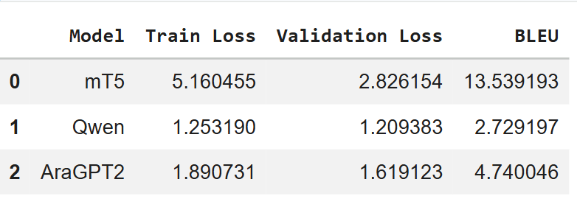
Transformer-Based QA
The results reveal an interesting trade-off between loss values and answer quality!!

Slide 21
Transformer-Based QA
Although Qwen achieved the lowest validation loss (1.21), it obtained the lowest BLEU score (2.73)
In contrast, mT5 achieved the highest BLEU score (13.54) despite having the highest validation loss
This suggests that lower loss value does not necessarily mean better answer generation quality. While Qwen learned the training distribution effectively, the generated answers were less similar to the reference answers used for BLEU evaluation.
On the other hand, mT5 is specifically designed for text to text tasks including question answering, translation and summarization as its architecture is optimized to generate target sequences that closely match reference outputs which explains its highest BLEU performance.
AraGPT2 achieved intermediate results which indicate better answer generation quality than Qwen but lower performance than mT5.
MT5

Slide 22
Transformer-Based QA
mT5 achieved the highest BLEU score because it follows the text-to-text learning paradigm where tasks such as question answering, translation and summarization are formulated as sequence generation problems. This training objective enables the model to generate answers that more closely match reference responses
Although mT5 achieved the best BLEU score among the transformer models, the BLEU value is relatively low. One possible reason is the limited size of the fine tuning dataset which contained approximately 5,000 question answer pairs. In addition, the model was fine-tuned for only three epochs due to available computational resources. Consequently, the model has not fully adapted to the domain specific patterns of the dataset leaving room for further performance improvement with larger datasets and longer training schedules.
MT5

Slide 23
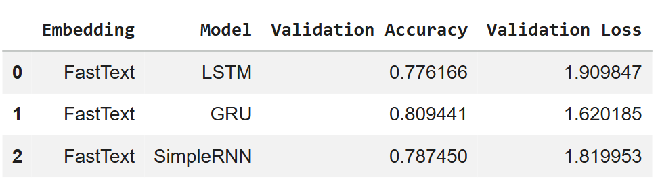
RNN vs LSTM vs GRU
Across all embedding representations, GRU achieved the highest validation accuracy and lowest validation loss which indicate that GRU provided the best balance between sequence learning capability and model complexity
Unlike SimpleRNN, GRU employs gating mechanisms that help preserve information over longer sequences and mitigate the vanishing gradient problem.
Compared to LSTM, GRU uses fewer parameters and simpler architecture which make optimization easier and reduce the risk of overfitting on our small dataset
GRU
GRU

Slide 24
Embedding Comparison
FastText achieved higher performance than contextual transformer embeddings within the Seq2Seq architecture.
This is because FastText provides relatively simple token level representations while preserving subword information through character n-grams which is particularly beneficial for morphologically rich languages such as Arabic.
Furthermore, the limited training dataset (~5,000 samples) may not have been sufficient to fully exploit the rich contextual information contained in transformer based embeddings. As a result, the GRU encoder-decoder architecture was able to learn task-specific sequential patterns more effectively from FastText representations which lead to better overall performance.
Embedding | Best Model | Accuracy
FastText | GRU | 80.80%
BERT | GRU | 75.00%
BGE | GRU | 73.70%
Qwen | GRU | 72.70%
E5 | GRU | 72.50%

Slide 25
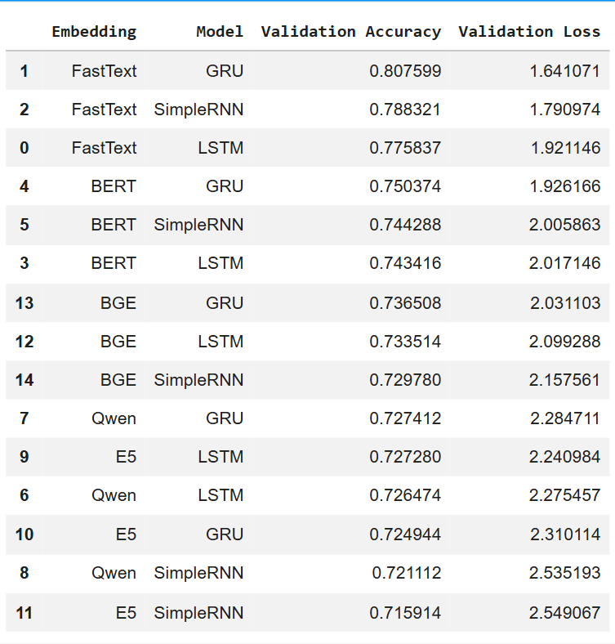
Why Did SimpleRNN Perform Worse
SimpleRNN consistently achieved lower performance across most experiments because Simple Rnn lacks gating mechanisms unlike GRU and LSTM that regulate information flow through time.
As sequence length increases, important contextual information may gradually disappear due to the vanishing gradient problem making the model less capable of capturing long range dependencies required for the task.

Slide 26
Accuracy vs BLEU Score
Results --> FastText + GRU, Validation Accuracy = 80.8%, BLEU Score = 0.044
Despite achieving high validation accuracy, the BLEU score remained extremely low which demonstrate that token level prediction accuracy does not necessarily correspond to high quality answer generation
During training, the model may correctly predict many individual tokens which result in high accuracy while the generated answer may still differ significantly from the reference answer in terms of wording, sentence structure or sequence composition
Therefore, BLEU provides realistic evaluation of generated answer quality because it directly measures similarity between generated and reference responses

Slide 27
Best Seq2Seq Model
FastText + GRU
FastText provides rich subword level representations that are particularly beneficial for morphologically rich languages such as Arabic, these representations help capture word variations and reduce OOV (out-of-vocabulary) issues.
GRU efficiently models sequential dependencies while maintaining relatively small number of trainable parameters. The combination of FastText's lexical representation and GRU's sequence modeling resulted in the highest validation accuracy among all Seq2Seq experiments

Slide 28
Why Not Traditional Embeddings
Traditional representations do not model semantic meaning or contextual relationships between words.
Question Answering requires understanding the relationship between the question and the answer including context, intent and semantic similarity.
Previous research in modern Question Answering systems has shown that dense contextual representations significantly outperform traditional sparse representations because they better capture semantic relationships between textual inputs and outputs.
Traditional representations such as BoW and TF-IDF were not used for the QA task because they ignore word order and sequential structure. These representations treat text as collection of independent words and therefore cannot capture how words interact within a sentence.
In contrast, QA is sequence generation task where the order of words plays critical role in understanding the question and generating meaningful answer.
Traditional and contextual
While TF-IDF and BoW performed competitively in the classification task, the objective of Question Answering is fundamentally different where instead of assigning category label, the model must generate meaningful answers Therefore, semantic understanding becomes more important than term frequency which make contextual embeddings and transformer based representations more appropriate choice.

Slide 29
Not Appling Additional Preprocessing to QA and MT?
Unlike the classification task, additional preprocessing techniques such as stopword removal and stemming were not applied to the Question Answering and Machine Translation tasks
In generative NLP tasks, every word contributes to the meaning and structure of the output sequence. Removing stopwords may discard important contextual information while stemming can alter grammatical forms and reduce linguistic richness
Furthermore, transformer based models such as mT5 and GPT rely on contextual understanding rather than simple word frequency statistics. Therefore, preserving the original sentence structure is more beneficial than aggressive text normalization

Slide 30
Limitations and Future Improvements
During interface testing, it was observed that using the original text without preprocessing sometimes produced more natural answers with less word repetition which suggest that some preprocessing operations may have removed linguistic information that was useful for sequence generation.
Unlike classification tasks, Question Answering and Machine Translation rely heavily on contextual understanding and sentence structure. Therefore, preserving the original text may be more beneficial than applying preprocessing techniques such as stemming or stopword removal or normlization.
Future work could investigate training the QA and MT models using minimally the original text to evaluate whether preserving more linguistic information improves answer quality

Slide 31
Thank You!

