Slide 1
Security Servers Configuration & Review Project
project requirment:
configuring each server
reviewing the configuration for security issues
DNS • Mail • Database
WT255

Slide 2
Project structure
Project process and structure
Part 1
Configuration
Part 2
Security review
Part 3
report
Sample lab configuration files showing how each service was set up during the university project.
Defensive review commands / queries used to detect weak or unsafe settings in the configuration.
PDF report with findings, screenshots of the results, severity, and recommendations.
WT255

Slide 3
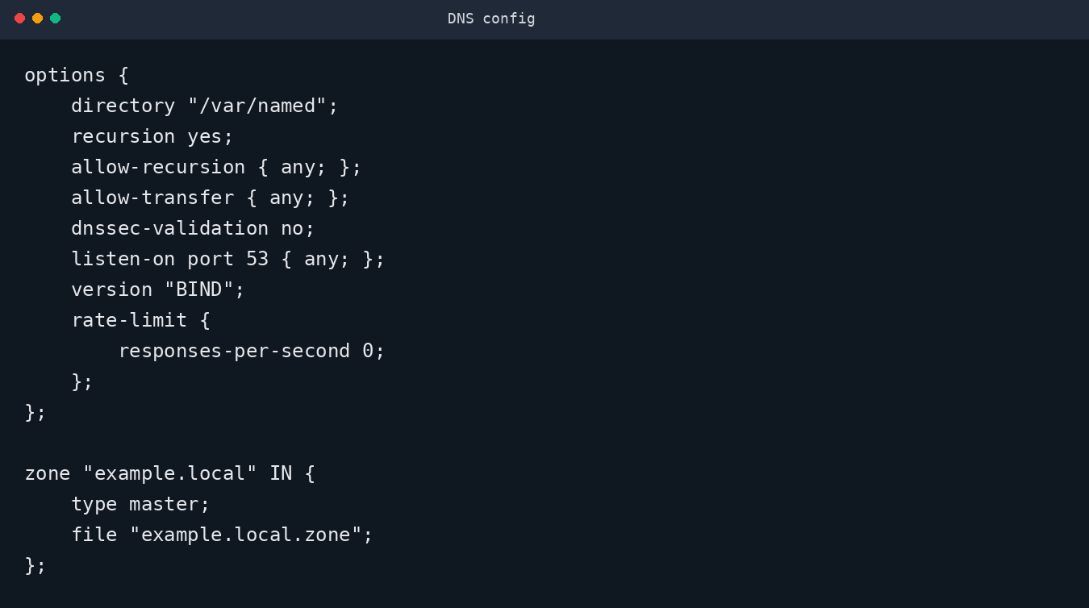
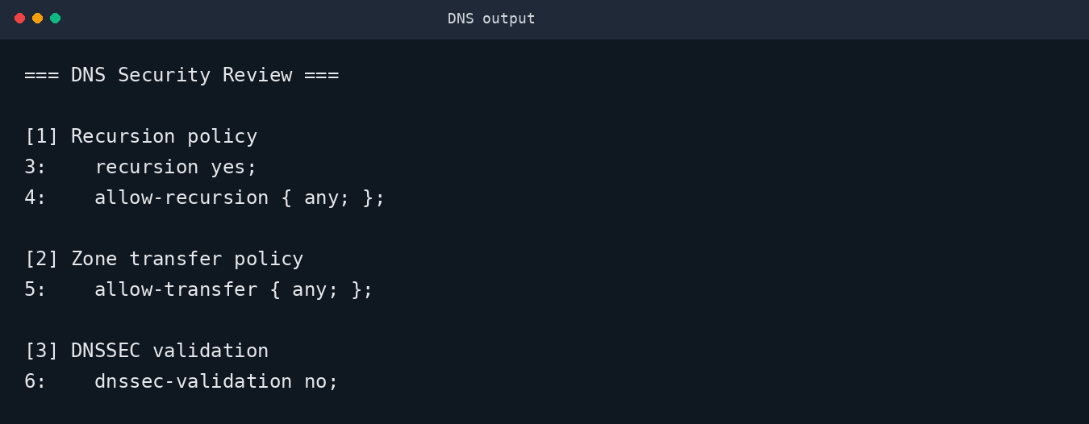
DNS Server: configuration + review evidence
Left: sample lab configuration. Right: defensive review output that flags the risky settings.
Configuration file
Security review output
Main issues shown: open recursion, unrestricted zone transfer, DNSSEC disabled.
DNS-Server: = config file + review file + PDF report

Slide 4
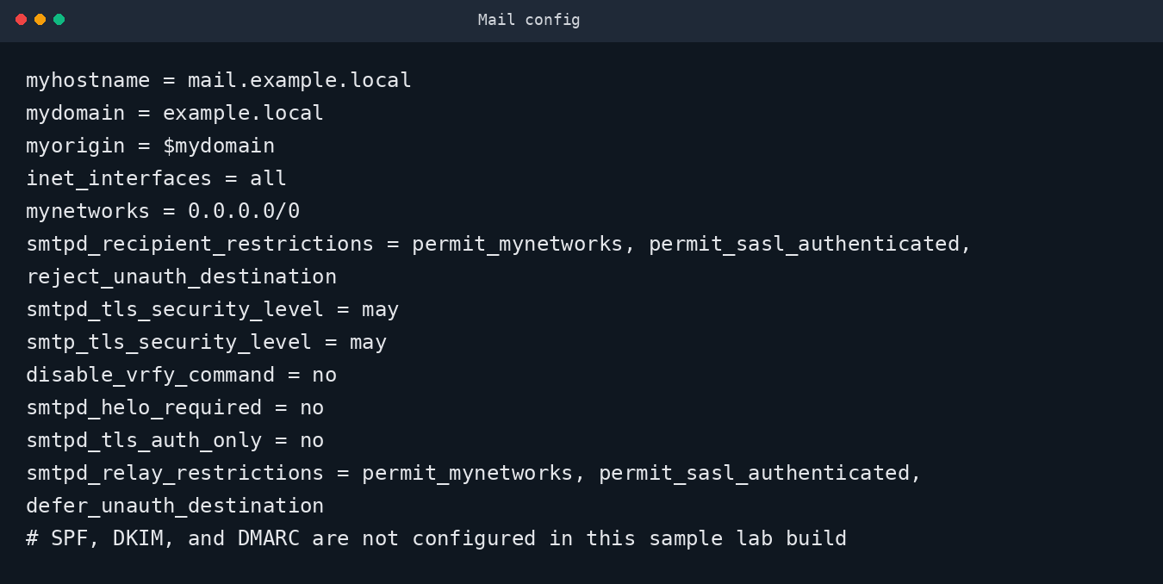
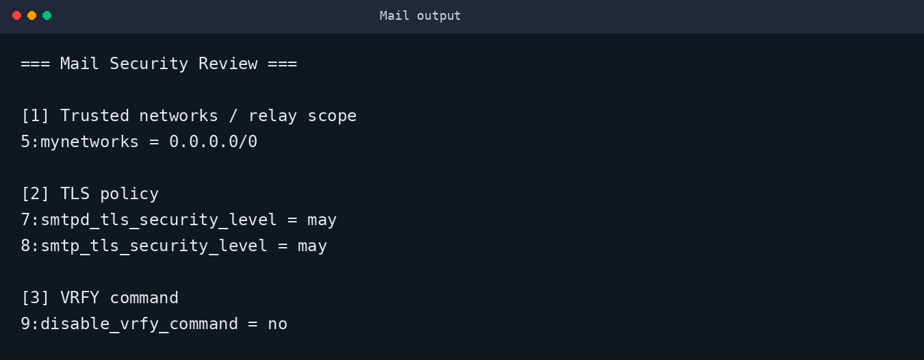
Mail Server: configuration + review evidence
Left: sample lab configuration. Right: defensive review output that flags the risky settings.
Configuration file
Security review output
Main issues shown: open trust scope, weak TLS posture, VRFY enabled, missing mail authentication records.
Mail-Server: = config file + review file + PDF report

Slide 5
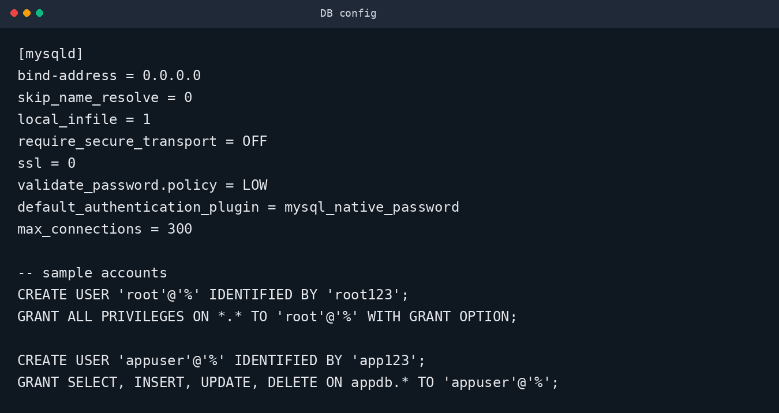
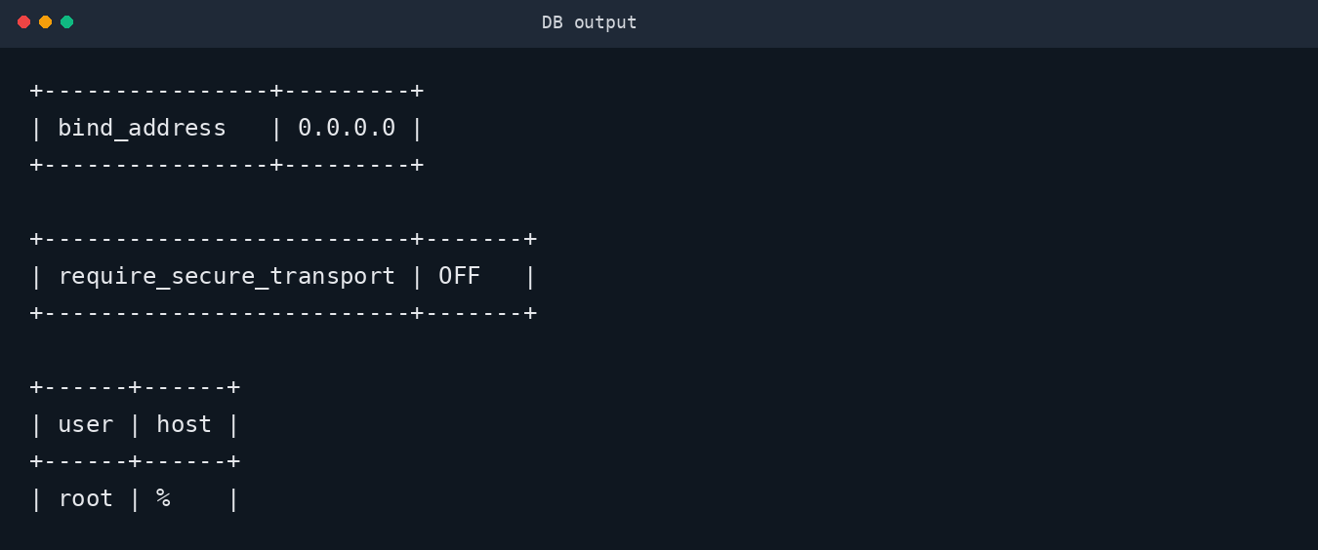
Database Server: configuration + review evidence
Left: sample lab configuration. Right: defensive review output that flags the risky settings.
Configuration file
Security review output
Main issues shown: bind-address 0.0.0.0, secure transport OFF, remote root access allowed.
Database-Server:= config file + review file + PDF report

