Slide 1

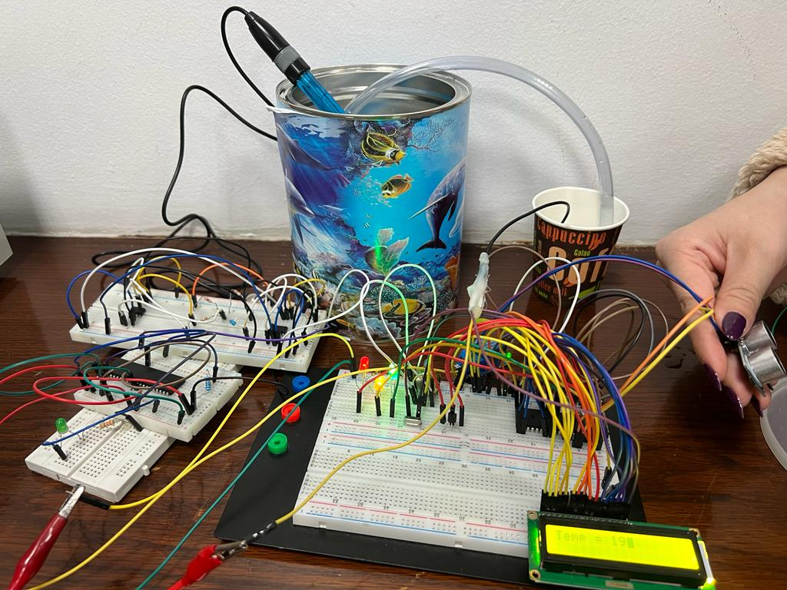
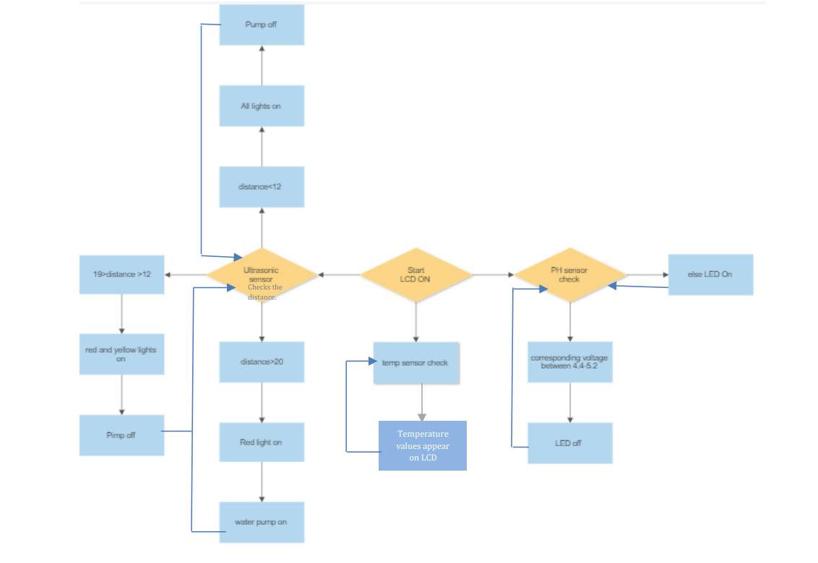
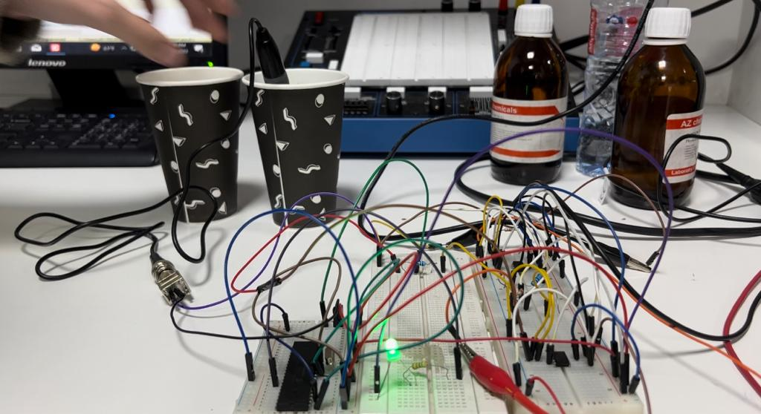
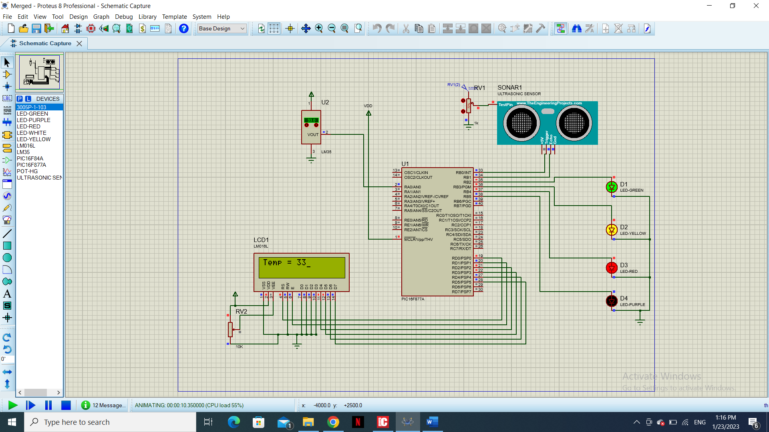
SMART WATER TANK
R.Al-Haddadien, D. Abu-alhasan, M. Jamalieh
Supervisor: Dr. Belal Sababha
Embedded Systems Final Design Project, Fall 2022
King Abdullah II School of Engineering
Princess Sumaya University for Technology
Introduction
Since water has a big influence on our lives, it's important to utilize it sparingly. We created a system to control water consumption using the information we gained from the embedded systems design course to accomplish this assignment. The growth of our project depends on embedded systems. Our initiative is focused on water tanks, whether they are house-based or located in rural areas. First off, ordinary water tanks cannot be used to monitor or check the water level, resulting in a major water shortage. This project will employ a water level sensor that is interfaced with a microcontroller to measure the amount of water to see if there is enough. Frequently, there are two water tanks, and when water is pumped from the lower tank to fill the upper tank.
Results
Figure 3: Final design
A smart water tank was successfully designed and implemented, the final project design pumps water from the cup which represents the lower tank whenever the ultrasonic measures high distance which means that the tank is empty, on the other hand, the tank is full the pump is turned off which means that the distance is low. Related to the tank condition and water level a specific LED will turn on/off.
Figure 4: Final design for the PH sensor
Design
It consists of a water tank that has the pH sensor inserted in it along with an ultrasonic sensor glued to the lid of the tank. A temperature sensor is also used to measure the temperature of the surrounding environment. The water pump is placed in another water container (representing another tank) to pump water from one tank to another through a tube connected to the pump. Two microcontrollers are used that are responsible for the ultrasonic, LEDs, temperature sensor, and LCD, and the other PIC is responsible for the pH.
Figure 1: Software Design
Figure 2: Electrical simulation
Designing our virtual circuit first so that we can have a step forward while connecting and implementing in reality check figure (2). The LEDs in this project will give us an indication of the water level as seen in the flowchart figure (1).
If the acidity of the water changes the PH sensor would be able to sense the change, the PH sensor sends an analog value that is converted to a digital value and compared to the desired range. If the value is not within the range, the LED will light up.
In the figure above the PH, the sensor was soaked inside the solution with a 4 PH level which turned the LED on.
Conclusion
We have been able to achieve our goal of developing an effective system employing the pic16F877A and other parts such as a motor and sensors that might deal with water use in homes in a safe and equitable manner. A two-tank water level and water quality monitoring system that includes embedded systems for real-time monitoring. The system's design and implementation aim to give a low-cost, convenient solution to water waste and water quality determination.

