Slide 1
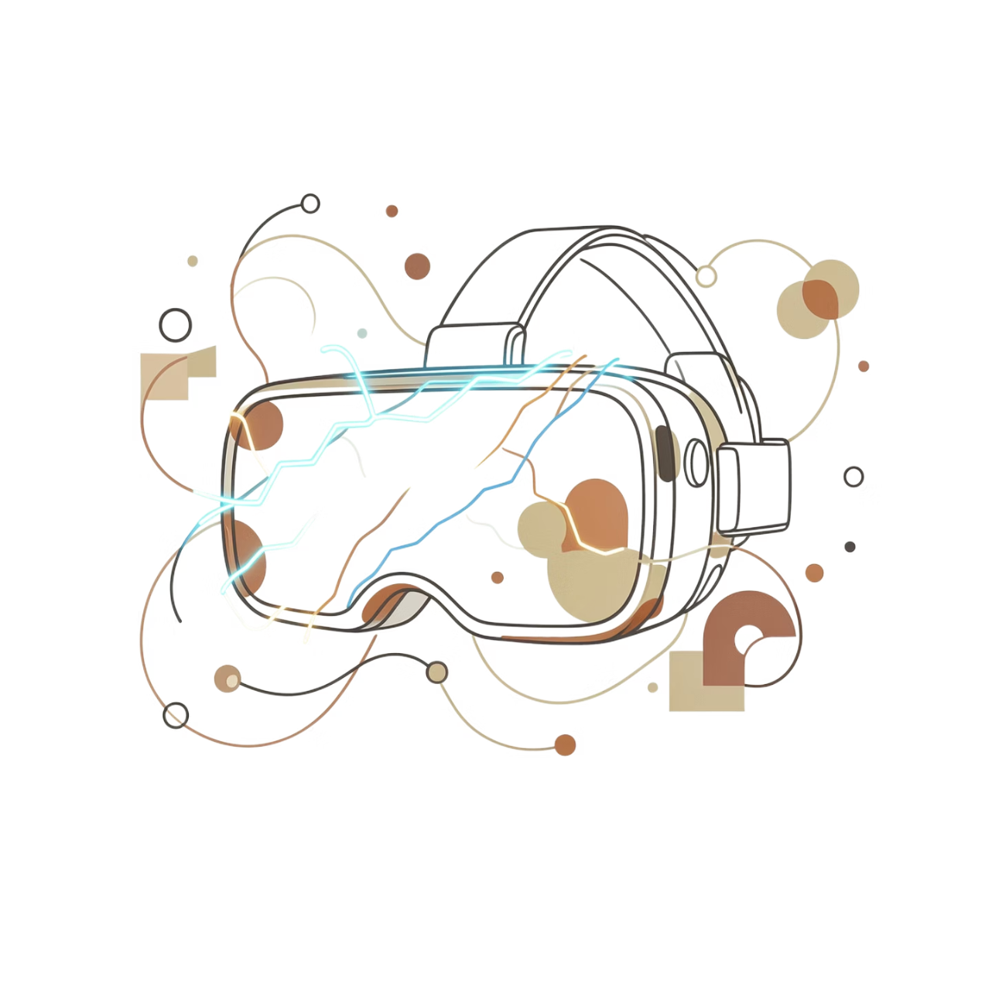
Scientific Experiment Simulator
Electric Field Visualization
Badrinath Tirlangi (231098)
Prem Santhosh Vempati (231137)
Hemanth Kumar Ampili (230128)
Shaik Jameel Ur Rahaman (230951)
Karthik Koneti (230568)
DES643 – Design with AR/VR

Slide 2
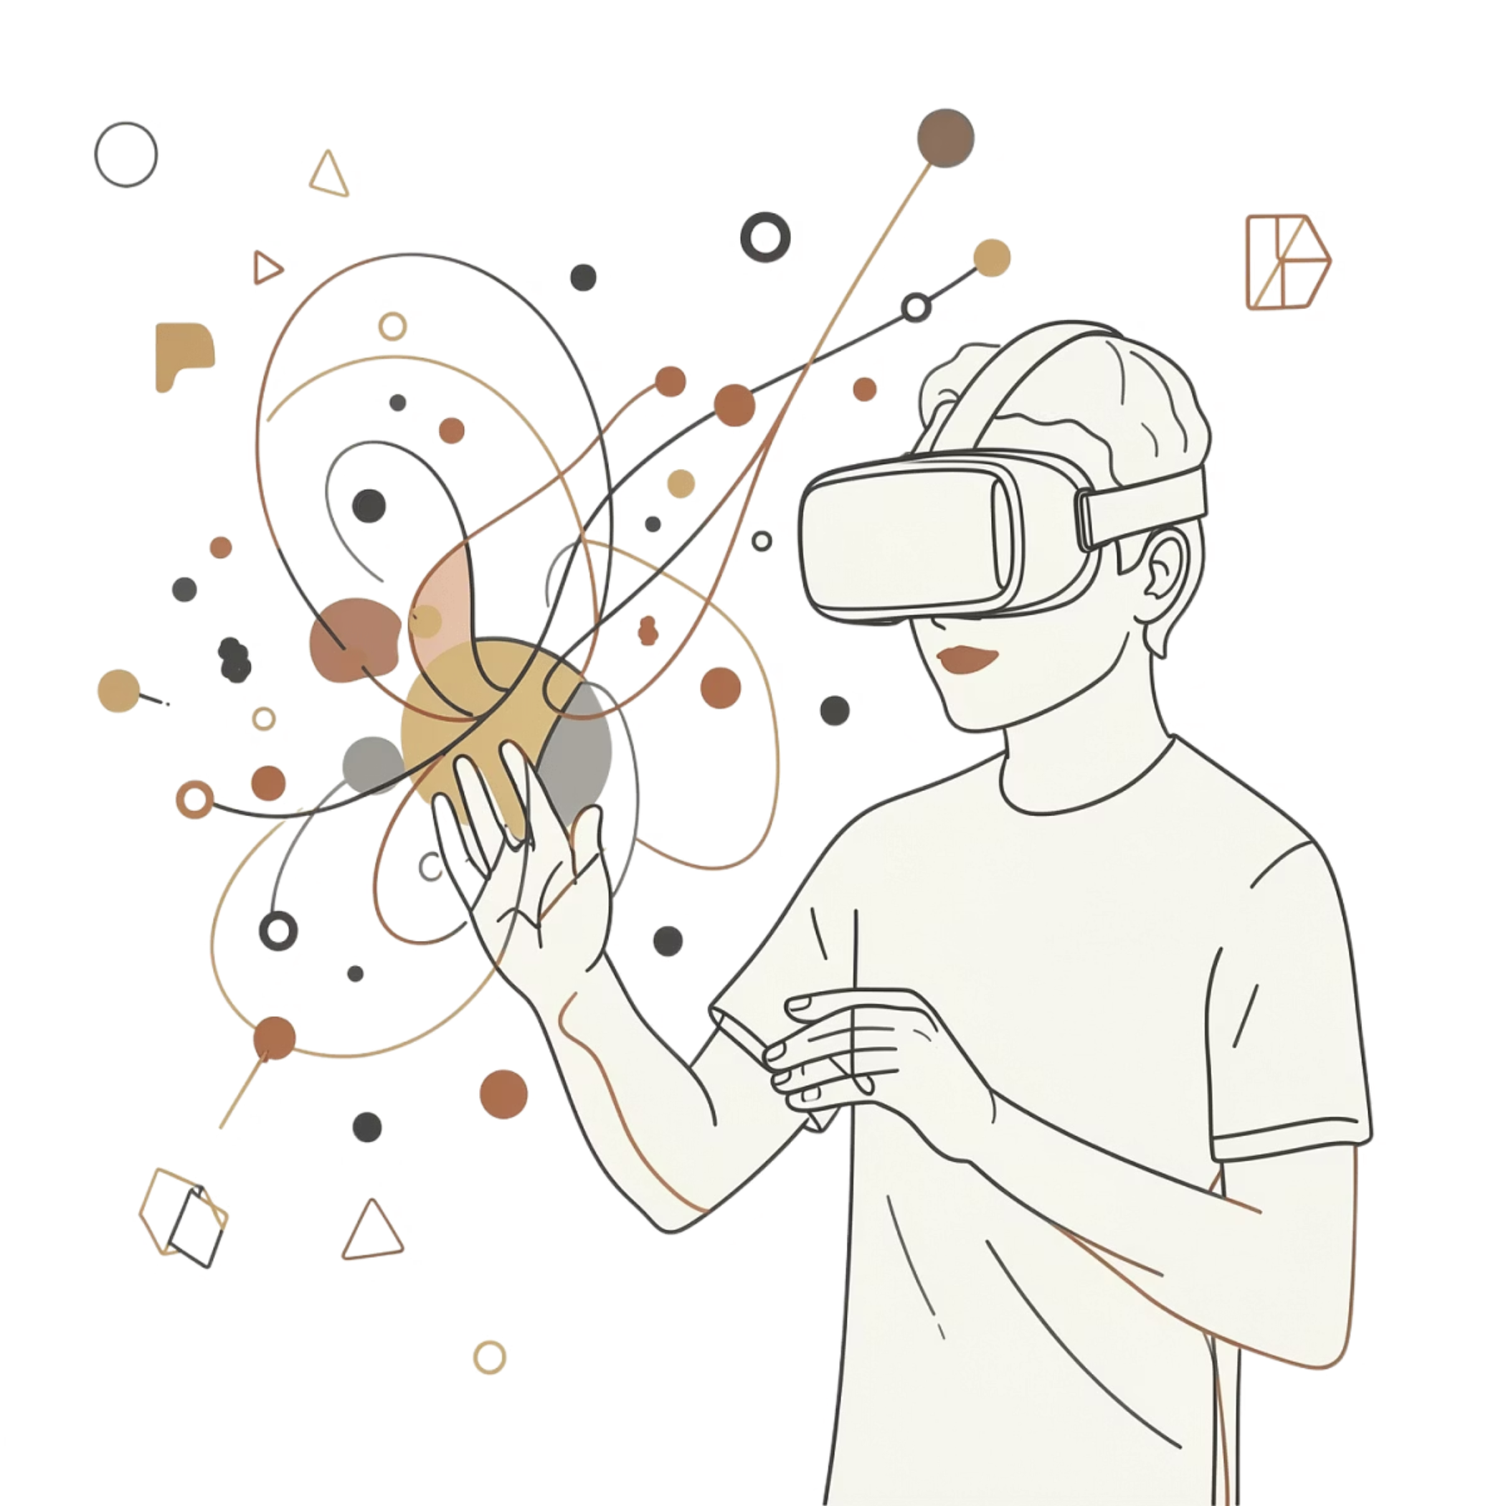
PROBLEM & MOTIVATION
Why VR is Better than Traditional 2D Methods
Electric fields are inherently three-dimensional, requiring spatial understanding.
2D diagrams cannot accurately represent complex spatial relationships and field behaviour.
VR offers dynamic exploration of fields from any angle, enhancing perception.
Provides an immersive and interactive learning environment for deeper engagement.
Facilitates clearer comprehension of principles like superposition and identification of null points.

Slide 3
OBJECTIVES
What We Set Out to Build
1
2
VR Visualization System
Interactive 3D Placement
Develop a VR-based electric field visualization system
Enable interactive placement of charges in 3D space
3
4
Dynamic Field Behavior
Immersive Learning
Visualize electric field behavior dynamically
Improve conceptual understanding using immersive learning

Slide 4

PROJECT OVERVIEW
System Overview
Platform
Virtual Reality scientific simulator for electric fields
Tech Stack
Built using Unity and XR Interaction Toolkit
Interaction
Users can place positive and negative charges
Configurations
Supports multiple configurations (single charge, dipole, multi-charge)

Slide 5
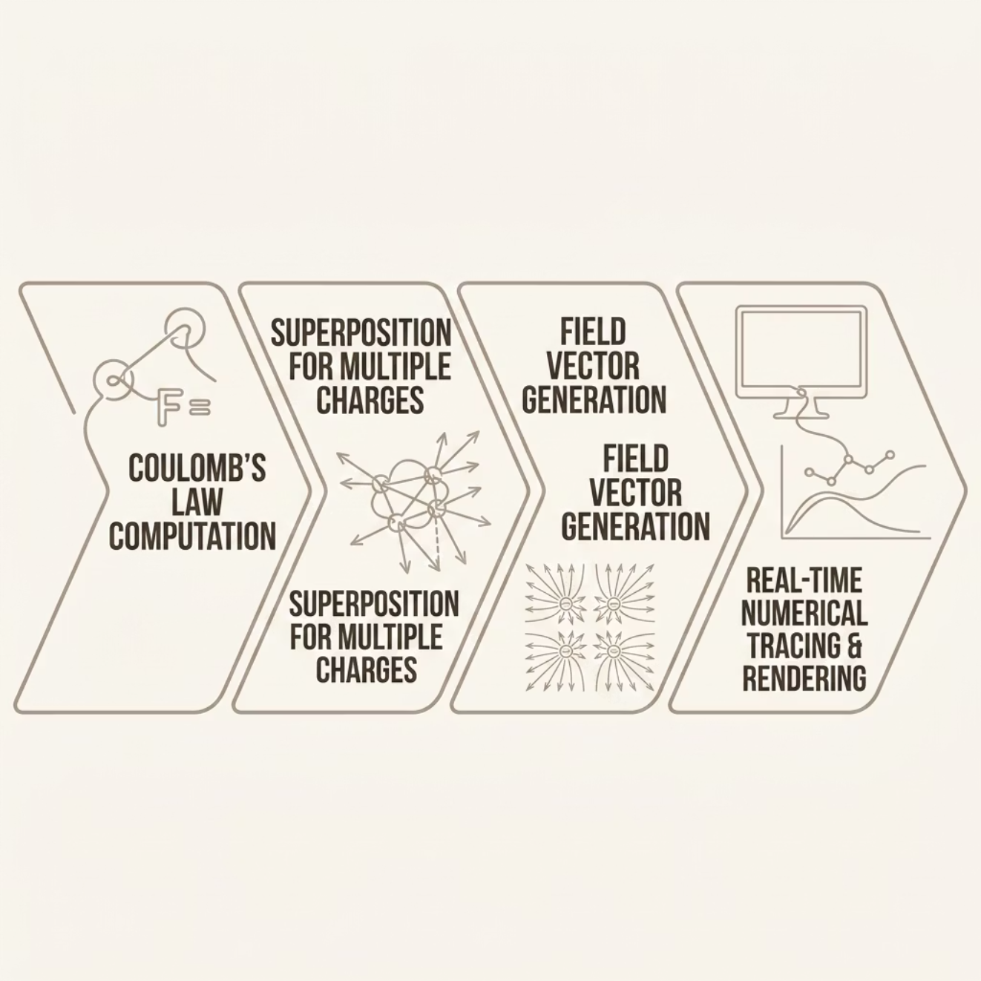
METHODOLOGY
Physics Engine & Field Computation
Electric field uses Coulomb's Law
Multiple charges use superposition
Vectors show magnitude and direction
Field lines use numerical tracing
Updates in real time as charges move

Slide 6
SYSTEM DESIGN
Interaction Modes & Visual Encoding
Place Mode
Edit Mode
Observe Mode
Charge placement system in 3D environment
Modify existing charges and properties
Animated flow particles along field lines
Visual Encoding
UI Controls
Color → charge polarity (positive/negative); Arrows → field direction; Density → magnitude of field
UI panels for controlling charge properties

Slide 7


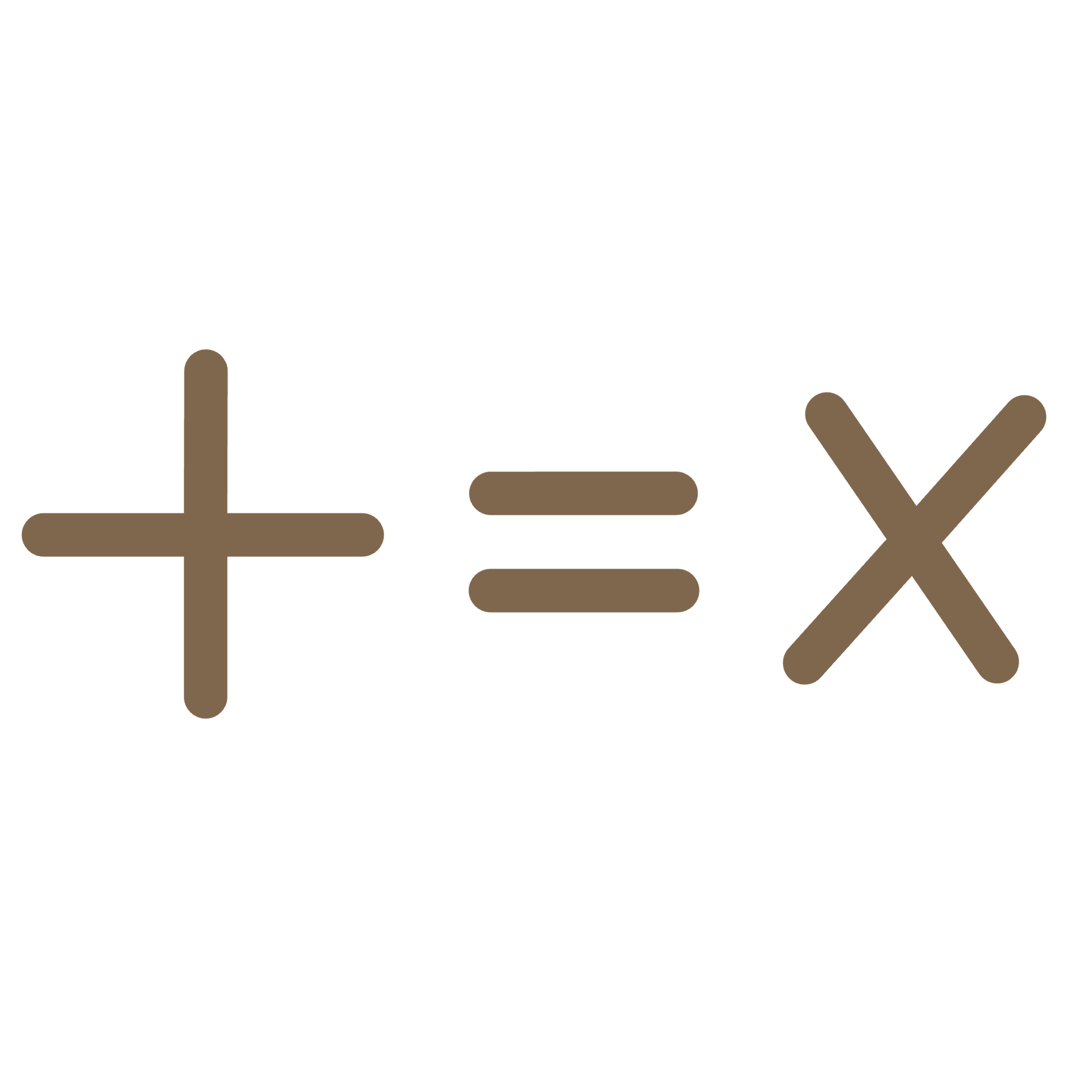


TECHNICAL IMPLEMENTATION
Core Technologies
Unity 2022.3 LTS
XR Interaction Toolkit
Field Computation Engine
Developed in Unity 2022.3 LTS
XR Interaction Toolkit for VR interaction
Field computation engine based on physics equations
Line Rendering System
Optimized Performance
Line rendering system for field visualization
Optimized for real-time performance

Slide 8

INTERACTION DESIGN
Advanced Interaction & Features
Real-time adjustment of charge magnitude
Intuitive 3D charge manipulation (grab, move, reposition)
Full support for both positive and negative charges
Introduction of a test charge to observe field behavior
Dynamic test charge movement along electric field lines
Enhanced comprehension of electric field dynamics

Slide 9
DEVELOPMENT PROCESS
Week-by-Week Progress
Week 1
1
Ideation and project selection; finalized VR electric field simulator and defined system components
2
Week 2
Set up Unity environment, created VR scene, implemented basic charge placement and interaction
Week 3
3
Implemented electric field computation using Coulomb's law, added vector visualization and real-time updates
4
Week 4
Implemented field lines, color-based strength visualization, UI controls, and completed system integration

Slide 10
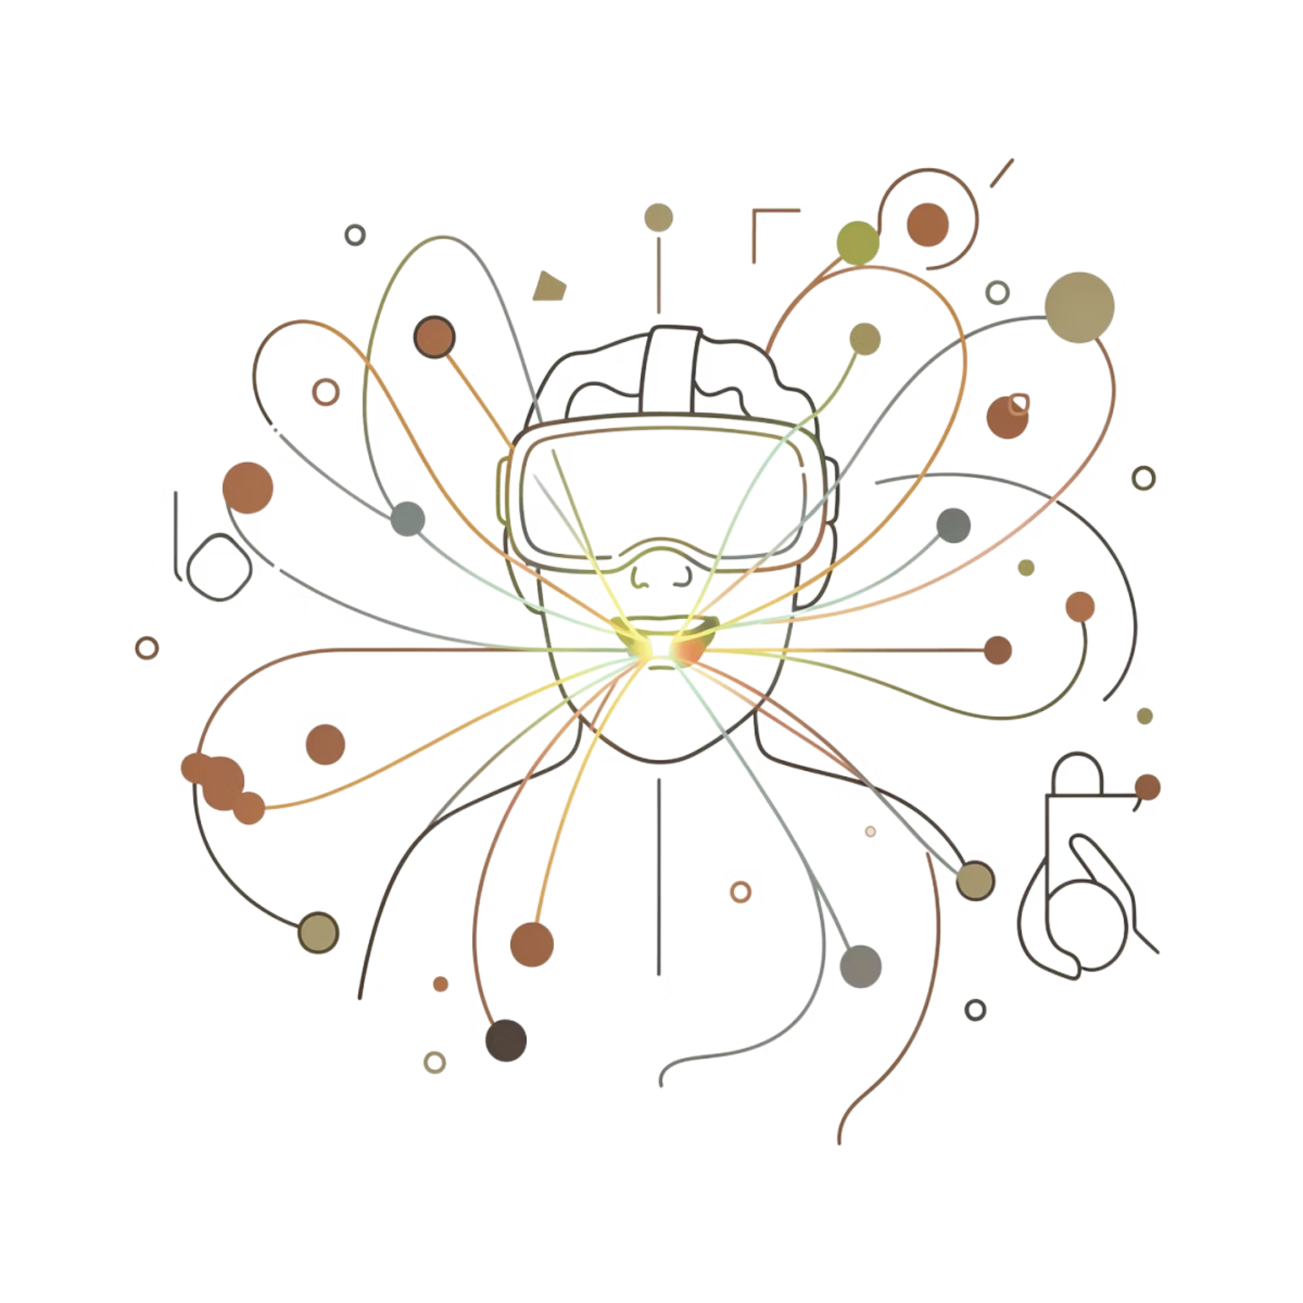
RESULTS & EVALUATION
User Study Insights
Users showed better understanding using VR compared to 2D tools.
Significant improvement in concepts like superposition.
Users found the system intuitive and engaging, enhancing their learning experience.
High usability scores indicate a positive and effective user experience.
VR enabled a superior spatial understanding of complex electric fields.

Slide 11

DEVELOPMENT HURDLES
Challenges Faced
1
2
Real-time Field Computation
Performance Optimization
Ensuring accurate electric field calculations without lag.
Maintaining smooth performance with an increasing number of charges.
3
4
Non-VR Interaction
Accuracy vs. Performance
Designing effective interaction methods for users without VR hardware.
Finding the right balance between computational precision and frame rates.

Slide 12
CONSTRAINTS & SCOPE
Project Limitations
Understanding these limitations helps clarify what the simulator can do today and where future improvements should focus. They define the current scope while guiding next development priorities.
Electric Fields Only
Extreme Scenario Performance
The simulator is currently limited to electric fields, with no support for magnetism or gravity.
Very large charge counts or complex field geometries may still affect real-time performance.
No Haptic Feedback
Limited Quantitative Analysis
The experience remains visual and interactive, without tactile force feedback.
Advanced data export and deeper analytical tools are not yet fully integrated.

Slide 13

APPLICATIONS
Applications and Use Cases
Transforming complex electric field concepts into intuitive 3D experiences for physics students, enhancing comprehension.
Providing hands-on virtual experience for engineering students and professionals to grasp advanced electromagnetic principles.
Enhancing traditional teaching methods in classrooms and labs with dynamic, engaging VR experiments and interactive visualisations.
Empowering students with a flexible and accessible self-learning tool for independent exploration and mastery of electric field theory.
Laying the groundwork for future expansion into other essential physics simulations, such as magnetism, fluid dynamics.

Slide 14
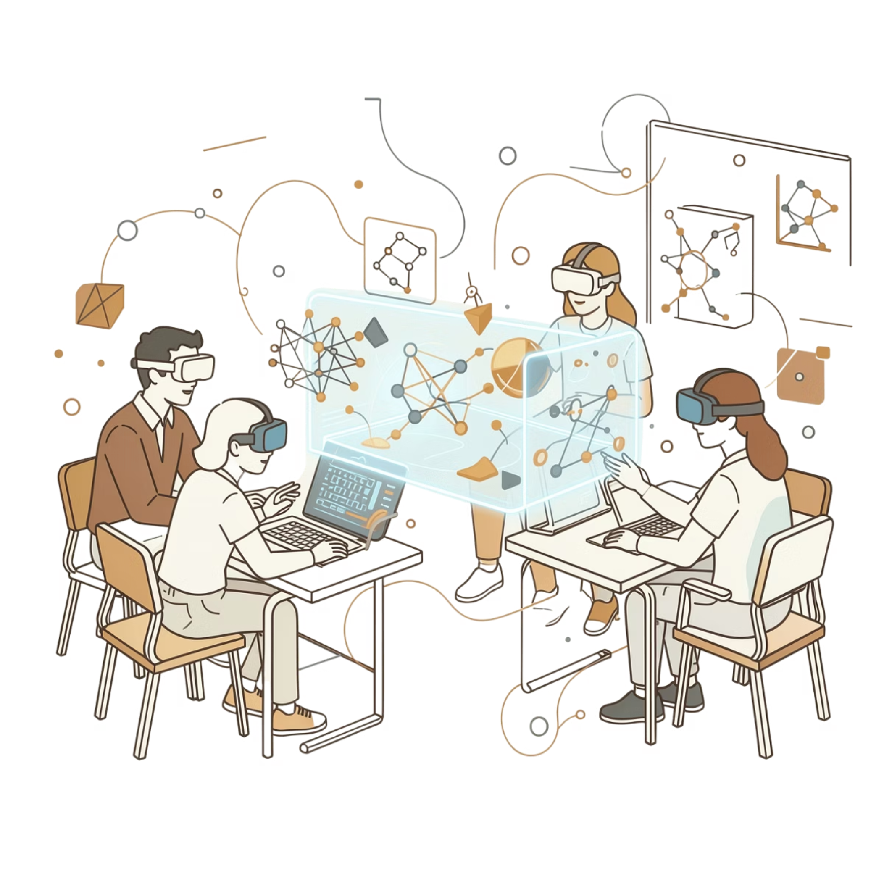
CONCLUSION & FUTURE WORK
Looking Ahead
Conclusion
VR significantly improves visualization of complex physics concepts
Interactive simulation enhances learning and engagement
System successfully demonstrates advantages of VR in education
Future Work
Support for magnetic field simulation
Improved 3D interaction (height control)
Multiplayer collaborative learning
Advanced visualization techniques

Slide 15

Thank You!
For your attention and support.
Badrinath Tirlangi, Prem Santhosh Vempati, Hemanth Kumar Ampili, Shaik Jameel Ur Rahaman, Karthik Koneti
DES643 – Design with AR/VR

