Slide 1
ABS Clearing House Step-by-Step Guide
Creating and Managing your CBD Account
Introduction to the ABSCH The Access and Benefit-Sharing Clearing-House (ABSCH) (http://absch.cbd.int) has been developed as a tool to support the implementation of the Nagoya Protocol. It serves as a means for sharing of information related to access to genetic resources and the sharing of benefits arising from their utilization. In particular, it provides access to information made available by each Party and other stakeholders relevant to the implementation of the Nagoya Protocol.
M inim um Requirem ents
• The ABSCH works best with the latest versions of popular internet browsers such as: Chrome, or
Firefox and Internet Explorer.
• Access to a valid email is required to get a CBD Account.
• Please
ensure
you
are
following
the
latest
version
of
this
guide
by
checking
https://absch.cbd.int/guides
Records can be published in one or more of the official UN languages. In each submission form, you will
see a blue language selection button, with which you can add or change the language of your
submission. An additional text box for each selected language will appear for each field in the
su b m issio n fo rm .
Getting help
Help using the ABS Clearing-House is always available. The Secretariat is happy to help if you experience
any technical difficulties or if you have any questions or feedback on using the ABS Clearing-House.
You can contact us via Skype (Skype name: abs-ch) or e-mail at absch@cbd.int. In order to receive
immediate technical support, a live chat help desk has been installed on the website that allows
interaction with Secretariat staff for technical support and guidance. Please note that live support is only
provided during the CBD Secretariat office hours, from 9am to 5pm ET (Montreal time), Monday to
Friday.
For additional information you are invited to read “About the ABSCH” (absch.cbd.int/about) and the
Frequently Asked Questions (absch.cbd.int/about/faq) sections on the ABSCH website.
Creating and Managing your CBD Account

Slide 2
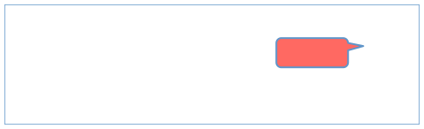
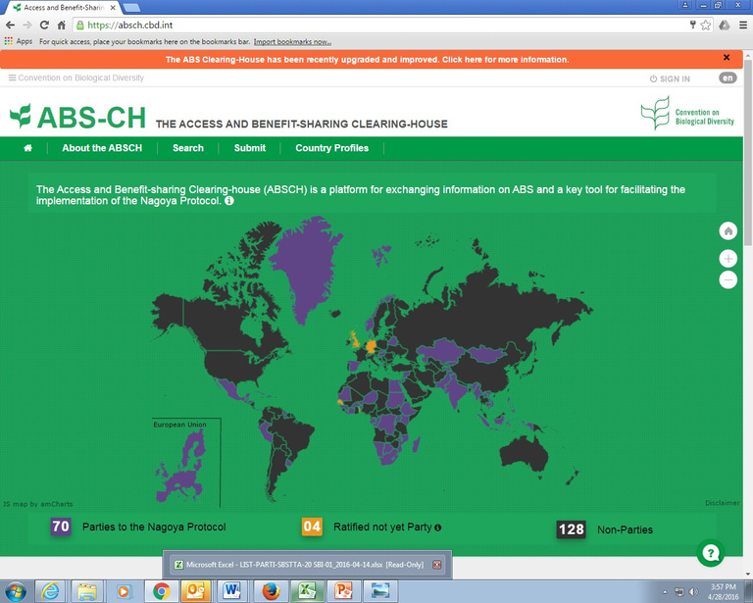

Introduction to CBD accounts The success of the ABS Clearing-House as a tool for the im plem entation of the Nagoya Protocol depends
on the collective effort and participation of Parties, non-Parties, indigenous and local communities
(ILCs), international and non-governmental organizations, research institutions and businesses in sharing
information related to access and benefit-sharing through the ABS Clearing-House.
While the information published in the ABS Clearing-House can be seen by anyone, in order to publish
records it is necessary to create a CBD account. You can also use one single CBD account to access and
manage your information registered under the CBD Website and all the Clearing-Houses (Biosafety
Clearing-House and CBD Clearing-House). Using the CBD account, and depending on your role in the ABS
Clearing-House, you can draft and publish records, and edit your published records in the ABS Clearing-
House.
Anyone with a CBD account can submit reference records for final publication by the Secretariat. For
national records, you would need to have been designated as publishing authority (PA) or national
authorized user (NAU). If you need assistance in assigning PA or NAU roles through the ABS Clearing-
House, please refer to the step-by-step guide on User Management in the Access and Benefit-
Sharing Clearing-House.
If you do not already have a CBD account the Secretariat would like to invite you take the simple steps
to create a CBD account.
Step 1: Click on sign in
In your web browser, go to http://absch.cbd.int to access the ABS Clearing-House. In order to submit information you must be signed in. To sign in, click the “SIGN IN” link located at the very the top right corner of any page.
Click here to sign in
Step 2: Sign up
If you do not have a CBD account, click on “Create an account”. This will open a new webpage (https://accounts.cbd.int/signup), where you will see the instructions for setting up your account. If you already have a CBD account, go to step 5.
Creating and Managing your CBD Account

Slide 3
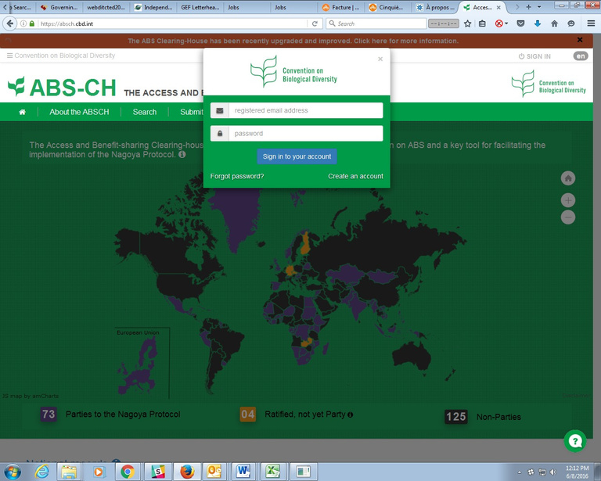


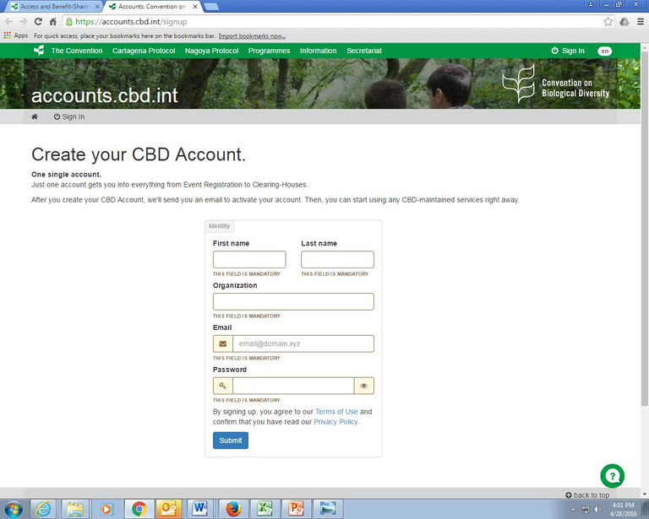

Create an account
Step 3: Create account
Follow the instructions for creating a new account; remember to fill out the mandatory fields. Your password must be at least 10 digits long and include at least: one uppercase letter, a lowercase letter, and a digit or special character (!@#$%^&*()_+-<>?/~|[]\). You may wish to use a personalized email (e.g., stephanie.chan@gotmail.org) to create a CBD account, rather than a generic email (e.g., secretariat@cbd.int).
Click ‘Submit’ after entering
i nformat ion
Step 4: Activate account
Check your email inbox for the automated welcome message from the Secretariat of the Convention on Biological Diversity (cbd-accounts@cbd.int) with the subject “Welcome to the CBD online network!” When you click on the activation link provided in the email it will validate your email address and complete the registration process. It can take up to an hour upon signing up for you to receive your welcome email. If you are unable to locate the welcome email in your inbox, check your spam/junk folder. If you still can’t locate the welcome email in your inbox or spam/junk folders, click on the button ‘resend the welcome email’.
Creating and Managing your CBD Account

Slide 4
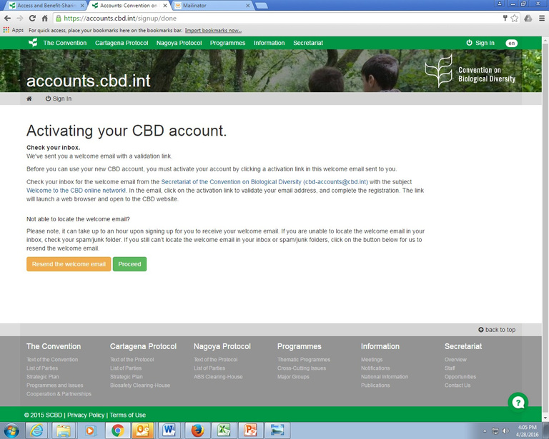



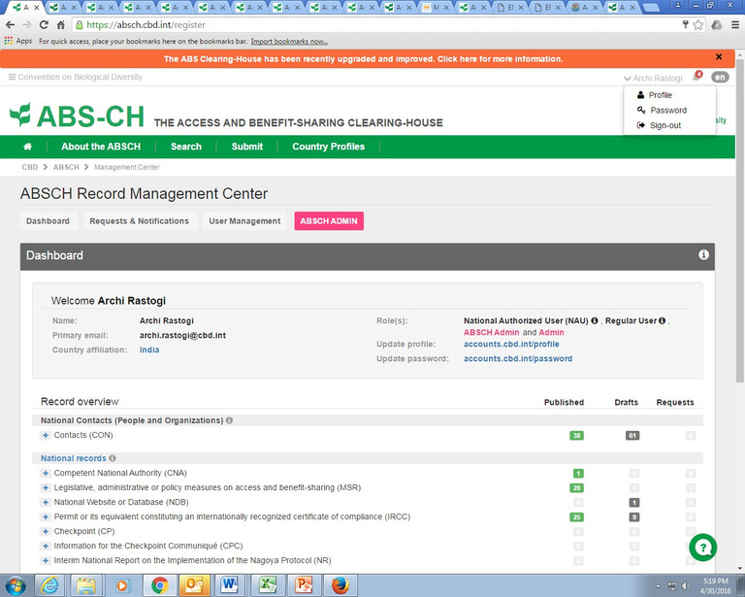

Cl ic k “P roce e d ” to act iv ate y our
account
Step 5: Sign in
You will now be able to sign in to the ABSCH with your CBD account. To sign in, go to
http://absch.cbd.int and click on sign in at the top right of the screen and enter your email and
password. You know you are signed in when your name appears at the top right corner of the screen.
Yo ur nam e appears here; you are signed in
Step 6: Update profile and password
When you are signed in, click on your name located in the top right corner of the screen and a menu will
appear with the following options: Profile, Password, and Sign-out. These links will take you to pages
Creating and Managing your CBD Account

Slide 5



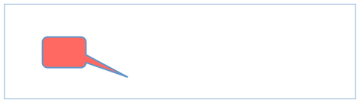
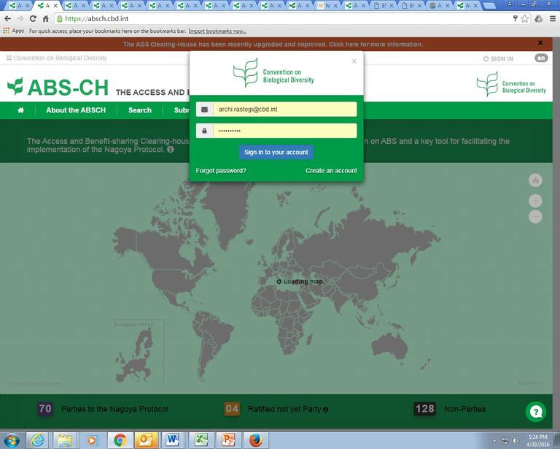
where you can update your profile or password information or simply sign out of the system. The links are also available in your Dashboard.
Si gn out
Upd ate profi le
Upd ate passw ord
Step 7: Reset a forgotten password
When you click on the link to sign in (Step 1), you will see a link “Forgot password?” When you click the link, you will be asked to enter the email address with which you created you CBD account.
‘Fo rgot password’
After filling the form, check your email inbox for an automated message with the subject “Your CBD
account password reset request”.
Creating and Managing your CBD Account

Slide 6
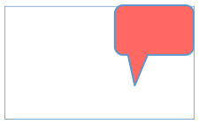
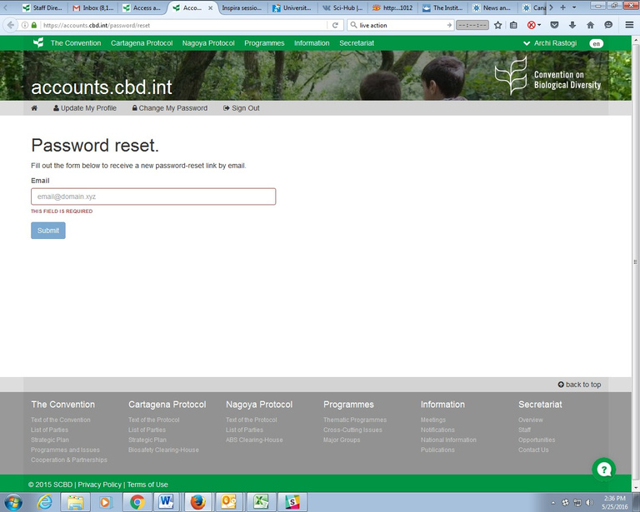

Ent e r y our e m a il address and click ‘Submit’
When you click on the link provided in the email, a new browser window will open, where you will be
asked to create a new password. Your password must be at least 10 digits long and include at least one:
uppercase letter, a lowercase letter, and a digit or special character (!@#$%^&*()_+-<>?/~|[]\). On
finishing this step, you will be able to access your CBD account again.
Step 8: Setting up your account to publish national records
In order to ensure that the national records published in the ABS Clearing-House are reliable and provide legal certainty for users, Parties (and Non-parties who wish to use the ABSCH) are to designate a single person responsible for publishing all national records. This role is referred to as the publishing authority (PA). The duties of the ABS National Focal Point (NFP) could also be expanded to incorporate the role of the publishing authority. The publishing authority can prepare draft records and publish them directly, or can designate one or more national authorized users (NAUs) to assist them in preparing draft records for their publication in the ABS Clearing-House on behalf of their country.
The NFP or the PA can designate PA or NAUs roles online. For more information on how to manage national user roles online please see the quick guide: www.cbd.int/abs/doc/guides/UserManagement.pdf
The registration of information on the ABS NFP is done by the Secretariat upon receipt of an official written communications addressed to the Executive Secretary and endorsed by the national focal point for the Convention on Biological Diversity (CBD NFP) or by a direct expression of the Government (i.e. a Minister of State). A designation form may be downloaded online and sent to the Secretariat by post, fax or e-mail.
ABS NFP Designation Form: http://www.cbd.int/abs/doc/commonformats/ABSCH-NFP.doc
Creating and Managing your CBD Account

