Slide 1

Customer Shopping Behaviour Analysis
Uncovering insights from 3,900 purchases to guide strategic business decisions

Slide 2
Problem Statement→
A leading retail company wants to better understand its customers’ shopping behavior in order to improve sales, customer satisfaction, and long-term loyalty. The management team has noticed changes in purchasing patterns across demographics, product categories, and sales channels (online vs. offline). They are particularly interested in uncovering which factors, such as discounts, reviews, seasons, or payment preferences, drive consumer decisions and repeat purchases.
You are tasked with analyzing the company’s consumer behavior dataset to answer the following overarching business question:
“How can the company leverage consumer shopping data to identify trends, improve customer engagement, and optimize marketing and product strategies?”

Slide 3

Dataset Overview
3,900
18
37
Total Purchases
Data Columns
Missing Values
Comprehensive transaction data
Customer demographics & behavior
Only in Review Rating column

Slide 4
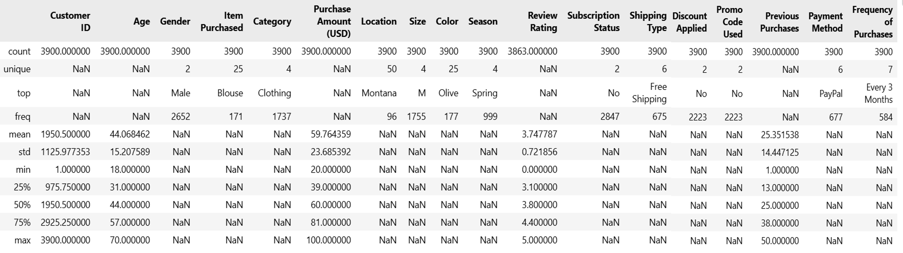
Exploratory Data Analysis using Python
Data Loading: Imported the dataset using pandas.
Initial Exploration: Used df.info() to check structure and .describe() for summary statistics

Slide 5
Missing Data Handling: Checked for null values and imputed missing values in the Review Rating column using the median rating of each product category.
Column Standardization: Renamed columns to snake case for better readability and documentation.
Feature Engineering:
○ Created age_group column by binning customer ages.
○ Created purchase_frequency_days column from purchase data.
Data Consistency Check: Verified if discount_applied and promo_code_used were redundant; dropped promo_code_used.
Database Integration: Connected Python script to PostgreSQL and loaded the cleaned DataFrame into the database for SQL analysis.

Slide 6
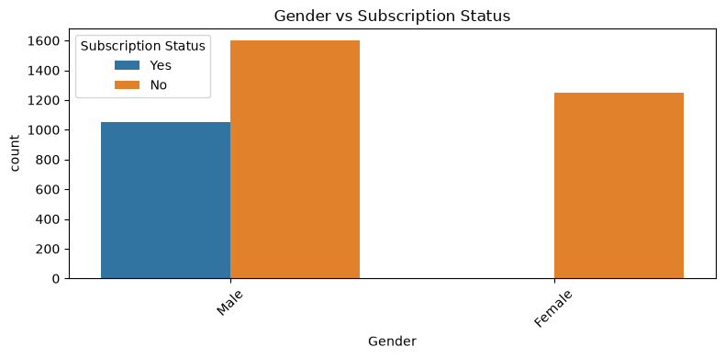
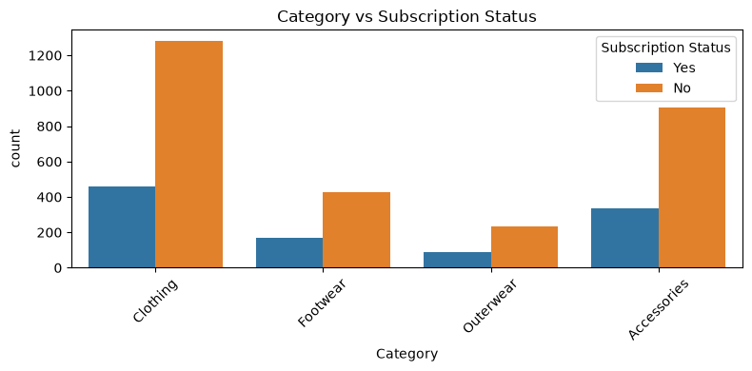
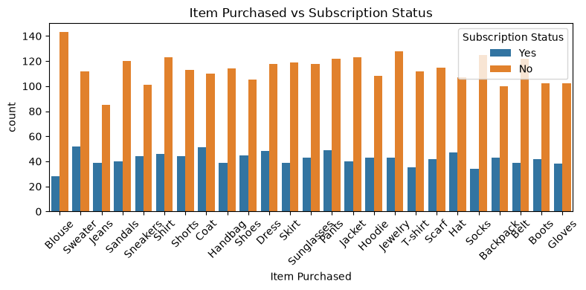

Slide 7
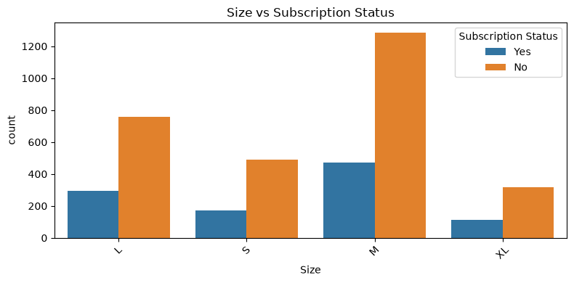
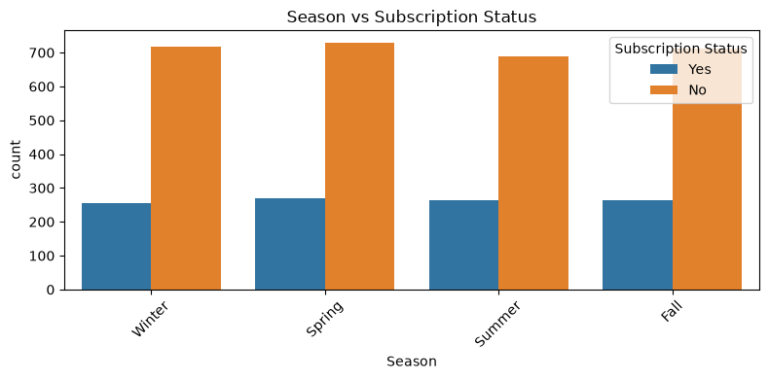
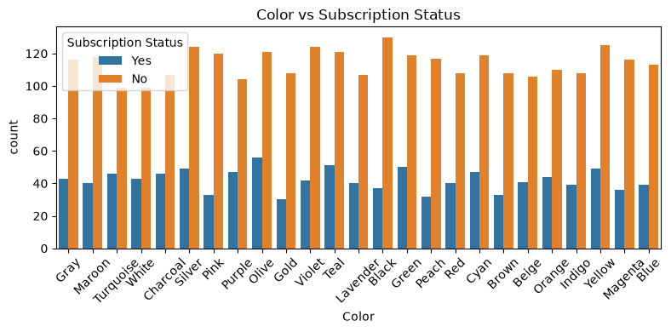

Slide 8
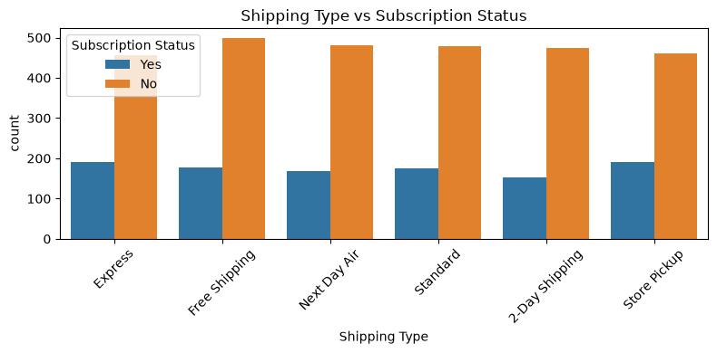
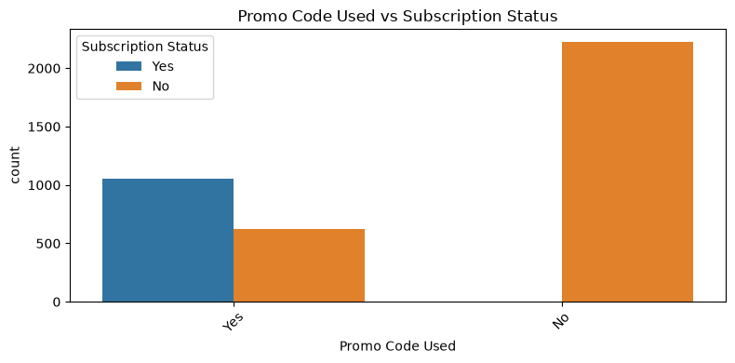


Slide 9
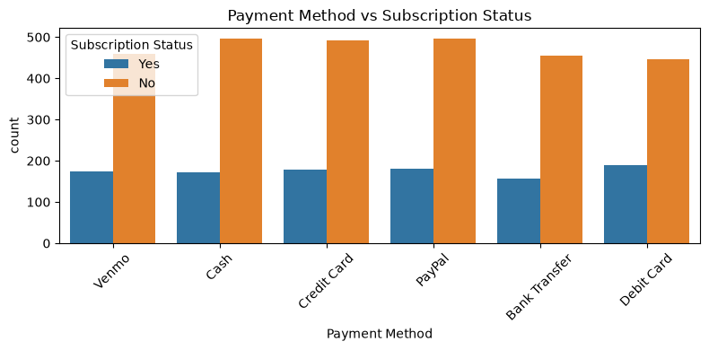
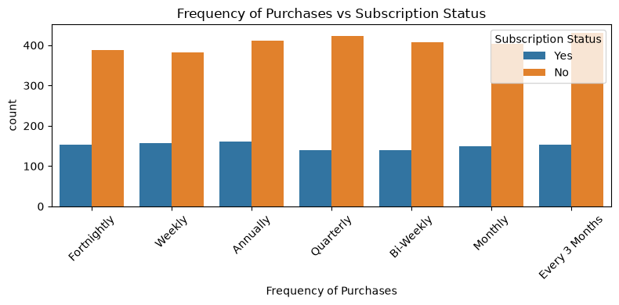

Slide 10

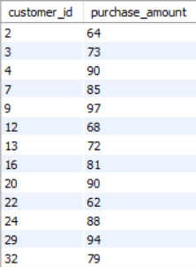

Data Analysis using SQL
Revenue by Gender – Compared total revenue generated by male vs. female customers.
High-Spending Discount Users – Identified customers who used discounts but still spent above the average purchase amount.

Slide 11
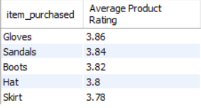


Top 5 Products by Rating – Found products with the highest average review ratings.
Shipping Type Comparison – Compared average purchase amounts between Standard and Express shipping.
Subscribers vs. Non-Subscribers – Compared average spend and total revenue across subscription status.

Slide 12
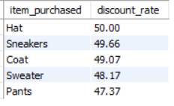
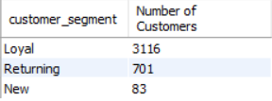
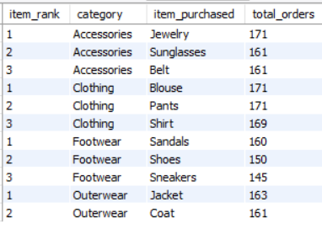
Discount-Dependent Products – Identified 5 products with the highest percentage of discounted purchases.
Customer Segmentation – Classified customers into New, Returning, and Loyal segments based on purchase history.
Top 3 Products per Category – Listed the most purchased products within each category.

Slide 13

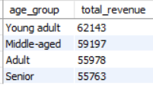
Repeat Buyers & Subscriptions – Checked whether customers with >5 purchases are more likely to subscribe.
Revenue by Age Group – Calculated total revenue contribution of each age group.

Slide 14
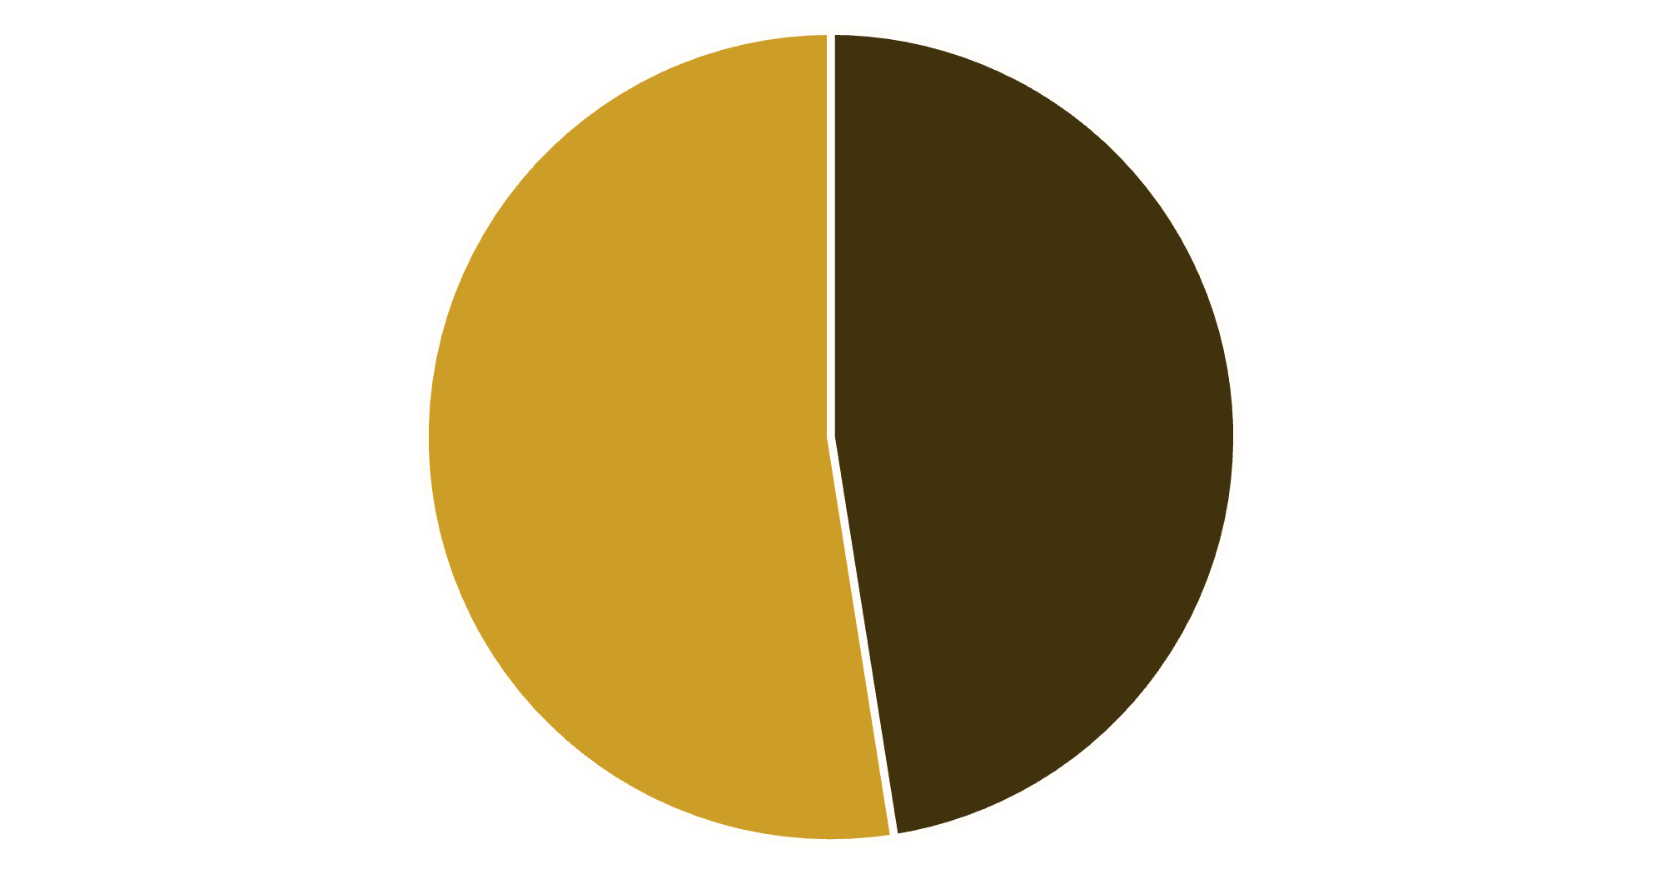

Revenue by Gender Analysis
Key Insight
Female customers generate slightly higher total revenue than male customers
Gender-based marketing strategies could optimize revenue streams
Male
Female

Slide 15

High-Value Discount Users
Customers using discounts while spending above average
Smart Shoppers
High spenders who maximize value with discounts
Strategic Opportunity
Target premium customers with exclusive offers

Slide 16



Top-Rated Products
5
5
4
Blouse
Dress
Shirt
Highest customer satisfaction
Consistently excellent reviews
Strong customer approval

Slide 17

Shipping Preferences Impact
Express Shipping
Standard Shipping
$65
$58
Average purchase amount
Average purchase amount
Express shipping customers spend 12% more per transaction

Slide 18
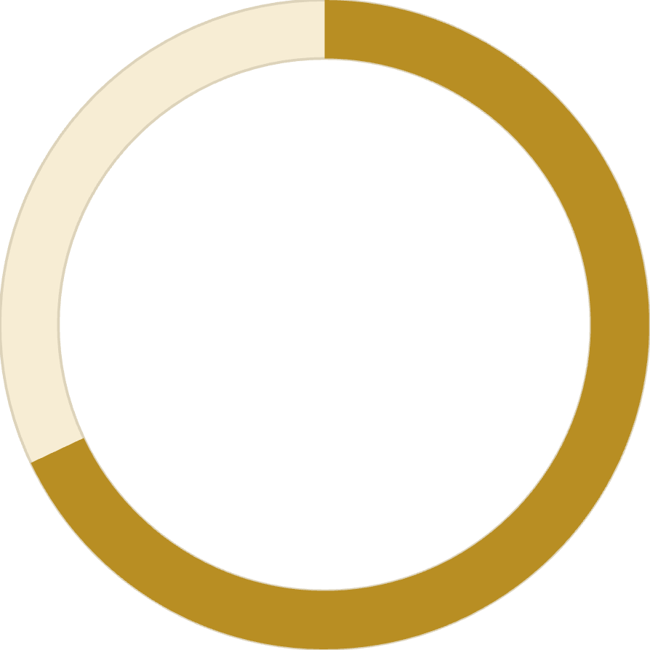

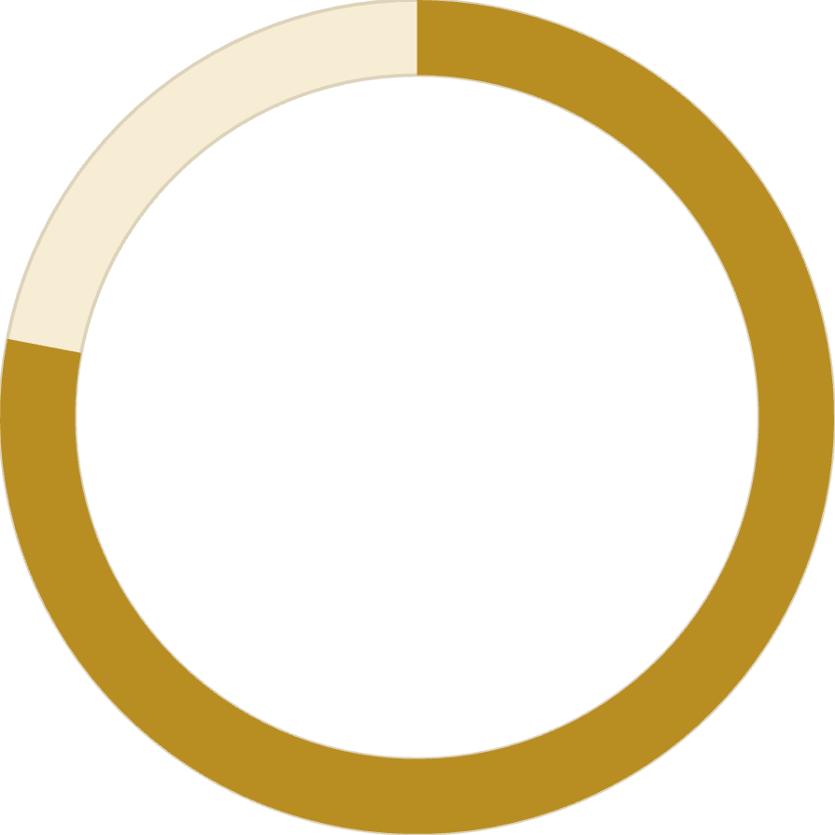
Subscription Impact
68%
45%
78%
Higher Spend
Revenue Share
Loyalty Rate
Subscribers vs non-subscribers
From subscription customers
Repeat purchase frequency

Slide 19
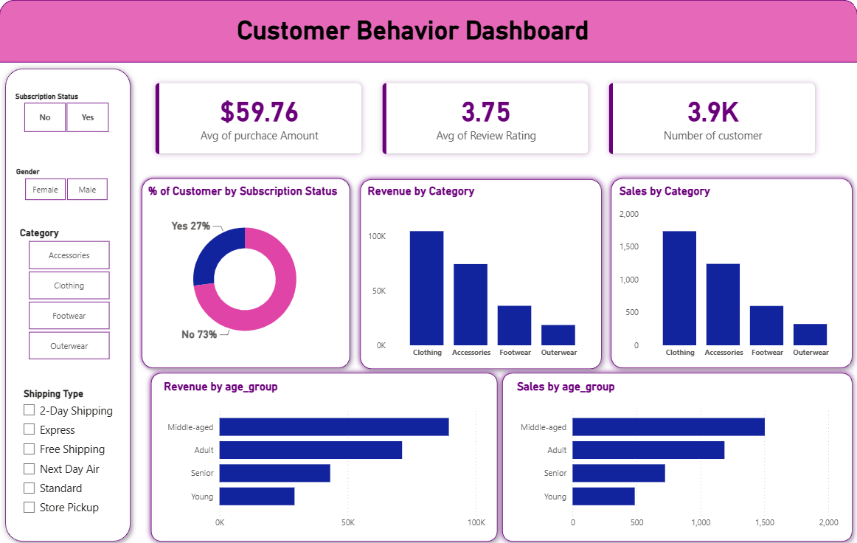
Dashboard in Power BI
Finally, we built an interactive dashboard in Power BI to present insights visually.

Slide 20





Strategic Recommendations
Strategic Recommendations
Boost Subscriptions
Promote exclusive benefits for subscribers
Loyalty Programs
Reward repeat buyers to increase retention
Targeted Marketing
Focus on high-revenue segments and express users
Product Positioning
Highlight top-rated products in campaigns

