Slide 1
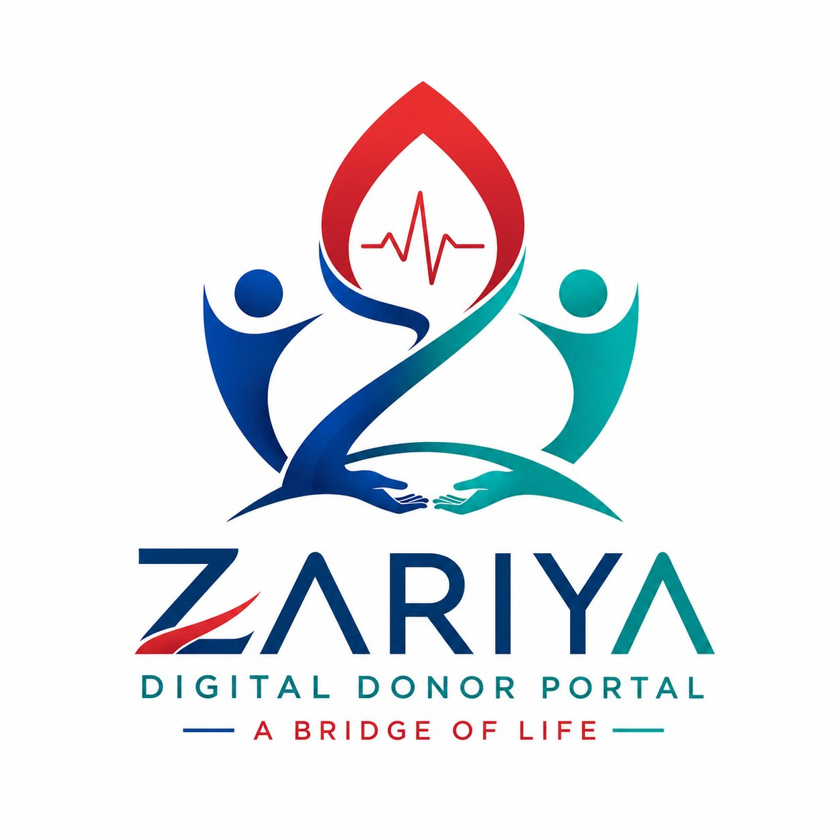
ZARIYA
A BRIDGE OF LIFE
Brand Playbook · Complete Identity Guide

Slide 2
01 / BRAND OVERVIEW
BRAND NAME
Zariya
TAGLINE
"A Bridge of Life"
CATEGORY
Digital Donor Portal
CORE IDEA
Life flows through connection
Zariya means "a medium of connection" — a digital bridge enabling life-saving help through trust, speed, and accessibility.

Slide 3
02 / BRAND PURPOSE
To Create a Trusted
Digital Ecosystem
👤
🏥
🔐
Donors
Patients
Admin
Register and offer
life-saving help
Find nearby support
quickly and easily
Ensure safety,
verification & transparency
The platform exists to connect life with life

Slide 4
03 / BRAND VALUES
❤️
Humanity First
🌍
Accessibility for All
People before process. Every decision leads with compassion and care for human life.
No barriers to help. Zariya is designed to work for everyone, everywhere.
🔐
Trust & Security
🤝
Connection & Care
Donors and patients can rely on Zariya. Privacy, verification, and data safety are non-negotiable.
Not just a platform — a network of human relationships built on mutual support.
⚡
Fast Response
In emergencies, speed saves lives. The platform is built to connect people in seconds.

Slide 5
04 / COLOR PALETTE
Visual Identity Colors
PRIMARY
ACCENT
Deep Blue
Teal Green
Soft Red
#1E3A8A
#2A9D8F
#E63946
Trust · Stability · System
Healing · Life · Success
Urgency · Alerts · Donation
SIGNATURE GRADIENT #1E3A8A → #2A9D8F

Slide 6
05 / TYPOGRAPHY SYSTEM
PRIMARY FONT
ALTERNATIVE FONTS
Inter
Poppins
Aa Bb Cc Dd Ee Ff
Friendly UI — rounded, approachable
USE: Mobile / App UI
1 2 3 4 5 6 7 8 9 0
H1 Heading
28pt · Bold
Montserrat
H2 Subhead
20pt · Semi-Bold
Body Text
14pt · Regular
Bold, strong presence
USE: Headers & Marketing
Caption / Label
10pt · Medium
Headings: Bold/Semi-Bold · Body: Regular · Buttons: Medium Weight · Always left-align body text

Slide 7
06 / LOGO USAGE RULES
✅
Use full logo on landing pages & web headers
✅
Use Z-icon only for app icon / favicon
✅
Maintain clear space equal to logo height around it
❌
Do not stretch, rotate, or distort the logo
❌
Do not change colors outside brand palette
On White Background
On Dark Background
❌
Do not place on busy or clashing backgrounds

Slide 8
07 / UI DESIGN LANGUAGE
STYLE DIRECTION
🩸 Zariya
Clean Medical-Tech UI · Soft shadows · Rounded corners 8-16px · Minimal visual clutter
🔍 Search blood group...
A+
Ahmed K.
UI EMOTION
Call
Lahore · 2km
Calm & Trustworthy · Fast & Responsive · Human-centered Design
B+
Sara M.
Call
Johar · 5km
COMPONENTS
O-
Bilal R.
Cards for donor profiles · Search-first interface · City & blood group filters · One-click contact actions
Call
Gulberg · 8km

Slide 9
08 / BRAND PERSONALITY & TONE OF VOICE
How Zariya Speaks & Acts
"Calm, intelligent, and compassionate digital helper that connects people in urgent need."
Respectful
Simple
Emotional — not dramatic
Trust-oriented
TONE EXAMPLES
✅ DO
❌ DON'T
"A donor is available near you."
"URGENT EMERGENCY!!!"
✅ DO
❌ DON'T
"Help is just a connection away."
"You MUST act NOW or it's too late!"

Slide 10
09 / APPLICATION EXPERIENCE
Login Page
Dashboard
Donor Profile
🔐
📊
👤
Soft gradient background
Clean donor cards grid
Profile photo
Centered Zariya logo
Quick search bar at top
Blood group badge
Simple clean login form
Map or city-based filters
Availability status
Brand color CTA buttons
Urgent request highlights
One-click contact button

Slide 11
10 / UX PRINCIPLES
🔍
01
⚡
02
📍
03
Search First
Minimal Steps
Location-Based
The search bar is the hero element. Donors must be findable in 2 taps or less.
From opening the app to contacting a donor: 3 steps maximum.
City and proximity filters surface the nearest available donors automatically.
📱
04
🚀
05
♿
06
Mobile-First
Fast Load
Accessible
All interfaces are designed for mobile screens before scaling to desktop.
Every screen loads in under 2 seconds. Lazy-load images, prioritize text.
High contrast, large touch targets, readable fonts — usable by everyone.

Slide 12
FINAL BRAND POSITIONING
Zariya is not just a system.
It is a life connection network
powered by trust, speed, and humanity.
A BRIDGE OF LIFE

