Slide 1
Classroom Management System
Group No :03
Contributions of different members
Member 1 (Md. Akib Hossain,16301028): Intro,Description,Use case diagram
Member 2 (Md.Alif-uz-zaman Dhrubo, 16101173): Data flow,activity diagram
Member 3 (Mohd. Rahat Bin Abdullah ,17301215): Class,Sequence Diagram,Conclusion
Notes:
1

Slide 2
Explain About your Project
For Instance
What is the story to make this project
Planning
Why build the system?
Analysis
Who, what, when, where will the system be?
Design
How will the system work?
Analysis of current system: What are the current drawbacks, restrictions or limitations
Analysis of Proposed System: Competitive Advantages, unique features, nobility, diversity, new dimensions or creative approach etc
2

Slide 3
Requirement analysis
Functional Requirements:
Admins will have the authorization of adding faculty users to the courses that they will take.
Faculty users will have the courses list with proper schedule.
Faculty will add course material and can announce anything regarding courses, exams.
Student and faculty users will have an open discussion thread.
Student users can check timings and add themselves in portal of the section of courses
Students can make post in the course section portals.
Students can submit assignment and the faculty users can check them while giving them proper feedback.
Option for video conferencing for emergency.
Non-Functional Requirements:
Our system should be available 24/7.
Users can download and upload unlimited amount of resources from the system.
Users can change the initial password to their own for security purpose.
Our system will be interactive with no system delay i.e. users can get instant help.
Only admin users can access all the information of the system.
3

Slide 4
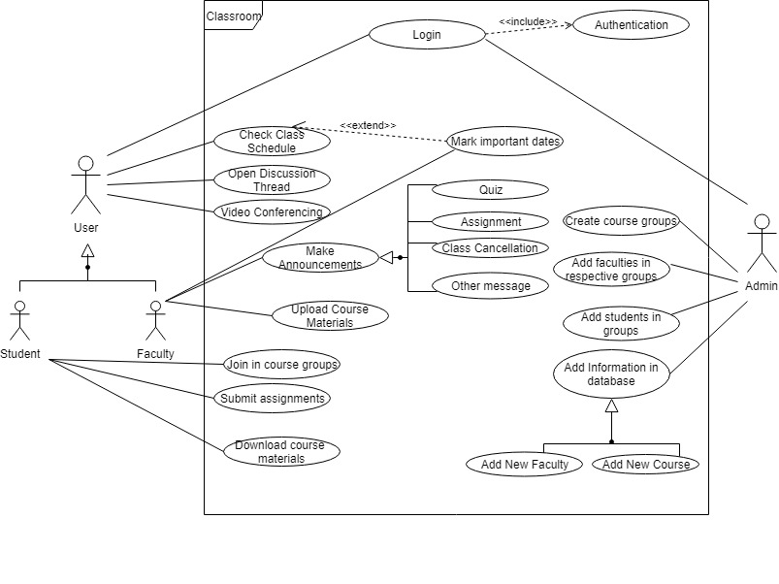
USE Case Diagram
4

Slide 5
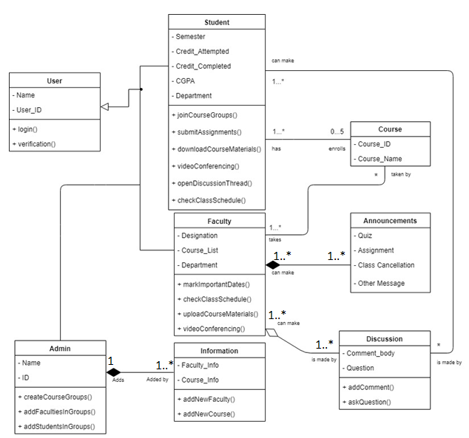
Class Diagram
5

Slide 6
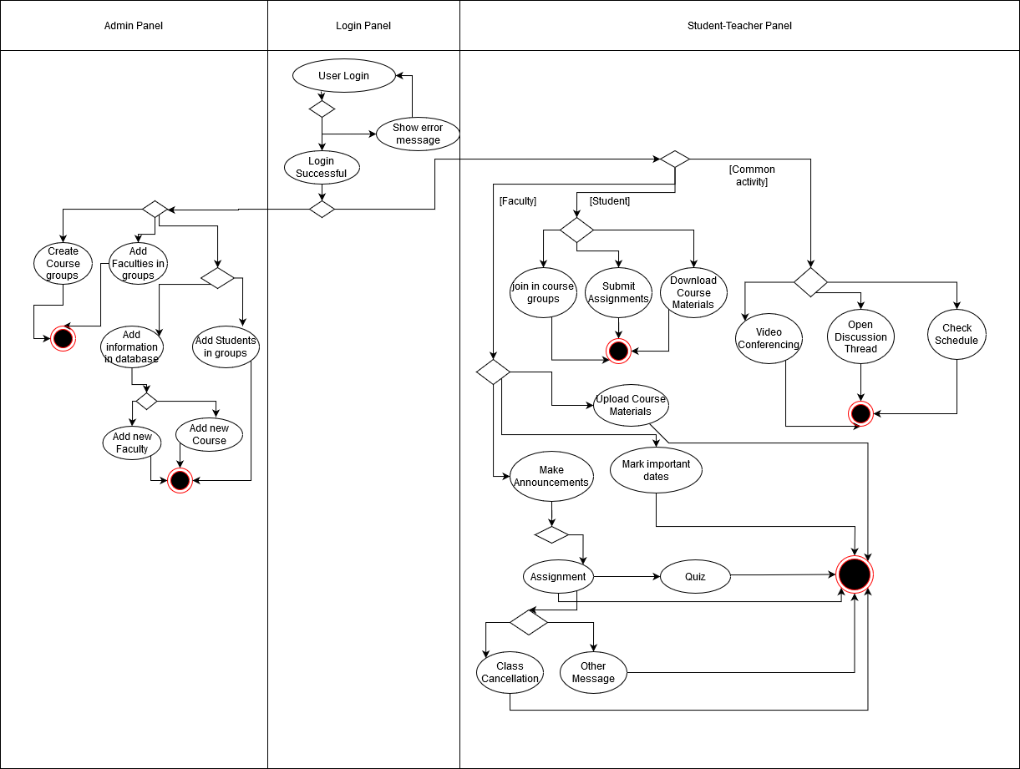
Activity Diagram
6

Slide 7
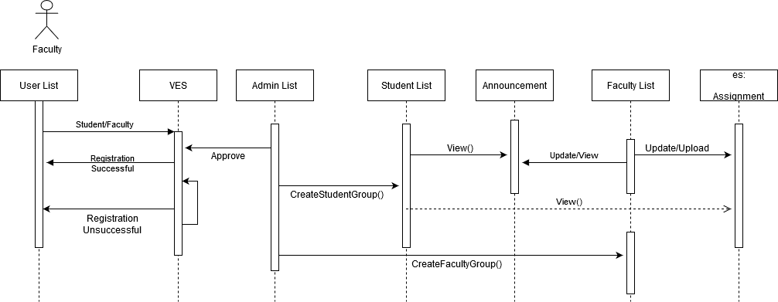
Sequence Diagram
7

Slide 8
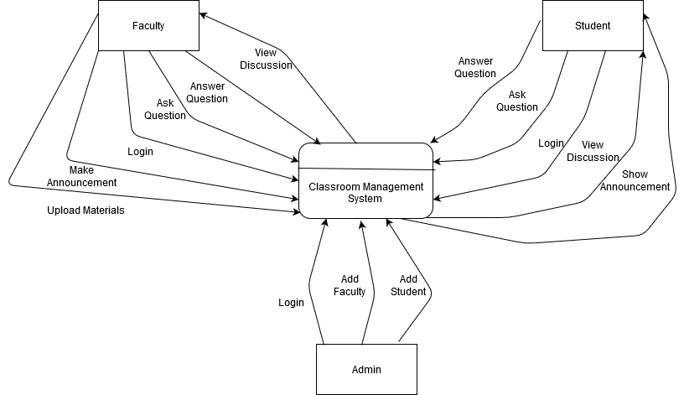
DFD Diagram
8

Slide 9
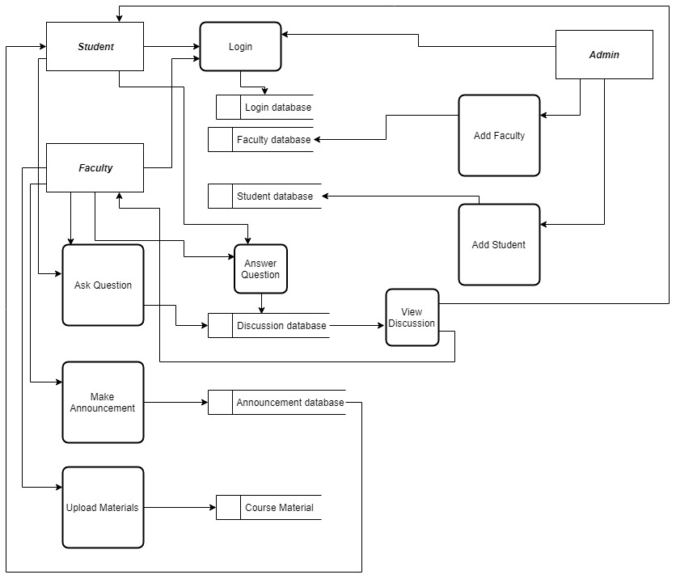
Level-1 Data Flow Diagram

Slide 10
Summary and Conclusion
In this classroom management system project we tried to build a smart classroom management system in which both teacher and students will have maximum flexibility and they can communicate with each other anytime anywhere. For this requirement we draw use-case diagram, activity diagram, class diagram, data flow diagram and sequence diagram. This diagram is useful to build our required model or system. Firstly, we plan the project then we go for system analysis and then we design our system specification. Finally, we build our new system and maintenance plan. We implemented our design through JAVA and .NET. and database will create by MySQL. In future, we add more features in our classroom management system for productive classroom. Moreover, we will add exam room, message notification, private message option, pin announcements etc. In conclusion, classroom management system is beneficial to the success of the students and faculties in modern time.
10

