Slide 1
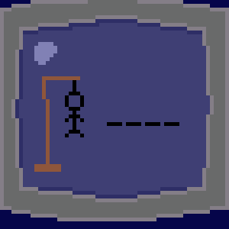
Hangman Game – Final Presentation
Group 3 MD Labib Daiyan Digonto Rahath Imran Abdullah Al Mamun MD Shahed Ahmed

Slide 2

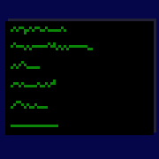
What our project is?
The classic game of Hangman
Translated from paper to the C language

Slide 3

Our engineering goals
Use of an appropriate architecture to prevent the exploitation of C vulnerabilities.
Design that focuses on a clean and readable codebase.
Visuals akin to the ones in the classic version.

Slide 4

The architecture
Entry of a secret word: an input that is securely taken and then validated.
The gameplay loop: guesses, updates state and relevant feedback.
Termination: displays a win or a loss message.

Slide 5
A deeper dive into the design
main() : controls the game flow
get_player_guess() : handles and validates the user input
print_hangman() : renders the ASCII art
print_game_state() : displays the progress of the word

Slide 6

Key feature: Secure input handling
The risk?
The solution
The presence of scanf:
It does not check input length.
This can overwrite memory on the stack.
Leading to crashes.
Safe reading with fgets().
Data sanitization with strcspn().

Slide 7
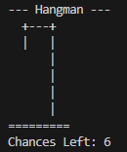
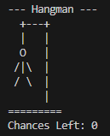
ASCII Visual Feedback
Visually stating the amount of lives the players has.

Slide 8
Testing
Results
Checked for buffer overflows and invalid inputs.
Played full games to authenticate the win/loss messages.
Used long words, duplicate guesses to check for stability.
All the tests were passed, even in extreme cases.
Game was said to be responsive and intuitive.

Slide 9
The limitations
No GUI.
No multiplayer option.
The word source being another player.

Slide 10
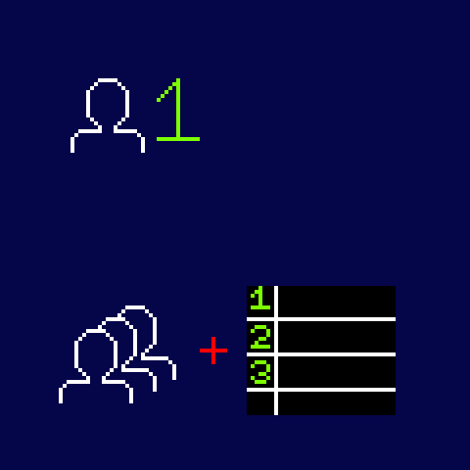
Future enhancements
Single-player with word bank
GUI or web interface
Multiplayer mode and score tracking

Slide 11
Thank you!

