Slide 1
Hangman Game Console-Based in C
Group: 3
Md. Labib Daiyan Digonto (ID:2521761642)
Rahath Imran (ID:2522916042)
Abdullah Al Mamun (ID:2522141642)
Md.Shahed Ahmed (ID:2523286042)

Slide 2
Objective
Build a fully functional Hangman game.
Effective file I/O, string handling, and logic building.

Slide 3
Features Completed
Secret word input with validation
Handling the input of the user properly
Display of hidden word with underscores

Slide 4
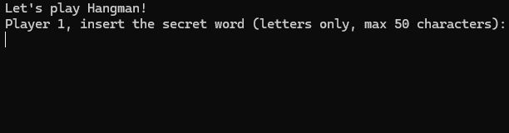

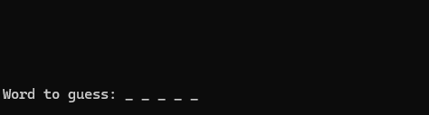
A Look Into the Game
The secret word input
Validation and reprompt
Word is hidden with underscores

Slide 5
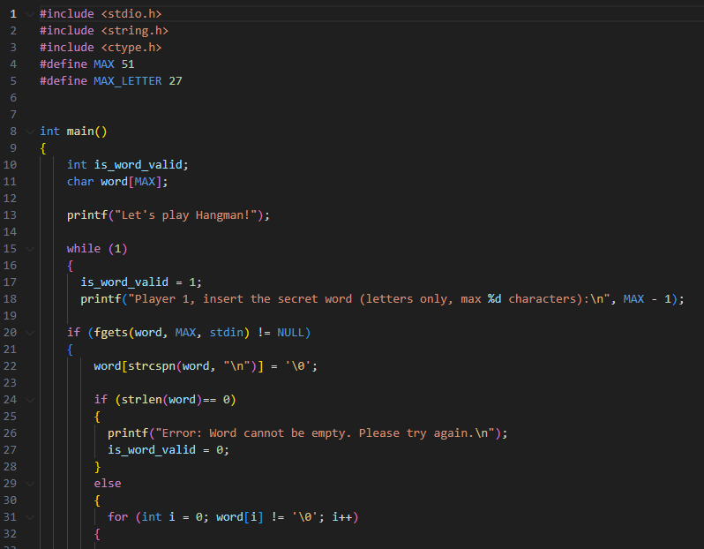
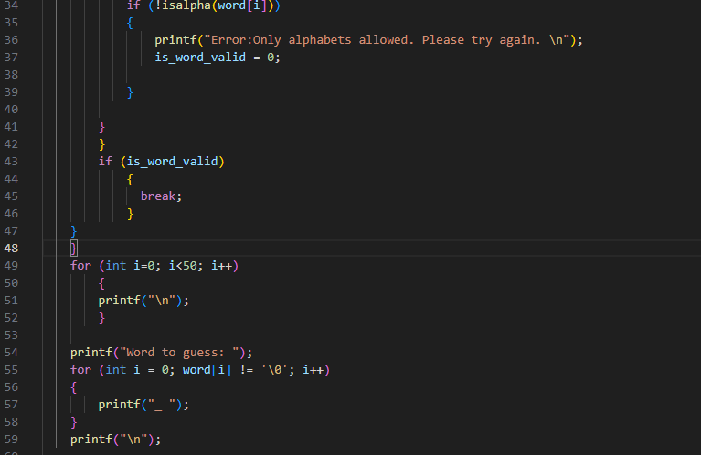
Code Snapshot
Key elements:
`fgets()`
`strcspn()`
`isalpha()`
Help received from AI: Input validation logic

Slide 6
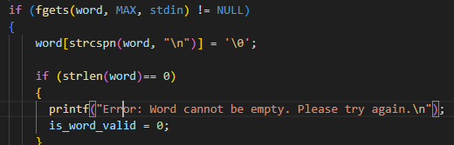
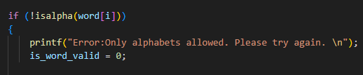
A Look Into the Elements
Restricts the number of input characters
Locates the index of “\n”
Checks whether alphabet or not

Slide 7
Next Steps
Implement guessing logic
Track guesses
Add win/loss messages

