Slide 1
Geographical 14 Bus
(Unity)

Slide 2
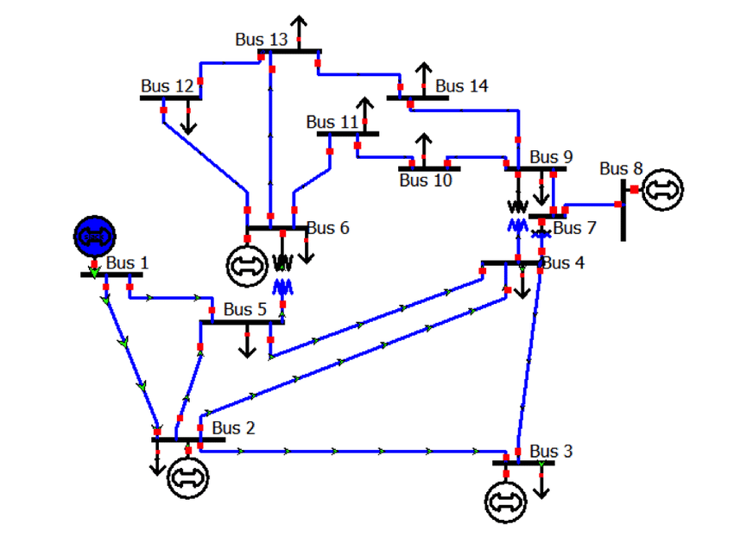
IEEE-14 Bus

Slide 3
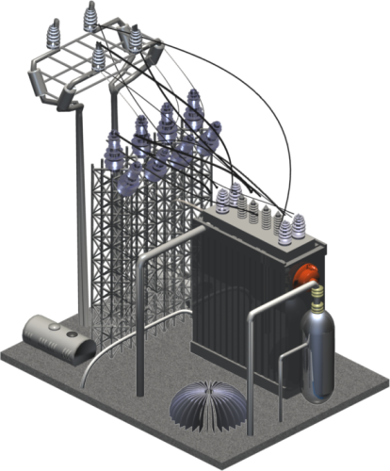
Bus 13
Bus 14
Bus 9
Line 17
Line 19
Line 20
Bus 12
Bus 11
Line 15
Line 13
Line 16
Line 11
Bus 8
Line 9
Line 12
Line 18
Line 14
Bus 1
Bus 6
Bus 10
Bus 7
Line 10
Line 8
Line 2
Line 7
Bus 5
Bus 4
Line 1
Line 5
Line 6
Line 4
Bus 3
Bus 2
Line 3

Slide 4
Bus 12
Bus 13
Line 19
Line 20
Bus 14
Unity3d Design input
Line 13
Bus 10
Bus 11
Line 12
Line 18
Line 17
Line 16
Bus 6
Line 11
Bus 9
Line 9
Line 10
Bus 4
Line 15
Bus 5
Bus 7
Line 7
Line 8
Line 14
Line 2
Line 6
Bus 8
Bus 1
Line 5
Line 4
Line 3
Bus 3
Line 1
Bus 2

Slide 5
Points
Line 1: 1 2 3 4 Line 2: 1 18 17
Line 3 : 4 5 6 7 8 Line 4: 4 11 12 13 14 10
Line 5: 4 15 16 17 Line 6: 8 9 10
Line 7: 10 20 19 17 Line 8: 10 21
Line 9 : 10 25 23 Line 10: 17 27 28
Line 11: 28 36 29 Line 12: 28 39 37 38 33
Line 13: 28 43 44 45 46 32 Line 14: 21 22
Line 15: 21 23 Line 16: 23 26 24
Line 17 : 23 35 34 31 Line 18: 24 30 29
Line 19 : 32 40 33 Line 20: 31 42 41 32

Slide 6
Bus 12
Bus 13
Line 19
32
Bus 14
33
Line 20
41
Line Points as per Unity3d
40
42
31
38
Bus 10
Line 13
24
37
34
Bus 11
Line 12
30
Line 17
39
Line 16
26
Bus 6
Line 18
36
35
29
28
Line 11
Bus 9
23
Bus 4
Line 9
Line 10
25
Line 15
Bus 5
27
Bus 8
Line 7
20
10
Bus 7
17
Line 8
22
19
14
21
Line 14
Line 2
16
9
Line 6
Bus 1
13
18
Line 5
Bus 3
12
Line 4
15
8
1
2
11
3
4
Line 1
Line 3
7
5
Bus 2
6

