Slide 1
Geographical 14 Bus
(Paper Purpose)

Slide 2
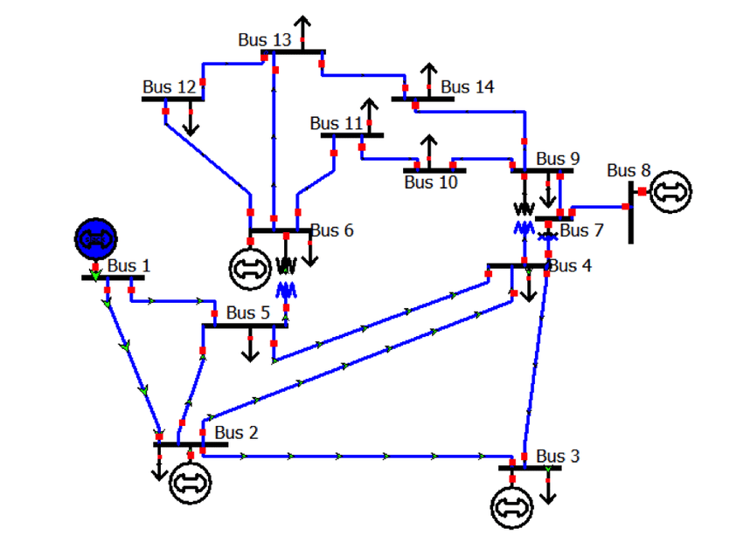
IEEE-14 Bus

Slide 3
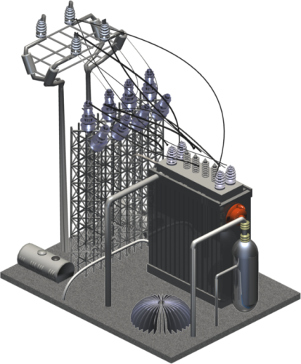
Bus 13
Bus 14
Bus 9
Line 17
Line 19
Line 20
Bus 12
Bus 11
Line 15
Line 13
Line 16
Line 11
Bus 8
Line 9
Line 12
Line 18
Line 14
Bus 1
Bus 6
Bus 10
Bus 7
Line 10
Line 8
Line 2
Line 7
Bus 5
Bus 4
Line 1
Line 5
Line 6
Line 4
Bus 3
Bus 2
Line 3

Slide 4
Points
Line 1: 1 15 16 17 2 Line 2: 1 18 19 20 5
Line 3 : 2 21 3 Line 4: 2 22 23 24 4
Line 5: 2 25 26 5 Line 6: 3 27 28 4
Line 7: 4 29 30 5 Line 8: 4 31 32 7
Line 9 : 4 33 34 35 9 Line 10: 5 36 37 38 6
Line 11: 6 39 11 Line 12: 6 40 41 12
Line 13: 6 42 43 44 13 Line 14: 7 45 46 8
Line 15: 7 47 9 Line 16: 9 48 49 50 10
Line 17 : 9 51 52 53 14 Line 18: 10 54 11
Line 19 : 12 55 56 57 13 Line 20: 14 58 59 13

Slide 5
Bus 13
58
59
14
12
55
56
57
13
Bus 12
Line 20
Bus 14
Line 19
44
10
41
43
Bus 10
53
Line Points as per input
42
Line 13
54
Line 12
40
Bus 6
50
Line 17
11
52
6
39
Line 18
49
51
Line 11
Line 16
48
Bus 11
9
38
35
Bus 9
37
34
Line 10
Line 9
47
Line 15
36
33
Bus 4
8
Bus 5
30
29
4
31
32
7
45
46
Bus 8
5
Line 8
Bus 1
20
Line 7
Line 14
19
24
Bus 7
18
28
1
Line 2
26
Line 5
23
15
25
27
Line 6
16
2
22
Line 4
17
3
Line 1
21
Bus 2
Bus 3
Line 3

