Slide 1

CREDIT CARD FRAUD DETECTION
BY:
ABHINAV RAHATE

Slide 2
PROBLEM STATEMENT
The Credit Card Fraud Detection Problem includes modelling past credit card transactions with the knowledge of the ones that turned out to be fraud. This model is then used to identify whether a new transaction is fraudulent or not. Our aim here is to detect 100% of the fraudulent transactions while minimizing the incorrect fraud classifications.

Slide 3
DATA description
The data set is highly skewed, consisting of 492 frauds in a total of 284,807 observations. This resulted in only 0.172% fraud cases. This skewed set is justified by the low number of fraudulent transactions.
The dataset consists of numerical values from the 28 ‘Principal Component Analysis (PCA)’ transformed features, namely V1 to V28. Furthermore, there is no metadata about the original features provided, so pre-analysis or feature study could not be done.
The ‘Time’ and ‘Amount’ features are not transformed data.
There is no missing value in the dataset.

Slide 4
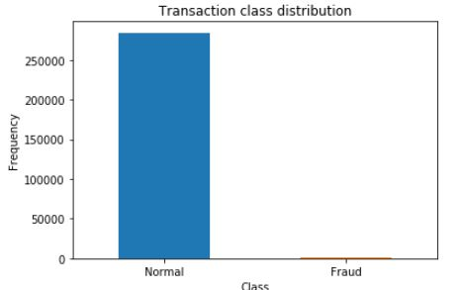
exploratory data analysis
TRANSACTION CLASS DISTRIBUTION

Slide 5
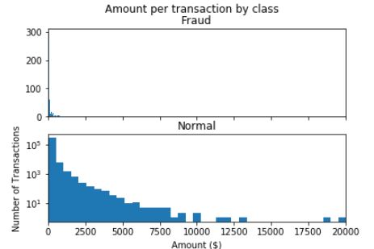
Amount per transaction by class

Slide 6
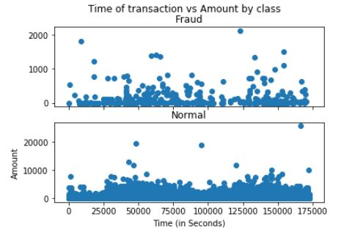
Time of transaction vs Amount by class

Slide 7
WHAT is imbalance class ?
Imbalanced data refers to a situation where the number of observations is not the same for all the classes in a classification dataset.
Machine learning classifiers such as Random Forests fail to cope with imbalanced training datasets as they are sensitive to the proportions of the different classes. As a consequence, these algorithms tend to favor the class with the largest proportion of observations (known as majority class), which may lead to misleading accuracies.

Slide 8
BALANCING the class
SMOTE stands for Synthetic Minority Oversampling Technique. This is a statistical technique for increasing the number of cases in your dataset in a balanced way. The module works by generating new instances from existing minority cases that you supply as input. This implementation of SMOTE does not change the number of majority cases.

Slide 9
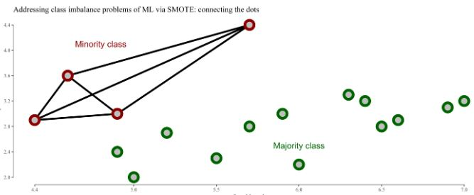
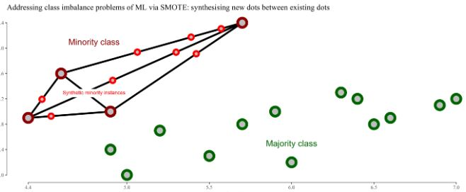
Working of smote
SMOTE synthesises new minority instances between existing (real) minority instances. Imagine that SMOTE draws lines between existing minority instances like this.
SMOTE then imagines new, synthetic minority instances somewhere on these lines.

Slide 10
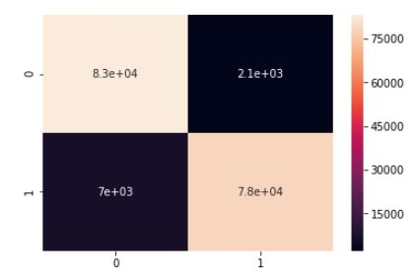
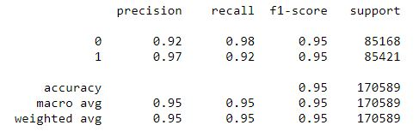
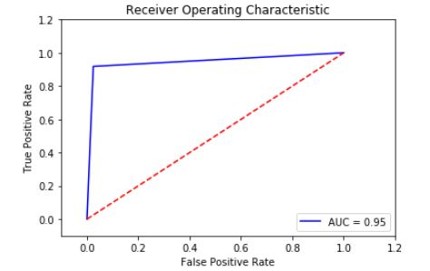
MODEL BUILDDING
LOGISTIC REGRESSION:

Slide 11
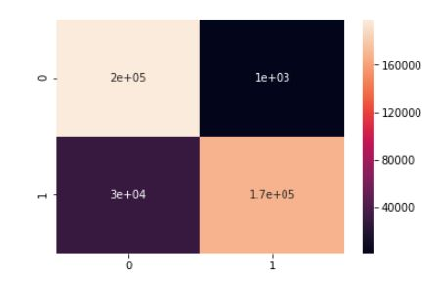
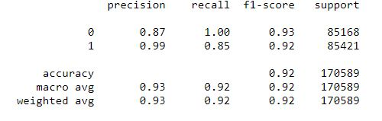
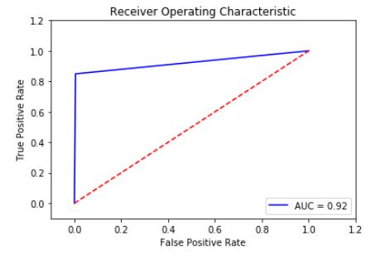
RANDOM FOREST

Slide 12
Terms:
True Positives: Correctly Classified Fraud Transactions
False Positives: Incorrectly Classified Fraud Transactions
True Negative: Correctly Classified Non-Fraud Transactions
False Negative: Incorrectly Classified Non-Fraud Transactions
Precision: True Positives/(True Positives + False Positives)
Recall: True Positives/(True Positives + False Negatives)
Precision as the name says, says how precise (how sure) is our model in detecting fraud transactions while recall is the amount of fraud cases our model is able to detect.
Precision/Recall Tradeoff: The more precise (selective) our model is, the less cases it will detect. Example: Assuming that our model has a precision of 95%, Let's say there are only 5 fraud cases in which the model is 95% precise or more that these are fraud cases. Then let's say there are 5 more cases that our model considers 90% to be a fraud case, if we lower the precision there are more cases that our model will be able to detect.

Slide 13
The Confusion Matrix:
Upper Left Square: The amount of correctly classified by our model of no fraud transactions.
Upper Right Square: The amount of incorrectly classified transactions as fraud cases, but the actual label is no fraud .
Lower Left Square: The amount of incorrectly classified transactions as no fraud cases, but the actual label is fraud .
Lower Right Square: The amount of correctly classified by our model of fraud transactions.

Slide 14
BENEFIT
Reduction in number of Fraud Transaction.
User can safely use his credit card /debit card for online transaction
Added layer of security.

Slide 15
Conclusion
Implementing SMOTE on our imbalanced dataset helped us with the problem of imbalance labels (more number fraud than fraud transactions).
Both the algorithm performance almost similar, but Random Forest perform slightly Better then a Logistic Regression.

Slide 16
THANK YOU

