Slide 1
PSO wind farm layout optimization
Guido Zuidhof
Luc Nies

Slide 2

The problem
2nd Edition of the Wind Farm Layout Optimazation Competition
Find a good wind farm layout
  Minimize the cost of energy
  Tested on 5 unknown scenarios

Slide 3
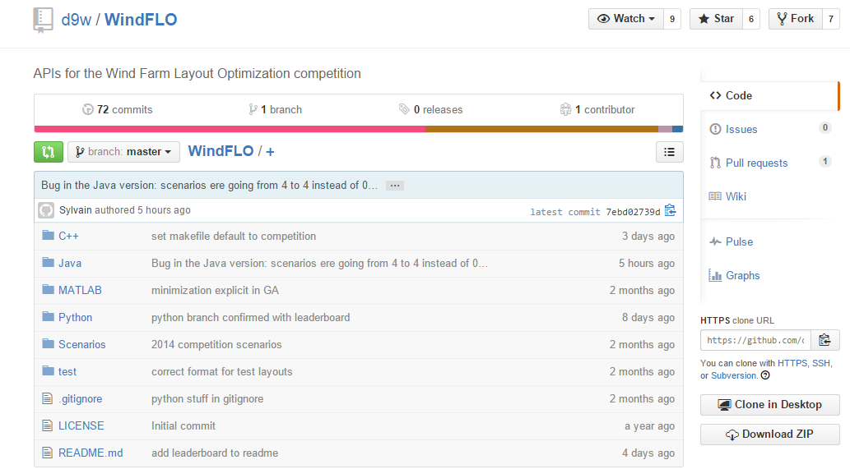
The API
Written in C++, Java, Python and MATLAB
Online layout evaluator
Now with leaderboard!

Slide 4


layout
Fitness
measures

Slide 5
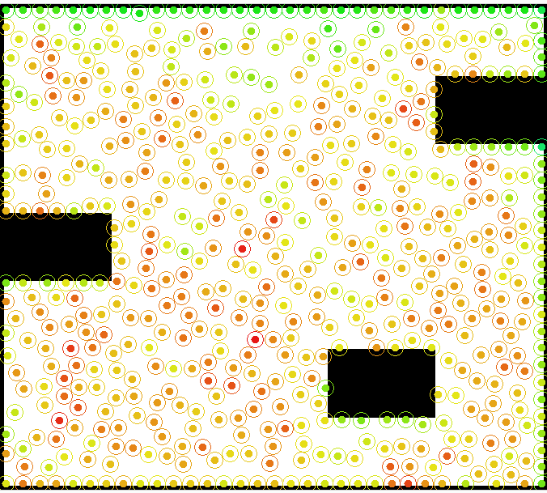
The scenarios
Obstacles
Wind direction
Wind power
Size

Slide 6
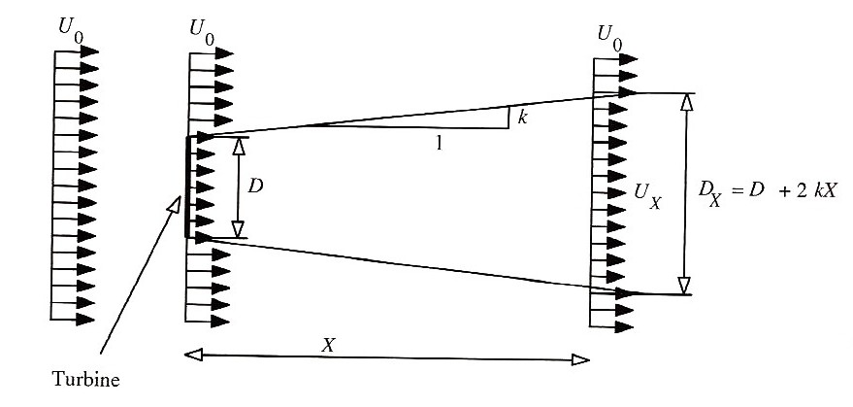
The evaluator: Wind wake effect
Wind turbine slows down wind
24 different directions are considered
Source: a novel method for optimal placing wind turbinges in a wind farm using PSO, Rasoul Rahmani et al.

Slide 7
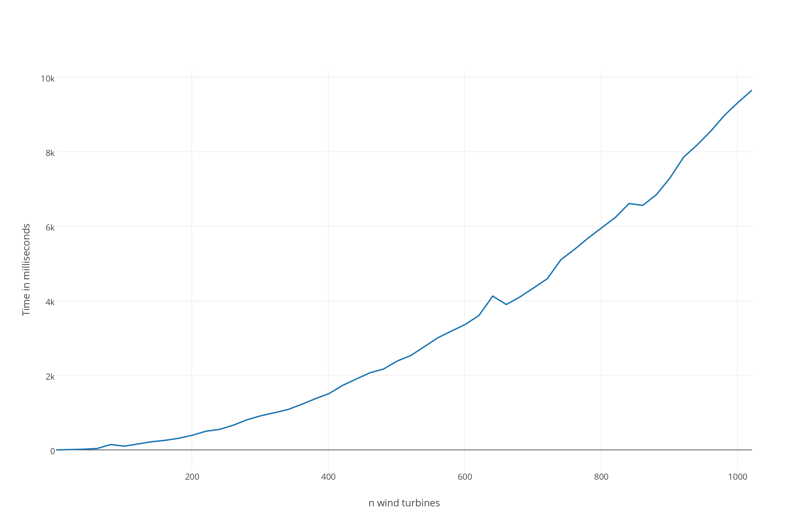
The evaluator: Calculating wind wake
Many different wind directions
Computationally very expensive

Slide 8
Our approach: Particle Swarm Optimalization
Each wind turbine is a particle
Pulled towards personal best
Pulled towards global best
Separation: turbines repel each other
Remove turbines with low fitness
Add turbines at random

Slide 9
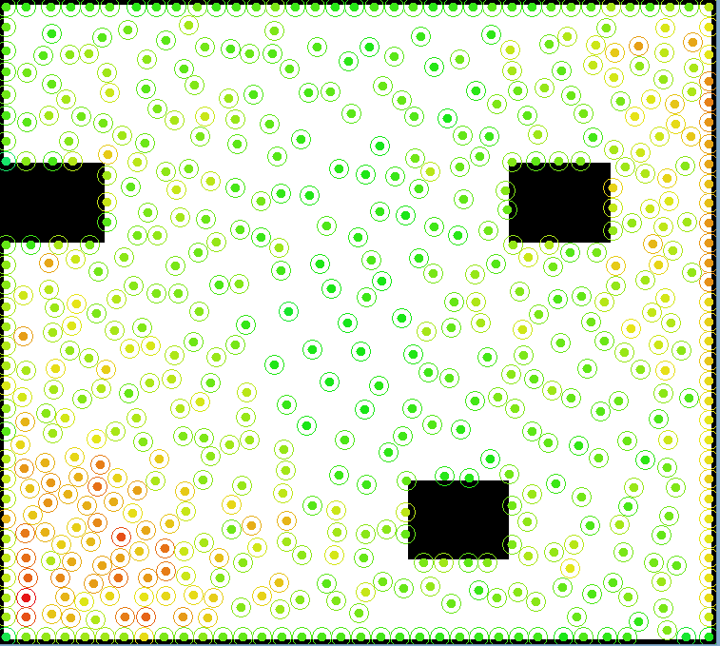
Progress
Fully implemented method
Remove/add strategy
Finetuning of parameters
  Social coefficient
  Individual coefficient
Demo

Slide 10
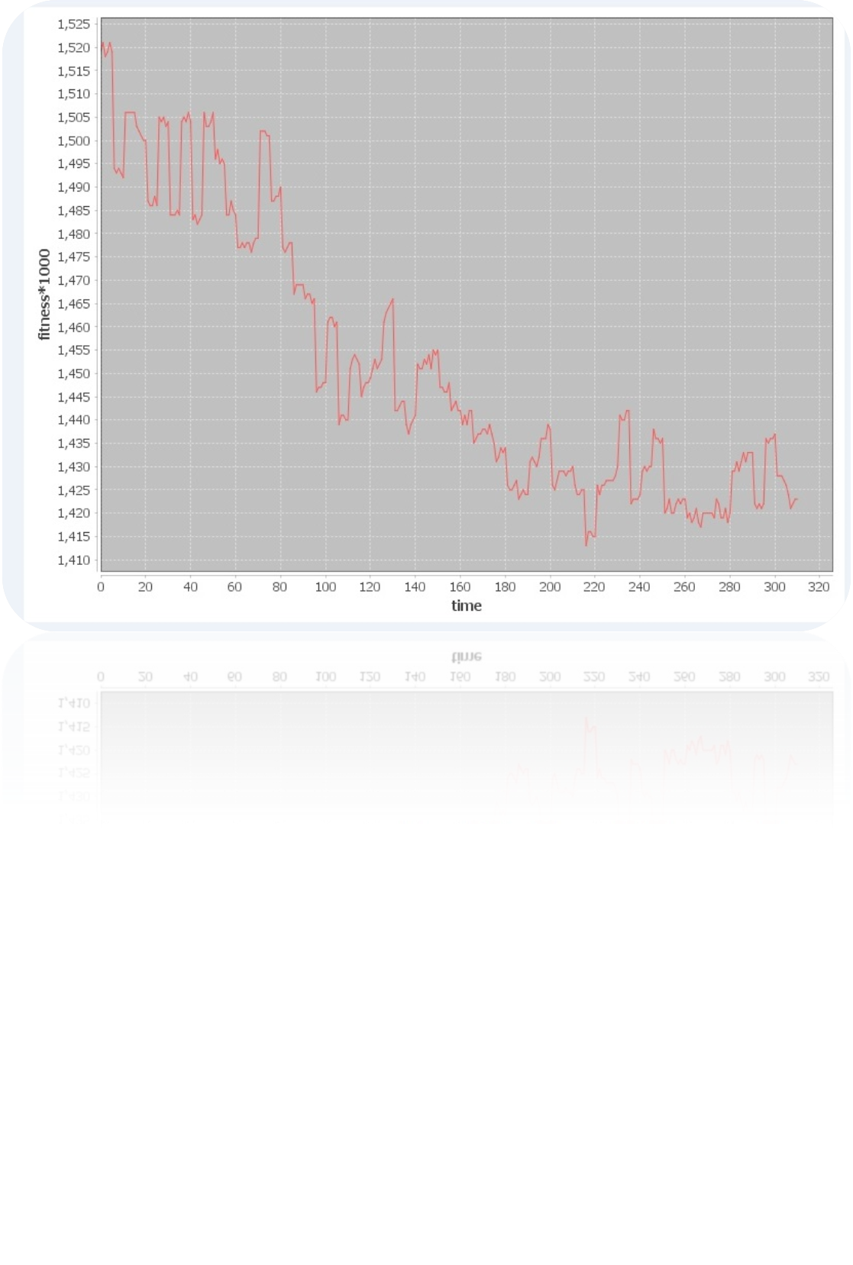
Performance so far
Iteratively improving algorithm on half the scenarios
Fourth on the leaderboard

Slide 11
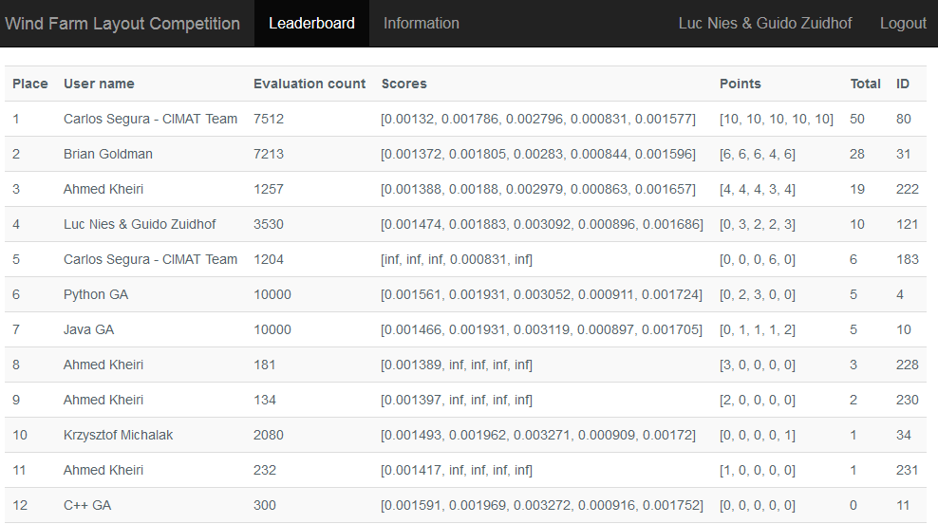
Is PSO worth pursuing for wind farm layout optimization?

