Slide 1
PSO wind farm layout optimization
Guido Zuidhof
Luc Nies

Slide 2

The problem
2nd Edition of the Wind Farm Layout Optimazation Competition
Find a good wind farm layout
  Minimize the cost of energy
  Tested on 5 unkown scenarios

Slide 3
The API
Written in C++, Java and MATLAB
Layout evaluator
20 training scenarios
Simple GA as benchmark

Slide 4

The scenarios
20 different scenarios
Differ in obstacles
Differ in wind power

Slide 5
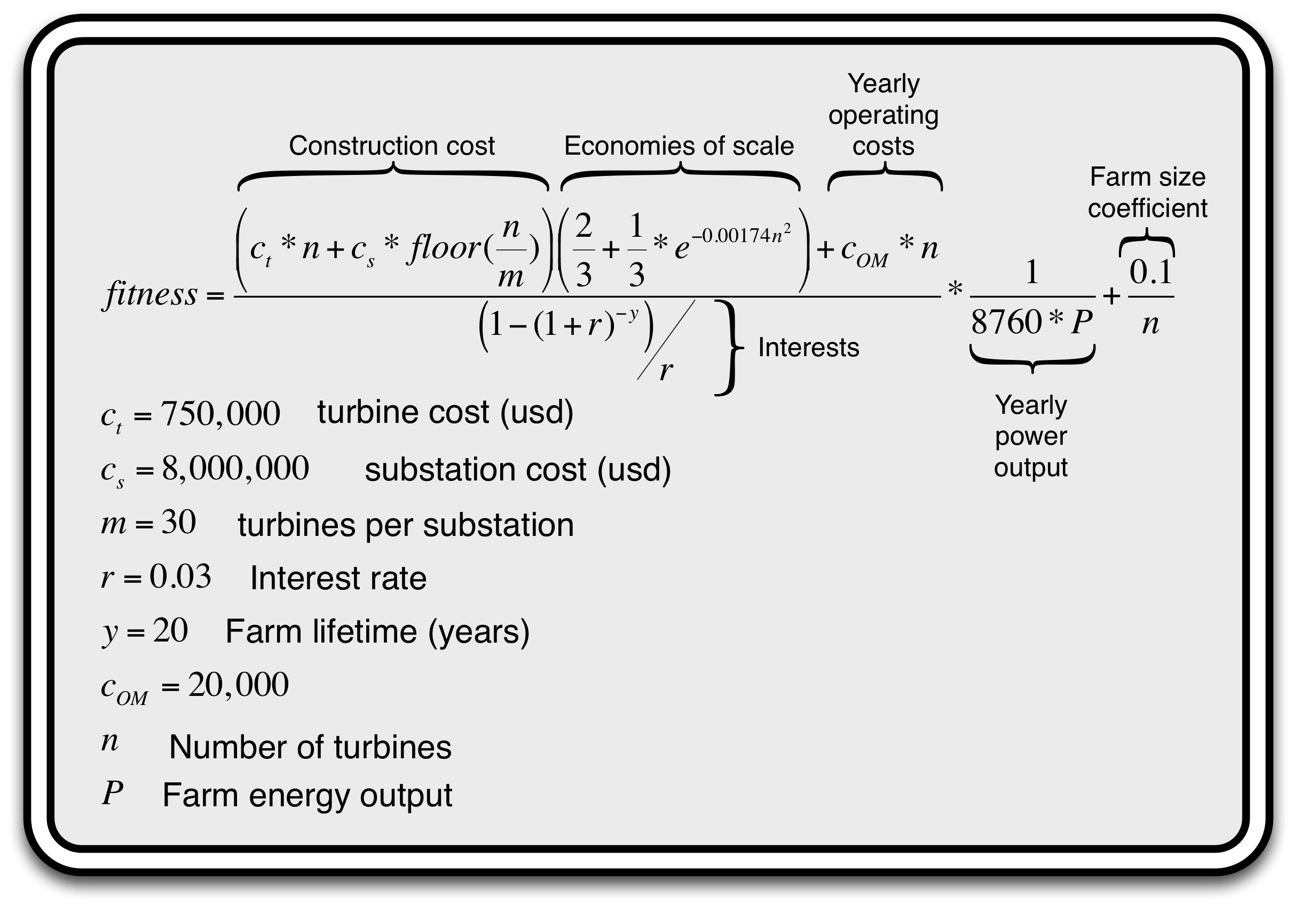
The evaluator: The fitness function

Slide 6
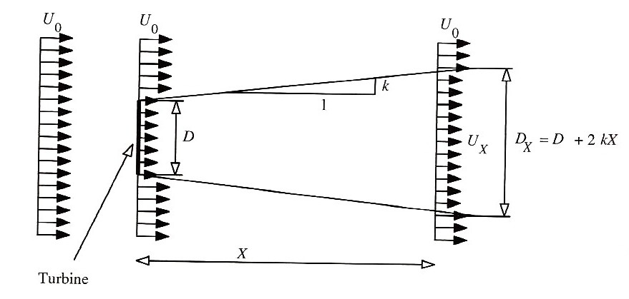
The evaluator: Wind wake effect
Wind turbine slows down wind
Source: a novel method for optimal placing wind turbinges in a wind farm using PSO, Rasoul Rahmani et al.

Slide 7
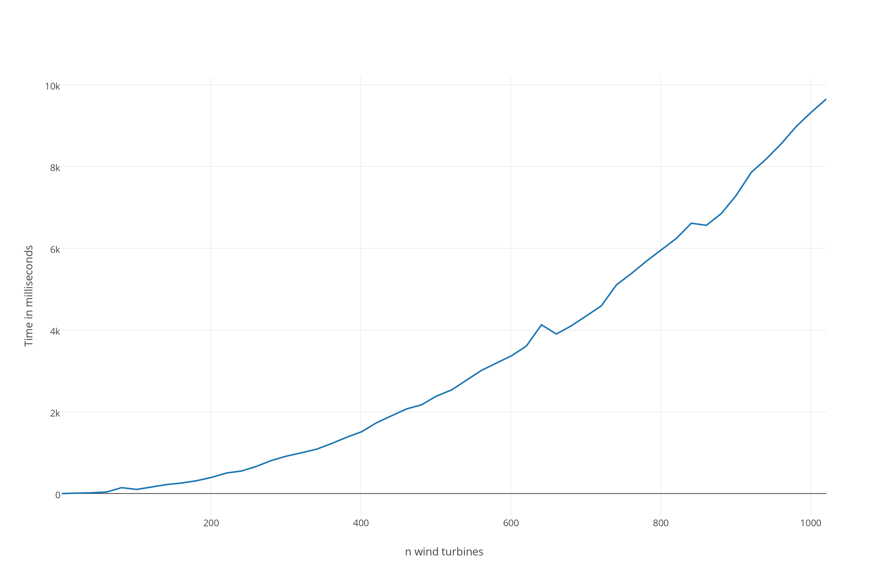
The evaluator: Calculating wind wake
Many different wind directions
Computationally very expensive

Slide 8
Our approach: Particle Swarm Optimalization
Each wind turbine is a particle
Pulled towards personal best
Pulled towards global best
The better the score, the heavier
The better the score, the more repulsive

Slide 9
Work so far
Random particle movement
Using physics engine for particle movement
GUI
Demo!

Slide 10
Verification
No open leaderboard
GA as benchmark
Random benchmark
Maximum possible turbines benchmark

Slide 11
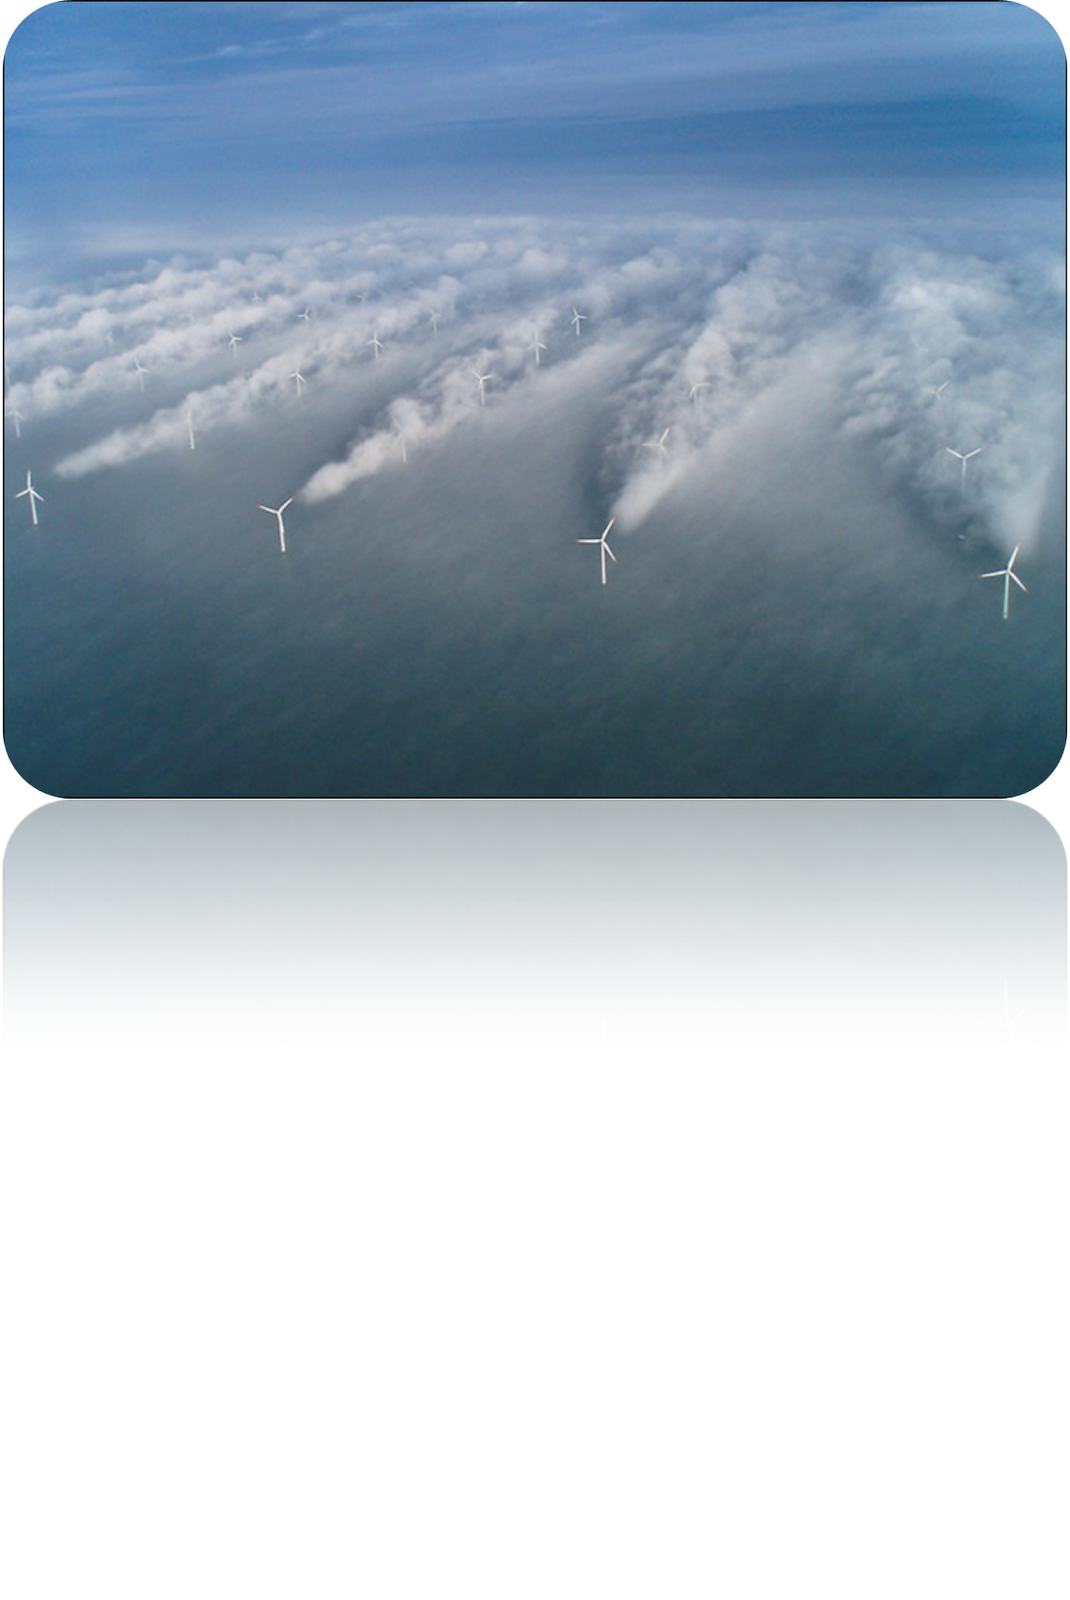
Questions?

