Slide 1

Clarus
AI-assisted patient follow-up that fills clinic calendars and recovers lost revenue
.
Notes:
Tell your origin story here: why you started Clarus, and what you saw in clinics that made you build it. Keep it under 30 seconds.

Slide 2
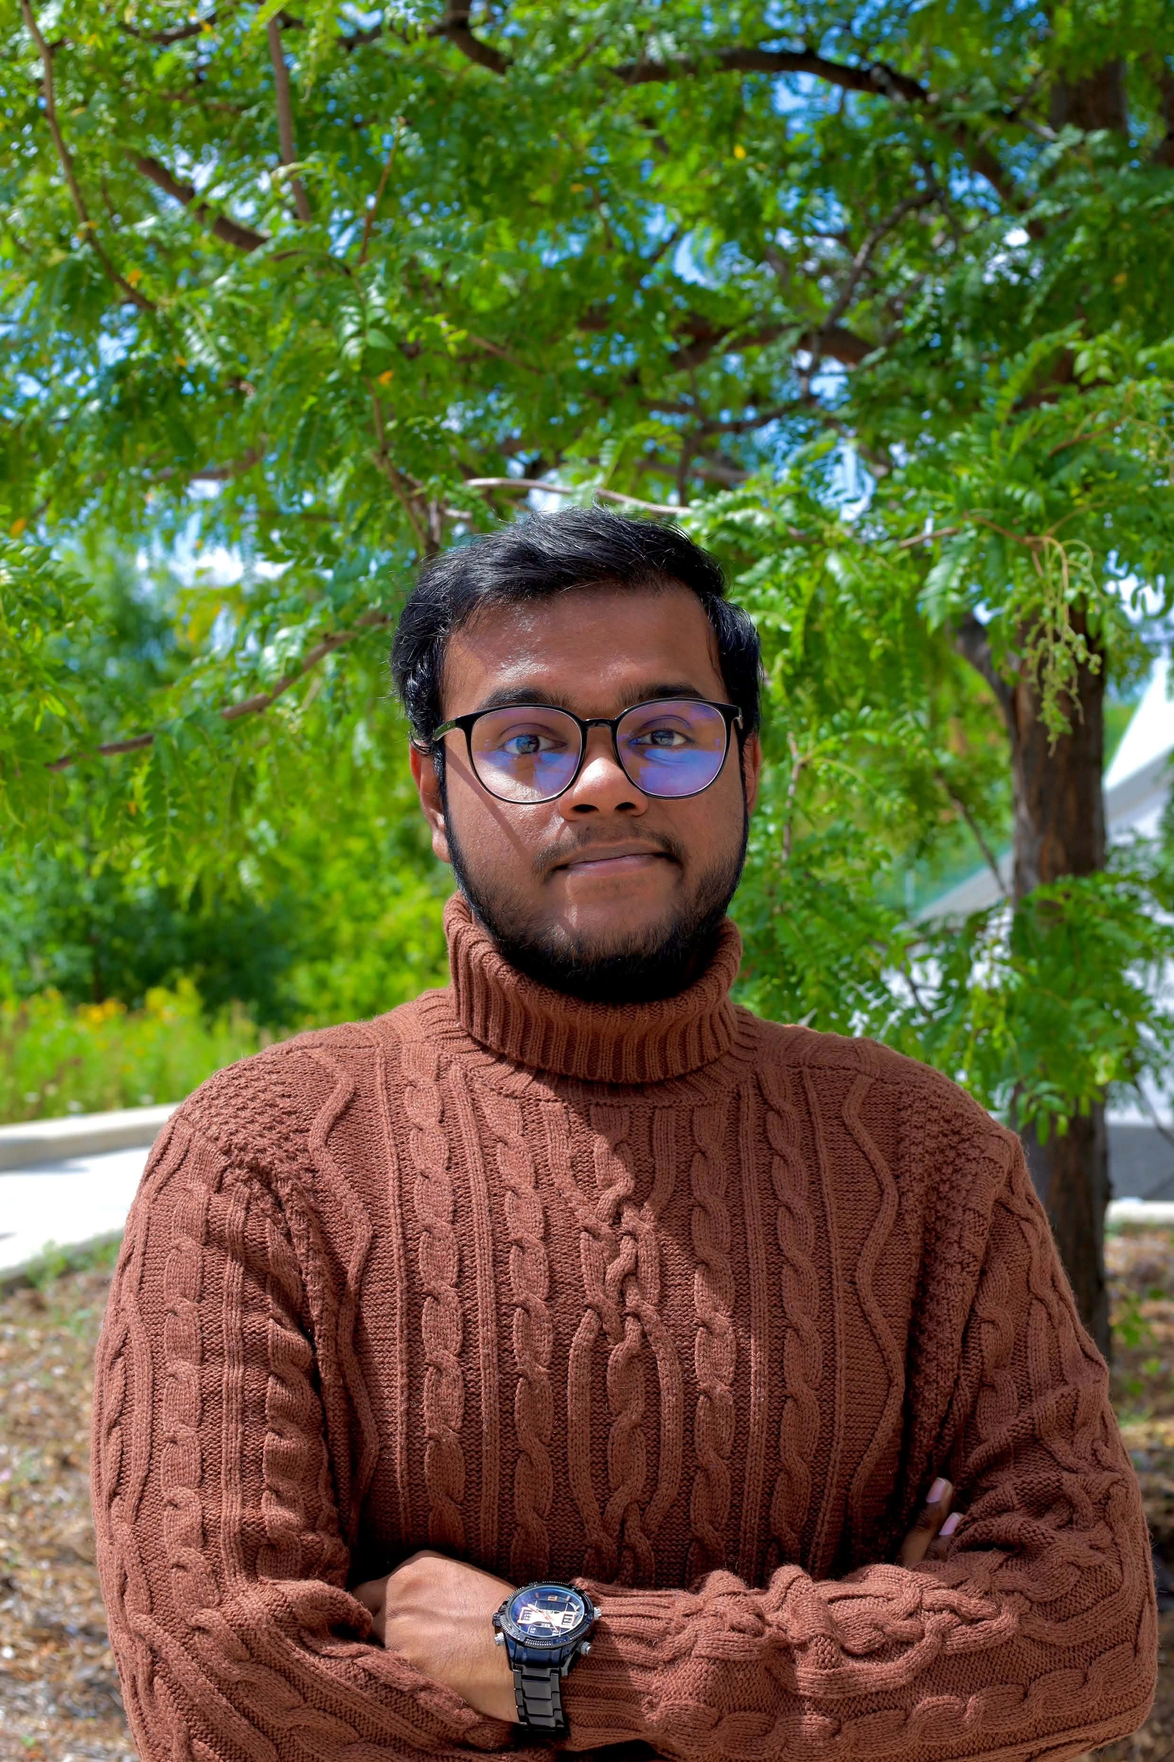

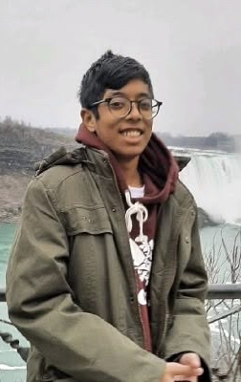
Team
Mohammed Faraz Kabbo
Rubaiya Hassin Farheen
MD Rahbir Mahdi
Co-founder & CEO
Co-founder & COO
Co-founder & CTO
2 years of experience
AI and software engineering
6 years of experience
Business operations, finance and growth
2 years of experience
AI and software engineering
Notes:
Four founders: CEO, COO, CTO and the head advisor. Replace the bracketed placeholders with real names, one-line bios and where each person has worked. Keep bios short. Investors like to see who is full time and what each person owns.

Slide 3
The Problem
Clinics lose revenue every day to missed appointments and forgotten follow-ups, while staff burn hours chasing patients by phone.
~23%
$196
Hours
of booked appointments are missed on average worldwide. Canadian clinics report 10–25%.
average cost of one no-show in a large hospital study. A clinic losing 8 visits a week loses $30–57K a year.
of staff time go into chasing lab results, follow-ups and reschedules by hand, every week.
The opportunity: about 163,000 healthcare facilities across Bangladesh, UAE, Qatar and Canada. Around 16,200 are our first serviceable market, worth about $69M a year at our premium prices.
Sources: Medimap (Jul 2026); no-show cost study PMC4714455; Clarus financial model (Sep 2026).
.
Notes:
Make it personal. Dig into the pain clinics feel WITHOUT Clarus. Every missed visit is revenue that never comes back, and overhead does not take the day off.

Slide 4
The Solution
Clarus turns clinical events into automatic patient follow-ups by WhatsApp, SMS or AI voice call, and books the next visit.
Fewer missed visits
Follow-ups that happen
Staff time back
Automatic reminders and recalls before every appointment. Reminders lift attendance by about 11% in trial evidence; vendors report 20–50% fewer no-shows.
A lab result or a missed appointment triggers a workflow. An AI voice agent calls the patient and books the next visit.
Clinicians draw the workflow once, with no code. Every run, transcript and outcome is logged against the patient.
The result: more patients through the door with the same staff. At 1,617 paying clinics in 2031, Clarus reaches $6.8M in annual recurring revenue.
Sources: RCT synthesis and vendor reports (see model Sources sheet); Clarus financial model, base case.
.
Notes:
Every solution maps to a problem on the previous slide. Talk benefits, not features: fewer empty slots, more repeat visits, less phone chasing.

Slide 5
Technology: How It Works
What is different
Why customers care
Why it is hard to copy
A visual workflow builder: trigger, conditions, action. The patient record decides who is contacted and why. The action ends in WhatsApp, SMS or an AI voice call. We are a workflow platform, not a carrier or call centre.
No code and no extra staff. Eight safety checks run before any call and all fail closed. A full audit trail records every run, transcript and result.
Clinical rules plus safety gates plus audit, built for local languages (Bangla, Arabic, English) and in-region data hosting. HMS/EMR integrations, on our roadmap, will lock in the data advantage.
From clinical event to booked visit
Clinical event
›
Workflow checks record
›
8 safety gates
›
WhatsApp, SMS or AI call
›
Outcome written back
.
Notes:
Answer three questions only: what is different, why customers care, why it is hard to copy. Be honest that the moat deepens with integrations and data.

Slide 6
Market: Big Enough, and Ours to Enter
163K
TAM: facilities in 4 markets, ≈ $928M a year
16.2K
SAM: first serviceable clinics, ≈ $69M a year
1,617
SOM: paying clinics by 2031, built bottom-up ≈ $6.8M ARR
Market | TAM facilities | SAM clinics | Blended price / mo | SAM value today | SAM value 2031*
Bangladesh | 18,178 | 6,362 | $110 | $8.4M | $9.5M
UAE (Dubai first) | 4,000 | 2,400 | $500 | $14.4M | $16.8M
Qatar | 600 | 420 | $520 | $2.6M | $3.1M
Canada | 140,387 | 7,019 | $520 | $43.8M | $49.3M
Total | 163,165 | 16,201 |  | $69.2M | $78.7M
* Price escalation only. Canada's TAM counts every physician and dentist office; our SAM is the 5% that are Ontario multi-provider dental and specialist clinics. We use the conservative Bangladesh count from DGHS; broader registers list over 55,000 facilities.
SOM, bottom-up: [X] sales reps × [X] clinics signed per rep per month, plus partner and referral sales, gives 79 → 277 → 601 → 1,049 → 1,617 paying clinics (2027–2031); × blended price per clinic ≈ $6.8M ARR in 2031.
Sources: DGHS via The Business Standard (2025); Dubai Health Authority; Qatar MoPH (2024); ISED Canada (2025); Clarus model.
.
Notes:
TAM is every private facility across our four markets. SAM is the urban, digitally-run clinics we target first. Values are clinic counts times our blended FY2027 monthly prices. 2031 SAM value reflects price escalation only.

Slide 7
Product Roadmap
Q4 2026
2027
2028
2029
Harden and pilot
Launch BD + Canada
Dubai + integrations
Qatar + integrations
Paying clinics in Bangladesh and Canada. Add the AI voice follow-up tier with an IPTSP partner on +880 numbers.
Launch in Canada with multi-provider dental and specialist clinics once certification is in place.
Use sales representatives and incubator programs to get into direct sales and traction into the Dubai market.
Enter Qatar from Dubai. Build HMS/EMR integrations. Start ISO 27001 / SOC 2. Raise the seed round.
Harden the MVP. Free pilots with Bangladesh clinics: workflow builder and WhatsApp reminders.
Notes:
Three key features only: the workflow builder with reminders, the AI voice tier, and HMS/EMR integrations. The commentary explains why each comes next.

Slide 8
Competitive Analysis
More automation (reminders to AI voice workflows)
Weave (Canada)
$199–599 per location per month plus setup fees
Clarus
Jane (Canada)
Practice management with built-in reminders
Weave
Okadoc and GCC booking apps
Booking first, light follow-up
Jane
Local HMS vendors (BD)
BDT 1,000–30,000 per month; software, no outreach
Okadoc / GCC booking apps
Our edge: event-triggered workflows and AI voice for emerging markets, priced at the level of Weave in the Gulf and Canada, because we recover revenue, not just send reminders.
Local HMS vendors (BD)
Wider reach (one market to BD + Gulf + Canada)
Positions are Clarus's own assessment. Pricing: Capterra, G2 and vendor sites, 2026.
Notes:
List every competitor so investors never find one you left off. Positions are our assessment. Note that we plan to partner with HMS vendors, not fight them.

Slide 9
Why You Should Invest In Us
No customers yet? The pain is proven.
Small home market? We start there on purpose.
About 23% of visits are missed and each costs around $196. The MVP is built, so pilots start now.
Bangladesh is the low-cost base. 82% of 2031 revenue comes from the Gulf and Canada.
Vendors add reminders? We do more.
Strict data rules? They are our moat.
Event-triggered workflows, safety gates, audit trail and AI voice. Rivals are single-market and booking-first.
In-region hosting and ISO 27001 / SOC 2 are budgeted. Few small rivals will clear that bar.
High prices? They follow the value.
Needs a telecom partner? Voice is upside.
A $500 monthly plan is paid back by 4 to 6 recovered visits. Gulf and Canada prices match Weave.
WhatsApp and SMS work on day one. AI voice is an upsell once an IPTSP partner is in place.
Profitable from 2029, 87% gross margin by 2031 and a 9.5x base-case return at a $3.1M cap. Backing us now means getting in before the growth.
.
Notes:
This answers the previous slide, concern by concern. Read the concern, then give the answer with the number. End on the return and the timing.

Slide 10
Go-To-Market Strategy
1. Founder-led pilots and direct sales
2. Partners and events
Private, dental and diagnostic clinics with a digital front desk. Founders close the first customers with free pilots. Then one account executive per market: Dhaka and Chattogram field reps, a Dubai country manager.
Integrate with HMS/EMR vendors and sell through clinic groups and associations. Show up at Arab Health and dental expos. Referral credits for clinics that bring clinics.
Blended unit economics improve as we scale: what a clinic is worth versus what it costs to win
2027
2028
2029
2031
4.8x
8.8x
8.1x
13.5x
LTV/CAC · payback 8 months
LTV/CAC · payback 4 months
LTV/CAC · payback 5 months
LTV/CAC · payback 3 months
Notes:
Two channels only. Founder-led pilots prove results; partnerships and events scale them. Unit economics below are FY2031 steady state.

Slide 11
Business Model
Bangladesh
UAE (Dubai)
Qatar
Canada
$110
$500
$520
$520
blended per clinic per month
blended per clinic per month
blended per clinic per month
blended per clinic per month
৳6K · ৳25K · ৳50K+ plans
setup fee waived
$249 · $599 · $1,199 plans
$500 setup
$249 · $599 · $1,249 plans
$500 setup
$249 · $599 · $1,249 plans
$600 setup
Starter: WhatsApp and SMS reminders and recalls. Growth: workflows, slot filling and revenue reports. Top plan: AI voice follow-up, multi-doctor and multi-branch, priority support.
AI voice minutes above each plan's allowance are billed per minute.
Gulf and Canada prices match Weave ($199–599 per location) and go above it for groups. Bangladesh top plans stay within local software range (up to ৳30,000+), and hospital groups get custom quotes.
Blended monthly revenue per clinic grows from $194 in 2027 to $342 in 2031. Gross margin rises from 79% to 87%.
Notes:
Keep it simple: a monthly subscription per clinic location on three plans, a one-time setup fee in the Gulf and Canada, and AI voice minutes as an upsell. Prices are set by market and sit at competitor levels or above where AI voice and revenue recovery justify it.

Slide 12
Financials (Premium-Price Case)
$6.8M
ARR in 2031
$0.77M
ARR at seed (2028)
2029
first EBITDA-positive year
$K unless noted | 2027 | 2028 | 2029 | 2030 | 2031
Paying clinics | 79 | 277 | 601 | 1,049 | 1,617
Revenue | 101 | 521 | 1,491 | 3,190 | 5,735
Gross margin | 79% | 84% | 86% | 87% | 87%
EBITDA | -232 | -115 | 213 | 1,392 | 3,249
Team (FTE) | 8.5 | 14.5 | 22 | 28.5 | 34.5
Closing cash | 375 | 2,252 | 2,454 | 3,726 | 6,674
Source: Clarus pre-seed financial model, re-priced. $2M seed round assumed in 2028.
Notes:
Clarus is pre-revenue, so there is no historical data. Revenue grows from $101K in 2027 to $5.7M in 2031. EBITDA turns positive in 2029. Assumes 25% fewer sign-ups and 15% higher churn than the low-price plan, because higher prices slow sales. Hosting, AI and voice costs are raised to cover about 250 voice minutes per clinic; validate these.

Slide 13
The Ask: Capital and Connections
$600K
What we need beyond money
Seeking professional networks from all over North America
Introductions to clinic groups, dental networks and health systems in North America (Canada, United States and others)
Connections to North American healthcare investors, advisors and pilot clinics
Introductions to clinic groups and health networks in Dubai and Qatar
An IPTSP telecom partner for AI voice calls on +880 numbers
Mentors on health-data compliance and North American and Gulf go-to-market
pre-seed on a post-money SAFE
$3.1M post-money cap ($2.5M pre-money)
~20 months of runway to seed milestones
Base-case exit 9.5x (~57% IRR) at FY2031
Milestones: 79 clinics and $184K ARR by end 2027; 277 clinics and $774K ARR across three markets by end 2028.
Sources: Clarus model (valuation, cap table).
Clarus Confidential. Do not copy.
Notes:
Ask for money and introductions. Base-case return is 9.5x for the SAFE on the premium-price plan; a slower-adoption case is a real risk, so say so.

Slide 14
Use of Funds: $600K
Product & Engineering
Compliance & Infrastructure
Engineering hires
Product & design hires
AI voice tier and HMS/EMR integrations
In-region data hosting
ISO 27001 / SOC 2 and legal
Patenting and licensing
$600K
Use of Funds
Sales & Marketing
Operations & Support
Sales reps (North America, Dubai, Qatar)
Pilots, events and referral credits
Customer support hire
Clinic onboarding

Slide 15
THANK YOU

