Slide 1






Emerging and Trending IT Skills for the Future
Ambarka Raheel
October 13, 2024

Slide 2



OUTLINE
Executive Summary
Introduction
Methodology
Results
Visualization – Charts
Dashboard
Discussion
Findings & Implications
Conclusion
Appendix

Slide 3

EXECUTIVE SUMMARY
The IT industry is highly competitive and constantly evolving, requiring professionals to continuously refine their programming skills and expertise in databases. This project aims to analyze emerging trends in IT and identify key areas for skill enhancement, helping professionals stay ahead of the curve in a rapidly changing landscape.
The project focuses on analyzing the following trends:
Current Technology Usage: Understanding the technologies being widely adopted in the industry today.
Future Technology Trends: Identifying upcoming technologies that are likely to dominate the future IT landscape.
Demographics in the IT Industry: Analyzing the diversity and demographic shifts within the IT workforce.

Slide 4
EXECUTIVE SUMMARY
Key objectives of the project include:
Identifying the Top Programming Languages: Determining which languages are most in demand and relevant in current and future contexts.
Highlighting Top Database Skills: Pinpointing the most sought-after database management and development skills.
Popular IDEs: Identifying the most widely used Integrated Development Environments (IDEs) among developers.
This analysis will provide a comprehensive overview of trends in the IT sector, offering insights that can guide skill development and career growth.

Slide 5

INTRODUCTION
In today’s rapidly evolving IT industry, staying ahead of emerging trends and skill demands is crucial for maintaining a competitive edge. As technology continues to advance, professionals must continuously refine their expertise, especially in areas like programming, database management, and cloud computing. This presentation will explore the key trends shaping the future of IT, the top programming languages in demand, essential database skills, and the most popular Integrated Development Environments (IDEs).
Using data collected from job postings, training portals, and surveys, we will provide insights into the future skill requirements, helping organizations and individuals navigate this dynamic landscape and prepare for the challenges ahead.

Slide 6

METHODOLOGY
Data Sources:
Data was sourced from Stack Overflow, utilizing two datasets:
Demographics Data
Survey Data on Technologies
Survey Data:
This dataset was used to analyze both current and future technology trends. The following variables were examined:
Respondents
Languages Worked With, Databases Worked With, Platforms Worked With, Web Frameworks Worked With
Languages Desired Next Year, Databases Desired Next Year, Platforms Desired Next Year, Web Frameworks Desired Next Year
Demographic Data:
The demographic data helped provide insights into the diversity of the IT industry. It included:
Gender (Men and Women)
Age
Formal Education Level
Countries
Data Cleaning and Filtering:
Null values or missing data were removed.
The demographic analysis was limited to men and women to focus on these two gender categories.
Data Illustration & Analysis Tools:
The following tools and libraries were used for data cleaning, analysis, and visualization:
Python Libraries: Numpy, Matplotlib, Pandas, Seaborn
IBM Cognos Analytics/Looker Studio Dashboard: For creating interactive dashboards and visualizations
Jupyter Notebook: For data cleaning and in-depth analysis

Slide 7
RESULTS
The following analysis compares the graphs between current technology usage and future technology trends, highlighting key shifts in industry preferences:
Here’s a refined version of your results section for the presentation:
1. Programming Language Trends
A comparative analysis between the most widely used programming languages today and the languages that are projected to be in demand in the coming years.
2. Database Trends
An exploration of current database technologies in use and those expected to gain popularity in the future, based on industry and survey data.
3. IDE Trends
A comparison of Integrated Development Environments (IDEs) currently favored by developers versus those predicted to dominate in the future.

Slide 8
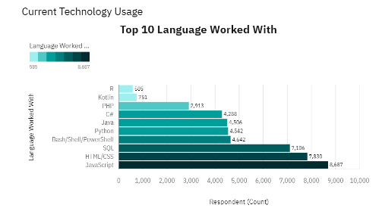
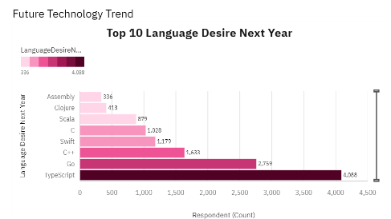
PROGRAMMING LANGUAGE TRENDS
Current Year
Next Year

Slide 9
PROGRAMMING LANGUAGE TRENDS - FINDINGS & IMPLICATIONS
Findings:
JavaScript remains the top most demanded programming language, both currently and in the future.
There is a significant increase in demand for Python, reflecting its growing importance across various domains, including data science, AI, and automation.
The overall trends in programming languages have shifted, with some emerging languages gaining traction while others decline.
The Top 5 most in-demand languages are:
JavaScript
Python
HTML/CSS
SQL
TypeScript
Implications:
JavaScript continues to be the most popular and widely used programming language in the IT industry, remaining a core skill for web and software development.
Python has rapidly become a critical skill for roles in data science, machine learning, and automation, making it essential for IT professionals to master.
The top 5 most desired skills—JavaScript, Python, HTML/CSS, SQL, and TypeScript—reflect the changing needs of the industry, where both frontend and backend skills are increasingly in demand.
The shift in desired programming languages signals the need for IT professionals to continuously update their skills to remain competitive in the evolving landscape.

Slide 10
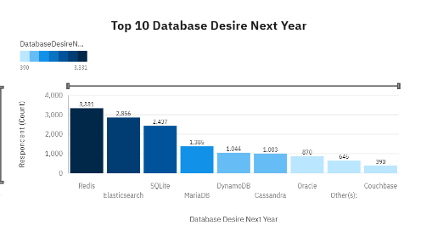
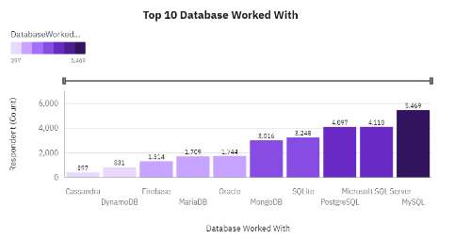
DATABASE TRENDS
Current Year
Next Year

Slide 11
DATABASE TRENDS - FINDINGS & IMPLICATIONS
Findings:
PostgreSQL, MongoDB, and Redis have emerged as the most desired databases among professionals.
There has been a notable rise in interest for MongoDB, Redis, and Elasticsearch, with approximately 10,000 more respondents indicating these databases as their preferred choices.
Oracle Database has seen a decline in popularity and is now considered less desired in the industry.
There is a drastic increase in demand for database skills, particularly for MongoDB and DynamoDB.
Implications:
PostgreSQL, MongoDB, Redis, MySQL, and Elasticsearch are recognized as the most desired and widely used databases, reflecting current industry needs.
The growing preference for MongoDB, Redis, and Elasticsearch is attributed to their enhanced functionalities and services that align with modern application requirements.
Oracle Database is increasingly seen as a less favorable option, suggesting that organizations may consider alternatives for their database solutions.
There is a need for further research on DynamoDB, as its growing usage indicates a shift in database architecture that may require more understanding and expertise.

Slide 12
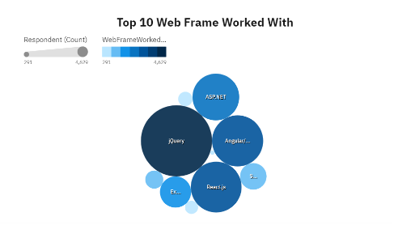
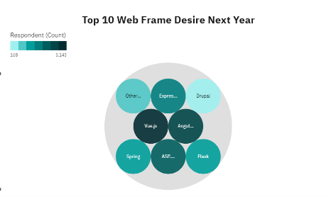
IDE TRENDS
Current Year
Next Year

Slide 13
IDE TRENDS - FINDINGS & IMPLICATIONS
Findings:
Trends in Integrated Development Environments (IDEs) indicate significant changes in developer preferences:
There has been a drastic decrease in the use of jQuery, reflecting a shift away from this framework in favor of more modern alternatives.
Both React.js and Vue.js have seen a dramatic increase in desirability as IDEs, indicating a growing preference among developers for these frameworks compared to current usage trends.
Implications:
There is a noticeable shift towards more advanced web frameworks like React.js and Vue.js, as developers seek enhanced functionality and improved user experiences.
The decline in jQuery usage suggests that it may be lacking certain functionalities compared to its competitors, which could hinder its appeal in modern web development.
As the industry evolves, jQuery may no longer be considered a necessary requirement for new technological skill sets, prompting organizations to focus on training in more relevant frameworks.

Slide 14

DASHBOARD
https://github.com/Rahee93/IBM-Data-Analyst-Capstone-Project-Module-5/tree/main

Slide 15
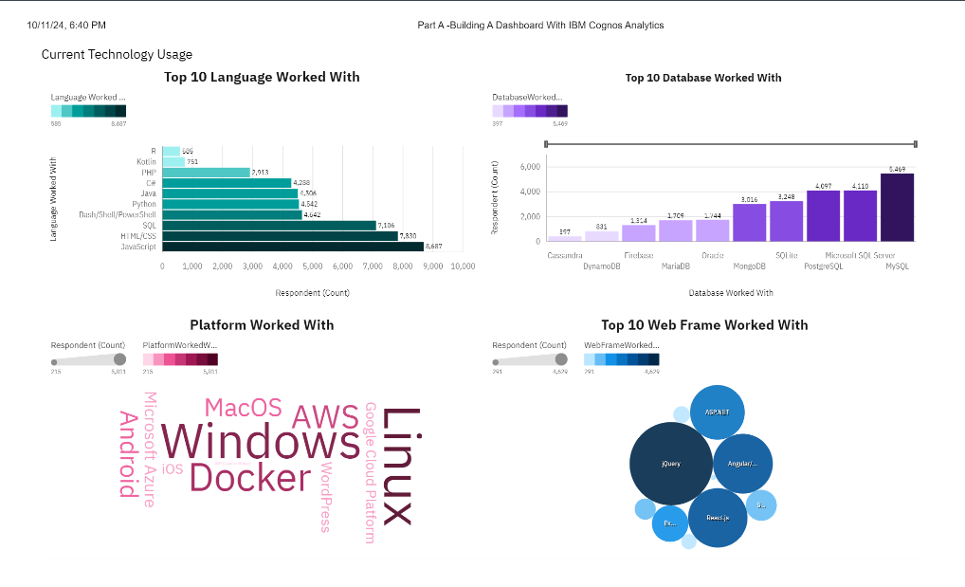
DASHBOARD TAB 1

Slide 16
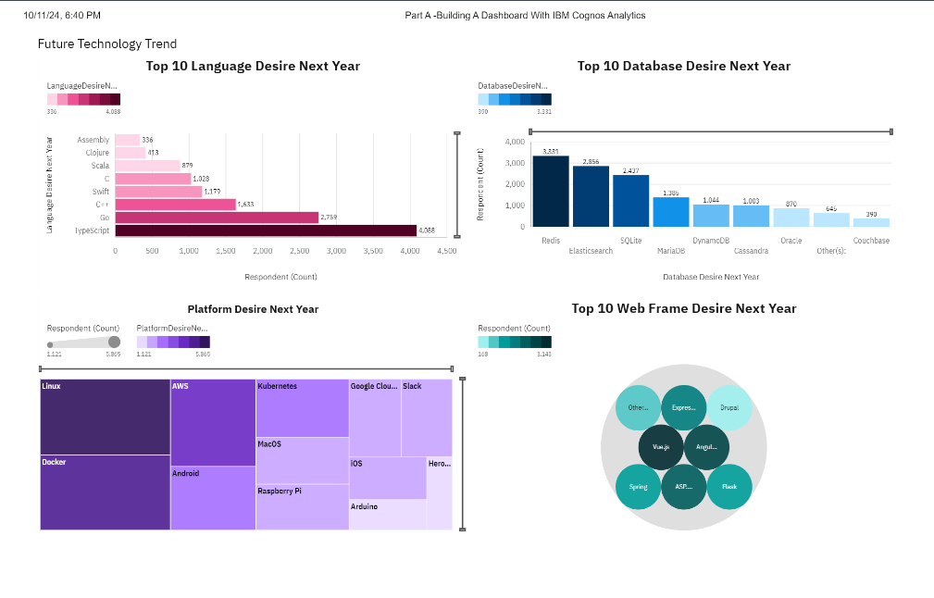
DASHBOARD TAB 2

Slide 17
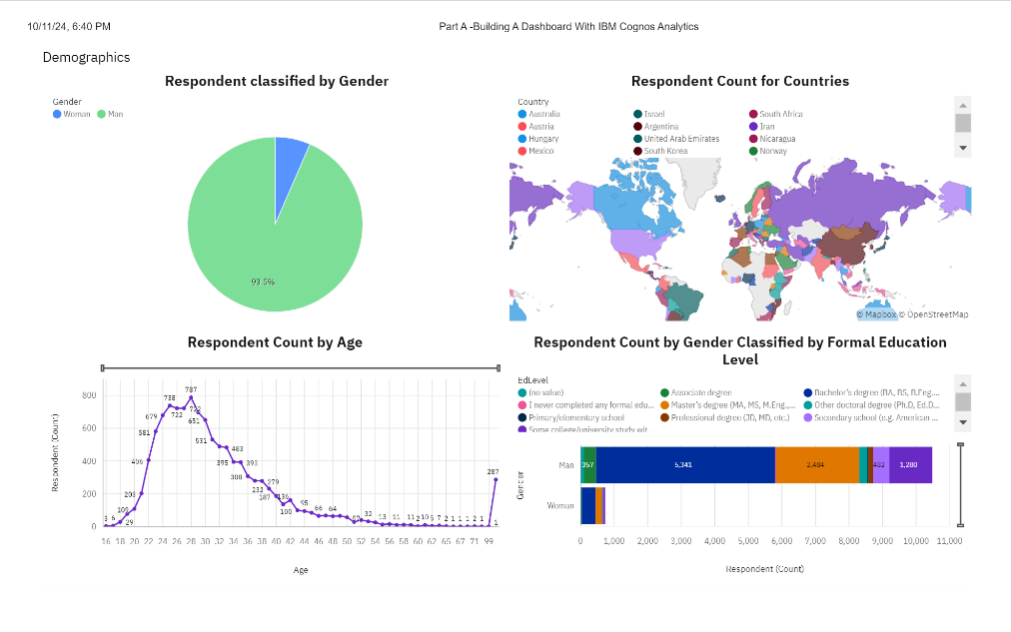
DASHBOARD TAB 3

Slide 18
Discussion: Future Skills Requirements and Recommendations
What are the Must-Have Skills or Desired Skills for the Industry?
To remain competitive and thrive in the rapidly evolving IT landscape, professionals need to focus on acquiring skills that are projected to be in high demand in the future. The following trends highlight the key skills that will shape the industry:
Top Programming Languages (Future Desire):
JavaScript, Python, HTML/CSS, SQL, and TypeScript are the most desired programming languages. These languages are increasingly gaining popularity across various sectors, with JavaScript and Python leading the demand due to their versatility and application in web development, data science, and more.
Top Database Skills:
PostgreSQL, MongoDB, Redis, MySQL, and Elasticsearch are emerging as the most sought-after databases. These technologies are becoming more desirable as compared to older, more traditional databases, reflecting the shift towards more scalable and flexible data storage solutions.
Popular IDEs:
React.js, Angular/Angular.js, Vue.js, jQuery, and ASP.NET are among the most popular Integrated Development Environments (IDEs). React.js and Vue.js are particularly gaining traction for their ease of use and advanced features, positioning them as future-proof tools in web development.

Slide 19
Overall Findings & Implications
Findings:
JavaScript, Python, HTML/CSS, SQL, and TypeScript have emerged as the most desired programming languages, reflecting their increasing adoption across various fields in the IT industry.
PostgreSQL, MongoDB, Redis, MySQL, and Elasticsearch are now considered the top desired databases, as businesses shift towards more modern and scalable data solutions.
React.js, Angular/Angular.js, Vue.js, jQuery, and ASP.NET remain popular IDEs, with a growing preference for frameworks like React.js and Vue.js.
There is a drastic shift in the desired skills for next year, with significant changes in the demand for programming languages, databases, and IDEs, suggesting a need for professionals to stay updated with emerging technologies.
Implications:
Future Skills Requirements:
To stay competitive in the ever-evolving IT industry, professionals must focus on acquiring the following key skills:
Programming Languages:
JavaScript, Python, HTML/CSS, SQL, and TypeScript are critical skills that will continue to be in high demand.
Databases:
PostgreSQL, MongoDB, Redis, MySQL, and Elasticsearch are becoming the go-to databases, with additional growth in demand for databases like DynamoDB.
IDEs:
React.js, Angular/Angular.js, Vue.js, jQuery, and ASP.NET are the most popular frameworks, with rising interest in React.js and Vue.js for web development.
As the IT industry rapidly evolves, the number of skills required to remain competitive is expanding, driven by the vast development and redefinition of current technology. Staying updated with these skills is crucial for long-term success.

Slide 20
Additional FINDINGS & IMPLICATIONS
Findings:
The gender distribution in the IT industry remains highly skewed, with 93.7% of respondents identifying as men, as depicted in the Dashboard 3 Pie Chart.
Survey data reveals that the majority of respondents are aged between 18 and 40, highlighting a younger demographic dominating the IT workforce.
The survey also indicates that most respondents have at least a bachelor's degree or higher, reinforcing the importance of formal education for entering the industry.
Implications:
The significant gender imbalance in the IT industry suggests a need for initiatives to encourage greater diversity and inclusion, particularly by increasing female participation.
The dominance of professionals aged 18-40 implies that younger individuals are more likely to pursue and maintain careers in IT, driving innovation and technological advancements.
Given the high level of educational attainment, a bachelor's degree or equivalent qualifications are increasingly essential for IT roles, making continuous learning and upskilling critical for future success.

Slide 21

CONCLUSION
The open-source data collected from Stack Overflow has been analyzed to provide a comprehensive overview of current and future trends, while minimizing potential bias.
The analysis reveals a noticeable shift in technology usage, highlighting the need for professionals to adapt to changing skill requirements in order to remain competitive in the IT industry.
Key areas of change include programming languages and databases, with the following emerging as essential skills for future success:
Programming Languages:
JavaScript, Python, HTML/CSS, SQL, TypeScript
Databases:
PostgreSQL, MongoDB, Redis, MySQL, Elasticsearch
IDEs:
React.js, Angular/Angular.js, Vue.js, jQuery, ASP.NET

Slide 22

APPENDIX
Additional Insights Summary
Detailed Analysis of Programming Language Shifts:
JavaScript has consistently dominated the programming landscape, but the surge in demand for Python over recent years is unprecedented. Our analysis shows Python's versatility, particularly in data science and machine learning, as key drivers of its increasing popularity.
TypeScript is gaining ground due to its enhanced features over JavaScript, offering better tooling and error handling, making it a strong contender for future projects that require scalable and maintainable code.
Database Popularity and Functionalities:
PostgreSQL and MongoDB continue to rise due to their flexibility and scalability in handling both structured and unstructured data. Our analysis revealed that NoSQL databases like MongoDB and Redis are particularly sought after for high-performance applications and real-time analytics.
The decline of traditional relational databases such as Oracle may reflect a broader industry shift towards open-source and cloud-native solutions, where cost and ease of integration are key factors.

Slide 23
APPENDIX
3. Evolving IDE Preferences:
The shift away from jQuery to more modern frameworks like React.js and Vue.js underscores the demand for more component-based architectures that simplify the development process and improve performance.
While ASP.NET remains popular in enterprise environments, the increasing preference for Angular.js and Vue.js in web development is linked to their extensive ecosystems and strong community support.
4. Demographic Trends:
Our demographic analysis reveals that men aged 18-40 dominate the IT workforce. However, the survey also highlighted a small but growing interest from women in emerging fields like data science and AI, signaling potential growth in gender diversity in these sectors.
The survey data also pointed to a high level of formal education, with the majority holding at least a bachelor's degree. This suggests that foundational knowledge in computer science or related fields remains essential for success, although self-taught programmers are becoming more common with the rise of online resources and bootcamps.
5. Future Skills Focus:
The data indicates that the industry is prioritizing full-stack development skills, where knowledge of both front-end frameworks and back-end databases is crucial. Developers with expertise in tools like React.js or Angular alongside PostgreSQL or MongoDB are becoming highly desirable.
Additionally, cloud-native development is a growing area, with demand for skills in containerization (e.g., Docker, Kubernetes) and serverless architectures, as evidenced by the rising popularity of databases like DynamoDB in cloud environments.

Slide 24
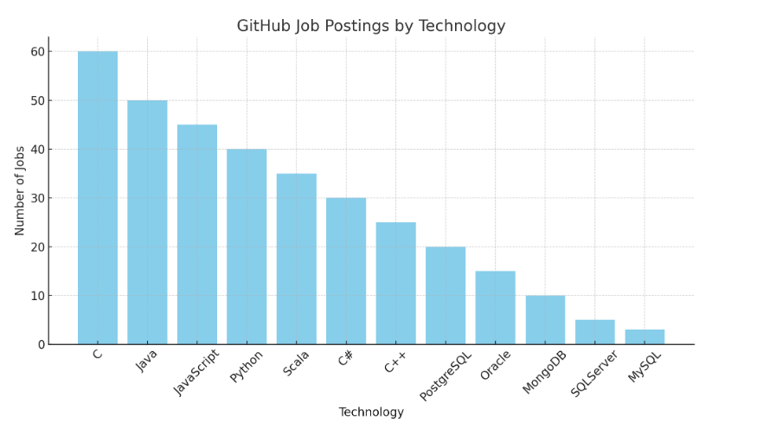
GITHUB JOB POSTINGS
In Module 1 you have collected the job postings data using GitHub API in a file named “github-job-postings.xlsx”. Present that data using a bar chart here. Order the bar chart in the descending order of number of job postings.

Slide 25
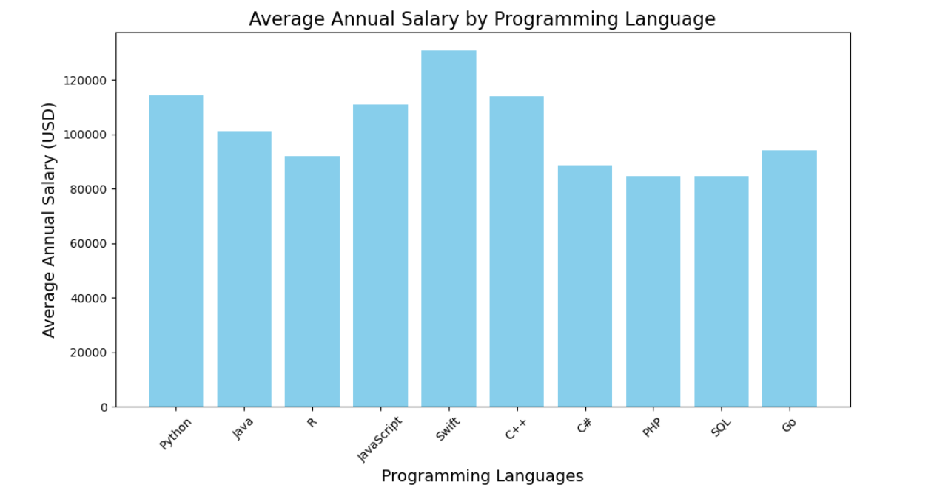
POPULAR LANGUAGES
In Module 1 you have collected the job postings data using web scraping in a file named “popular-languages.csv”. Present that data using a bar chart here. Order the bar chart in the descending order of salary.

