Slide 1
sales dataset ANALYSIS

Slide 2
Agenda
Introduction
Data Source
Data Exploration and cleaning
Data Forecasting
Visualization
Summary and Insights
Conclusion

Slide 3

Introduction
Overview of the Project: This project analyzes a sales dataset to uncover trends, answer analysis questions, and provide forecasts to aid business decision-making.
Problem Statement: Decision-makers need insights into sales performance across regions and product categories to optimize their strategies.
Objectives and Goals:
Understand sales performance and profitability.
Forecast future sales trends.
Provide actionable insights for different regions and product categories.
Motivation for the Project: Improving business performance and supporting data-driven decisions in a competitive retail environment.

Slide 4
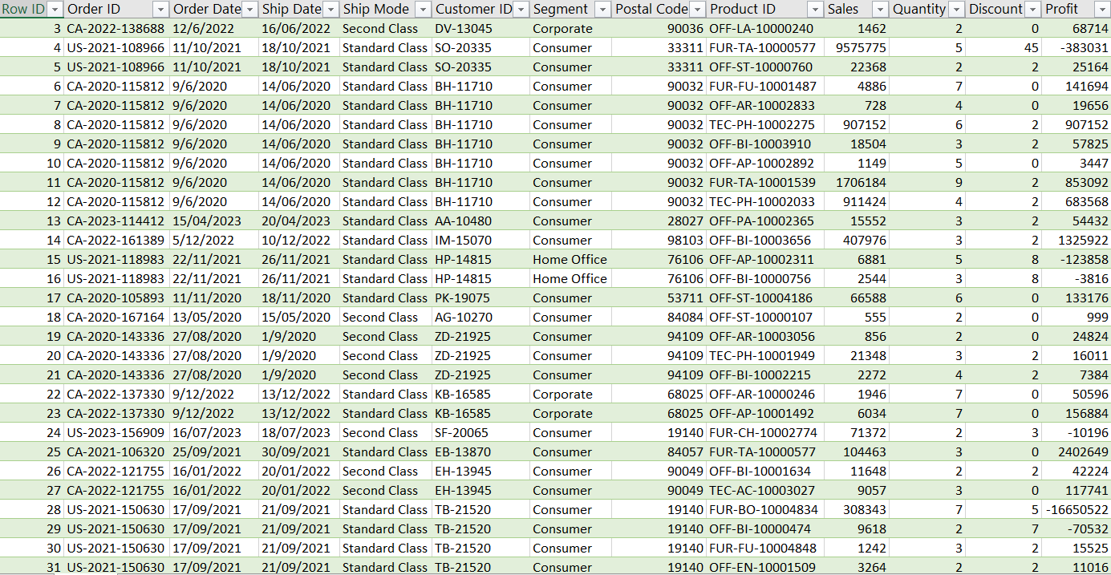
cleaning data with power query
Data Cleaning and Analysis of Kaggle Dataset.
dataset Orders 2020-2023

Slide 5
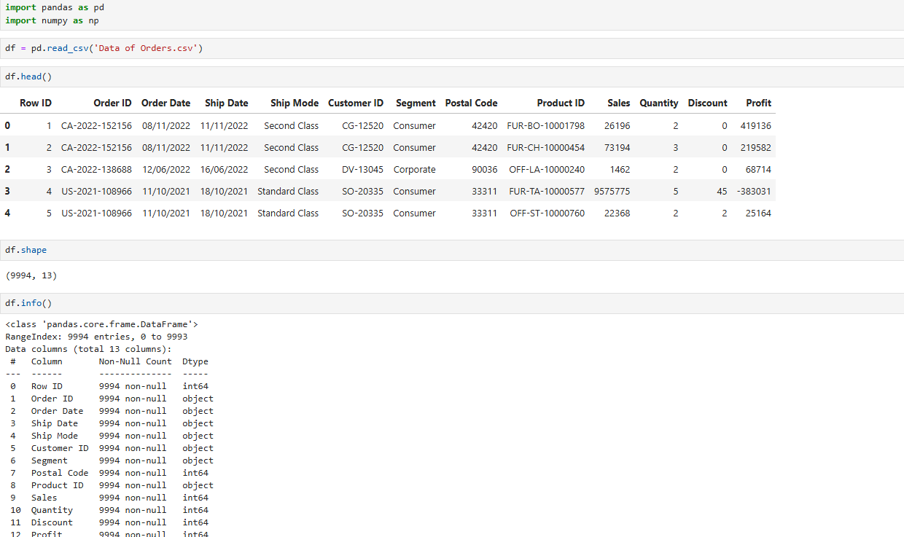
cleaning data with python
Read the file .csv
Show data details

Slide 6
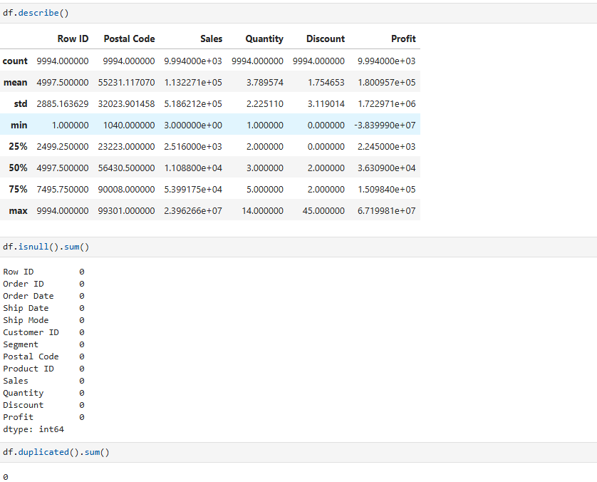
cleaning data with python
Show statistical details on the data
Ensure that the data does not contain null values

Slide 7
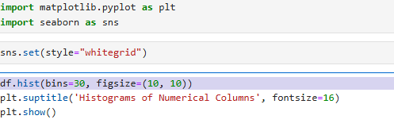
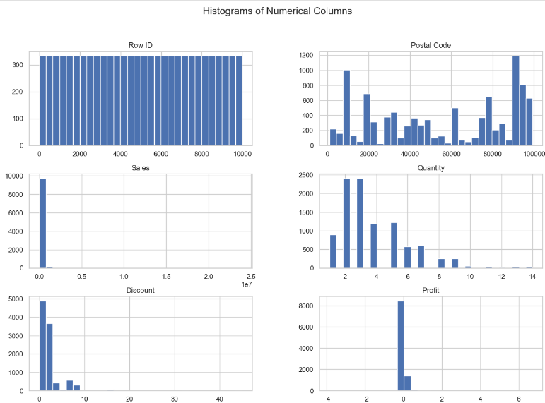
cleaning data with python
Use a matplotlib as a library to show data as a graphs.
Histogram graph

Slide 8
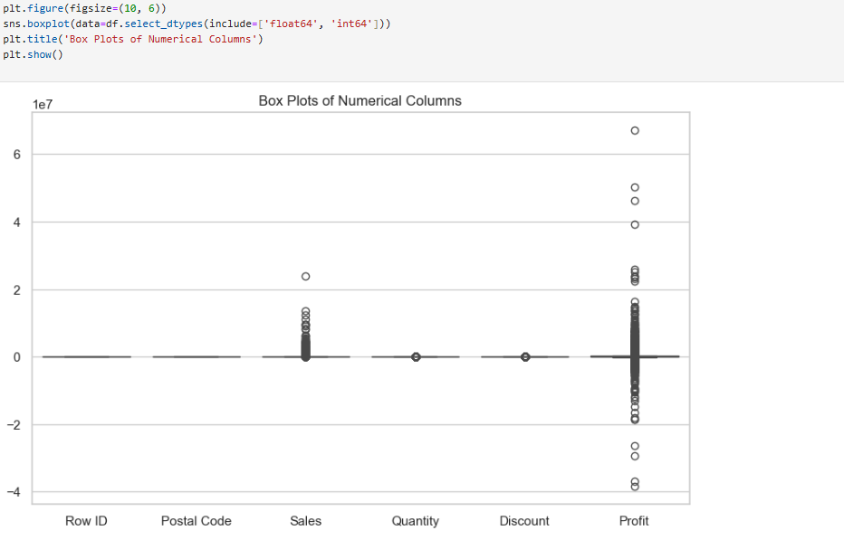
cleaning data with python
Boxplot graph
Sales: There are several outliers , which means that some sales were significantly higher than the rest of the data
Profit: There are many outliers in this column, some negative (representing losses) and some positive (representing large profits). The chart shows that the median profit values are close to zero.

Slide 9
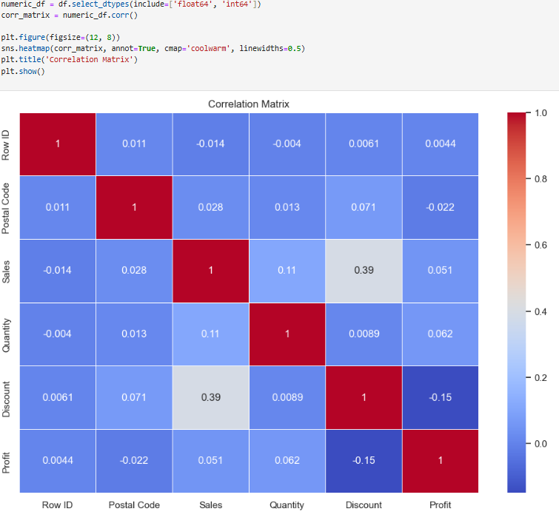
cleaning data with python
Heat map
Sales: There is a positive correlation between sales and discount (discount) 0.39. This indicates that discounts want sales, as sales decrease.

Slide 10
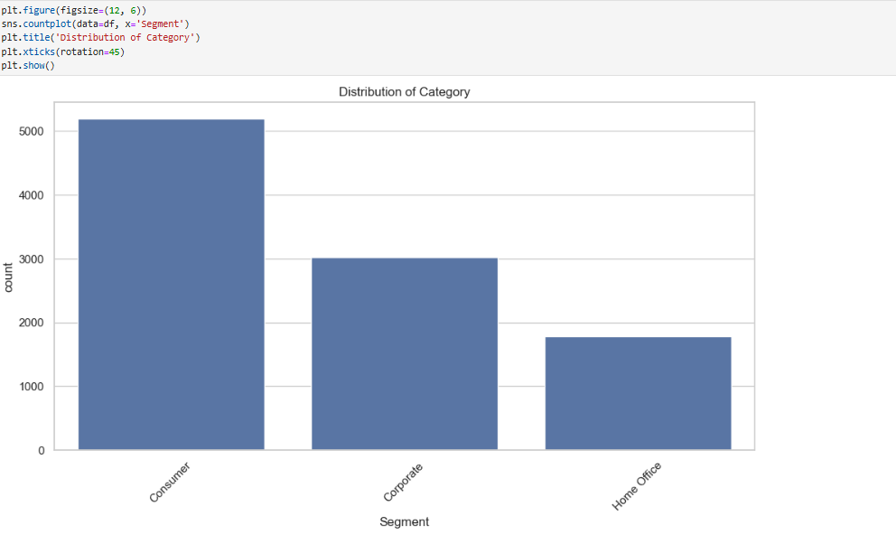
cleaning data with python
bar plot visualizing the distribution of the "Segment" category in your data.

Slide 11
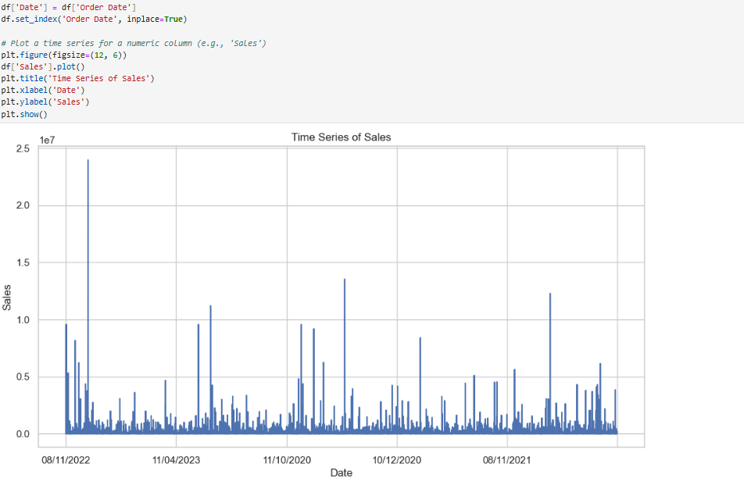
cleaning data with python
A graph showing the time series
of sales.

Slide 12
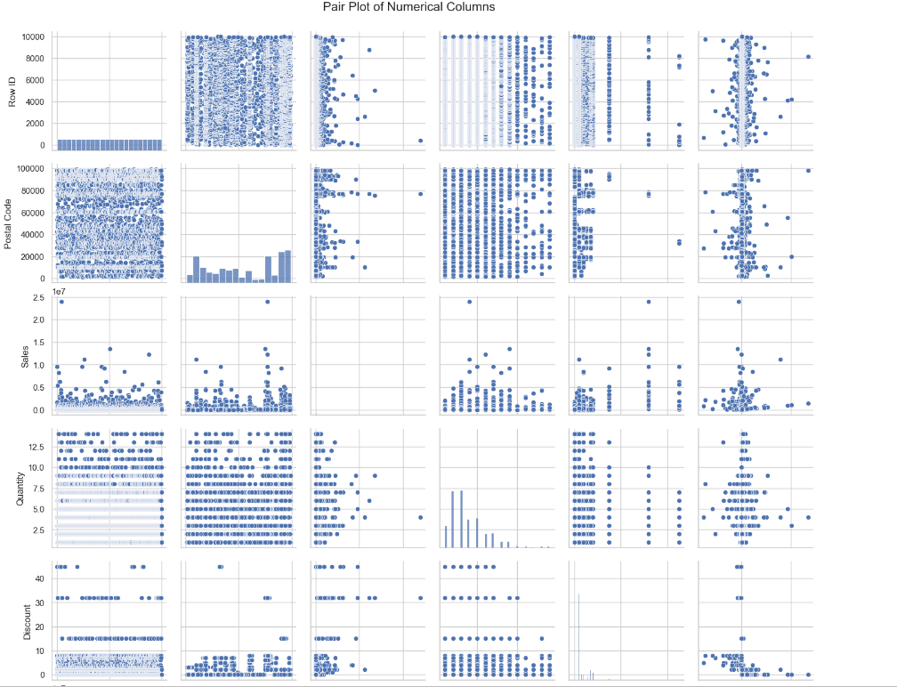
cleaning data with python
Pair plot

Slide 13
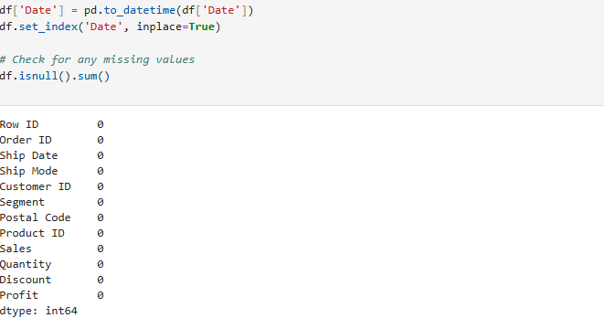
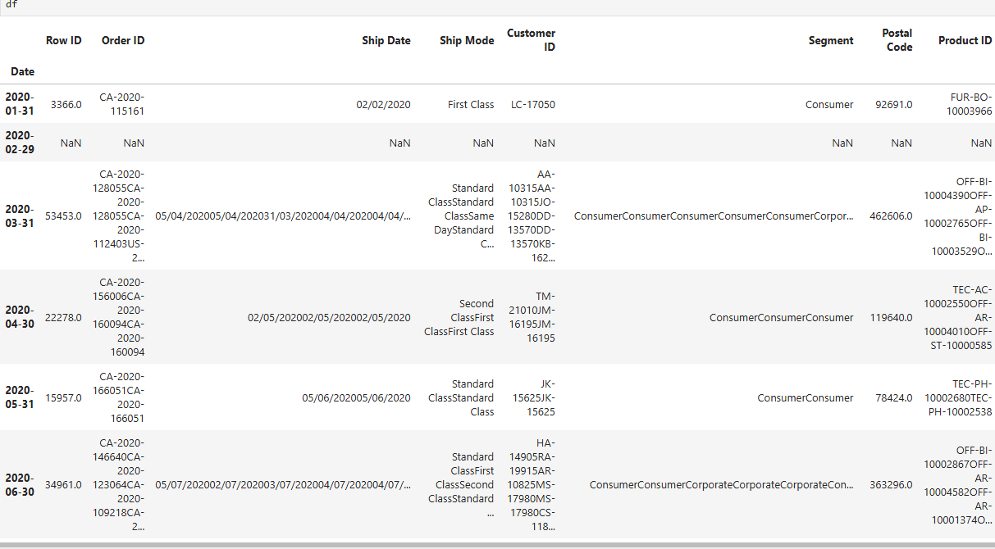
cleaning data with python ,forcasting

Slide 14
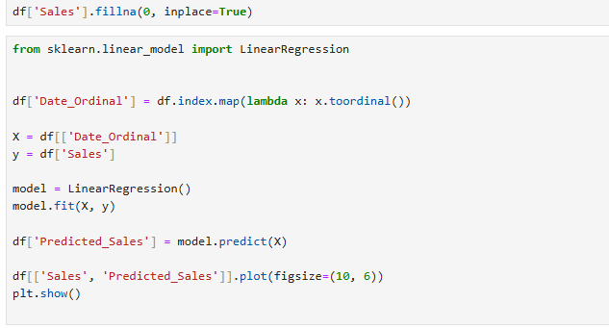
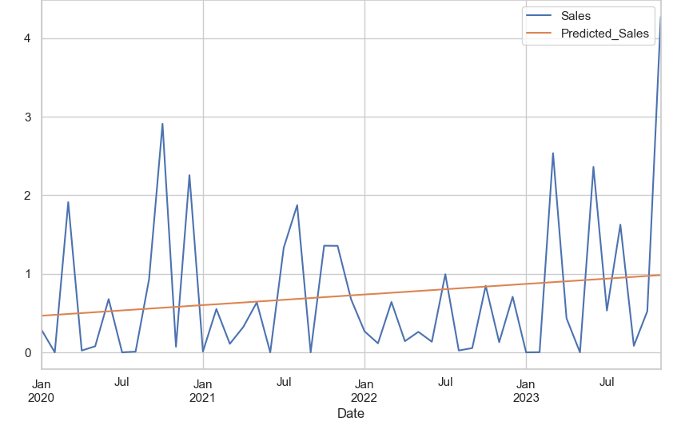
cleaning data with python ,forcasting

Slide 15
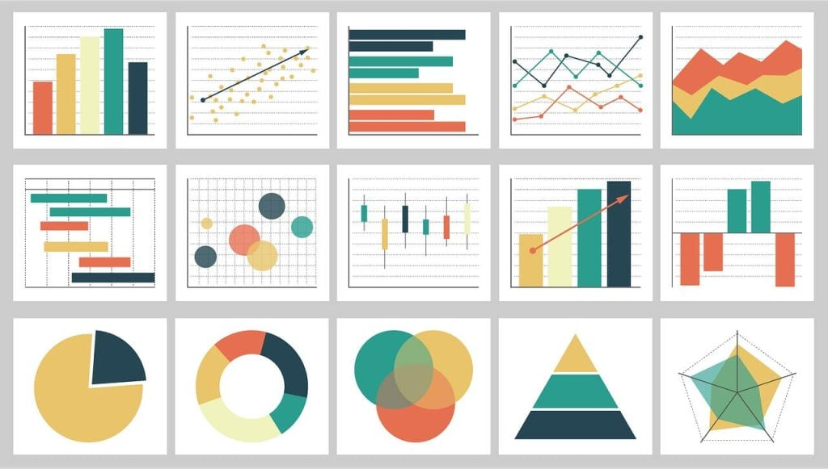
Visualization

Slide 16
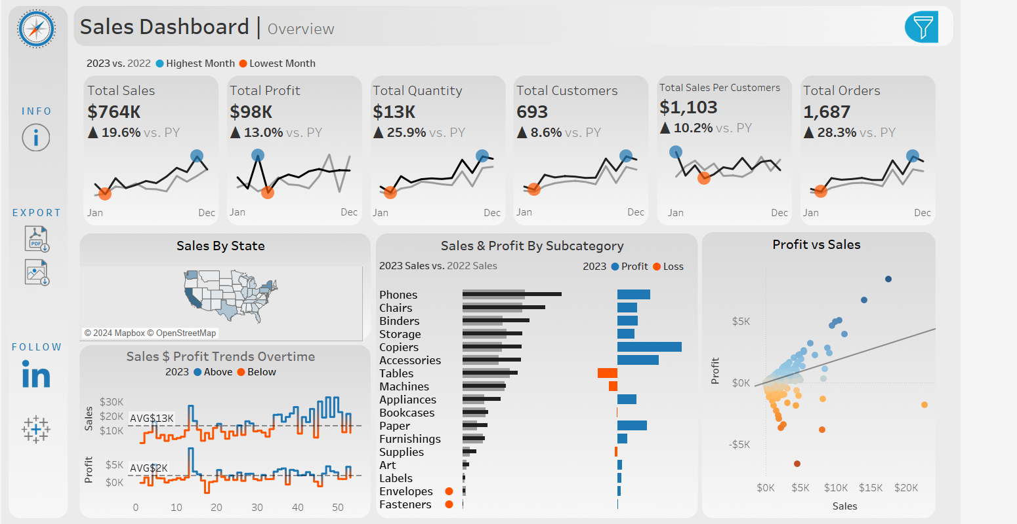
Sales Dashboard

Slide 17

Key Performance Indicators

Slide 18
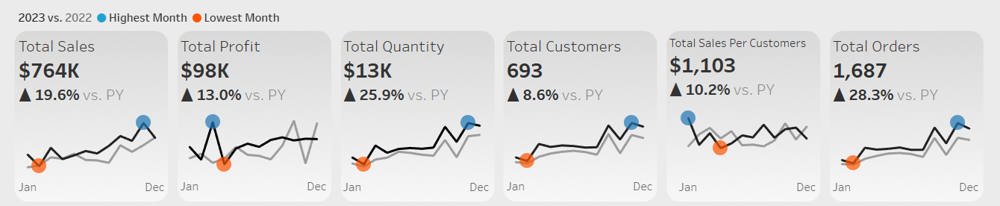
KPIs Displayed

Slide 19
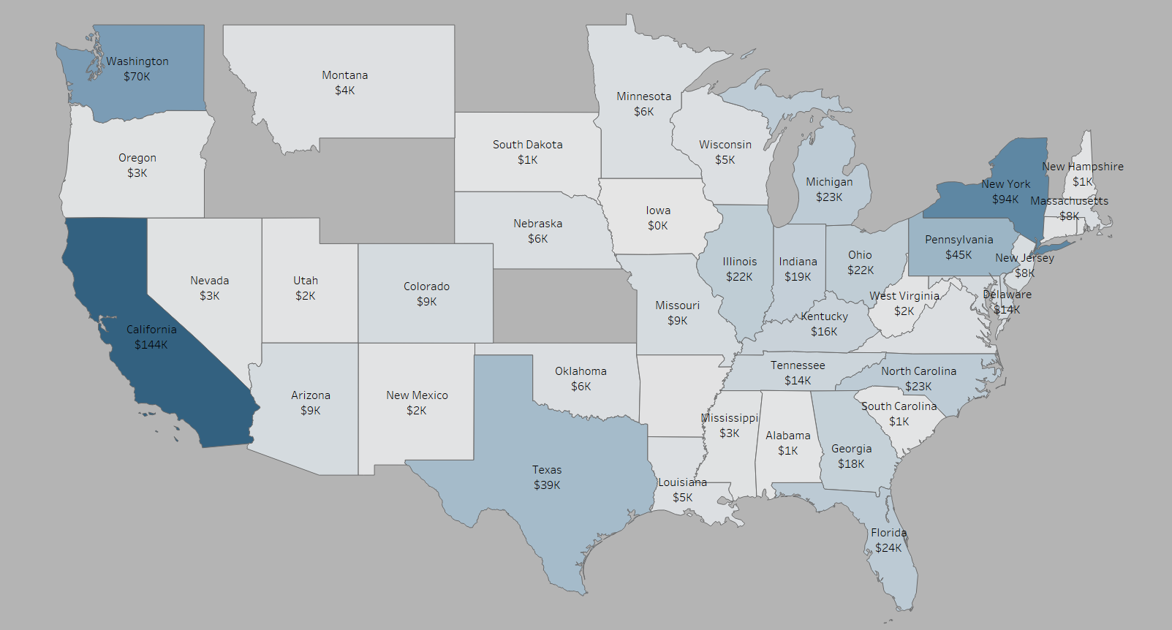
Sales & Profit Trends Over Time
Geographical Sales Performance :
The map visualizes sales across different states.
Highlighted Region : California is prominently displayed, indicating either a high volume of sales or a significant regional focus.
Insight: This map allows us to quickly understand which regions are performing well and identify areas that may need additional focus or support.

Slide 20
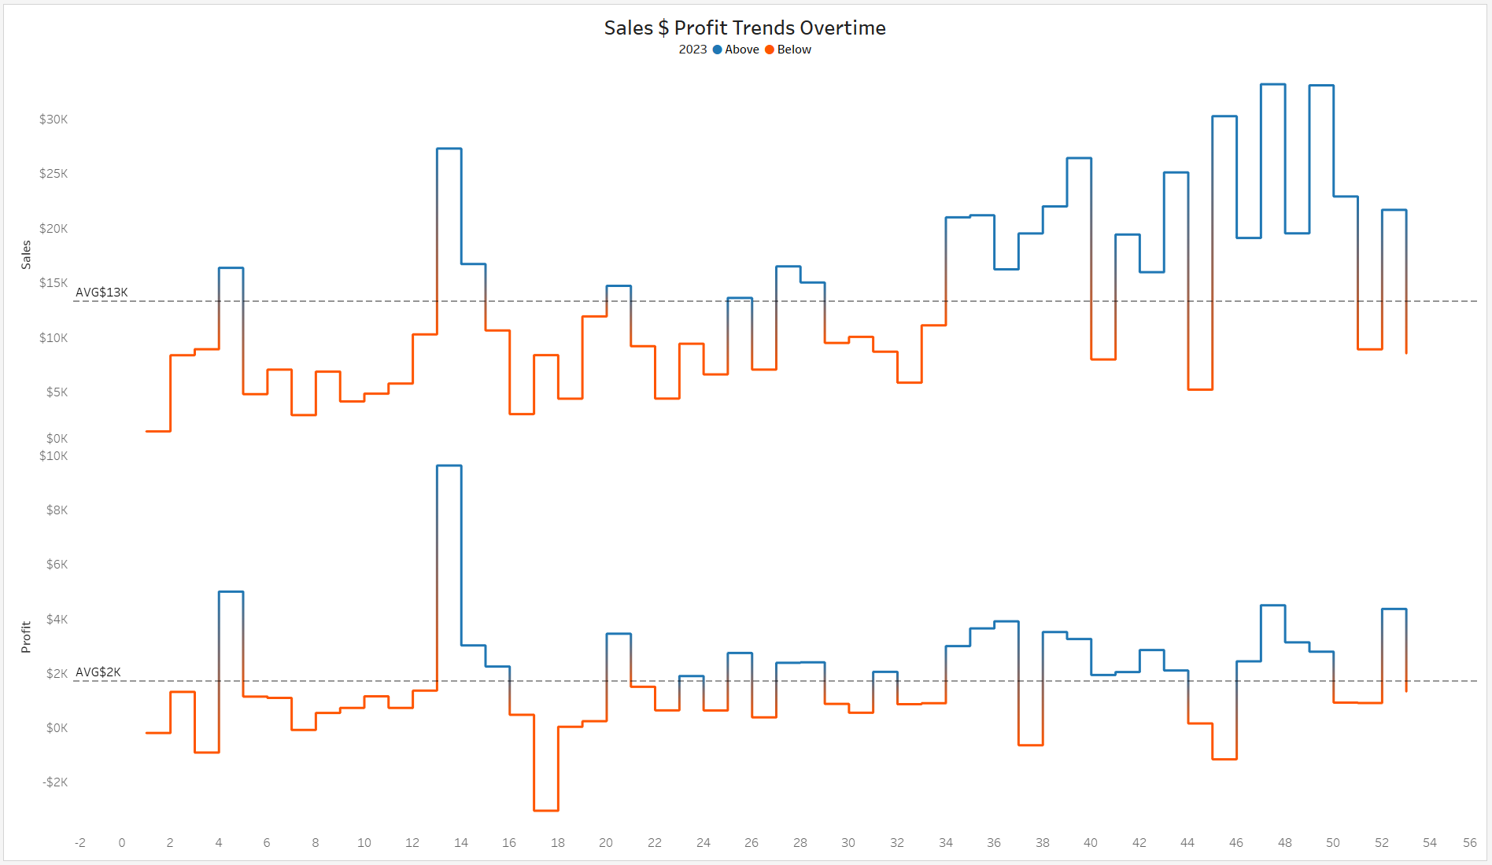
Sales & Profit Trends Over Time
This chart visualizes the weekly sales and profit trends.
Data Comparison: The chart shows the trends for average sales and profit on weekly basis
It clearly highlights weeks where sales and profit were above or below expectations.
Insight: We can identify peak sales weeks and low-performing periods, providing insights into seasonal patterns or external factors influencing sales.

Slide 21
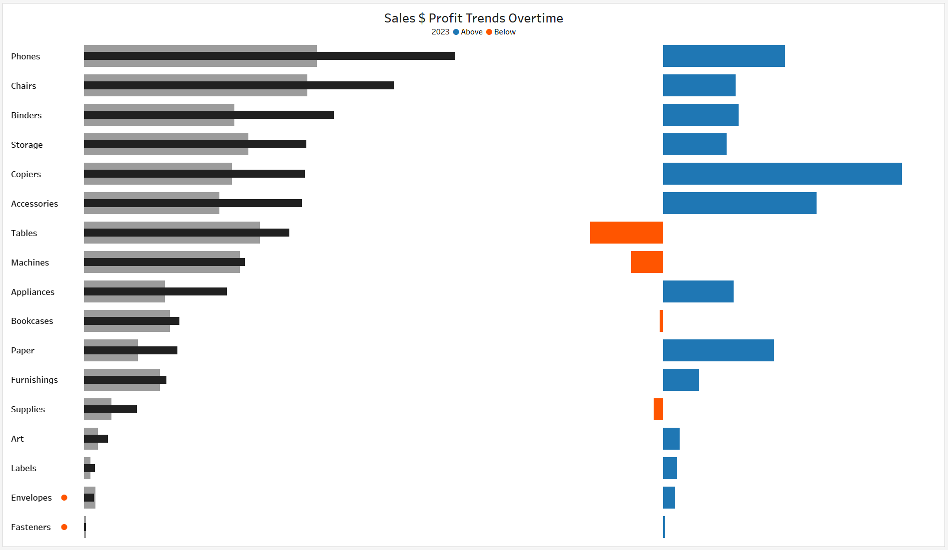
Sales & Profit by Subcategory
This bar chart shows a comparison of sales for 2023 vs. 2022 across different product subcategories and it’s profit and Loss .
Key Insights : Subcategories like Copiers and Accessories show strong performance in both sales and profit . On the other hand, Tables and Machines appear to be less profitable, indicating potential issues like high costs or low sales in these categories.
Actionable Insight: Focus on improving performance in low-profit subcategories while continuing to drive sales in successful ones.

Slide 22
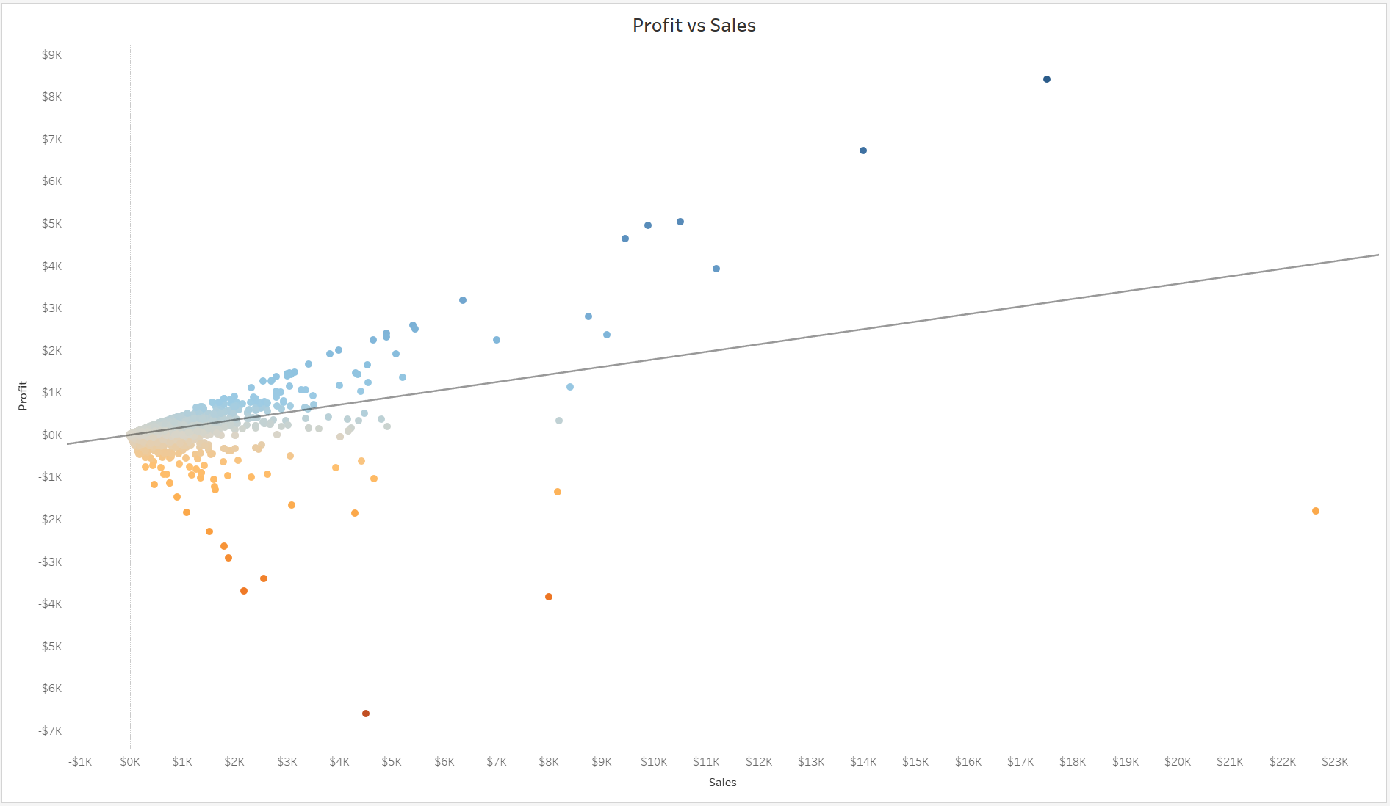
Profit vs. Sales Analysis
This scatter plot visualizes the relationship between sales and profit .
Trend Line : A positive correlation is indicated, meaning as sales increase, so does profit, which is a good sign of business health .
Data Points : Each point represents an individual customer transactions over the year.
Insight : Identifying outliers in this scatter plot can help us understand which products or regions may be generating sales but not delivering adequate profit.

Slide 23
Summary and Insights

Slide 24

Overall Performance:
Sales performance is healthy with a positive trend in key areas such as orders and profit. However, there are some areas of concern, particularly a slight decline in the number of customers and total sales.

Slide 25
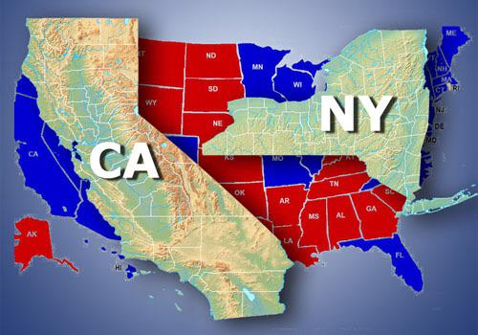
Top-Performing Regions and Products:
Regions like California and New York and products such as Copiers and Accessories are performing well, indicating strong market demand.

Slide 26
Recommendations
Consider focusing marketing efforts on customer acquisition to reverse the decline in customer numbers .
Explore opportunities to reduce costs or improve profitability for underperforming subcategories .
Continue to monitor sales trends and respond to any emerging issues in key regions or product categories.

Slide 27
Conclusion
The project successfully cleaned and analyzed the sales dataset, answering key business questions and providing forecasts through an interactive Tableau dashboard.
Reflection on Impact:
The insights gained from this analysis will help decision-makers optimize strategies across regions and product categories.
Final Remarks:
The project has laid the foundation for more detailed business analysis and offers significant value to stakeholders.

Slide 28




Tools
Kaggle

