Slide 1

MATCH MAKING SYSTEM
Submitted by
Rahgul.S - 220701212
Praveen Kumar.S - 220701203

Slide 2

ABSTRACT
The Match-Making System(MMS) helps the users in providing their details to the software user. This also helps the customer in searching for a suitable bride on the basis of Profession and also groom on basis of appearance. Once we fill the search Column automatically the software will fetch the related data available and displays it. The user can use the registration number to view the Registered details. This programme can be used only if the Login ID and the
Password is correct.

Slide 3

KEY FEATURES
Match making without Caste & Community
Easy retrieval of information
Implemented to College

Slide 4


TECHNOLOGIES USED
Python
Mysql

Slide 5
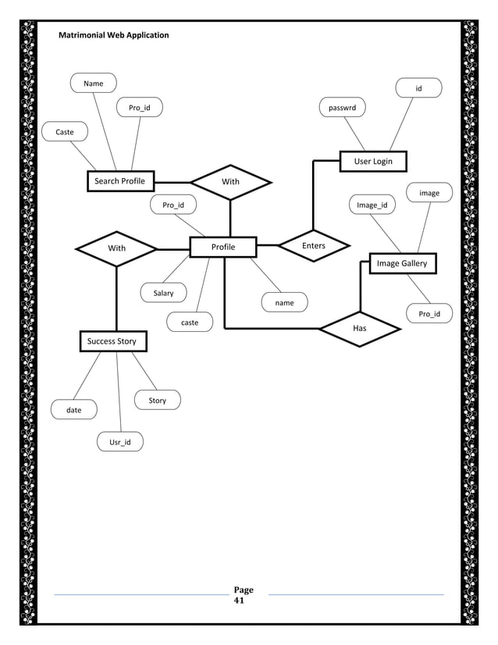
ER DIAGRAM

Slide 6
SOURCE CODE
import mysql.connector as sql
conn = sql.connect(host='localhost', user='root', passwd='rahgul', database='marriage')
cur = conn.cursor()
print('************************************* ************************************************MARRIAGE BUREAU MANAGEMENT**************************************************** ********************************')
while True:
print('1.REGISTER')
print('2.LOGIN')
n = int(input('Enter your choice:'))
if n == 1:
name = input('Enter your Username:')
passwd = int(input('Enter your Password:'))
V_SQLInsert = "INSERT INTO user_id (password, user_name) VALUES (%s, %s)"
cur.execute(V_SQLInsert, (passwd, name))
conn.commit()
print('User created successfully')

Slide 7
SOURCE CODE
if n == 2:
name = input('Enter your Username:')
passwd = int(input('Enter your Password:'))
V_Sql_Sel = "SELECT * FROM user_id WHERE password = %s AND user_name = %s"
cur.execute(V_Sql_Sel, (passwd, name))
if cur.fetchone() is None:
print('Invalid username or password')
else:
while True:
print('____________________________________________________________ ________WELCOME TO MATRIMONIAL SERVICE____________________________________________')
print("1. Provide details")
print('2. In search of bridegroom')
choice = int(input('Enter your choice:'))
if choice == 1:
print('1. Male customer details')
print('2. Female customer details')

Slide 8
SOURCE CODE
gender_choice = int(input('Choose the gender:'))
if gender_choice == 1:
name = input('Enter the name:')
add = input('Enter the address:')
caste = input('Enter the caste:')
appearance = input('Enter the appearance:')
age = input('Enter the age:')
profession = input('Enter the profession:')
ph_no = input('Enter the phone number:')
sql_insert = "INSERT INTO boys_details VALUES (%s, %s, %s, %s, %s, %s, %s)"
cur.execute(sql_insert, (name, add, caste, age, appearance, profession, ph_no))
conn.commit()
print('Data inserted')
elif gender_choice == 2:
name = input('Enter the name:')
add = input('Enter the address:')
caste = input('Enter the caste:')
appearance = input('Enter the appearance:')
age = input('Enter the age:')
profession = input('Enter the profession:')
ph_no = input('Enter the phone number:')

Slide 9
SOURCE CODE
sql_insert = "INSERT INTO girls_details VALUES (%s, %s, %s, %s, %s, %s, %s)"
cur.execute(sql_insert, (name, add, caste, age, appearance, profession, ph_no))
conn.commit()
print('Details are successfully inserted')
elif choice == 2:
print('3. Handsome Bride')
print('4. Beautiful Groom')
search_choice = int(input('Enter the choice:'))
if search_choice == 3:
prof = input('Enter the profession:')
c1.execute("SELECT * FROM boys_details WHERE profession = %s", (prof,))
data = c1.fetchall()
print("name\t\t address\t\t caste\t\t appearance\t\t age\t\t profession\t\t phone_no \t\t ")
for row in data:
print(*row, sep='\t\t')

Slide 10
SOURCE CODE
elif search_choice == 4:
appearance = input('Enter the appearance:')
c1.execute("SELECT * FROM girls_details WHERE appearance = %s", (appearance,))
data = c1.fetchall()
print("name\t\t address\t\t caste\t\t appearance\t\t age\t\t profession\t\t phone_no \t\t ")
for row in data:
print(*row, sep='\t\t')
c = input('Do you want to continue (y/[n]):')
if c.lower() != 'y':
break

Slide 11
Thank
you!!

