Slide 1

CSYE 6200 Project Daycare
Team 1

Slide 2
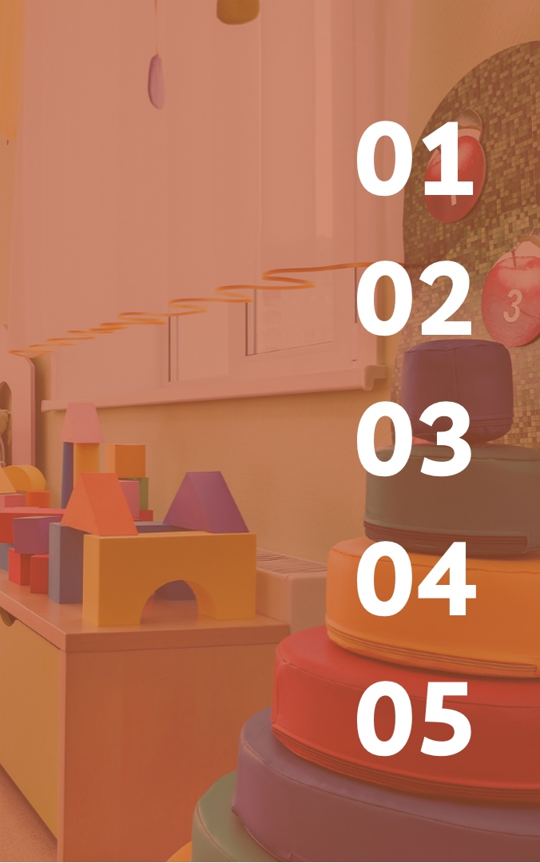
ABOUT THE PROJECT
TECH STACK
TABLE OF CONTENTS
FUNCTIONALITIES
FUTURE ENHANCEMENTS
CONTRIBUTION
Programming Language, Software, Front/Back-end, Database
Screen Shots, UML DIAGRAM, Code Snippets

Slide 3

ABOUT THIS PROJECT
The system is designed based on the Factory Design Pattern and adheres to the Model-View-Controller (MVC) architectural pattern.
The daycare management application features a login page for Administrators to manage and monitor the information of students, teachers, and vaccination records.
Data entry for tracking individual details could be recorded by uploading CSV files or GUI input.
Assignment of students to teachers within classrooms is carried out in compliance with state educational standards and regulations.
The application is equipped with a notification feature that provides alerts for overdue vaccination.

Slide 4

Tech Stack
Software
Front-end
Programmin Language
Back-end
Database
Design Pattern Used
Eclipse IDE, NetBeans
Java Swing
Java
Build Tool
Java Spring Boot
H2 Embedded Database
Maven
Model View Controller Design Pattern, Factory Desiign Pattern, Stream API

Slide 5

FUNCTIONALITIES
Enroll students: capture data
Student name, age
Parents name, address, phone
GUI and CSV file input
Track annual student registration renewal
Track student immunization anniversaries
Immunization records from CSV file
Assign students to Teachers according to state regulations
Assign student/teacher Groups to classrooms according to state regulations
Track annual employee review
Age (months) | Group Size | Ratio (S:T) | Max Groups/ Room
6-12 | 4 | 4:1 | 3
13-24 | 5 | 5:1 | 3
25-35 | 6 | 6:1 | 3
36-47 | 8 | 8:1 | 3
48-59 | 12 | 12:1 | 2
60 on up | 15 | 15:1 | 2

Slide 6
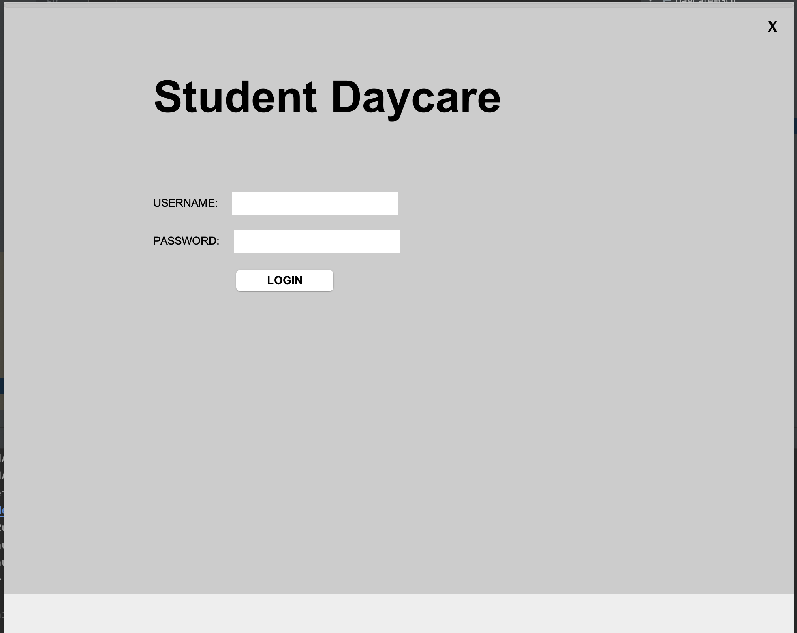
FUNCTIONALITIES Sceenshots

Slide 7
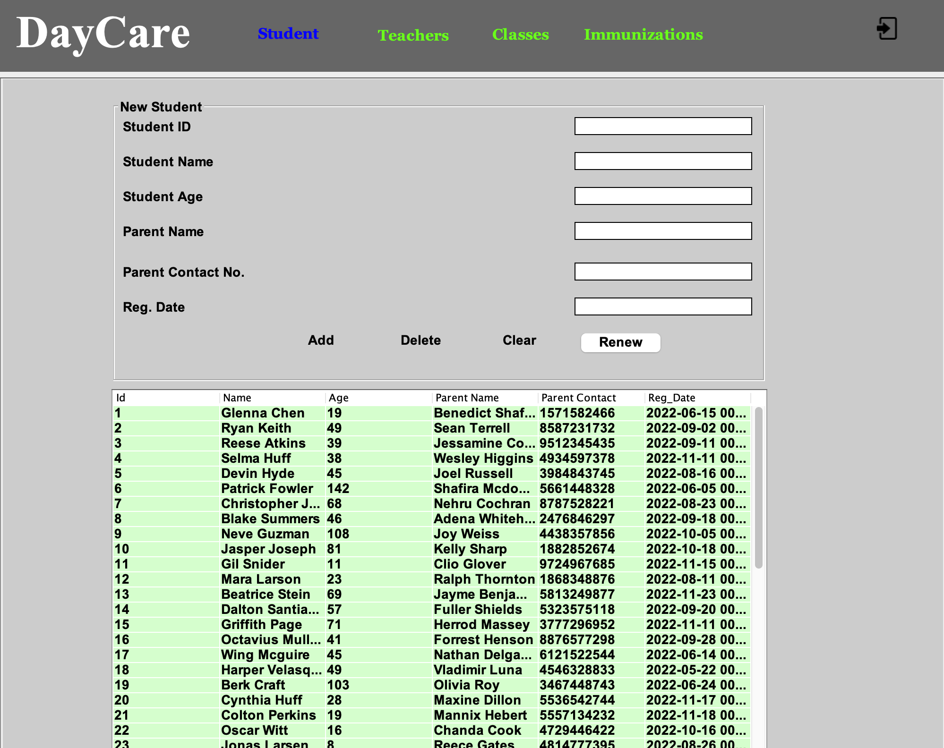
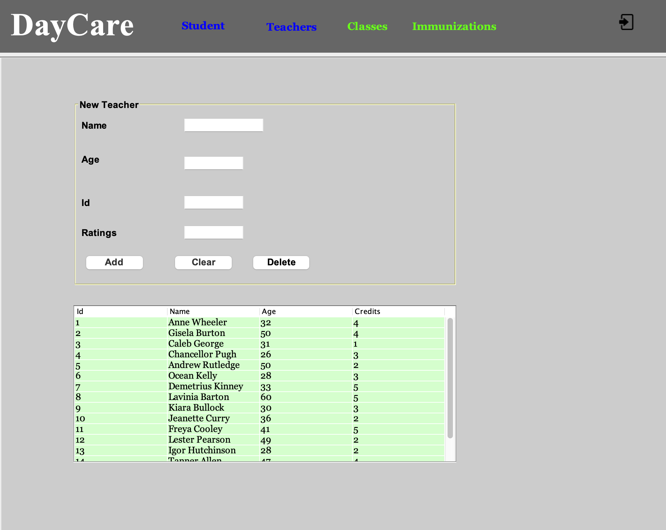
FUNCTIONALITIES Sceenshots

Slide 8
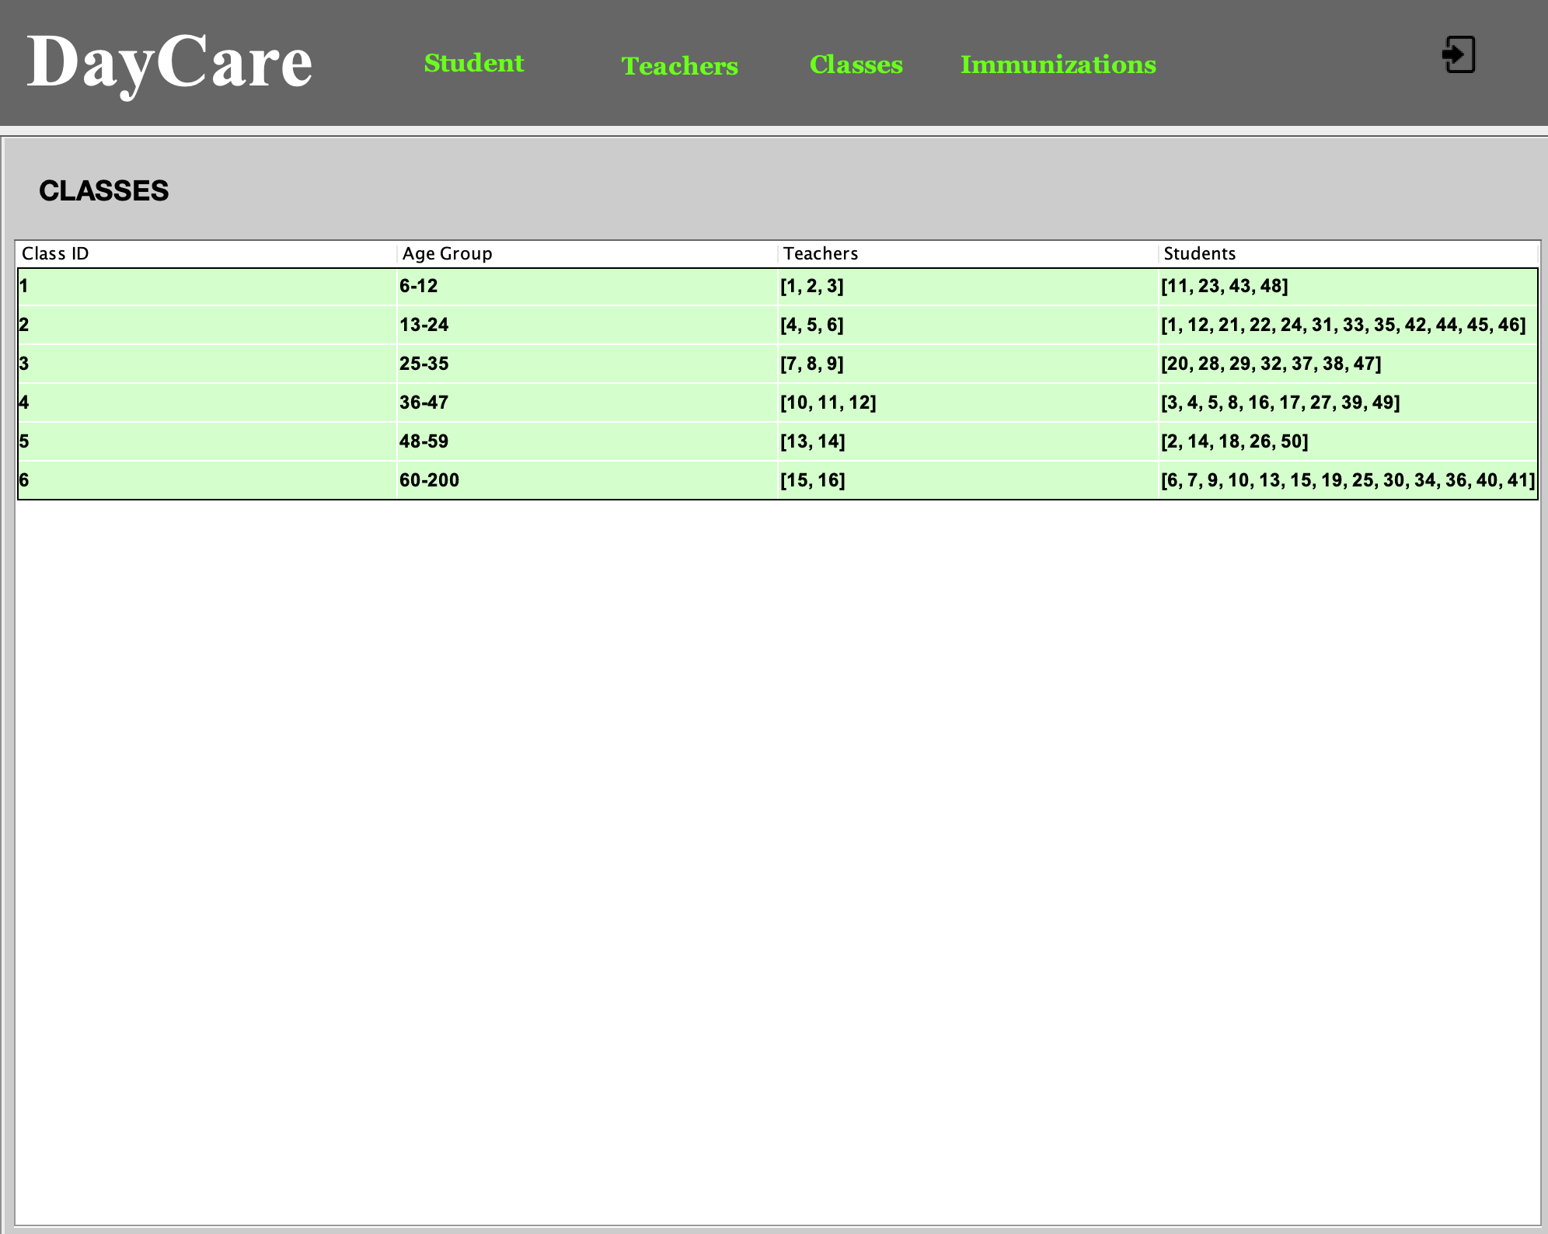
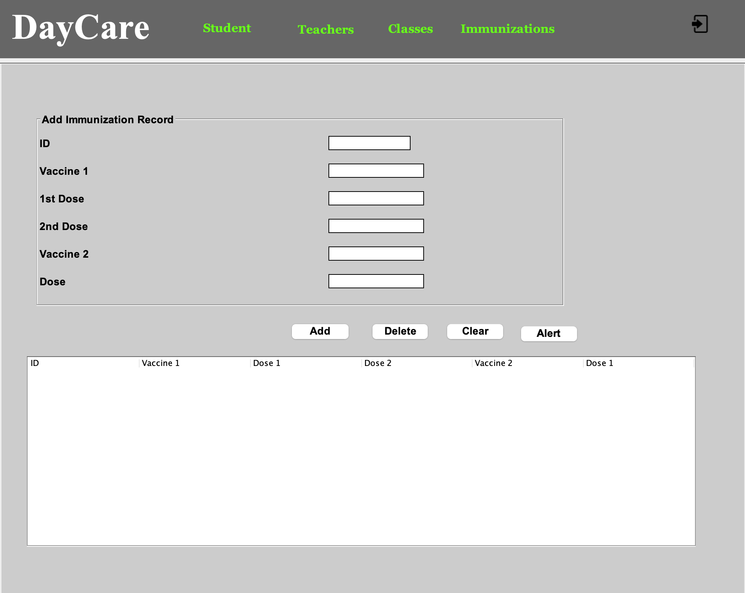
FUNCTIONALITIES Sceenshots

Slide 9
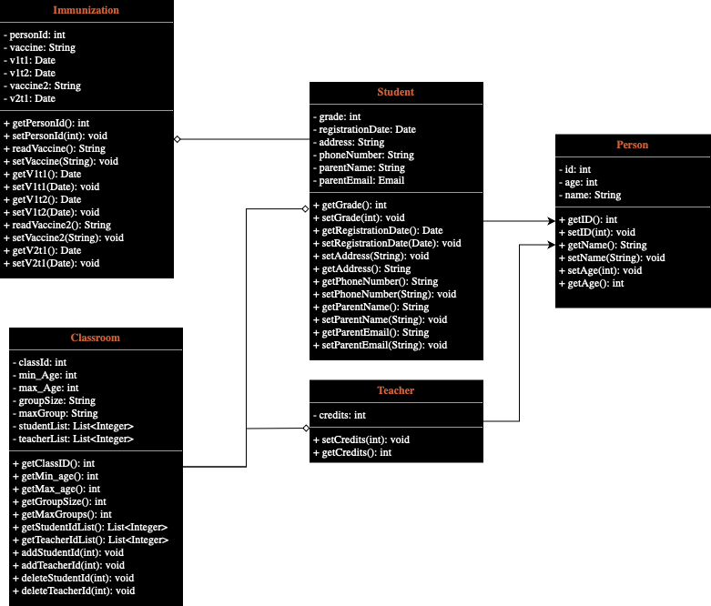
FUNCTIONALITIES UML Diagram

Slide 10
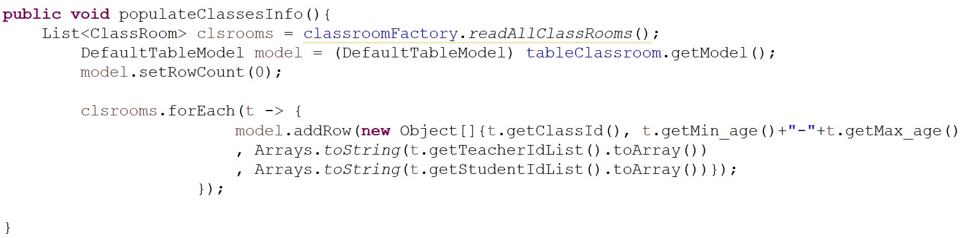
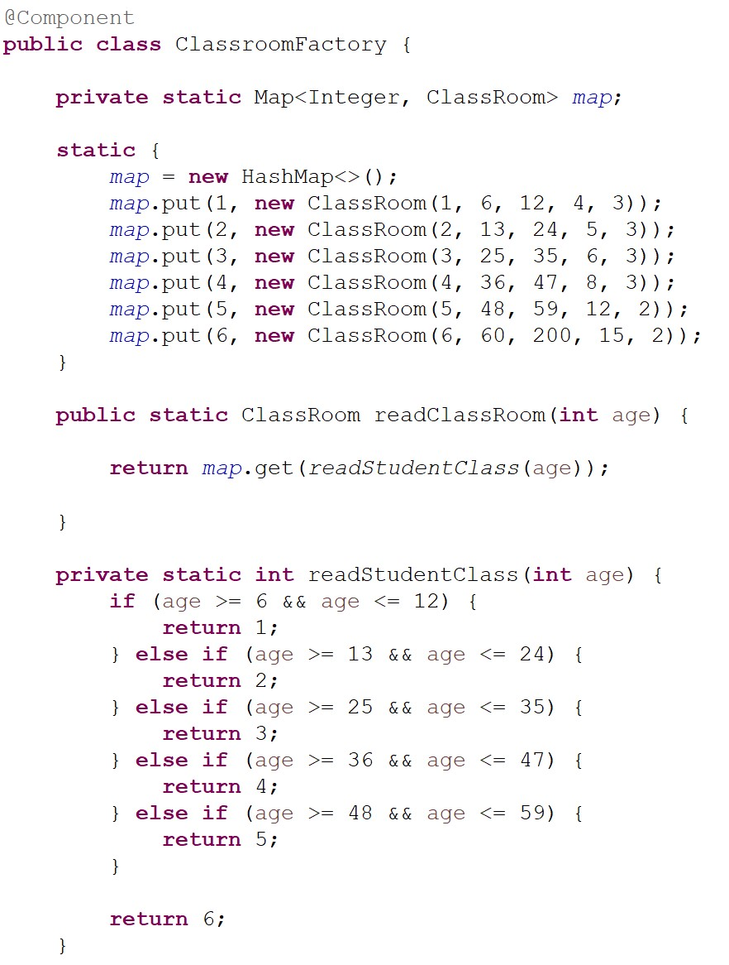
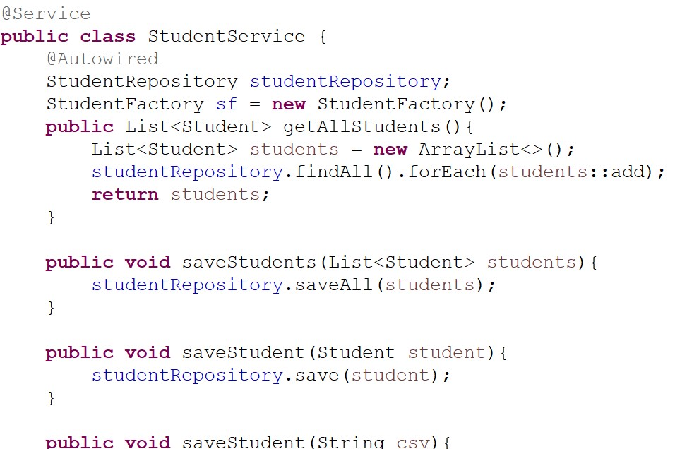
Stream
FUNCTIONALITIES Code Snippets
Generic
Singleton
Factory

Slide 11

FUTURE ENHANCEMENT
Implement Tests such as Unit Test and Integration Test to ensure codebase stability.
Implement Angular or React for interactive user experience.
Introduce diverse roles including parent and teacher logins.
Use cloud deployment to enhance scalability.

Slide 12
CONTRIBUTION
Min Yang Huang & Hsuan-Pei Lee | Slide Design, Group Discussion Coordination, Swing UI & Back End Integration
Rahhul Ganeesh Reddi Abbavaram & Karthik Ananthnarayan | Immunization class and other related dependencies
Nithish Chandrasekaran & Pinkaew Horputa | Spring Integration & Student Classes and other related dependencies
Faiyaz Kadhar Kani & Naveen Rajagopal Mohanraj | Teacher class and other related dependencies & Spring Integration
Aneesh Arunjunai Saravanan & Tirupathi Rushi Vedulapurapu | Swing UI and Pane Class

