Slide 1
INTERNSHIP PROJECT REVIEW
SmartCampus
School Management System
Implementation-led review
Evidence-based scope
No invented features
A role-aware PHP/MySQL ERP for academic, administrative,
and parent–student workflows.
Developed during internship at
Mind Merge Soft Tech Private Limited (MMST)
PROJECT REVIEW
Presenter: [Add name] • Mentor: [Add name] • Date: [Add review date]

Slide 2
01 • CONTEXT
02
What SmartCampus is
SmartCampus consolidates school operations into one authenticated web application. The repository implements a multi-role portal with shared navigation, role dashboards, module permissions, and MySQL/MariaDB persistence.
Centralized operations
Role-aware experience
Practical ERP foundation
Academic records, attendance, exams, fees, payroll, transport and notifications are organized as modules.
Admin, teacher, student, parent and driver roles route to separate portals and permission-aware menus.
199 PHP files and an SQL schema with 40 base tables provide a substantial implementation footprint.
Evidence: index.php, config/auth.php, config/permissions.php, shared/helpers/portal.php, database/mindmerge_db.sql
SmartCampus • Project Review
Mind Merge Soft Tech Private Limited

Slide 3
02 • NEED
03
Problem statement
Traditional school administration often fragments information across registers, spreadsheets, isolated tools and informal communication channels.
Scattered records
Delayed visibility
Student, academic and finance data are difficult to reconcile.
Attendance, marks and fee status are not available to the right stakeholder at the right time.
Manual coordination
Weak control
Teachers, parents and administrators depend on repetitive follow-up and paper workflows.
Without role-based access, sensitive operations are harder to govern.
The project objective is not only digitization; it is controlled, traceable access to everyday school workflows.
SmartCampus • Project Review
Mind Merge Soft Tech Private Limited

Slide 4
03 • DIRECTION
04
Project objectives
01 Unify operations
02 Improve visibility
03 Control access
Provide a single portal for academic, administrative and communication workflows.
Expose attendance, results, fees, timetables and notifications through role-specific views.
Enforce authentication, role routing and module/action permissions.
04 Reduce repetition
05 Enable extension
Use reusable forms, reports, exports, receipts and shared UI components.
Support additive modules such as Student Development through an idempotent schema migration.
SmartCampus • Project Review
Mind Merge Soft Tech Private Limited

Slide 5
04 • SOLUTION
05
Proposed system and advantages
User portals
Permission layer
Business modules
Database
One authenticated entry point with role-specific redirects
Centralized data model for academic, financial and transport records
Action-level permission matrix: view, create, edit, delete
Reports and exports support operational follow-up
Additive schema migration protects existing installations
Implemented advantage: the same authentication and permission contract is reused across protected modules.
SmartCampus • Project Review
Mind Merge Soft Tech Private Limited

Slide 6
05 • ENGINEERING
06
Technology stack verified in source
Runtime
PHP 8.1/8.2 evidence
Procedural + service-oriented PHP
Database
MySQL/MariaDB via mysqli
InnoDB + utf8mb4 SQL dumps
Frontend
HTML/CSS/JavaScript
Bootstrap 5, Font Awesome, Poppins
UI behavior
Custom CSS/JS, AOS, Swiper
Responsive landing/auth screens
Engineering
Transactions, prepared statements in new flows,
role/permission helpers, CSV/XLSX exports
Note: “AI-powered” appears in the landing-page marketing title, but no AI implementation was verified in the reviewed source.
SmartCampus • Project Review
Mind Merge Soft Tech Private Limited

Slide 7
06 • ARCHITECTURE
07
Request and data flow
Browser
User
PHP entry point
module/*.php
config/auth.php
permissions.php
mysqli
business queries
MariaDB
Session → role resolution → permission guard → module query/write → rendered view/report
Authentication
Authorization
Persistence
session_start, password_verify, session_regenerate_id
admin bypass; user override; role default; deny
InnoDB tables, transactions in attendance flow, exports
SmartCampus • Project Review
Mind Merge Soft Tech Private Limited

Slide 8
07 • DATA
08
Database design and relationships
students
attendance
+ records
student_fees
+ payments
users
teachers
results
+ marks
timetables
+ entries
Schema evidence: 40 base tables in mindmerge_db.sql, including users, students, parents, classes, sections, subjects, teacher_assignments, attendance, results, fees, notifications and transport.
Integrity pattern
Operational pattern
Extensibility
Primary keys, foreign-key-like IDs and InnoDB tables.
Parent/child tables model repeated records such as marks and payments.
Student Development schema is installed idempotently at first authenticated use.
SmartCampus • Project Review
Mind Merge Soft Tech Private Limited

Slide 9
08 • FUNCTIONALITY
09
Major implemented modules
Academic core
Attendance
Finance
Classes, sections, subjects, teacher assignments, timetables, periods, exams and results.
Daily/period attendance, timetable checks, teacher scope checks, status validation and reports.
Fee structures, student fees, payment collection, receipts, reports and exports.
People & access
Communication
Mobility & payroll
Students, teachers, parents, profiles, role permissions and user overrides.
Notifications, targets, reads, templates and reports.
Transport routes/buses/stops/live location and salaries/payment records.
Module presence is verified from directories and source files; feature depth should be demonstrated live before claiming production completeness.
SmartCampus • Project Review
Mind Merge Soft Tech Private Limited

Slide 10
09 • ACCESS CONTROL
10
User roles and role-based access
Admin
Dedicated admin login; dashboard; all modules; permission matrix management.
Teacher
Teacher dashboard; assigned class/section scope; attendance, results, timetable and reports.
Student
Student dashboard; own attendance, results, timetable, transport and development flows.
Parent
Parent dashboard; linked children, attendance, results and transport views.
Driver
Driver portal is routed by the portal helper; exact operational scope should be demonstrated.
Permission resolution order: admin bypass → user-specific override → role default → deny.
SmartCampus • Project Review
Mind Merge Soft Tech Private Limited

Slide 11
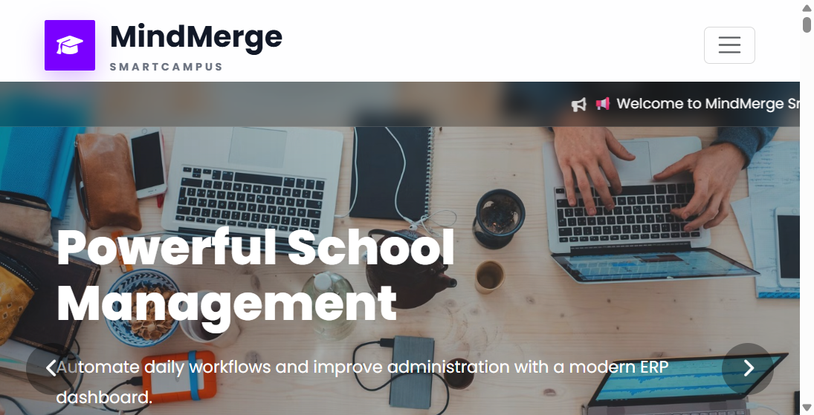
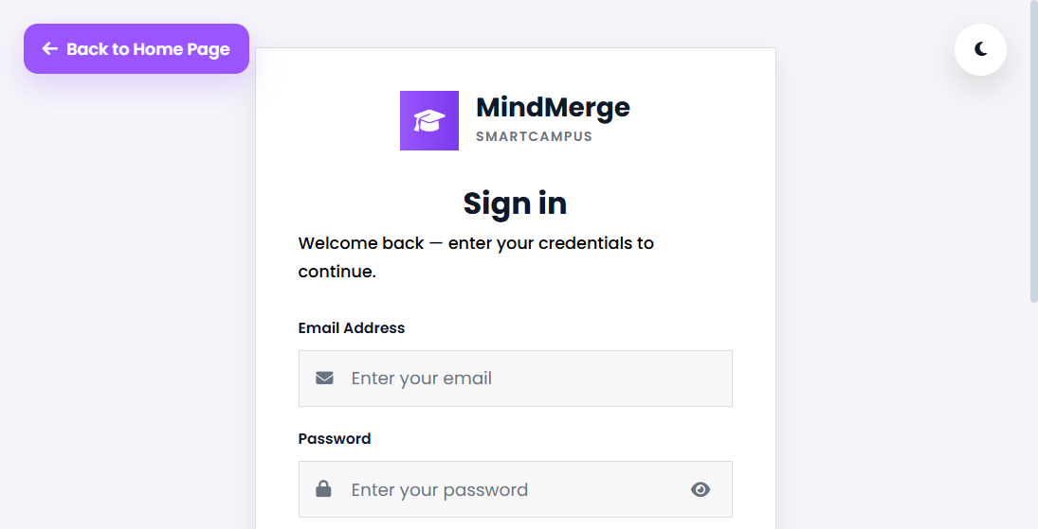
10 • EVIDENCE
11
Implementation screenshots and demo evidence
Public landing page
Authenticated login screen
Captured from the running local application. Authenticated dashboards and CRUD screens were not captured because no test credentials were provided; show them during the live demonstration.
SmartCampus • Project Review
Mind Merge Soft Tech Private Limited

Slide 12
11 • TRUST
12
Security and validation controls
Authentication
Authorization
Email validation, password_verify, dedicated admin login, session_regenerate_id.
config/auth.php requires a session; permission_guard_request checks protected routes.
Scope control
Request validation
TeacherScopeService and timetable checks constrain attendance operations.
Required-field checks, numeric casts, enum allow-lists and balance checks are present.
CSRF evidence
Caveat
Student Development generates a session token and validates with hash_equals.
Legacy code still mixes escaped SQL and direct queries; security hardening should continue.
SmartCampus • Project Review
Mind Merge Soft Tech Private Limited

Slide 13
12 • DELIVERY
13
Challenges and practical solutions
01
Multiple personas
Shared auth + portal routing + permission registry keep access behavior consistent.
02
Complex attendance rules
Timetable existence, period/day checks, duplicate detection and teacher scope are validated before writes.
03
Growing schema
Student Development uses version tracking and idempotent migration logic.
04
Operational reporting
CSV/XLSX exports, receipts, reports and statements convert stored records into usable outputs.
SmartCampus • Project Review
Mind Merge Soft Tech Private Limited

Slide 14
13 • STATUS
14
Current progress and future enhancements
Verified in repository
Recommended next steps
• Multi-role portal routing
• Permission registry and guards
• Academic, attendance, finance, notification, transport and payroll modules
• SQL schema/dump with populated sample records
• Student Development migration and workflows
• Public landing and login screens run locally
• Add automated tests for auth, permissions and financial invariants
• Replace remaining concatenated SQL with prepared statements
• Add consistent CSRF protection across all state-changing forms
• Centralize error logging and user-safe error handling
• Capture and validate every role dashboard in a staging environment
• Confirm deployment, backups, monitoring and privacy controls
Status wording: implemented means evidenced in source; pending means not verified from the supplied materials.
SmartCampus • Project Review
Mind Merge Soft Tech Private Limited

Slide 15
14 • CLOSE
15
Conclusion and learning outcomes
SmartCampus is a substantial PHP/MySQL school-management foundation that brings operational data, role-aware access and everyday workflows into one system.
Technical outcome
Practical outcome
Learning outcome
A modular ERP with shared authentication, permissions, CRUD workflows and reporting.
Faster access to attendance, results, fees, schedules and stakeholder updates.
Experience in PHP, SQL, session security, data modeling, validation and delivery trade-offs.
Thank you
Questions & demonstration
SmartCampus • Project Review
Mind Merge Soft Tech Private Limited

