Slide 1
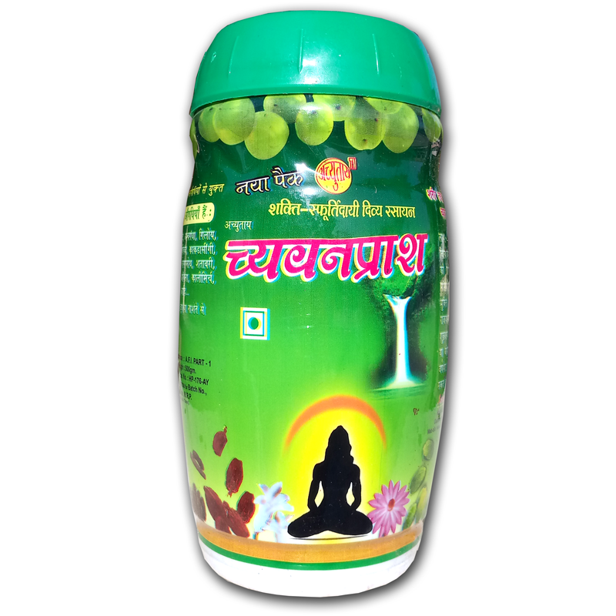

chyawanprash
Protection against COVID-19,
With 2 spoons of
Chyawanprash daily
Incredible
Health Benefits of
Chyawanprash
Arrests Skin Ageing
Bolsters Immunity
Augments Memory
Enhances Digestion
Promotes Cardiac Functioning

