Slide 1
Working with OpenSim API

Slide 2
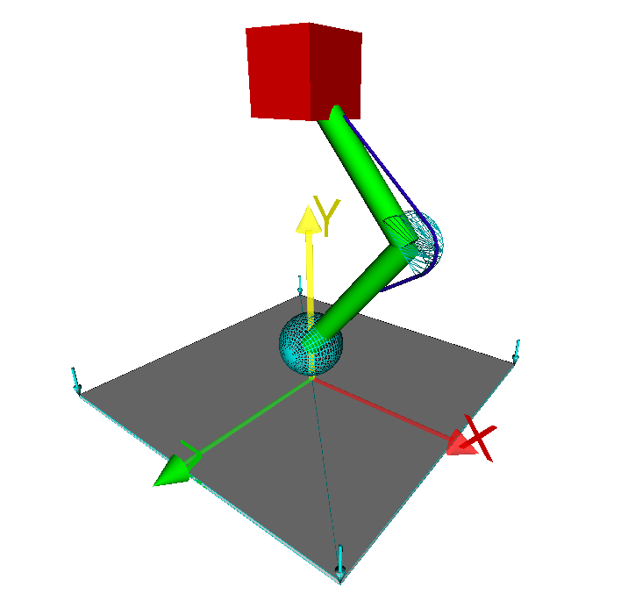
Modeling and Simulation of a Single-Legged Hopping Mechanism
Part A
Bottom up modeling
Part B
Simulation
Optimization
Plugins

Slide 3
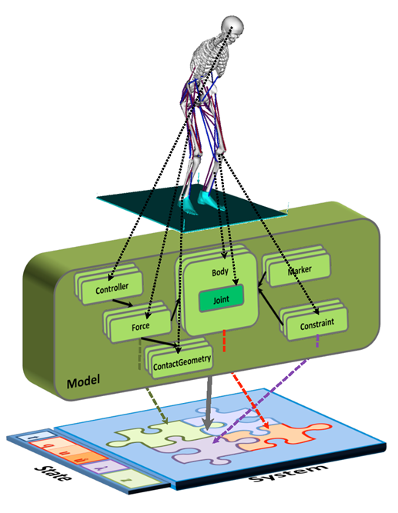
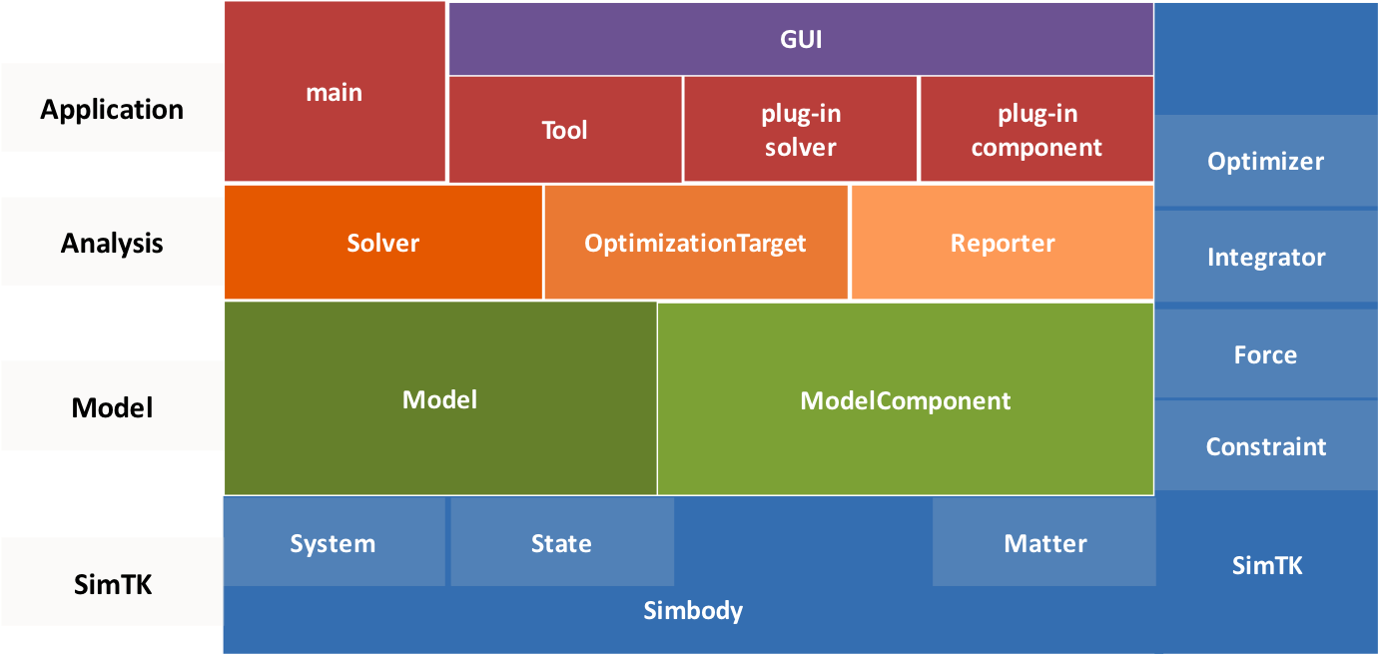
OpenSim API

Slide 4
C++ development process
A simple program
Control structures
Constants, variables, pointers
Functions, pass by value, pass by reference
Separation between header and source files
Classes, encapsulation, inheritance, message passing, instantiation
Compilation, linking, dynamic linking
CMake
Visual Sutdio

Slide 5
Simple Program
1 // c style
2 #include <stdio.h>
3
4 // c++ style
5 #include <iostream>
6 using namespace std;
7
8 int main()
9 {
10 // c style
11 printf("Hello\n");
12
13 // c++ style
14 cout << "Hello" << std::endl;
15
16 return 1;
17}

Slide 6
Control Structures
1 bool isPrime = false;
2 if (isPrime == true) {
3 cout << "Is prime" << endl;
4 }else {
5 cout << "Not prime" << endl;
6 }
7
8 for (int i = 0; i < 10; i++){
9 cout << i << endl;
10 }
11
12 while(true){
13 cout << "Infinite loop" << endl;
14 }

Slide 7
Constants, Variables and Pointers
1 // c style
2 #define PI 3.1415926
3
4 // c++ style
5 const double PI = 3.1415926;
6
7 // pointer
8 int a = 3; // variable of type int with value of 3
9 int* p = nullptr; // p is a pointer to an int (or = NULL, = 0)
10 int* p1 = &a; // p1 is a pointer to an int (and points to the address of a)
11
12 cout << p1 << endl; // address of a e.g. 0xFFFFFFFA
13 cout << *p1 << endl; // pointer dereference 3
14
15 int foo[5] = {16, 2, 77, 40, 12071};
16 int foo[] = {16, 2, 77, 40, 12071};
17
18 cout << foo[0] << endl; // zero based indexing, 0
19 cout << &foo[0] << endl; // the address of the first element, e.g. 0xFFFFFFFA
http://www.cplusplus.com/doc/tutorial/pointers/

Slide 8
Functions
1 // ------- simple function call
2 double distSquared(double x, double y){ // x, y are copied to stack (pass by value)
3 return (x - y) * (x - y);
4 }
5 cout << distSquared(3, 0) << endl; // 9
6
7 // ------- example pass by reference
8 double distSquared(double* x, double& y){ // pass by reference
9 *x += 1; // x = x + 1
10 return (*x - y) * (*x - y);
11 }
12
13 int x = 3, y = 0;
14 cout << distSquared(3, 0) << endl; // 9
15 cout << x << endl; // 4 (changed!!!)
16
17 // ------- return multiple outputs and pass by reference to improve execution time
18 void calcSomething(const std::vector<double>& in_array,
19 std::vector<double>& out_array1, std::vector<double>& out_array2){
20 in_array[3] = 5.0; // compile time error because in_array is const
21 ...
22 }
23 std::vector<double> in_array, result1, result2;
24 in_array = ... // set values
25 calcSomething(in_array, result1, result2);

Slide 9
Header and Source
util.h
util.cpp
#ifndef UTIL_H
#define UTIL_H
void f1(double x);
int f2(double x, double y);
#endif
#include "util.h"
void f1(double x)
{
return x + 1;
}
int f2(double x, double y)
{
return atan2(x, y);
}
main.cpp
#include <iostream>
using namespace std;
#include "util.h"
int main(){
cout << f1(3) << endl;
cout << f2(1, 2) << endl;
return 1;
}

Slide 10
Classes 1/3 Encapsulation
person.h
person.cpp
#ifndef PERSON_H
#define PERSON_H
#include <string>
class Person{
public:
Person(std::string name, int age);
int getAge();
private:
std::string name;
int age;
}
#endif
#include "person.h"
Person::Person(std::string name, int age) : name(name) {
age = age; // two ways to initialize private variables
}
int Person::getAge(){
return age - 5; // make someone appear younger
}

Slide 11
Classes 2/3 Inheritance
worker.h
worker.cpp
#ifndef WORKER_H
#define WORKER_H
#include <string>
#include "person.h"
class Worker : public Person{
public:
Worker(std::string name, int age, double salary);
double tellMeYourSalary();
private:
double salary;
}
#endif
#include "worker.h"
Worker::Worker(std::string name, int age, double salary)
: Person(name, age), salary(salary) {
}
double Worker::tellMeYourSalary() {
return salary;
}

Slide 12
Classes 3/3 (Instantiation – Message Passing)
main.cpp
#include <iostream>
using namespace std;
#include "person.h"
#include "worker.h"
int main(){
Person kostas("kostas", 20); // allocation on stack
cout << kostas.getAge() << endl;
cout << kostas.name << endl; // compile time error (private member)
Person alexis; // compile time error no default constructor?
Person* dimitris; // contractor is not called
// allocation on heap + polymorphism
dimitris = new Worker("dimitris", 13, 100);
cout << dimitris.getAge() << endl; // inherited from Person
cout << dimitris.tellMeYourSalary() << endl; // new property of Worker
return 1;
}

Slide 13
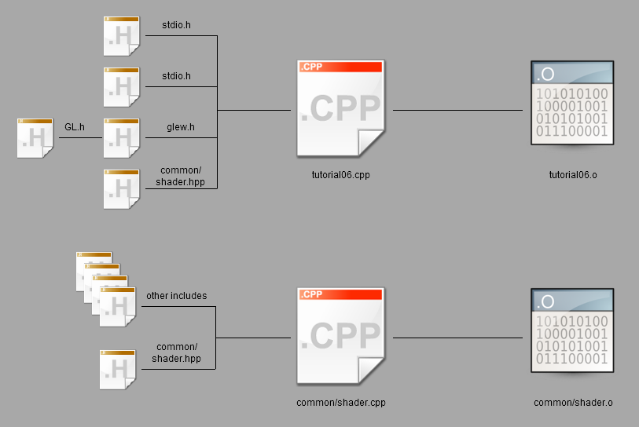
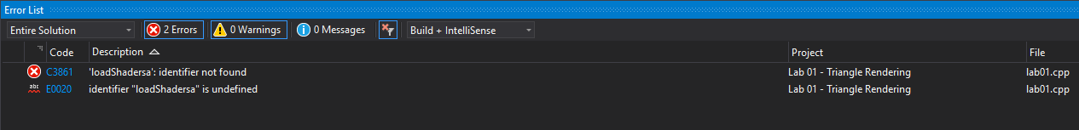
Compilation
Syntax error
Unable to find <GL/glew.h>
Include directory must be known at compile time (e.g. where are <stdio.h>, <iostream> etc.)

Slide 14
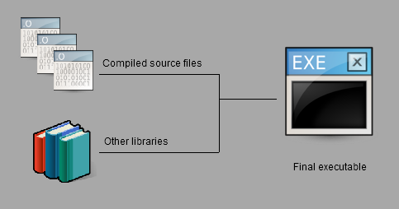
Linking
Linking error: unable to find static libraries
The linker must know the location of the static libraries (Windows -> .lib, Linux -> .a)

Slide 15
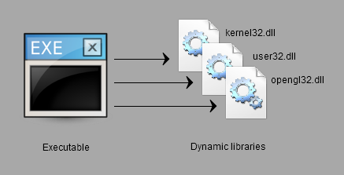
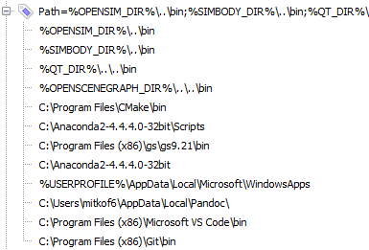
Dynamic Linking
The application was unable to find opengl32.dll
Dynamic libraries (Windows -> .dll, Linux -> .so) need to be located from the PATH variable or copied along with the application (.exe)

Slide 16
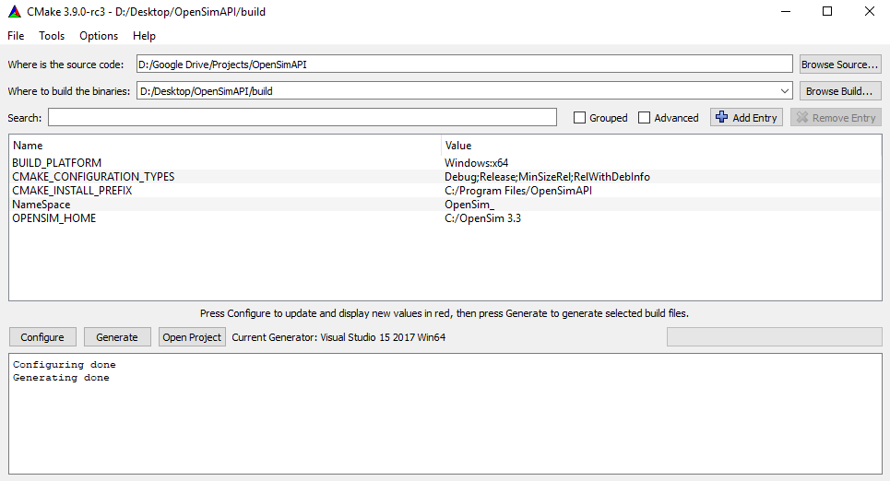
CMake
cmake_minimum_required (VERSION 2.6)
project(your_project_name)
# Creating a new project
find_package(OpenSim REQUIRED)
set(target lab01)
# Adding a source files in a project
add_executable(${target}
lab01.cpp
)
# Adding include directories
include_directories(
${OpenSim_INCLUDE_DIRS}
)
# Link with libraries
set(ALL_LIBS
${OpenSim_LIBRARIES}
)
# Create target
target_link_libraries(${target} ${ALL_LIBS})

Slide 17
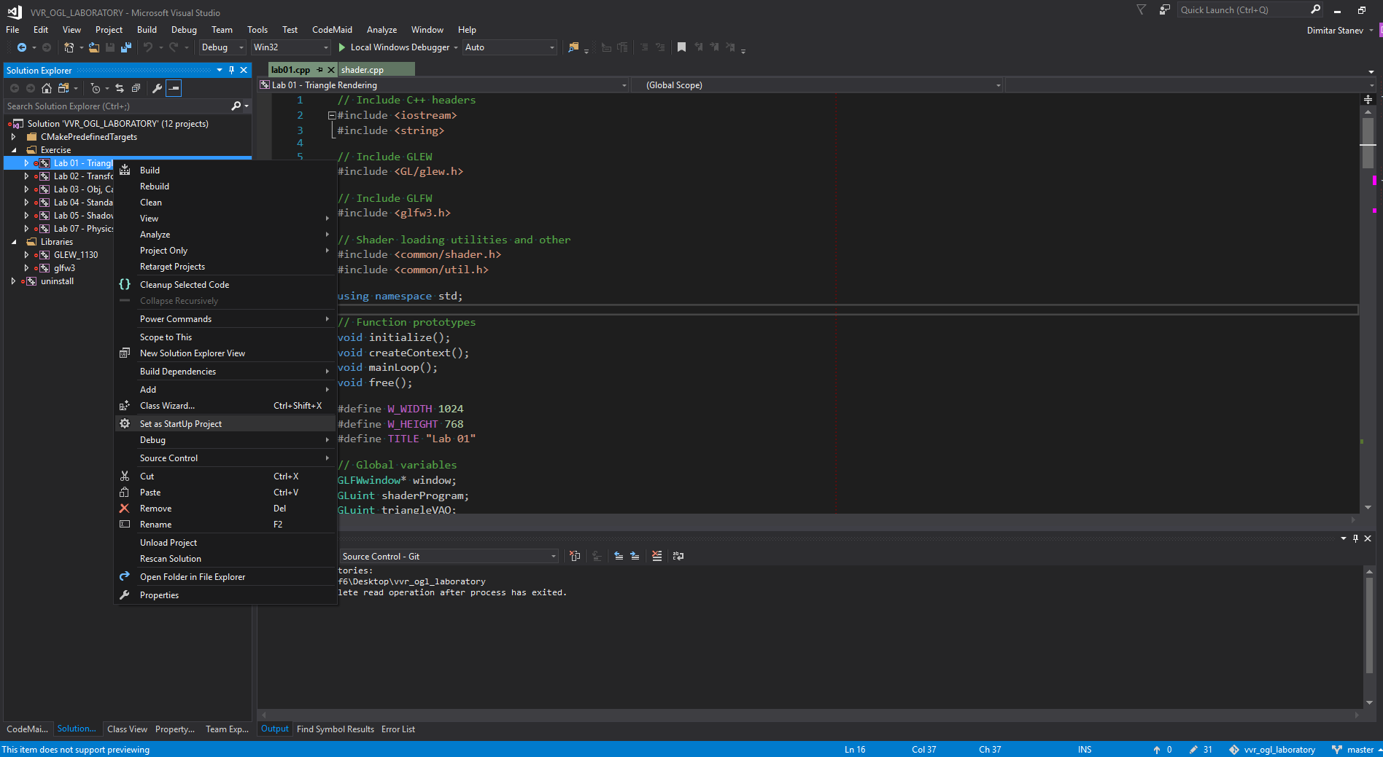
Visual Studio

Slide 18
Links
https://simtk-confluence.stanford.edu:8443/display/OpenSim/API+Examples#
https://simtk-confluence.stanford.edu:8443/display/OpenSim/Developer%27s+Guide

