Slide 1
Miss Shaders and Sky Models
CS 481/681 Computer Graphics Rendering

Slide 2
Project Pitch
Exciting Ideas
Realtime Ray Tracing
Virtual Reality Experiences
Comparing Renderer Results
Applying Machine Learning to CG

Slide 3
Miss Shaders and Sky Models
Ray Tracing Pipeline
Miss Shaders
Sky Models
Astronomical Calculations

Slide 4
Ray Tracing Pipeline
Ray Generation
Ray Traversal Acceleration Structure
Intersection Shader
Any Hit Shader
Miss Shader
Closest Hit Shader

Slide 5
Ray Tracing Pipeline

Slide 6
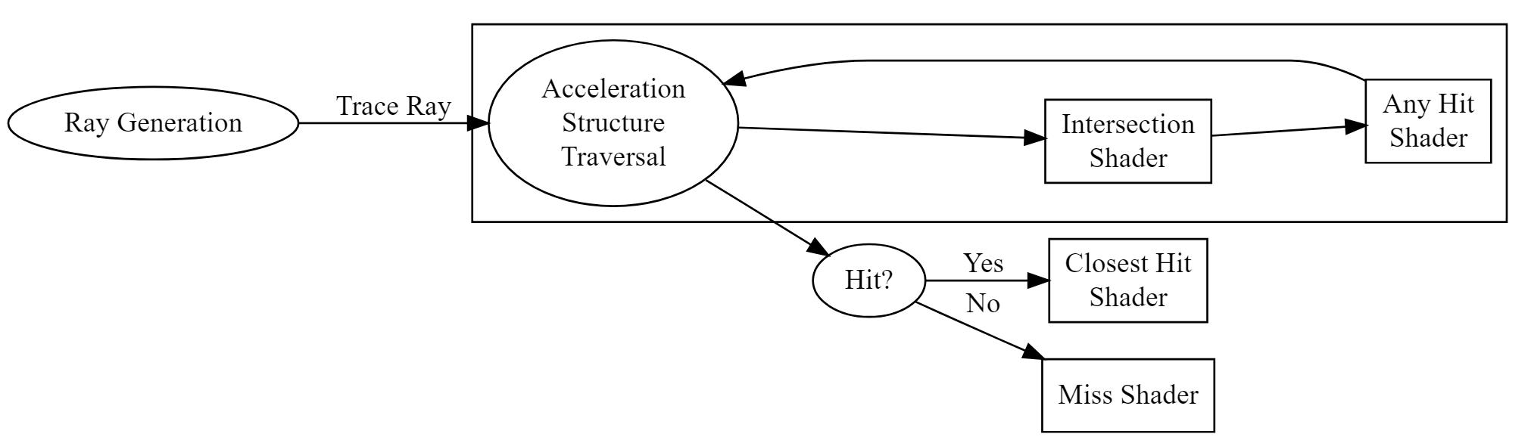
Ray Tracing Pipeline

Slide 7
Miss Shaders
If we have no hits, we need to do something
A good candidate is a sky model
What about the ground?

Slide 8
Sky Models
CIE Clear Sky and Overcast Sky
Preetham et al. (1999)
Hosek-Wilkie (2012)
Bruneton-Neyret (2008)
DIHARAW’s port

Slide 9
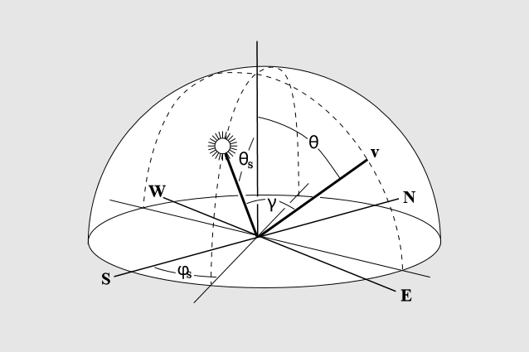
Preetham et al Frame of Reference
Preetham et al. Sun Sky

Slide 10
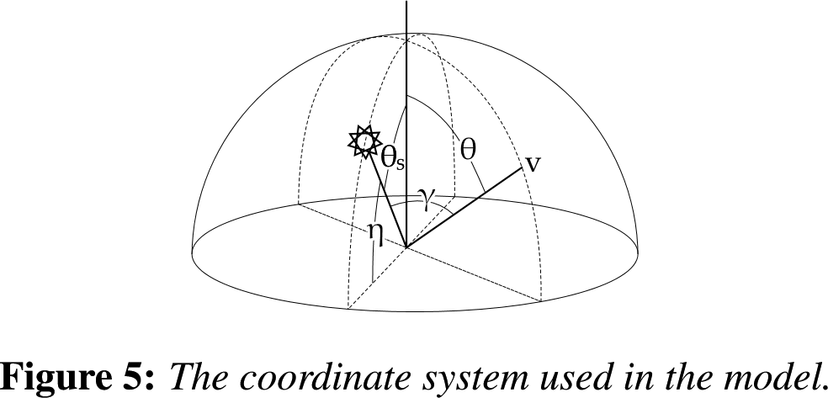
Hosek-Wilkie Frame of Reference
Hosek-Wilkie Sun Sky

Slide 11
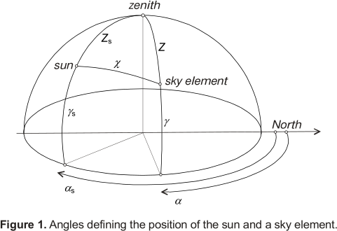
CIE Model Frame of Reference
CIE ISO 15469:2004

Slide 12
Parameters
Turbidity $T$
Ground Albedo $α$
Sun inclination or declination?
Gamma $γ$ is measurement from sky position to sun position
Think about it: which way is north or west?

Slide 13
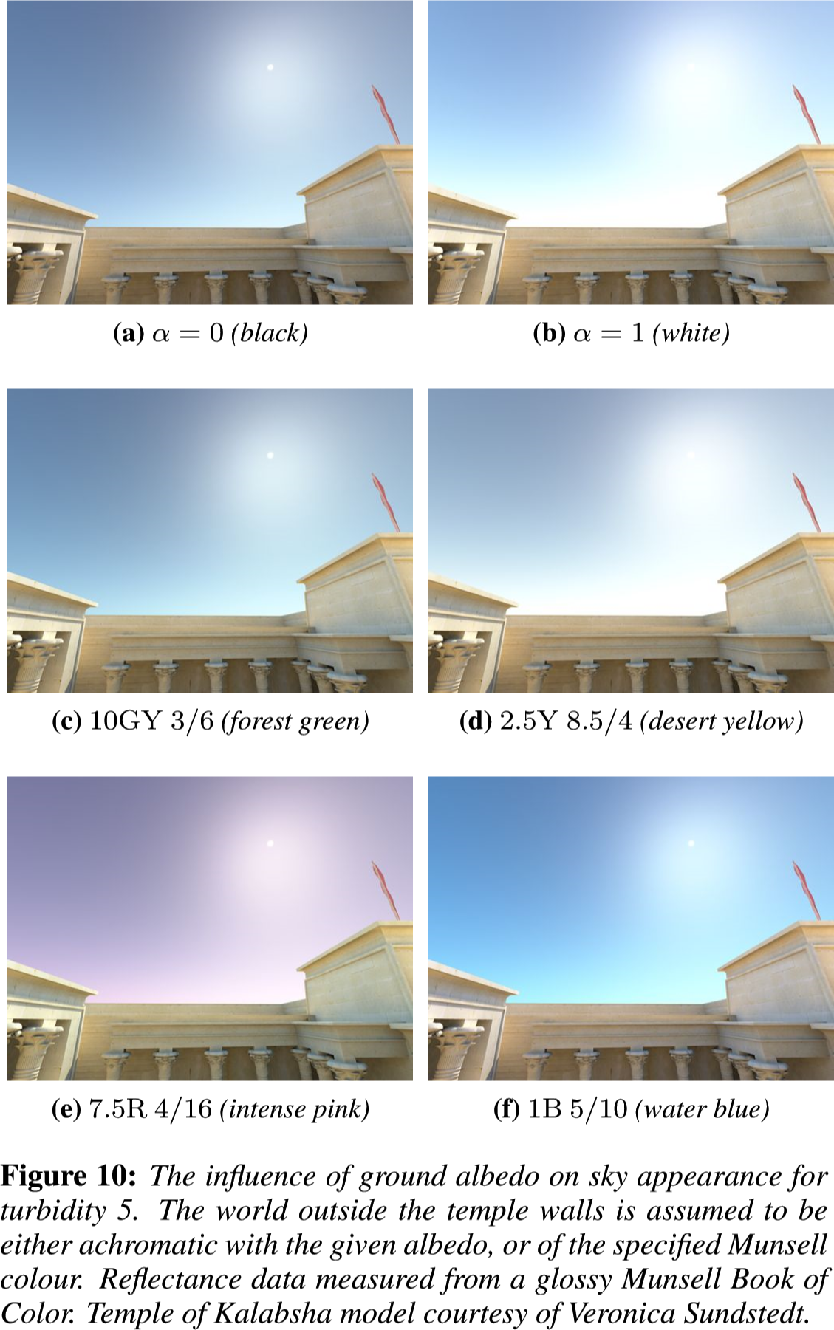
Ground Albedo
Hosek-Wilkie Ground Albedo

Slide 14
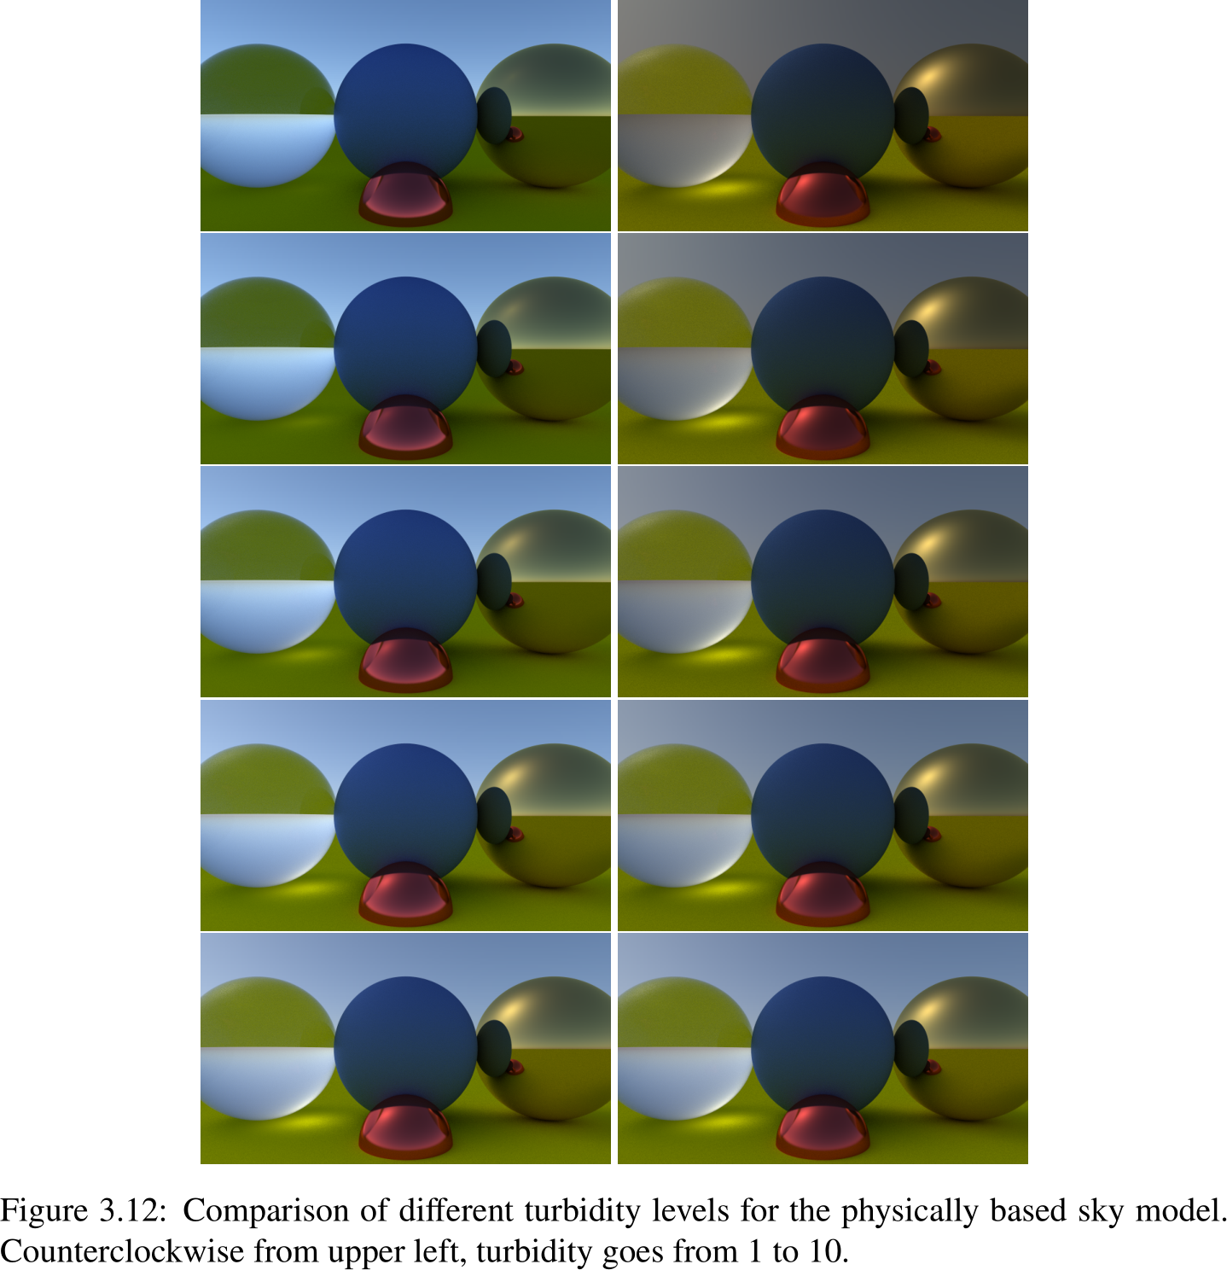
Turbidity
Metzgar Turbidity

Slide 15
Astronomical Calculations
Video: Carla’s Island (1981)
Video: NASA Voyager 2 Flyby (1981)
Use astronomical calculations to determine animation parameters

Slide 16
Implementation
Example 6

Slide 17
Hybrid Topics and Activity Worksheet
Any Hit Shaders and Shadows

