Slide 1
Closest Hit Shaders & BRDFs
CS 481/681 Computer Graphics Rendering

Slide 2
Overview
Review the Ray Tracing Pipeline

Slide 3
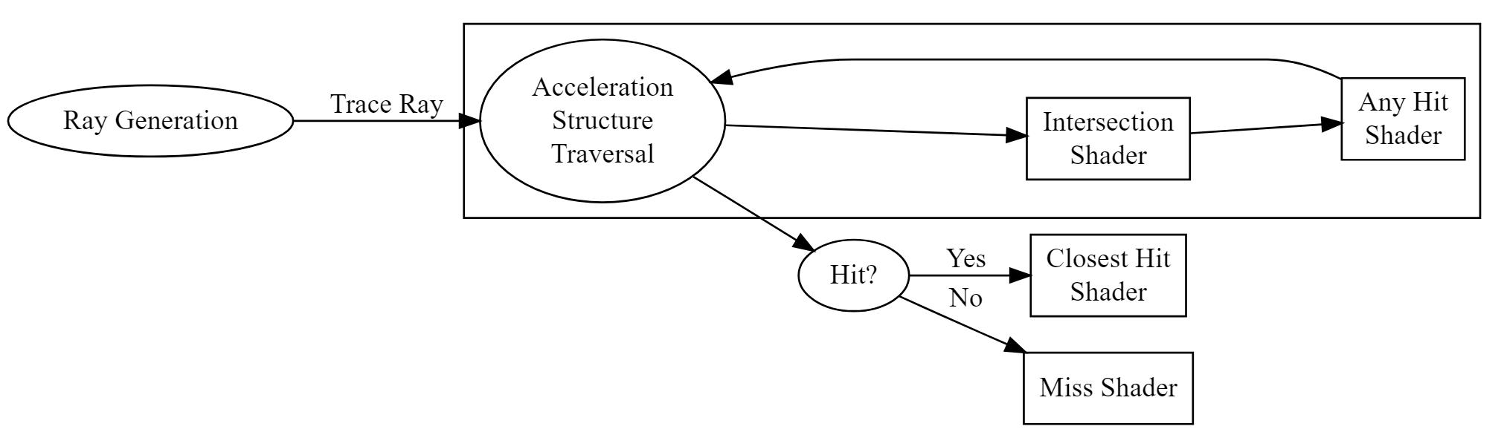
Ray Tracing Pipeline

Slide 4
Closest Hit Shaders
Reflection
Refraction
Shadow Rays

Slide 5
Bidirectional Reflectance Distribution Functions
Specular
Phong
Blinn-Phong
Cook-Torrance
GGX
Diffuse
Lambert’s cosine law ($N⋅L$)
Oren-Nayer
Disney Diffuse BRDF

Slide 6
Frame of Reference
Geometric normal: $N$ – $ω_{g}$
View direction: $V$ – $ω_{o}$
Light direction: $L$ – $ω_{i}$
Hemisphere: $Ω$
Half-angle vector: $H$ – $ω_{h}$
Reflection vector: $R$ – $ω_{r}$
Refraction vector: $T$ – $ω_{t}$

Slide 7
The Rendering Equation
[Nicodemus 1965] $f_{r}(ω_{i},ω_{o})=\frac{dL_{o}(ω_{o})}{dE_{i}(ω_{i})} = \frac{dL_{o}(ω_{o})}{L_{i}(ω_{i})cosθ_{i} dω_{i}}$
[Kajiya 1986]
Lo(x→ωo)=Le(x→ωo)+Ω​fr(ωi,ωo) Li(ωi→x) ⟨ωi,ωo⟩ dωi

Slide 8
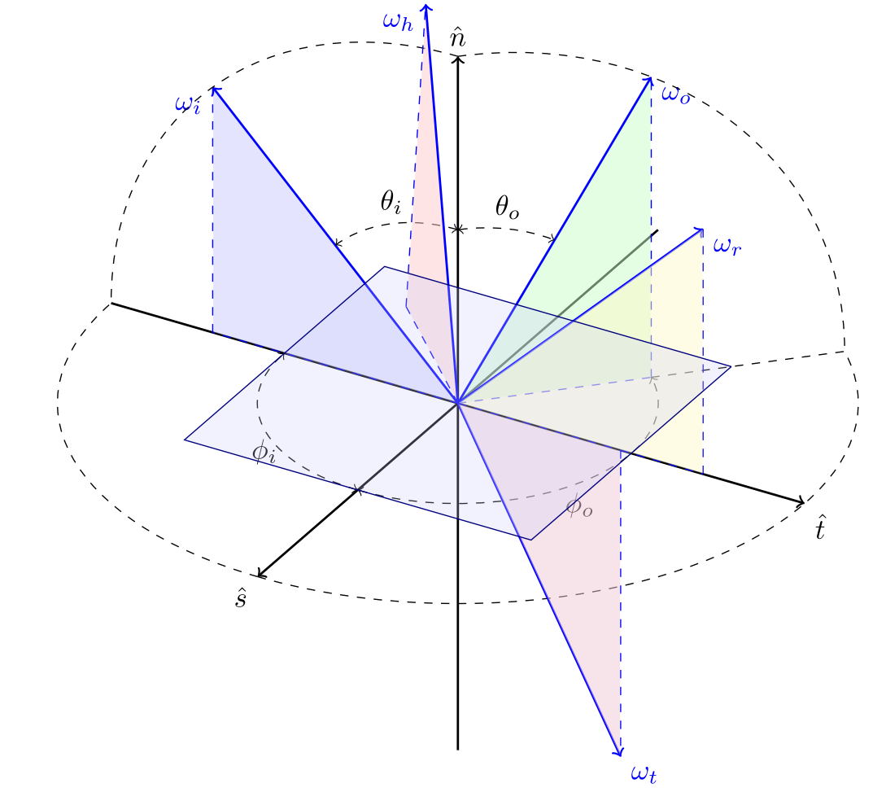
Frame of Reference

Slide 9
Paul Heckberts’ Notation
$E$ is eye
$L$ is vector
$S$ is specular interface
$D$ is diffuse interface
$LSE$ path is light-specular-eye path
$L\{SD\}E$ path is light to a single specular/diffuse interface to eye
$L\{SD\}^{+}E$ path is light to several specular/diffuse interfaces to eye

Slide 10
Physically Based BRDFs
Conservation of Energy
Ω​fr(ωi,ω) dωi≤1
Helmholtz Reciprocity
$$f_{r}(ω_{i},ω_{o})=f_{r}(ω_{o},ω_{i})$$
Positivity
$$f_{r}(ω_{i},ω_{o})≥0$$
Conservation of visible projected area
cosθo=Ω​G1(ωo,ω)⟨ωo,ω⟩D(ω)dω

Slide 11
Diffuse BRDFs
Lambertian $f_{r}=\frac{ρ}{π}$
Oren-Nayer
$$\begin{matrix}f_{r}= & \frac{ρ}{π}(A+(B⋅max\left[0,cos(ϕ_{i}−ϕ_{o})\right]⋅sinα⋅tanβ)) \\ A= & 1−0.5\frac{σ^{2}}{σ^{2}+0.33} \\ B= & 0.45\frac{σ^{2}}{σ^{2}+0.09} \\ α= & max(θ_{i},θ_{o}) \\ β= & min(θ_{i},θ_{o})\end{matrix}$$

Slide 12
Specular BRDFs
[Cook-Torrance 1981] $f_{r}(ω_{i},ω_{o})=\frac{D(ω_{h}) F(θ_{d}) G_{2}(ω_{i},ω_{o})}{4cosθ_{i}cosθ_{o}}$
Microfacet Distribution
Normalized Blinn-Phong: $D_{BP}(ω_{g},ω_{h})=\frac{1}{πα^{2}}(ω_{g}⋅ω_{h})^{2/{α^{2}+ϵ}−(2+ϵ)}$
GGX: $D_{GTR}(ω_{g},ω_{h})=\frac{1}{π}{\left(\frac{1}{(α^{2}−1)(ω_{g}⋅ω_{h})^{2}+1}\right)}^{γ}$

Slide 13
Masking-Shadowing Function
$G_{2}(ω_{i},ω_{o},ω_{g})=\frac{1}{1+Λ(ω_{i})+Λ(ω_{o})}$
GGX: $Λ(ω)=\frac{−1+\sqrt{1+\frac{(ω_{g}⋅ω)^{2}}{α^{2}(1−(ω_{g}⋅ω)^{2})}}}{2}$
Blinn-Phong: $G_{2}(ω_{i},ω_{o},ω_{g})=min\left\{1,{(ω_{g}⋅ω_{h})(ω_{g}⋅ω_{o})}/{ω_{o}⋅ω_{h}},{(ω_{g}⋅ω_{h})(ω_{g}⋅ω_{i})}/{ω_{o}⋅ω_{h}}\right\}$

Slide 14
Fresnel
[Schlick 1995] $F(θ_{d})=F_{0}+(1−F_{0})(1−\cos^{5}θ_{d})$
$F=\frac{ρ_{∥}^{2}+ρ_{⊥}^{2}}{2}$
$ρ_{∥}^{2}=\frac{(η_{2}^{2}+κ_{2}^{2})\cos^{2}θ_{d}−2η_{2}cosθ_{d}+1}{(η_{2}^{2}+κ_{2}^{2})\cos^{2}θ_{d}+2η_{2}cosθ_{d}+1}$
$ρ_{⊥}^{2}=\frac{(η_{2}^{2}+κ_{2}^{2})−2η_{2}cosθ_{d}+\cos^{2}θ_{d}}{(η_{2}^{2}+κ_{2}^{2})+2η_{2}cosθ_{d}+\cos^{2}θ_{d}}$

Slide 15
Hybrid Topics and Activity Worksheet
Global Illumination
Spherical Harmonics

